Slide 1


Acea Smart Water (Aquifer Petrignano)
Sweta Gaurav
Data Science Intensive Capstone Project

Slide 2
Overview
The Acea Group is one of the leading Italian multiutility operators. Listed on the Italian Stock Exchange since 1999, it is foremost Italian operator in the water services sector supplying 9 million inhabitants in Lazio, Tuscany, Umbria, Molise, Campania.
The Acea Group deals with four different type of waterbodies:
water springs
lakes
rivers
aquifers.
The wells field of the alluvial plain between Bastia Umbra and Petrignano is fed by three underground aquifers separated by low permeability septa.
The groundwater levels are influenced by the following parameters:
Rainfall
depth to groundwater
temperatures
drainage volumes

Slide 3
Introduction to Time Series Analysis
A time-series is a set of observations on a quantitative variable collected over time.
In time series analysis, we analyze the past behavior of a variable in order to predict its future behavior
Component of Time Series
Cyclic
An up and down repetitive movement in demand.
Repeats itself over a long period of time.
Seasonal variation
An up and down repetitive movement within a trend occurring periodically
Random Variable
Erratic movements that are not predictable because they do not follow a pattern
When I go through my dataset it shows me cyclic pattern.

Slide 4
The Problem
As it is easy to imagine, a water supply company struggles with the need to forecast the water level in a waterbody (aquifer) to handle daily consumption. Forecast the depth to groundwater of an aquifer located in Petrignano, Italy.
Criteria of Success
we must determine what features influence the amount of water in that waterbody, and in which way those features affect it.
To handle daily consumption, Petrignano water Plant need to forecast the underground(aquifers) water level and water flow, for each day of the year.

Slide 5
Data Information
Data acquired for the period: 2006-03-14 to 2020-06-30
Number of records: 5223
Number of fields: 8
Prediction period: 365 days till 2021-06-30

Slide 6
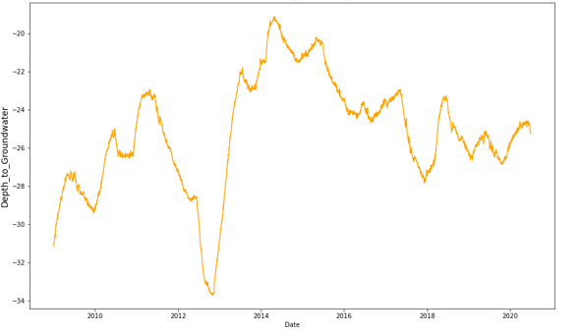
Depth of underground water from year 2009 to 2020
Depth of underground water is maximum in year 2013 around -34m and minimum in year 2014 around -18m. Water label has not such trend sometimes it goes up and sometimes it goes down. Water label is not constant.

Slide 7
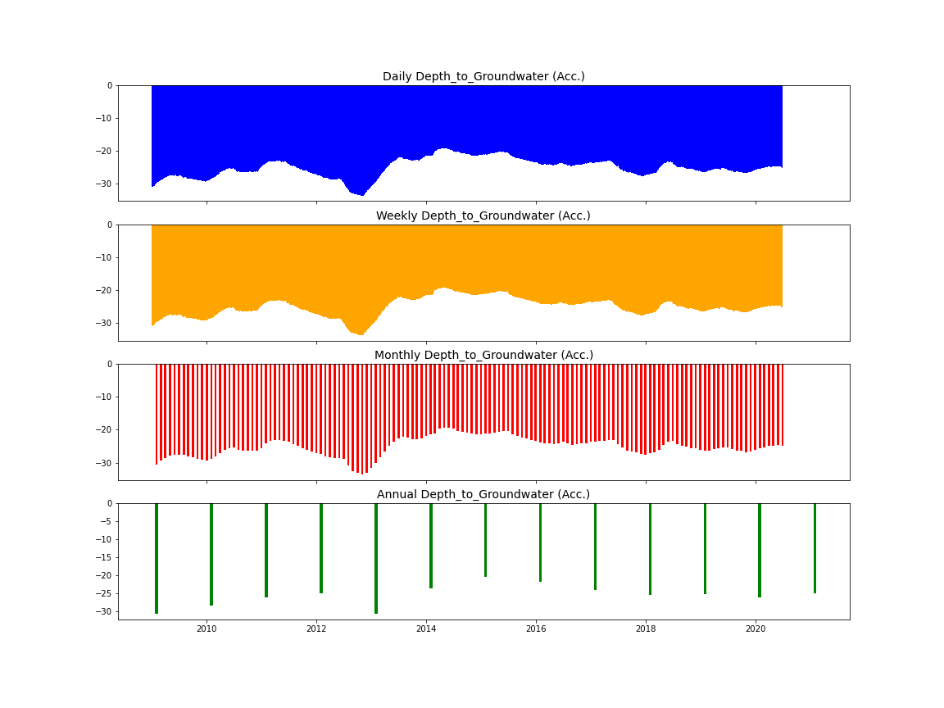
Resampling to Daily, Weekly, Monthly & Yearly

Slide 8
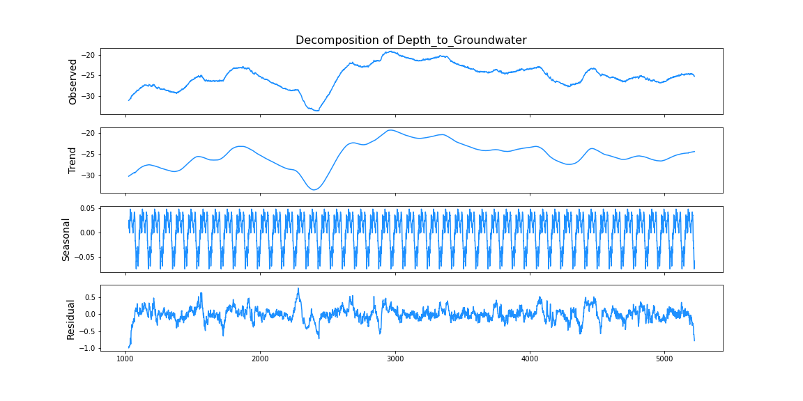
Decomposition Time series decomposition involves thinking of a series as a combination of level, trend, seasonality, and noise components.Here I use Additive.

Slide 9
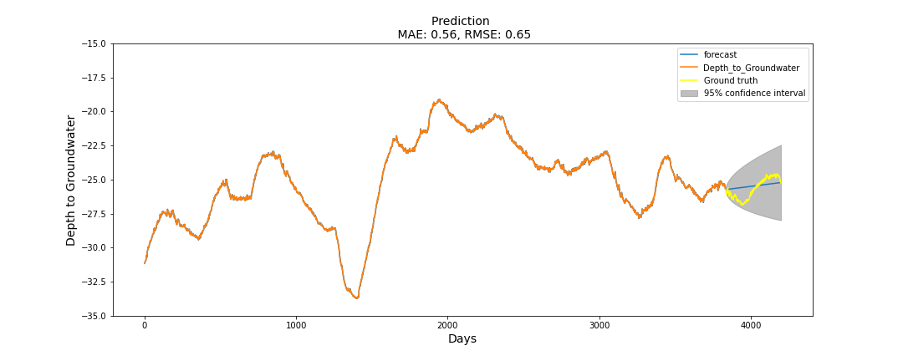
Underground water depth prediction (ARIMA)
It shows increasing pattern and label varies from -25.75m to -25.25m has variation of only 0.5 m.

Slide 10
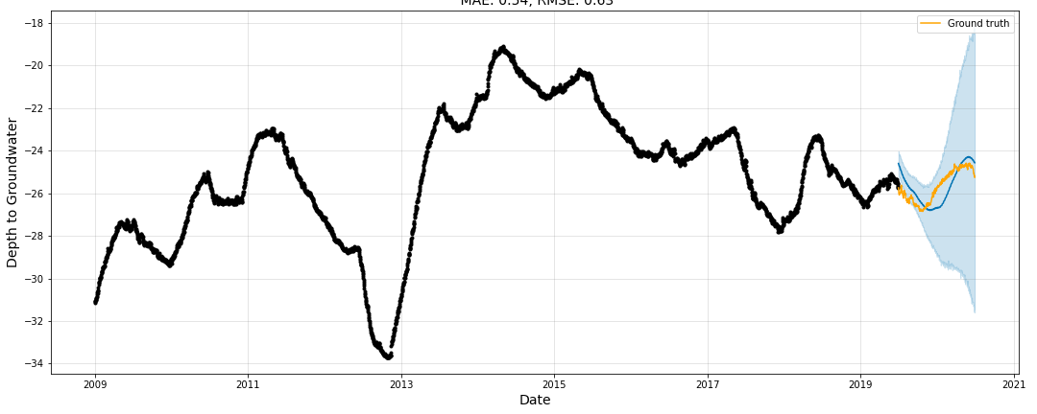
Prediction of underground water depth for Prophet
According to prediction water label goes from -27m to -24.6m and it follow the previous pattern.

Slide 11
Summary and conclusion
As noted, ARIMA modeling fails to effectively capture the trend. An alternative model is used be to analyze the result, as a conclusion Facebook prophet is more accurate in predicting the water label and its error is low than ARIMA. It follows the same pattern whatever past data shows. Minimum label is -27m and maximum label is -24m it indicates that predicted water label is in not vary much with respect to actual label.
Predicted value shows almost same cyclic pattern to actual data Beginning of year label is up and end quarter label goes down. Predicted label range from -27m to -24.4m so label varies between 3 m range. So, in the month of May and June water label is up, may be due to temperature. We must control on water supply but in the last quarter water label is down, so we do not have to control the supply. 365 days ahead value shows same cyclic pattern.

