Slide 1
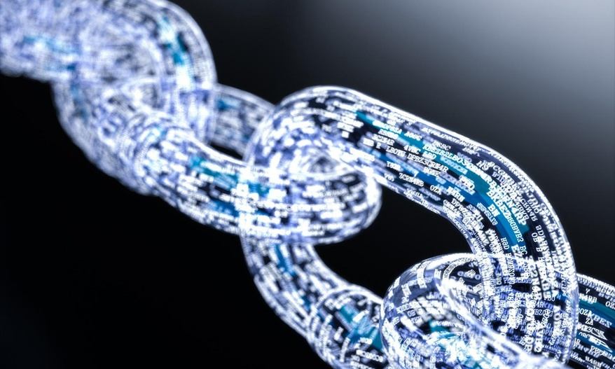
Blockchain
April 12th, 2020
Rahul Sinha and Sweta Sharma
Image Source: Link

Slide 2

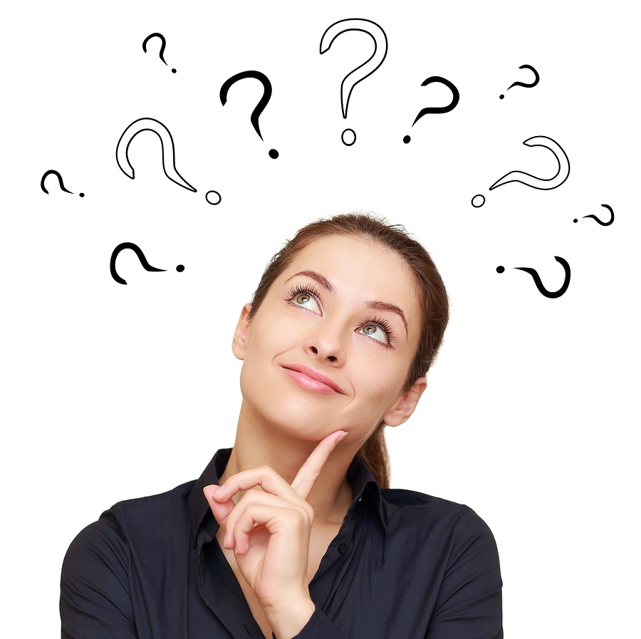
Agenda
Agenda
Walmart Mango Story
What is Blockchain
Usage in Supply Chain
Usage in Financial Sector
Image Source: Link
Source: NEED TO POPULATE

Slide 3

Food Traceability
Walmart’s Mango traceability from weeks to seconds
Image Source: Link
Notes:
In Dec 2016, Frank Viannas, vice president of food safety at Walmart, picked up a package of sliced mangoes on his way to company headquarters at Fayetteville, Arkansas. He placed the packed mango container on the conference table and gave his team the mission of tracing the origin of mangoes while setting the timer. It took his team six days, 18 hours, and 26 minutes to get the answer . A week to figure out the food source in the event of a foodborne illness outbreak in which a suspected pathogen is tied to mangoes somewhere wouldn’t be desirable for Walmart, and everyone, including farmers, distributors, and Walmart would take a hit. Walmart then tested a technology solution for food traceability in partnership with IBM. The result – in a few months as soon as Frank entered the lot number on a web portal, it took him 2 seconds to get mango’s weight, harvest date, origin, hot-water treatment, shipment, US entry, and slicing details. And what made that possible was Blockchain .
Source:
1 Hackett, Robert. “Why Big Business Is Racing to Build Blockchains.” Fortune, Fortune, 26 Sept. 2017, fortune.com/2017/08/22/bitcoin-ethereum-blockchain-cryptocurrency/

Slide 4
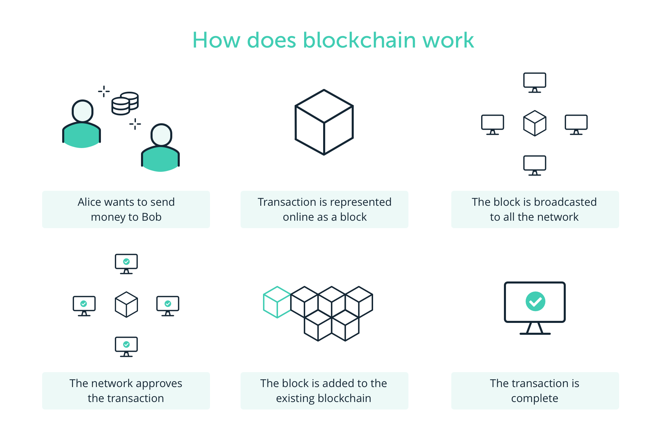
Image Source: Link
Notes:
Blockchain is a kind of ledger that businesses use to track credits and debits, and it concatenates (or “chains”) cryptographically verified transactions into the sequence of lists (or “blocks”). Blockchain is a platform technology enabling an improved ability to verify and record the exchange of value among an interconnected set of users . Blockchain technology enables any
network of users to track and trade virtually anything of value. Blockchain is a secure and transparent way to do transactions that involve multiple stakeholders. Blockchain assures data integrity, maintains auditable records, and renders financial contracts into programmable software. It’s a ledger but an edgy one.
There are two types of blockchains: the public also called permissionless, blockchain, and private or permissioned blockchain. The public blockchain network is open to anyone, and everyone uses their native currencies such as bitcoin, which can be used to either compensate miners or to claim underlying assets from its issuer. A private blockchain, on the other hand, provides permissioned access to its network.
Source:
An Introduction to Blockchain by Richard A. Mayo Center for Asset Management

Slide 5
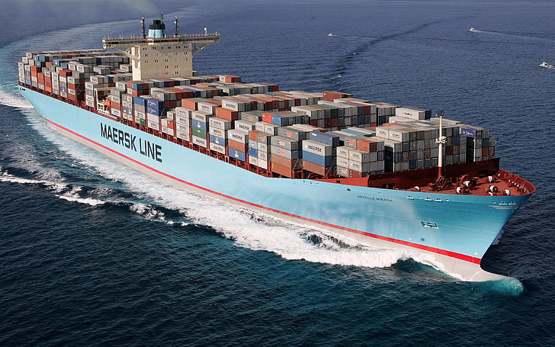
Supply Chain
Global Trade Digitalization
Shipping Industry
IBM & MAERSK
Image Source: Link
Notes:
In the supply chain industry, Maersk, the largest container ship and supply vessel operator in the world, recently partnered with IBM for the Global Trade Digitalization venture that leverages Blockchain to address the long-existing problems of supply chain management and the container shipping industry. Maersk’s business model involves multiple stakeholders, for e.g., flowers to be transported from the Netherlands to the rest of Europe move from the shipper in the Netherlands to a trucking company, to the freight forwarder to the terminal operator, to shipping lines to customs to trucking at the destination before finally making it to the distribution centers for deliveries in the retail stores. The shipping industry’s business model has its challenges with transparency, inefficiency, and overall administration. Like the rest of the industry, Maersk also had to deal with inefficient and error-prone manual processes that relied heavily on people, caused copious documentation, and contributed to significant delays in deliveries. The inconsistent information across organizational boundaries and ‘blind spots’ throughout the supply chain hindered the efficient flow of goods. The involvement of multiple companies and the lack of transparency made Blockchain a suitable solution to Maersk’s problems as Blockchain enables any network of users to track and trade virtually, securely, and transparently.
Source:
An Introduction to Blockchain by Richard A. Mayo Center for Asset Management

Slide 6
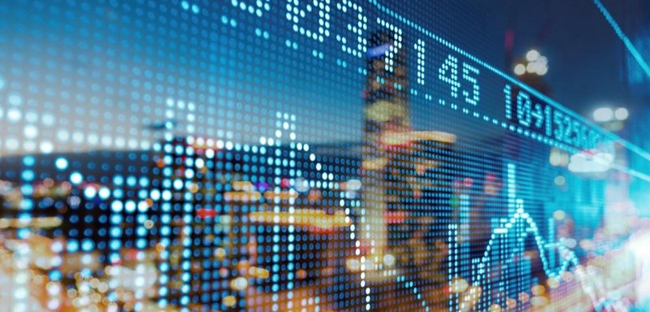
Usage in Finance Industry
Payments & Settlements
Digital Identity
Smart Contracts
Image Source: Link
Notes:
Currently, in finance, the major blockchain products and services are leveraged in three broad areas: 1) the clearing, payments, and settlement functions in financial services companies (e.g., banks, asset managers), (2) creation and use of a digital identity within an enterprise, and (3) smart contracts that self execute when requirements are met
Source:
An Introduction to Blockchain by Richard A. Mayo Center for Asset Management

Slide 7
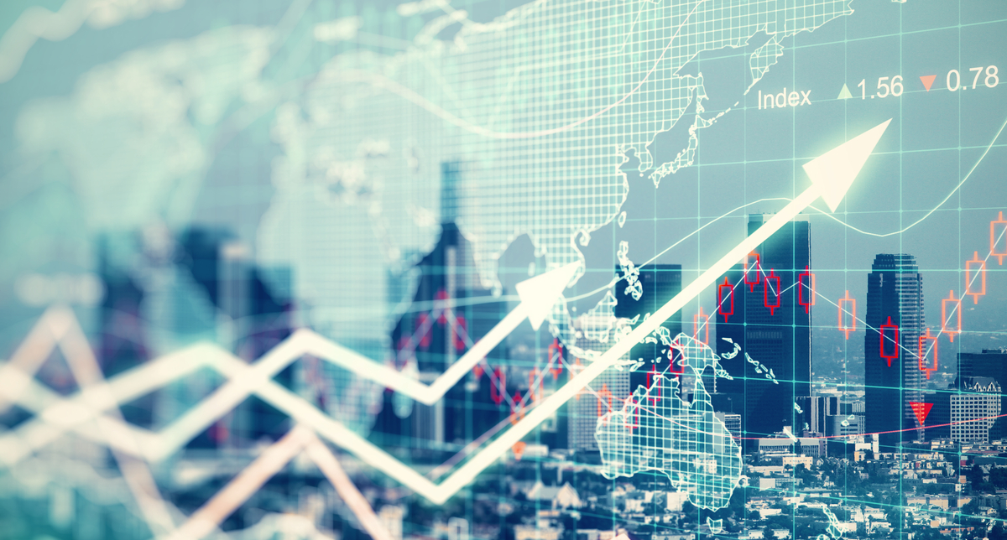
Benefits of Blockchain
Reduced Costs
Faster Transactions
Improved Data Quality
Image Source: Link
Notes:
Blockchain currently provides plenty of benefits such as reduced costs, faster transactions, improved security, and improved data quality to financial institutions.

Slide 8
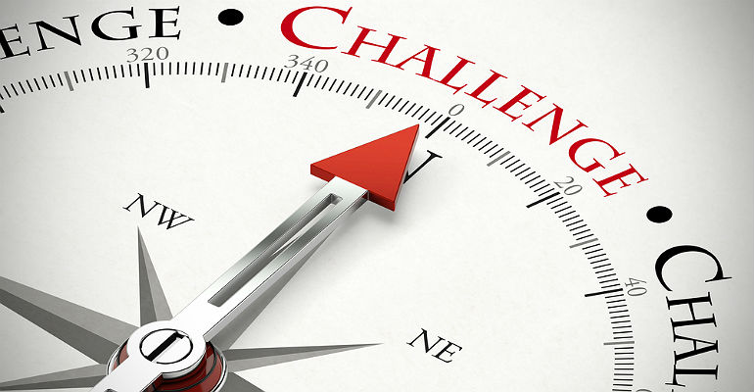
Challenges
Digitalization
Change Management
Technology Acceptance
Image Source: Link
Notes:
Blockchain isn’t a new software that organizations could just install and start using. Although there is a lot of excitement about the technology, its success depends on all relevant members joining the initiative.
The network-based technology requires a vast ecosystem to engage and participate and getting everybody in the chain on board with the idea will be a significant challenge.
The involvement of all stakeholders will require collaboration within and across organizations, and doing so requires organizational change, which is challenging.
To increase ROI with blockchain, organizations not only need to digitalize their operations fully but also change people’s mindset to change their way of work.

Slide 9
Thank you!

