Slide 1

Introduction myself
Sweta Patel​

Slide 2
My name is sweta.
I am 20 years old.
I live in Ahmedabad.
I completed my bachelor degree in umiya girl college.

Slide 3

I am
1) Honest person
2) Open-minded
3) Punctual
4) Discipline
5) Kind
6) creative

Slide 4

I like :
Listening music
Playing games
Travel
Watching movie
Eating ice-cream

Slide 5

I hate :
Someone speaks in angry
traffic
summer
Someone ignore me
party

Slide 6
Swot analysis
Strength
My strength is Logical thinking
My strength is discipline
My strength is focuse
My strength is empthy
Weakness
My weakness is Public speaking
My weakness is multi-tasking
My weakness is procrastination
opportunity
freelance
Understand customer requirements
Threats
Competition from automated design tool
Copyright issues

Slide 7
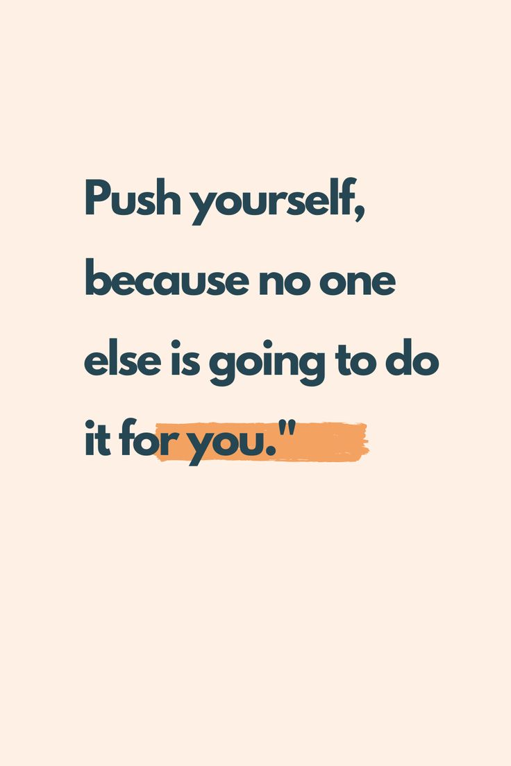


Believe system

Slide 8
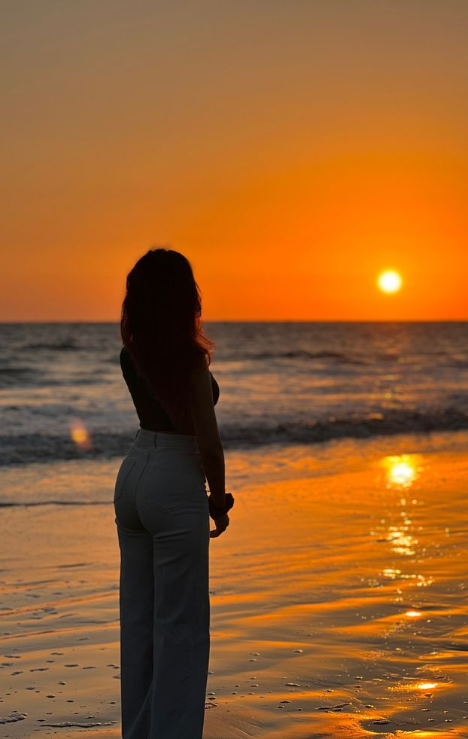
Life purpose
My life first priority is my family and friends.
Finding career success.
Helping other people.
Living with joy.

Slide 9
Thank you
“
”
Sweta Patel

