Slide 1
HR ANALYTICS | FINAL REPORT
Employee Attrition
Prediction & Retention Report
KPI Analysis • Risk Scoring • What-If Scenarios • Retention Strategies
Prepared by: K.B.Swetaa
Final HR Analytics Report | Power BI
EMPLOYEE ATTRITION PREDICTION & RETENTION REPORT • 1

Slide 2
Executive Summary
OVERVIEW
KEY PROJECT OUTPUTS
PROJECT OBJECTIVE
Analyze employee attrition patterns, identify elevated attrition risk, and support retention planning.
A rule-based Attrition Risk Score was developed using tenure, performance rating, salary position, overtime and training hours.
The current dashboard identifies 3 employees in the High Risk category.
Three What-If interventions were tested: Training Hours +20%, Low-Performer Salary +10%, and Overtime −30%.
ANALYSIS AREAS
Department
Job Role
Tenure
Performance
Overtime
Training
Salary
Gender
3
HIGH-RISK
EMPLOYEES
EMPLOYEE ATTRITION PREDICTION & RETENTION REPORT • 2

Slide 3
Attrition Trends & KPIs
KPIS
200
39
19.50%
TOTAL HEADCOUNT
EMPLOYEES LEFT
ATTRITION RATE
4.28
30.50%
3
AVG. TENURE (YEARS)
OVERTIME
HIGH-RISK EMPLOYEES
ADDITIONAL KPI
Average Salary ₹731.16K
Average Performance Rating 3.22
Average Training Hours 15.90
Key observation: The workforce has a total headcount of 200 employees, with 39 employees recorded as having left.
EMPLOYEE ATTRITION PREDICTION & RETENTION REPORT • 3

Slide 4
Department & Demographic Analysis
ANALYSIS
01
02
03
Attrition Rate
Attrition Rate
Attrition
by Department
by Job Role
by Gender
04
05
06
Attrition Rate
Attrition Rate
Attrition Rate
by Tenure Group
by Performance Rating
by Overtime
Key observation
The analysis examines attrition across organizational, demographic and workforce characteristics to identify patterns associated with employee turnover.
EMPLOYEE ATTRITION PREDICTION & RETENTION REPORT • 4

Slide 5
High-Risk Employee Analysis
RISK MODEL
EMPLOYEES IDENTIFIED
HIGH-RISK THRESHOLD
≥ 70
EMP019
Business Development Executive
HIGH RISK
Attrition Risk Score
EMP079
HR Executive
HIGH RISK
CURRENT HIGH-RISK COUNT
3
EMP132
Finance Executive
HIGH RISK
Interpretation
The rule-based risk model identifies three employees who fall within the High Risk category based on the combined risk factors used in the model.
EMPLOYEE ATTRITION PREDICTION & RETENTION REPORT • 5

Slide 6
What-If Scenario Analysis
SCENARIOS
Scenario | Intervention | High-Risk
Current | Baseline | 3
Training +20% | Increase training hours by 20% | 3
Salary +10% | Increase low-performer salary by 10% | 3
Overtime −30% | Reduce overtime by 30% | 3
MODEL RESULT
3
High-Risk Employees
under each tested scenario
KEY OBSERVATION
Under the current risk model, all three tested scenarios result in 3 High-Risk employees.
The scenario analysis compares changes in the modelled risk score; an Attrition % reduction is not reported because the project model does not define a documented conversion from risk score to forecast attrition percentage.
EMPLOYEE ATTRITION PREDICTION & RETENTION REPORT • 6

Slide 7
Recommended Retention Strategies
ACTION AREAS
01
02
03
Training & Development
Salary Benchmarking
Workload Balancing
Review employees with low training hours.
Provide relevant learning and development opportunities.
Monitor training participation and related risk indicators.
Review salary positioning where relevant.
Compare compensation with department-level salary patterns.
Monitor changes in salary-related risk indicators.
Review overtime patterns.
Examine workload distribution.
Monitor overtime percentage and attrition patterns.
Overall approach: Use these interventions as supportive retention actions to evaluate, rather than as automatic decisions about individual employees.
EMPLOYEE ATTRITION PREDICTION & RETENTION REPORT • 7

Slide 8
Conclusion
KEY TAKEAWAYS
200
39
19.50%
3
TOTAL HEADCOUNT
EMPLOYEES LEFT
ATTRITION RATE
HIGH-RISK
The dashboard provides a structured view of employee attrition and associated workforce risk indicators.
The rule-based model currently identifies 3 High-Risk employees.
Training, salary and overtime interventions were tested using What-If parameters.
All three tested scenarios currently show 3 High-Risk employees.
The analysis provides a basis for further HR review, retention planning and evaluation of supportive interventions.
EMPLOYEE ATTRITION PREDICTION & RETENTION REPORT • 8

Slide 9
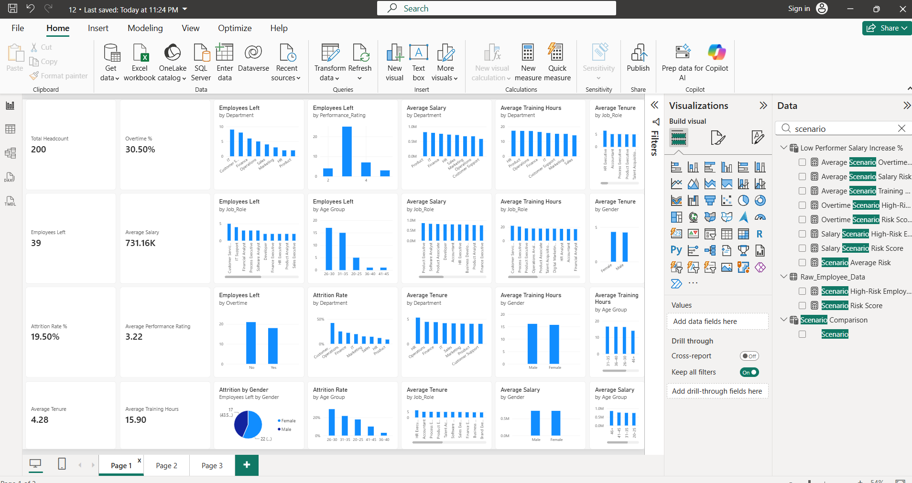

Slide 10
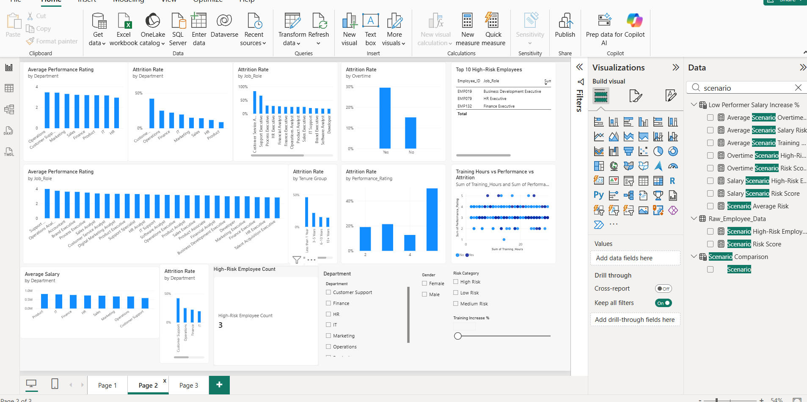

Slide 11
