Slide 1
HR ANALYTICS PROJECT
Recruitment Funnel
Efficiency Analyzer
Data-driven analysis of recruitment performance, bottlenecks, sourcing efficiency and what-if scenarios.
Prepared by Swetaa K.B.
Microsoft Excel | Power BI

Slide 2
Executive Summary
Turning recruitment data into actionable HR insights
APPLICATIONS
HIRES
APPLICATION → HIRE
AVG. TIME-TO-HIRE
COST / HIRE
250
58
23.20%
35.81 days
₹5,192
• Analyzed 250 applications across Applied, Screened, Interviewed, Offered and Hired stages.
• Identified major candidate losses at Screening → Interview and Interview → Offer.
• Compared recruitment sources using applications, hires, conversion and cost-per-hire.
• Built what-if scenarios to evaluate potential improvements in funnel efficiency.
Recruitment Funnel Efficiency Analyzer | HR Analytics
2

Slide 3
Recruitment Funnel Overview
Candidate movement through recruitment stages
Candidates by Recruitment Stage
250
SCREENING CONVERSION
INTERVIEW CONVERSION
84.40%
57.82%
211
OFFER CONVERSION
OFFER → HIRE
122
58.20%
81.69%
71
58
Overall Application → Hire
23.20%
Applied
Screened
Interviewed
Offered
Hired
Recruitment Funnel Efficiency Analyzer | HR Analytics
3

Slide 4
Recruitment KPIs
Core measures of hiring efficiency
TOTAL APPLICATIONS
TOTAL HIRES
APPLICATION → HIRE
OFFER → HIRE
AVG. TIME
250
58
23.20%
81.69%
35.81 d
TOTAL RECRUITMENT COST
COST-PER-HIRE
HIRING CYCLE
₹301,116
₹5,191.66
~36 days
The KPI set combines volume, conversion, speed and cost to provide a balanced view of recruitment performance.
Recruitment Funnel Efficiency Analyzer | HR Analytics
4

Slide 5
Funnel Drop-Off & Bottleneck Analysis
Where candidate leakage is highest
Drop-Off % by Stage
HIGHEST DROP-OFF
SECOND HIGHEST
42.18
41.8
42.18%
41.80%
HR ACTIONS
18.31
• Review screening criteria and candidate-job fit.
15.6
• Standardize interview evaluation and feedback.
• Monitor candidate engagement between stages.
App→Screen
Screen→Interview
Interview→Offer
Offer→Hire
• Set turnaround-time targets.
Recruitment Funnel Efficiency Analyzer | HR Analytics
5

Slide 6
Source Effectiveness Analysis
Comparing recruitment channels
Hires by Recruitment Source
SOURCE COMPARISON
21
Source
Apps
Hires
Conversion
Cost/Hire
20
Job Portal
92
14
15.22%
₹6,692.79
14
Referral
54
20
37.04%
₹3,674.10
LinkedIn
76
21
27.63%
₹5,382.86
Campus
28
3
10.71%
₹6,965.00
3
Referral shows the highest conversion (37.04%) and lowest cost-per-hire (₹3,674.10) in this dataset.
Job Portal
Referral
LinkedIn
Campus
Recruitment Funnel Efficiency Analyzer | HR Analytics
6

Slide 7
Time-to-Hire Analysis
Monitoring recruitment cycle duration over time
Average Time-to-Hire Trend by Month
41
39.9
OVERALL AVERAGE
36
36.8
37.2
35.81 days
30.5
31.8
HR FOCUS AREAS
• Reduce delays between stages.
• Set turnaround-time targets.
• Monitor pending candidates.
Feb
Mar
Apr
May
Jun
Jul
Aug
• Improve recruiter–manager coordination.
Recruitment Funnel Efficiency Analyzer | HR Analytics
7

Slide 8
Recruitment Cost Analysis
Understanding cost efficiency across sources
TOTAL RECRUITMENT COST
TOTAL HIRES
COST-PER-HIRE
₹301,116
58
₹5,191.66
Cost-per-Hire by Source
INTERPRETATION
6692.79
6965
• Cost-per-hire varies across channels.
5382.86
• Referral has the lowest cost-per-hire in this dataset.
3674.1
• Review cost together with conversion and hiring volume.
Job Portal
Referral
LinkedIn
Campus
Recruitment Funnel Efficiency Analyzer | HR Analytics
8

Slide 9
Scenario & What-If Analysis
Testing potential HR interventions
SCENARIO 1
SCENARIO 2
SCENARIO 3
Reduce Interview → Offer drop-off by 20%
Increase Referral Hiring by 15%
Reduce Average Time-to-Hire by 5 days
PROJECTED DROP-OFF
PROJECTED TOTAL HIRES
CURRENT AVERAGE
33.44%
≈61
35.81 days
PROJECTED A → H RATE
PROJECTED COST / HIRE
PROJECTED TIME-TO-HIRE
≈26.40%
≈₹4,936
30.81 days
Scenario results are based on the assumptions defined in the Power BI model; they are not actual future outcomes.
Recruitment Funnel Efficiency Analyzer | HR Analytics
9

Slide 10
HR Recommendations
Action areas supported by the analysis
01
Strengthen screening
02
Improve interviews
Review screening criteria and candidate–job fit.
Use structured evaluation and timely feedback.
03
Leverage referrals
04
Reduce cycle time
Referral shows strong conversion and lower cost-per-hire here.
Track stage delays and set turnaround targets.
05
Engage candidates
06
Use HR analytics
Maintain timely communication between stages.
Monitor funnel, source, cost and time KPIs.
Recruitment Funnel Efficiency Analyzer | HR Analytics
10

Slide 11
Power BI Recruitment Dashboard
Interactive view of funnel, KPIs, source effectiveness and time trends
RECRUITMENT FUNNEL EFFICIENCY
Applications
Hires
A→H
Avg. Time
Cost/Hire
250
58
23.20%
35.81 d
₹5,192
Funnel
Hires by Source
Time-to-Hire
250
20
21
41
36.8
37.2
39.9
211
36
31.8
14
30.5
122
71
58
3
Applied
Screened
Interviewed
Offered
Hired
Job Portal
Referral
LinkedIn
Campus
Feb
Mar
Apr
May
Jun
Jul
Aug
Recruitment Funnel Efficiency Analyzer | HR Analytics
11

Slide 12
Conclusion
Recruitment performance can be improved through focused, measurable HR interventions
APPLICATIONS
HIRES
A → H RATE
AVG. TIME
250
58
23.20%
35.81 d
• Major candidate leakage occurs at Screening → Interview and Interview → Offer.
• Recruitment sources differ meaningfully in conversion and cost-per-hire.
• Referral records the strongest conversion and lowest cost-per-hire in this dataset.
• What-if analysis demonstrates potential improvements under defined assumptions.
• The Power BI dashboard provides a repeatable framework for monitoring recruitment efficiency.
Thank You
Recruitment Funnel Efficiency Analyzer | HR Analytics
12

Slide 13
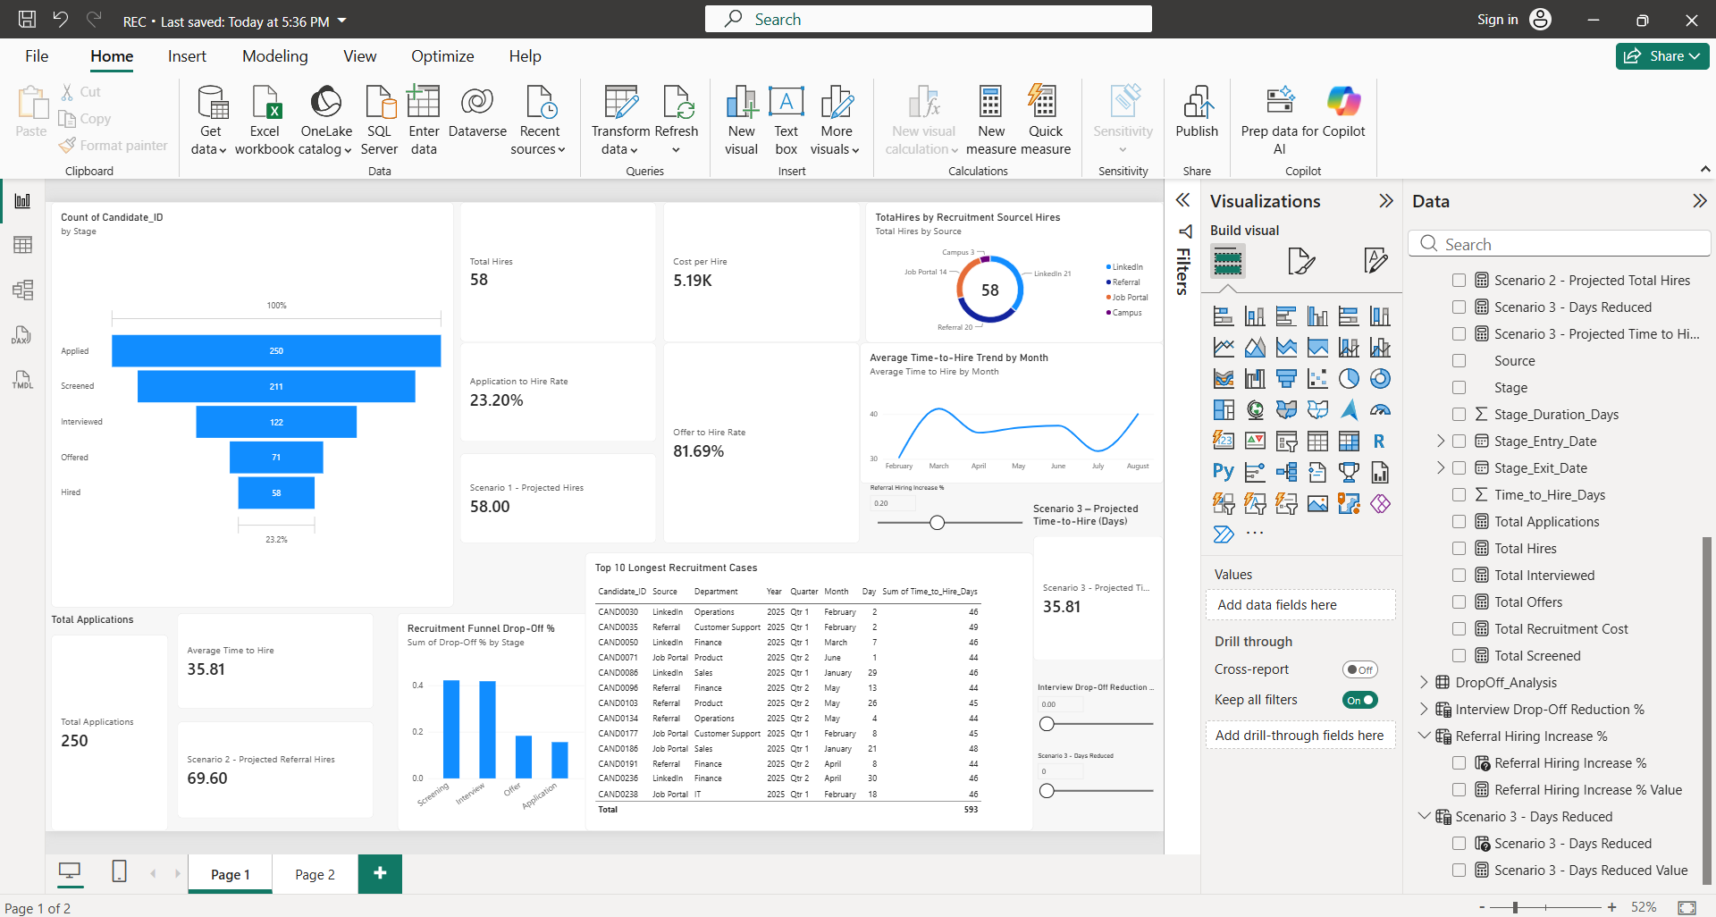

Slide 14
