Slide 1
HR ANALYTICS REPORT
WORKFORCE DIVERSITY
& INCLUSION ANALYTICS
Turning workforce data into measurable inclusion insights
PREPARED BY
200 synthetic employee records
K.B. Swetaa | BBA
Microsoft Excel • Power BI

Slide 2
Executive Summary
OVERVIEW
TOTAL EMPLOYEES
FEMALE REPRESENTATION
TRAINING PARTICIPATION
200
47%
97%
Records analyzed
Workforce share
194 employees
OVERALL DIVERSITY INDEX
EXIT RATE
FEMALE PAY EQUITY RATIO
88.17
17%
97.71%
Illustrative scorecard
34 employees exited
Comparison indicator
KEY TAKEAWAYS
ANALYTICS FLOW
• Gender representation is balanced at 47% female and 47% male.
• Training participation is high across the analyzed workforce.
• Pay-equity and ethnicity mix require further contextual review.
DATA → KPIs → DASHBOARD → SCENARIOS → ACTION
Workforce Diversity & Inclusion Analytics
2

Slide 3
Project Objectives & Methodology
FOUNDATION
01
Measure
02
Analyze
03
Score
Demographic representation
Promotions, pay equity, training & exits
Diversity Index
04
Simulate
05
Recommend
Workforce interventions
HR actions
METHODOLOGY
Data
Clean
KPI
Power BI
Scenario
Action
Tools: Microsoft Excel • PivotTables • Scenario Manager • Power BI
Workforce Diversity & Inclusion Analytics
3

Slide 4
Workforce Demographics — Gender
DEMOGRAPHICS
GENDER REPRESENTATION
Gender | Employees | Share
Female | 94 | 47%
Male | 94 | 47%
Non-Binary | 4 | 2%
Prefer Not to Say | 8 | 4%
Total | 200 | 100%
KEY OBSERVATION
47% / 47%
Female and male representation are equal
Workforce Diversity & Inclusion Analytics
4

Slide 5
Workforce Demographics — Age & Ethnicity
DEMOGRAPHICS
ETHNICITY DISTRIBUTION
Ethnicity | Employees | Share
Category A | 59 | 29.5%
Category B | 58 | 29.0%
Category C | 48 | 24.0%
Category D | 30 | 15.0%
Prefer Not to Say | 5 | 2.5%
Largest age group: 25–34 (42%)
Workforce Diversity & Inclusion Analytics
5

Slide 6
Inclusion Analysis — Promotions
INCLUSION
Gender | Eligible | Events | Events / Eligible
Female | 53 | 56 | 105.66%
Male | 61 | 48 | 78.69%
Non-Binary | 3 | 0 | 0%
Prefer Not to Say | 5 | 7 | 140%
TOTAL PROMOTION EVENTS
111
Among 122 promotion-eligible employees
3-year event measure, not a single-cycle promotion selection rate.
Workforce Diversity & Inclusion Analytics
6

Slide 7
Inclusion Analysis — Pay Equity
INCLUSION
FEMALE PAY EQUITY RATIO
97.71%
Comparison indicator
Department-level ratios
Department variation warrants contextual review by job level, role, tenure and experience.
Ratios shown relative to the overall average salary benchmark.
Workforce Diversity & Inclusion Analytics
7

Slide 8
Inclusion Analysis — Training & Retention
INCLUSION
TRAINING PARTICIPATION
97%
194 employees
OVERALL EXIT RATE
17%
34 employees exited
Monitor demographic differences alongside tenure, department and job level.
Workforce Diversity & Inclusion Analytics
8

Slide 9
Diversity Index & Scorecard
SCORECARD
OVERALL DIVERSITY INDEX
88.17
Average of four scorecard components
Metric | Score
Gender Balance | 100.00
Age Representation | 100.00
Ethnicity Mix | 71.88
Pay Equity | 80.80
Illustrative educational scoring methodology.
Workforce Diversity & Inclusion Analytics
9

Slide 10
Power BI Interactive Dashboard
DASHBOARD
WORKFORCE DIVERSITY & INCLUSION DASHBOARD
DEPARTMENT
JOB LEVEL
GENDER
ETHNICITY
All
All
All
All
EMPLOYEES
FEMALE
DIVERSITY INDEX
PAY EQUITY
PROMOTION EVENTS
200
47%
88.17
97.71%
111
Gender Distribution
Age Group Distribution
Exit Rate by Gender
Interactive slicers: Department • Job Level • Gender • Ethnicity
Workforce Diversity & Inclusion Analytics
10

Slide 11
Scenario & What-If Analysis
SCENARIOS
Scenario | Change | Diversity Index | Change vs Base
Base Case | Current workforce | 88.17 | 0.00
Scenario 1 | Female leadership hiring +10% | 88.17* | N/A
Scenario 2 | Minority training +20% | 88.17* | N/A
Scenario 3 | Pay Equity target = 1.00 | 92.97 | +4.80
BASE CASE
SCENARIO 3
IMPROVEMENT
88.17
92.97
+4.80 points
Current illustrative index
Salary correction model
Scenario 3 vs Base Case
* Scenarios 1–2 do not have prescribed formulas for converting adjustments into Diversity Index points, so no unsupported numerical improvement is assigned.
Workforce Diversity & Inclusion Analytics
11

Slide 12
HR Recommendations
ACTION
01
Inclusive Leadership Hiring
Monitor gender representation across leadership pipelines and expand diverse sourcing channels.
02
Compensation Equity Reviews
Review department-level salary differences by job level, role and experience.
03
Learning & Development
Maintain high participation and monitor access to development opportunities.
04
Promotion Equity
Track promotion outcomes and increase transparency around career progression.
05
Retention Analytics
Investigate demographic exit patterns alongside tenure, department and job level.
Workforce Diversity & Inclusion Analytics
12

Slide 13
HR Action Plan
EXECUTION
Area | Action | KPI
Leadership Diversity | Monitor diverse leadership hiring | Female leadership representation
Pay Equity | Periodic compensation equity reviews | Pay Equity Ratio
Promotions | Monitor promotion outcomes | Promotion Events / Eligible
Training | Track participation by group | Training Participation %
Retention | Investigate demographic exits | Exit Rate
Workforce Diversity | Monitor representation | Diversity Index
CONTINUOUS HR ANALYTICS CYCLE
MEASURE
ANALYZE
IDENTIFY GAPS
ACT
MONITOR
Workforce Diversity & Inclusion Analytics
13

Slide 14
CONCLUSION
From workforce data
to informed HR action
• Gender representation is balanced at 47% female and 47% male.
• Training participation is high at 97%.
• Overall exit rate is 17% in the synthetic dataset.
• The illustrative Diversity Index is 88.17.
• Scenario 3 models a +4.80-point improvement through salary-equity correction.
“Data-driven HR analytics can support more transparent workforce monitoring, evidence-based review and continuous improvement.”
Project takeaway
Synthetic / anonymized educational dataset • Observed disparities require contextual review
Workforce Diversity & Inclusion Analytics
14

Slide 15
Tools & Project Deliverables
APPENDIX
MICROSOFT EXCEL
POWER BI
DELIVERABLES
• Data cleaning
• PivotTables & KPIs
• Diversity Scorecard
• Scenario Manager
• Interactive dashboard
• KPI cards
• Charts & slicers
• Workforce analysis
• Cleaned dataset
• Dashboard
• Scenario analysis
• HR report & recommendations
DATASET
200 employee records
Workforce Diversity & Inclusion Analytics
15

Slide 16
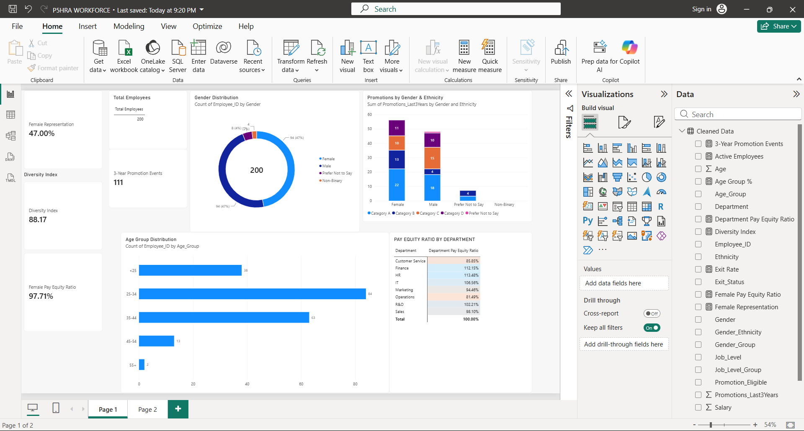

Slide 17
