Slide 1
Case De Brief
By: Swetaleena Satpathy

Slide 2

Problem Statement
The dataset contains a lot of data and the ‘LICENSE STATUS’ column which depicts whether the person has been able to get a business license or not. Based on the given features you have to predict whether a person will be given a license or not to run his business. The ‘LICENSE STATUS’ contains the following categories:
AAC (license was cancelled during term)
AAI (license was issued)
INQ (license requires inquiry)
REA (license revocation has been appealed)
REV (license was revoked)
The objective is to predict the column “LICENSE STATUS”.

Slide 3
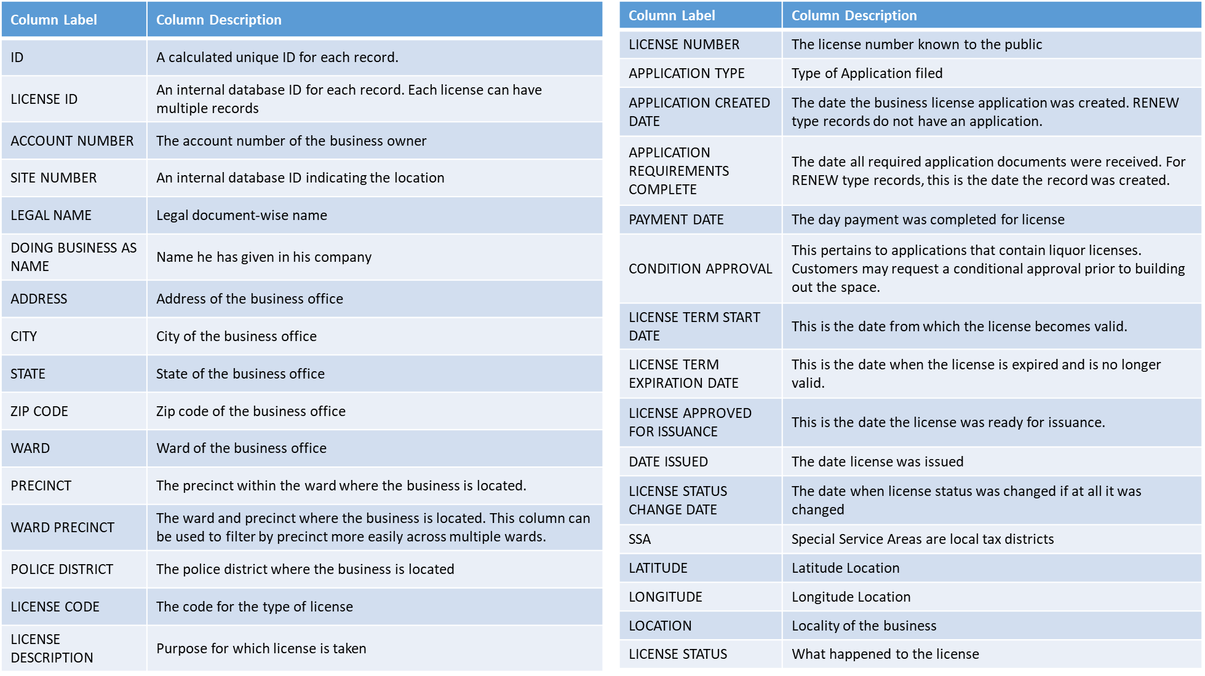
Columns Description

Slide 4
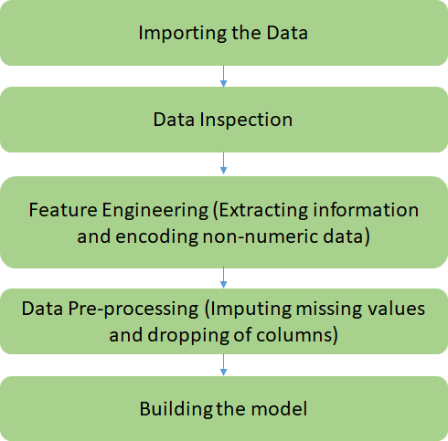
Project Flow
From the problem statement it was clear that it is a multiclass classification task.

Slide 5
Importing the datasets
TRAINING DATA contains 85895 rows and 32 features
TEST DATA contains 57239 rows and 31 features
train_data = pd.read_csv("train_file.csv")
train_data.head()
test_data = pd.read_csv("test_file.csv")
test_data.head()
train_data.shape
test_data.shape

Slide 6

Data Inspection
LICENSE STATUS | COUNT
AAI | 55400
AAC | 30200
REV | 290
REA | 3
INQ | 2

Slide 7
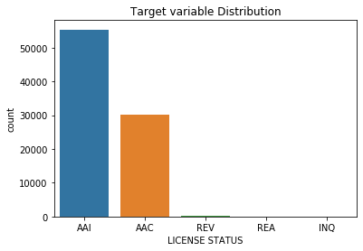
Data Inference
The target distribution shows that this is an imbalanced dataset.
All the target classes are not equally distributed.
AAI is the dominating class and INQ is the minor one.
From the above distribution we can also guess that ML model can learn patterns for AAI, AAC and REV but it can struggle to learn patterns for REA and INQ classes.

Slide 8
Code : Count of NA and Unique values for every feature
#To check for the not available data
train_data.isna().sum()
test_data.isna().sum()
#To check for the unique data
train_data.nunique()
test_data.nunique()

Slide 9
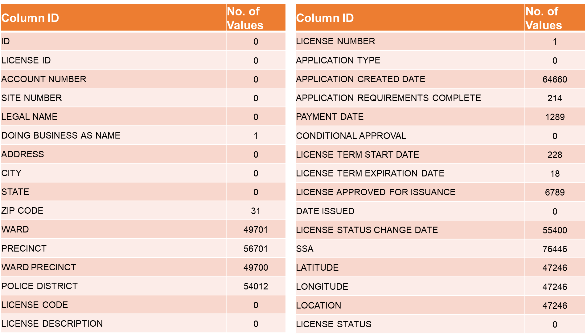
Count of NA values (Train Dataset)

Slide 10
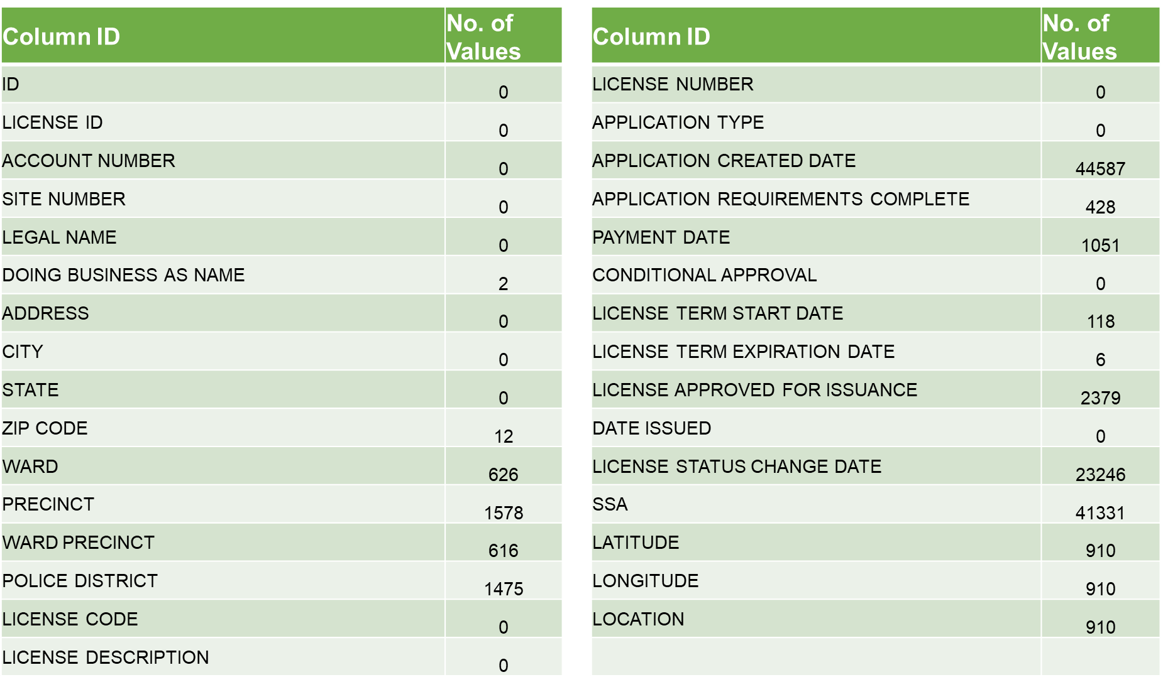
Count of NA values (Test Dataset)

Slide 11
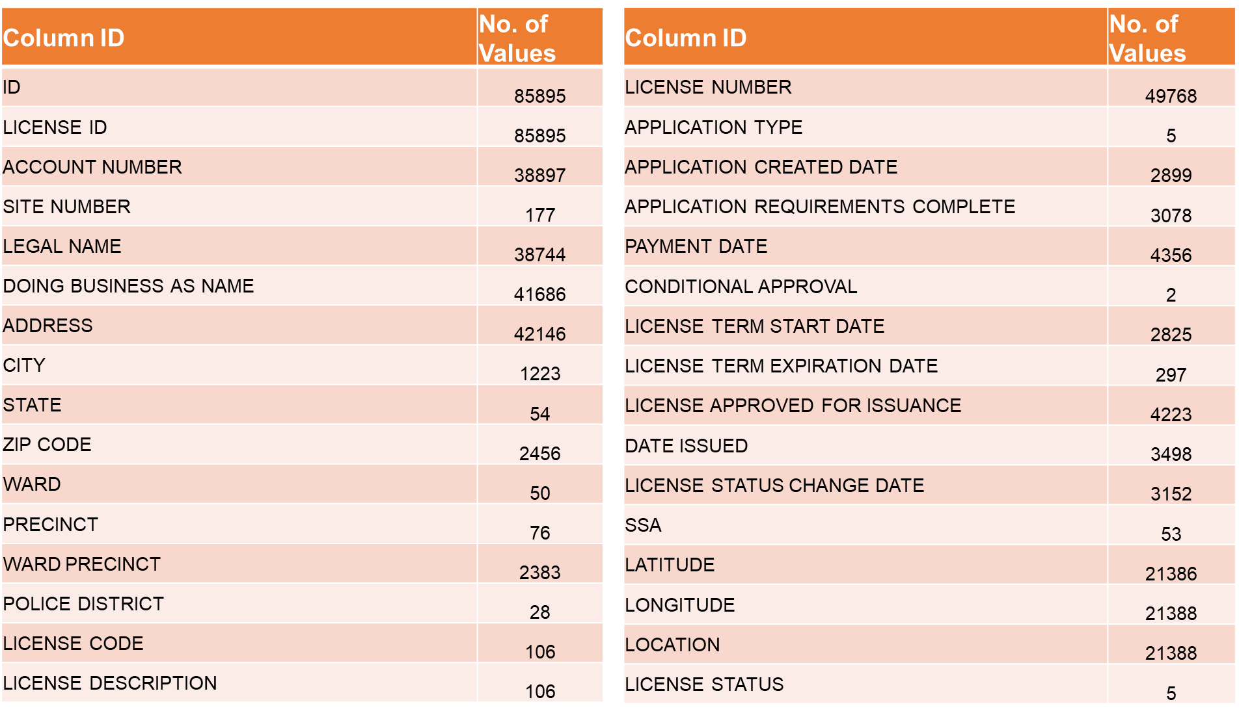
Count of Unique values (Train Dataset)

Slide 12
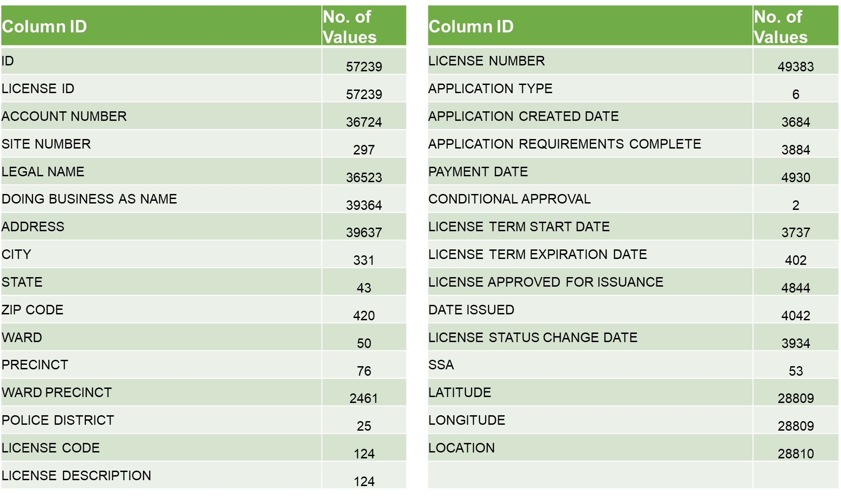
Count of Unique values (Test Dataset)

Slide 13
Data Preprocessing and Feature Engineering Steps
Extract year and month from datetime data
Extraction of year and month into separate columns from features like PAYMENT DATE, DATE ISSUED, APPLICATION REQUIREMENTS COMPLETE , LICENSE TERM EXPIRATION AND START DATES etc.
1
Dropping of columns which will be of no use for our model
Dropped off the original columns from which I extracted the month and year alongwith some other features which seemed unnecessary.
2
3
Imputing missing values
Imputed the missing values in various features with the average, rounded average and zero.
Clubbing of similar values from the column 'LICENSE DESCRIPTION’
Grouped together many similar values to one value like Motor Vehicle Repair, Day Care Center, Peddler etc.
4
Encoding the non numeric values
Label encoded the target variable and other categorical features like CITY, STATE, APPLICATION TYPE etc.
5

Slide 14

Extract year and month from datetime data
Sample code to extract year and month:
Rationale of extracting year and month:
Year : If the year comes up as an important variable then while running the model on retrospection, we can get a clear result.
Month : If the month comes up as an important variable (seasonality) then having the month as a separate variable will give a better result.

Slide 15
Dropping irrelevant features from the dataset
LEGAL NAME , DOING BUSINESS AS NAME : Names can not affect the decision of whether a person is entitled to get a business license or not.
ID, LICENSE ID : These features have unique values for every data point, so the ML model might not learn any pattern from it. Also multiple records belonging to the same license application have different License IDs and these IDs are not known to the general public.
ADDRESS : Not necessary since the city,state,zip code etc of the business office is given as separate features.
WARD PRECINCT : Made up of Ward and Precinct data which are already two separate features.
APPLICATION CREATED DATE : RENEW type records do not have an Application Created Date.
SSA : This feature has a lot of missing values.
LOCATION : Not necessary since LATITUDE AND LONGITUDE data given as separate features.

Slide 16
Imputing missing values
Methods used to handle missing data
Average : Used for Latitude, Longitude (Location data)
#train_data[j] = train_data[j].fillna(train_data[j].mean())
Rounded Average : Used for year and month ( These features cannot be decimal)
#train_data[i] = train_data[i].fillna(round(train_data[i].mean()))
Impute to zero: Used for identifiers ( WARD, PRECINCT, POLICE DISTRICT, LICENSE NUMBER, ZIP CODE)
#train_data[i] = train_data[i].fillna(0)

Slide 17
Clubbing of similar values from the column 'LICENSE DESCRIPTION’
Clubbing together similar values, rationale:
Include different class of same vendors under one category to solve the problem of having too few data points for one particular class of vendor.
To avoid including too many points when non-numeric data is being encoded.
Licenses which were clubbed:
Motor vehicle repair
Day care center
Peddler
Tire Facility
Repossessor
Expediter
Itinerant Merchant
Navy Pier
Massage Service

Slide 18
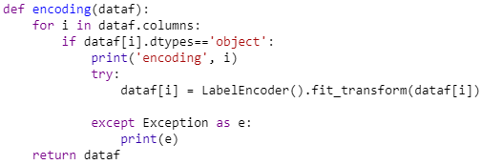
Label Encoding of non-numeric Data
Encoding the categorical data so that they can be used to fit and evaluate the model.

Slide 19
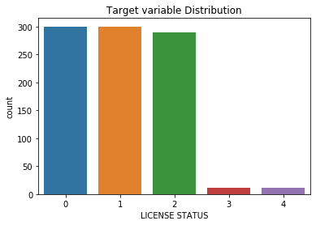
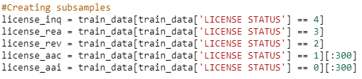
Sampling and encoding the output variable
Oversampling the data of REA, REV since we have very few records of those in the training set.
Taking a sample of 300 points each from the shuffled data of AAC and AAI since the abundance of their data may add bias to our model.
Hence we will train our model on a very balanced data.
This is how the data looks after sampling.
Pretty much balanced !!!

Slide 20

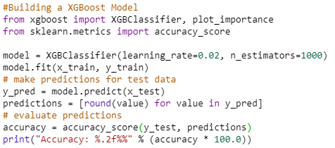
Model Building
Test-Train Split
Model Code
Accuracy = 93.01%

Slide 21
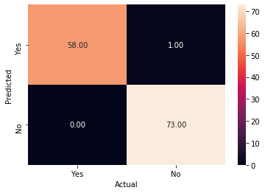
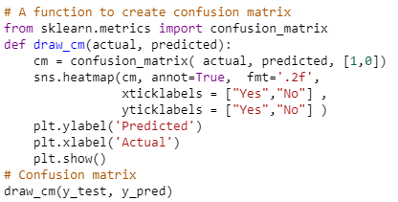
Evaluation of the Model

Slide 22
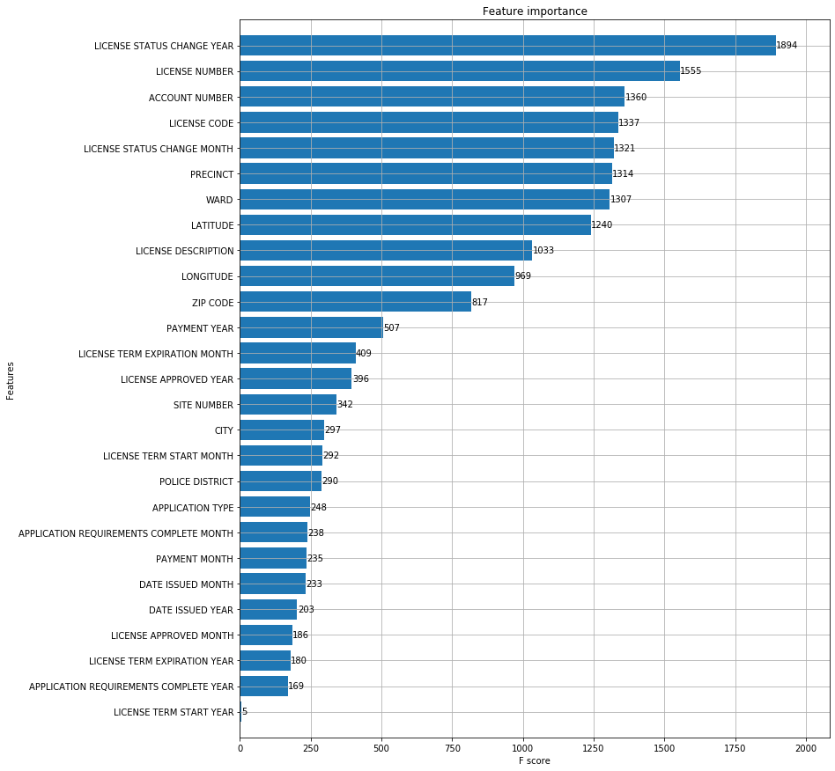

Feature Importance
We can see from the graph that the LICENSE STATUS CHANGE YEAR and the LICENSE NUMBER are the most important features in our model.

Slide 23
THANK YOU

