Slide 1

CODE MERGE HACKATHON
DEPARTMENT OF DATA SCIENCE AND BUSINESS SYSTEMS
V2.0 · AI FOR IMPACT
PROJECT PITCH DECK
FIREBREAK
Which alarm becomes a catastrophe — and the cheapest action that stops it
Track: AI for Safety & Security · “The Chain Reaction”

Slide 2
Problem Statement
01
UNDERSTAND THE CHALLENGE
What problem are you solving?
A city's lifelines are one network, and a control room sees them as five separate alarm queues. Chennai, December 2015: rain floods the substations, so pumping stops, so hospitals fall back to diesel — and the roads are underwater, so the diesel never arrives. The node that killed the city was a road, because it carried the fuel. Not one monitoring system was broken that night; every one of them reported its own alarm correctly. None could say which alarm ends with hospitals dark in six hours.
Current gaps
Alarms are ranked by how loud they are. Measured over 52,631 held-out events, that ranking scores ROC-AUC 0.483 — chance, and slightly below it. The alternative on offer is an expert-declared interdependency matrix, but 81% of the links that actually propagate failure here are load redistribution between flow-peers, which appears in no declared matrix. And the literature predicts that a cascade will happen; nobody picks the intervention that stops it.
Why now?
Catastrophes are too rare to learn from — roughly three per decade in a given city — so the field trains on synthetic scenario sweeps and inherits the assumptions of whoever wrote the generator. The training data already exists and nobody collects it: a cascade that stopped after two hops is the same stochastic process, sitting unlabelled in every operational log because nobody was hurt. Aviation has mined precursors this way since ASRS. Nobody has done it for a networked, multi-sector city.

Slide 3
Proposed Solution
02
YOUR IDEA
What is your solution?
Firebreak reads an ordinary alarm stream and answers the three questions no deployed system answers: which alarm becomes a catastrophe, what happens if nobody acts, and the cheapest action that stops it — with a deadline. The criterion is one number. An abnormality is dangerous exactly when its local branching ratio nᵢ = Σ αᵢⱼ · sⱼ(t) exceeds 1 — danger is not a property of an event, it is a property of its position in a network. The α are mined from near-misses already in the logs, not declared by an expert.
How does it work?
1 · Mine the near-misses — cause chains recovered from the log an operator already keeps. The miner never sees ground truth: precision 0.855, recall 0.898.
2 · Fit the kernel — a multivariate Hawkes process per dependency edge yields α (how much propagates) and β (how fast). 1,936 kernel edges.
3 · Score the live alarms — branching ratio against current stress: ROC-AUC 0.732, against 0.483 for the anomaly score. Two alarms, identical scores, one red.
4 · Roll it forward — Monte Carlo counterfactual. If nobody acts: 407 assets fail, 5 hospitals are hit, 1,947,483 people affected.
5 · Pick the firebreak — the cheapest action under budget that changes that: preposition five assets, cost 12, and the option expires in 523 s.
6 · Run it at the edge — one command prints that decision, with no server, no uplink and no LLM anywhere in the path.

Slide 4
Key Features
03
WHAT MAKES IT WORK
1
2
3
4
One number for danger
nᵢ > 1, independent of how loud the alarm is. 0.732 ROC-AUC against 0.483 for the anomaly score, on 52,631 held-out events.
Near-misses as training data
Cause chains mined from logs the miner never sees the answer in — precision 0.855, recall 0.898. The failures that did not matter teach the one that will.
A deadline, not a warning
β gives timing, so every recommendation carries the minute after which it is worth less than 90% of acting now. In the demo run: 523 seconds.
Evidence that can lose
Seven arms, held-out scenarios, Wilcoxon signed-rank with Holm correction, against a pre-registration. Four of five predictions went against us; all four are published.

Slide 5
Tech Stack
04
HOW IT'S BUILT
Technologies used
Python 3.12 — numpy, scipy, networkx, pydantic, pytest, pinned to the versions every number in this deck was generated with, because a results table that cannot be reproduced is not evidence. The simulator, the Hawkes fitter, the near-miss miner and the counterfactual search are all first-party: no ML framework, and no LLM anywhere in the decision path. The console is vanilla ES5 with WebGL through three.js, vendored into the repo so the demo needs no network — a venue's wifi is not part of the demo — with a 2D fallback beside it for a projector that cannot give us a GL context.
APIs & integrations
None at runtime, deliberately: the decision loop has to run with the uplink cut. What we stand on is declared instead — InfraRisk (BSD-3) for interdependent water–power–transport failure, the Hawkes/ETAS kernel from seismology, and NASA's ASRS precursor work as the licence for mining near-misses. I³ (Tsinghua, arXiv 2503.02890) is the intended SOTA baseline and we did not reproduce it on our hardware: published numbers only, said in the arms table where the row would be rather than quietly dropped.
Data & infrastructure
A five-layer geo-anchored Chennai twin — 1,069 assets, 281 declared dependencies, hazard fields for monsoon, heat, cyber and equipment age. Same seed gives a byte-identical run, or the ablation means nothing. GitHub Actions runs the invariants, the leakage tests and the six demo beats, including the assertion that beat 5 still fails; GitHub Pages serves the write-up and the console as static files. The decision loop itself needs neither.

Slide 6
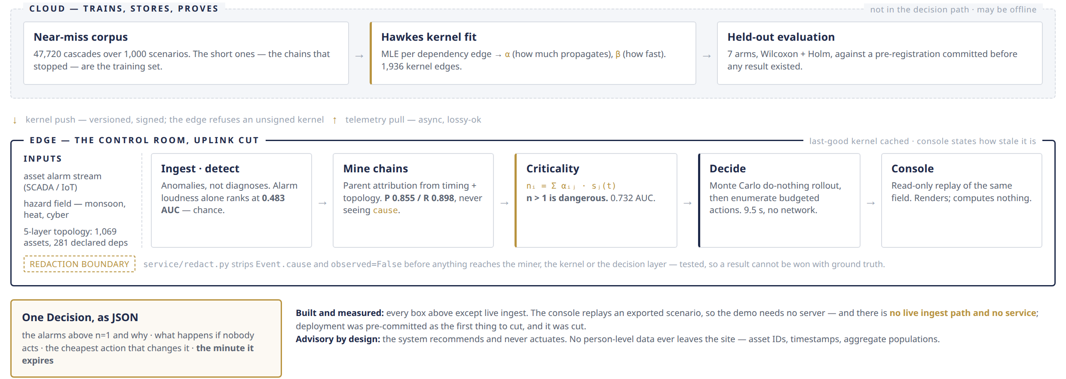
System Architecture
05
HOW IT ALL CONNECTS
Architecture / data flow — the cloud trains, the edge decides

Slide 7
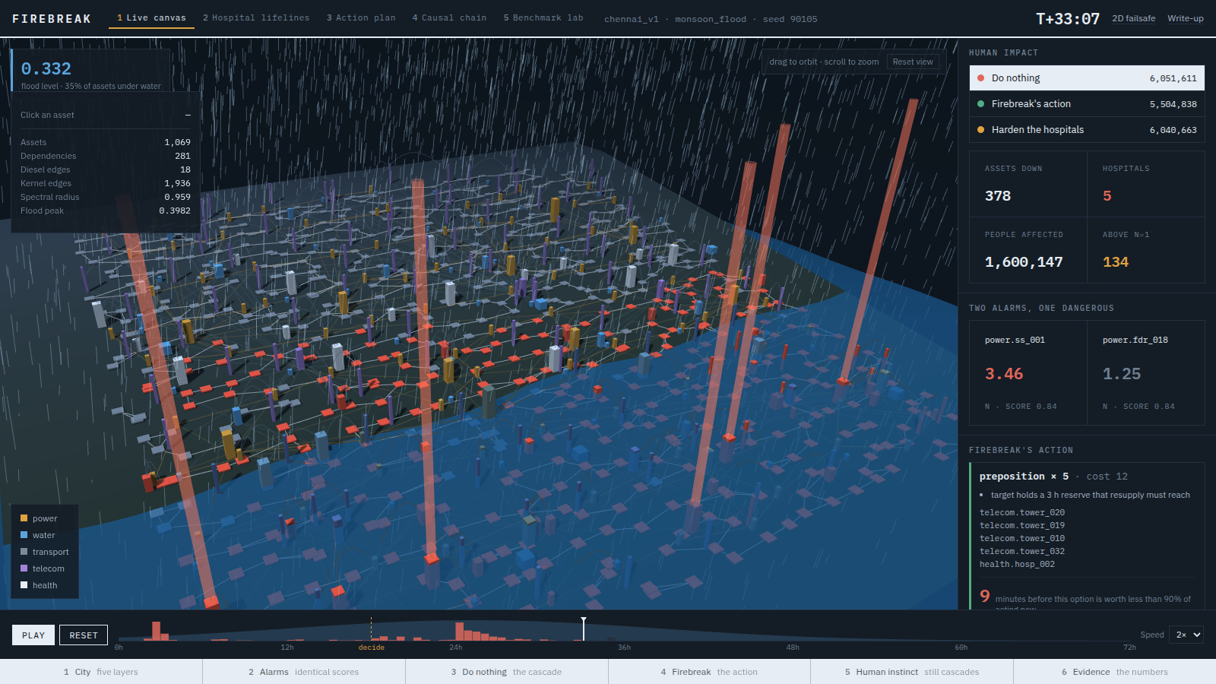
Prototype & Links
06
SEE IT IN ACTION
Prototype preview — Chennai at hour 33, doing nothing
GitHub Repository
github.com/swetank18/firebreak
Live Demo / Deployed Link
swetank18.github.io/firebreak/sim/ — the 3D console; keys 1–6 drive the six beats, offline. Write-up and evidence tables: swetank18.github.io/firebreak
Demo Video
None recorded — and that gap is written into LIMITATIONS.md rather than left for a judge to find. The page is static and needs no server, so it is run live.

Slide 8
Innovation & AI Integration
07
WHAT SETS YOU APART
How does AI power your solution?
A multivariate Hawkes process with exponential kernels — the ETAS model seismology uses to reason about large earthquakes from thousands of small tremors — fitted per dependency edge on mined near-miss chains. The branching ratio it yields ranks the alarms, β sets the deadline, and a Monte Carlo rollout plus an enumeration over budgeted actions picks the intervention. The learning is in the propagation structure, and the path from alarm to instruction is a kernel, a rollout and an enumeration you can read line by line. No LLM produces any part of a decision. A redaction boundary strips the simulator's ground-truth cause before anything reaches the miner, so no result here was won by peeking.
What makes your approach unique?
Three things. The training data is near-misses mined out of ordinary logs rather than synthetic sweeps or an expert-declared matrix — and the propagation it recovers is mostly load redistribution between flow-peers, which no declared matrix contains. The output is an action with an expiry rather than a risk score: the literature predicts cascades, and nobody picks the firebreak. And the evaluation was pre-registered before any result existed, which is why this slide also carries the finding we did not want — at equal budget our counterfactual search is not distinguishable from protecting five random assets, while static betweenness, with no learning at all, is. It is in the deck because a pitch that shows only what worked is not evidence.

Slide 9
Impact, Feasibility & Scalability
08
WHY IT MATTERS
Impact
On the demo seed, doing nothing costs 6,051,611 person-hours of lost lifeline service, 5 hospitals and 1,947,483 people. Firebreak's action — preposition five assets, 12 cost units — spares one hospital, 122,909 people and 546,774 person-hours on the identical seed and the same randomness.
The action an experienced operator reaches for, hardening the hospitals at the same budget, moves it by 0.2%: the cascade still arrives. That contrast is beat 5 of the demo, and CI fails if it ever stops being true.
Ranking is what is deployable today: 0.732 against 0.483 means the operator triaging by our number looks at the dangerous alarm instead of the loud one.
Feasibility
It runs now, on a laptop. pip install -r requirements.txt, pytest, then one command prints a full Decision as JSON — the alarms above n=1 and why, what happens if nobody acts, the cheapest action that changes it, and the minute it expires. It took 9.5 seconds with no server, no database and no network. That is the whole edge-deployability claim, so it is a command rather than a slide.
It is advisory by construction — the system recommends and never actuates, which is what makes it installable in a real utility — and it holds no person-level data: asset IDs, timestamps, and populations aggregated by service area.
Scalability
The kernel is estimated per edge, so a second city is a topology and a log stream, not a retrained monolith. The cloud fits and signs kernels; the edge caches the last good one and says on screen how stale it is. Real hydraulics and power flow (wntr, pandapower) plug in behind city/engine/physics.py — the cascade mechanism is the contribution, not the hydraulics.
The honest ceiling: the decision layer has to beat a random pick at equal budget before anyone should trust it to choose where to act, and it does not yet. Ranking ships; intervention is the next thing to earn.

Slide 10
FIREBREAK
MEET THE TEAM
[ Name ]
[ Role ]
[ Name ]
[ Role ]
[ Name ]
[ Role ]
[ Name ]
[ Role ]
Thank You
github.com/swetank18/firebreak · dynamicsanvil@gmail.com

