Slide 1


Made By : Birappa Patil
: Roshan Kanwal

Slide 2
What is Git?
Version control system
Which changes were made?
Who made the changes?
When were the changes made?
Why were changes needed?
- Distributed version control system

Slide 3
What is Github?
GitHub is a code hosting platform for version control and collaboration.
Repository site
Home for open source project
FB for Developers

Slide 4
What’s a repository?
Entire collection of files and folders associated with a project, along with each file’s revision history.
What is Branch?
- Branching is the way to work on different versions of a repository at one time.
We use branches to experiment and make edits before committing them to master.
What is Commit?
- saved changes are called commits.

Slide 5
Basic Git commands
git init
git clone
git add
git commit
git status
git branch
git merge
git pull
git push
Notes:
explanation

Slide 6
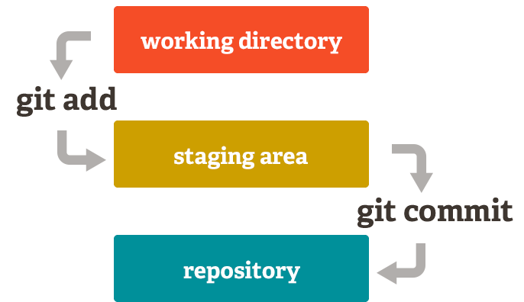

Slide 7
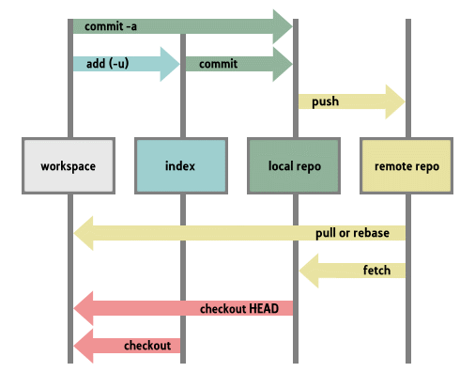

Slide 9
Create and use a repository
Start and manage a new branch
Make changes to a file and push them to GitHub as commits
Open and merge a pull request

Slide 10
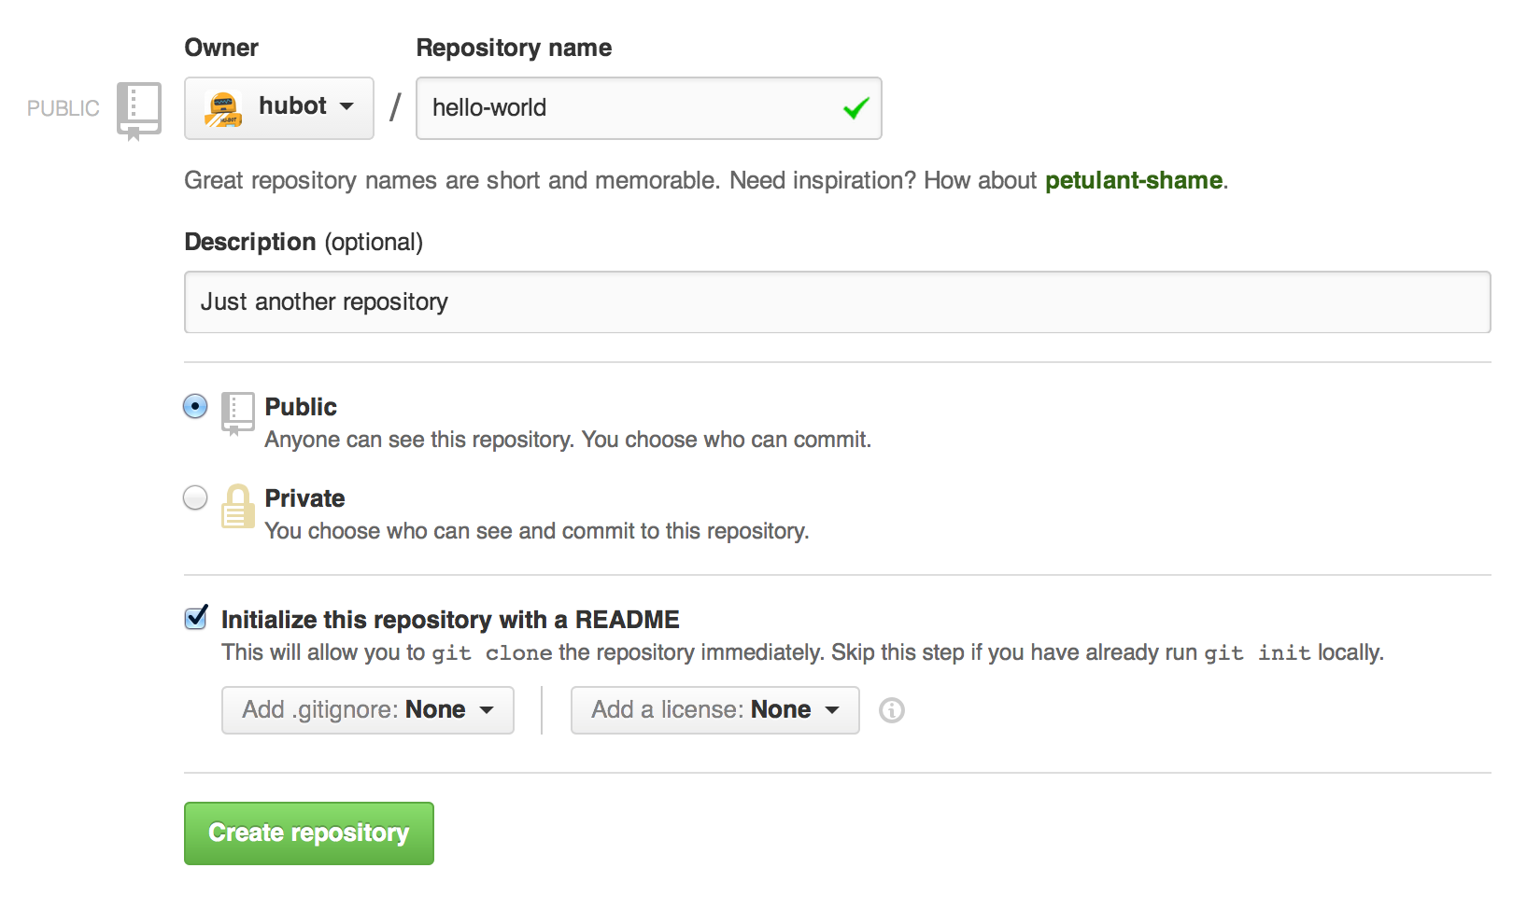
Step 1. Create a Repository

Slide 11
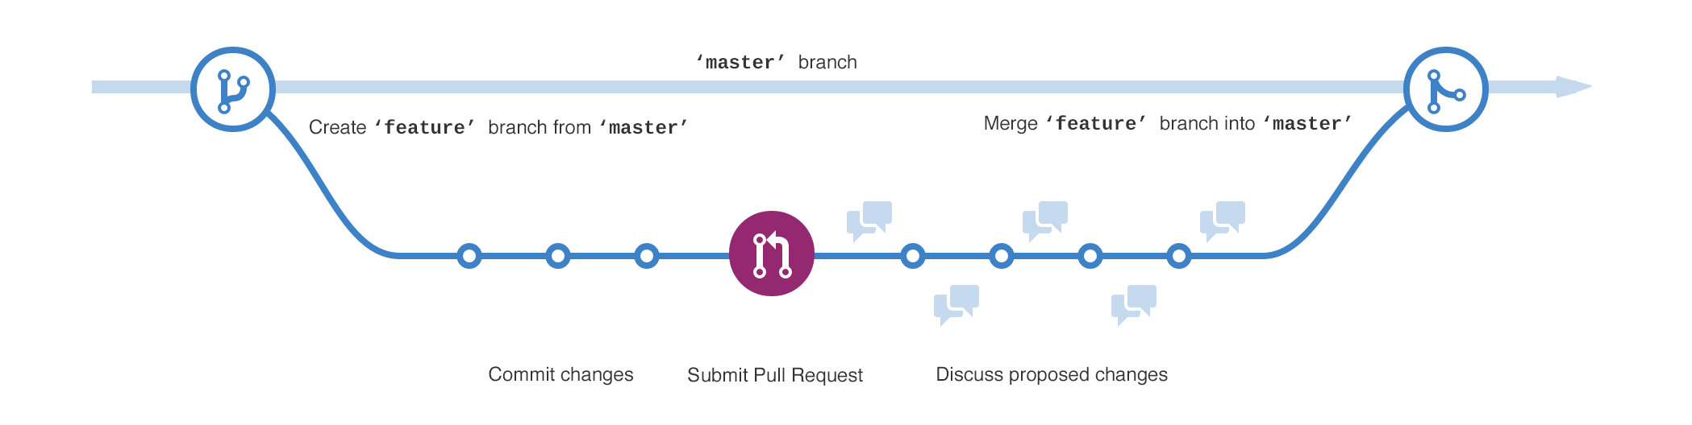
Step 2. Create a Branch

Slide 12
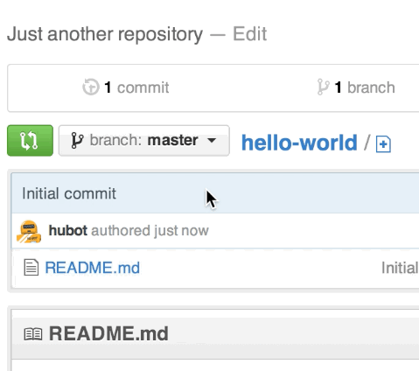

Slide 13
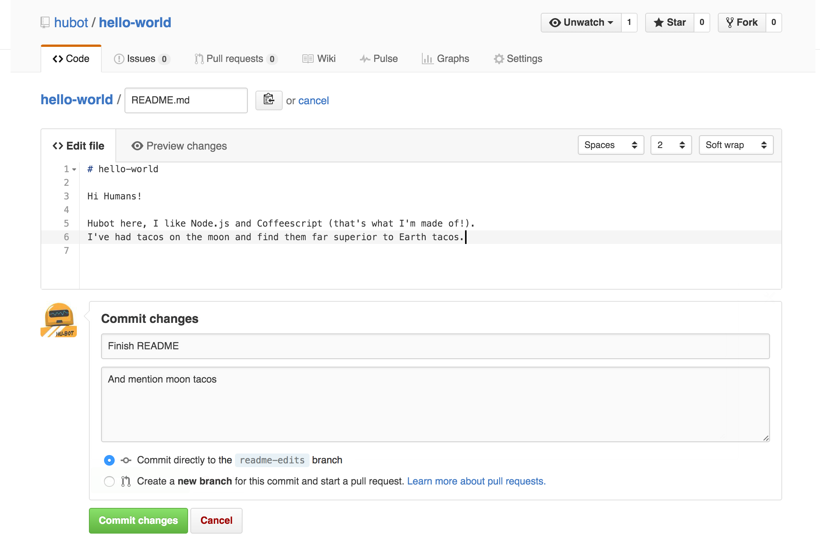
Step 3. Make and commit changes

Slide 14
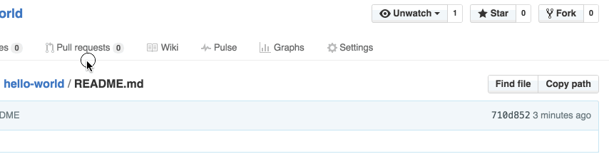
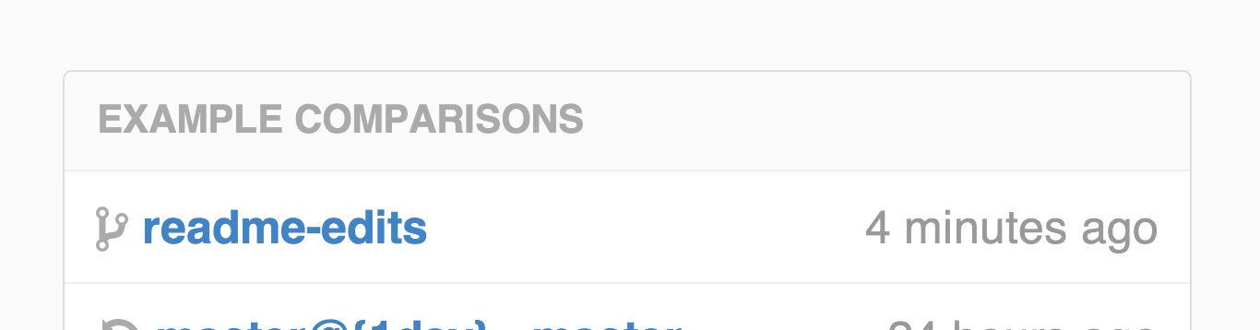
Step 4. Open a Pull Request

Slide 15
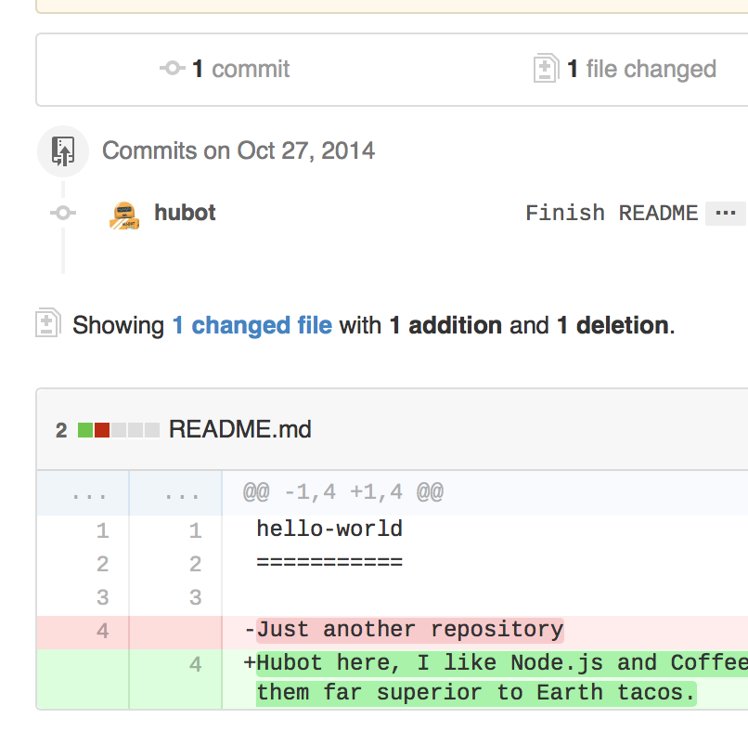

Slide 16
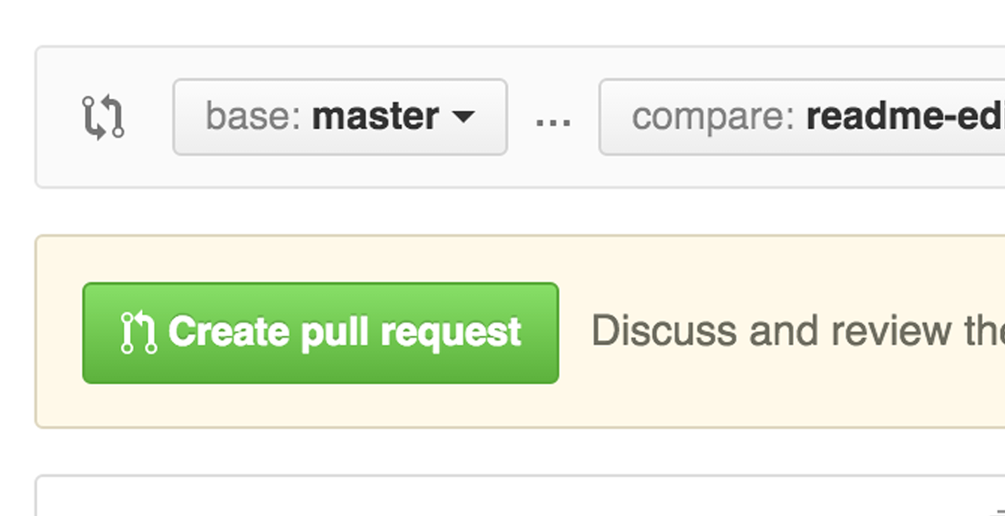

Slide 17
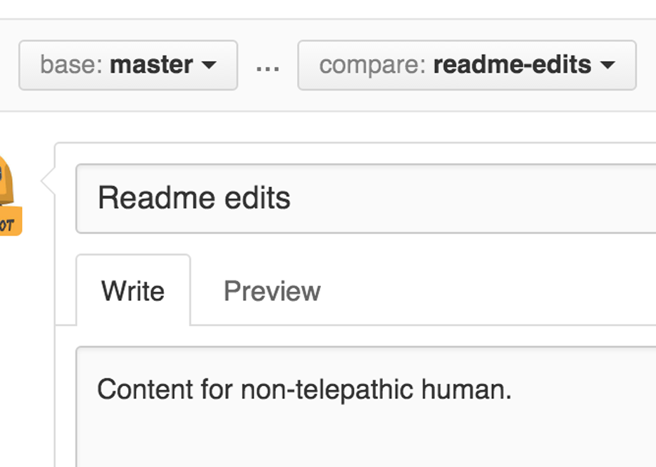

Slide 18
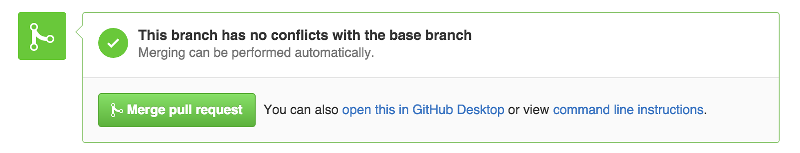
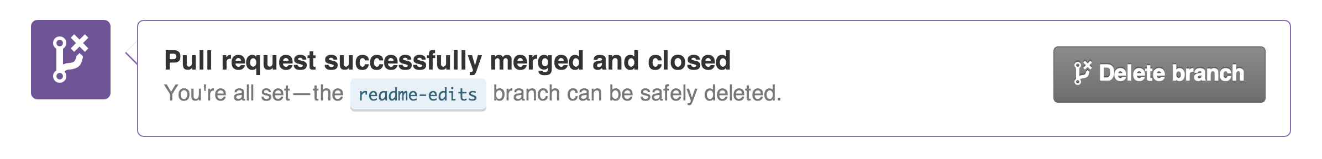
Step 5. Merge your Pull Request

Slide 19
Example: Contribute to an existing repository
# download a repository on GitHub.com to our machine
git clone https://github.com/me/repo.git
# change into the `repo` directory
cd repo
# create a new branch to store any new changes
git branch my-branch
# switch to that branch (line of development)
git checkout my-branch
# make changes, for example, edit `file1.md` and `file2.md` using the text editor
# stage the changed files
git add file1.md file2.md
# take a snapshot of the staging area (anything that's been added)
git commit -m "my snapshot"
# push changes to github
git push --set-upstream origin my-branch

Slide 20
Example: Start a new repository and publish it to GitHub
# create a new directory, and initialize it with git-specific functions
git init my-repo
# change into the `my-repo` directory
my-repo
# create the first file in the project
touch README.md
# git isn't aware of the file, stage it
git add README.md
# take a snapshot of the staging area
git commit -m "add README to initial commit"
# provide the path for the repository you created on github
git remote add origin https://github.com/YOUR-USERNAME/YOUR-REPOSITORY.git
# push changes to github
git push --set-upstream origin master

Slide 21
How to create local and remote repository ?
Notes:
Local repository: -create folder with appropriate name. open git bash

Slide 22
Any Questions?

