Slide 1
Intelligent Agents
Unit 2

Slide 2
What is an Agent?
An agent perceives environment using sensors
Acts using actuators
Works in perceive-think-act cycle

Slide 3
Examples of Agents
Human agent
Robotic agent
Software agent

Slide 4
Rational Agent
Chooses best action
Maximizes performance
Uses percepts & knowledge
PEAS and Rational Agent
The task of a rational agent is defined using PEAS:
P – Performance Measure
E – Environment
A – Actuators
S – Sensors
PEAS helps in designing a rational agent properly.

Slide 5
PEAS Framework
Performance Measure
Environment
Actuators
Sensors

Slide 6
Intelligent Agent
An intelligent agent is an entity that perceives its environment through sensors, thinks or decides, and acts on the environment using actuators to achieve its goals.

Slide 7
Properties of Intelligent Agent
Autonomy - An intelligent agent can work on its own without continuous human control.
Example:Robot vacuum cleaning the house automatically
Perception - An agent can sense its environment using sensors.
Examples: Camera, microphone, GPS, touch sensors,Chatbot reading user messages.
Reasoning - The agent can think and make decisions using logic, rules, or algorithms.
Example: Chess program deciding the best move
Learning - The agent can learn from experience and improve over time.
Example: Spam filter improving accuracy
Adaptability - The agent can change its behavior when the environment or goal changes.
Example: GPS changing route due to traffic

Slide 8
Types of Agents
Simple Reflex
Model-Based
Goal-Based
Utility-Based
Learning Agent

Slide 9
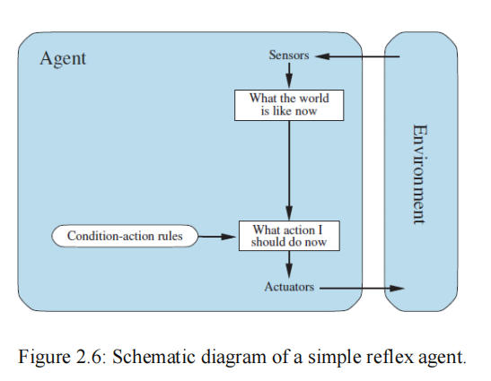
Simple Reflex Agent
Works on current percept only
Uses condition-action rules
No memory
Fast but limited
Works well in fully observable environments

Slide 10
Simple Reflex Agent
Current situation → Immediate action
Example:
Vacuum cleaner
If dirt → Suck
If clean → Move
Note: Simple reflex agent reacts instantly using IF–THEN rules.

Slide 11
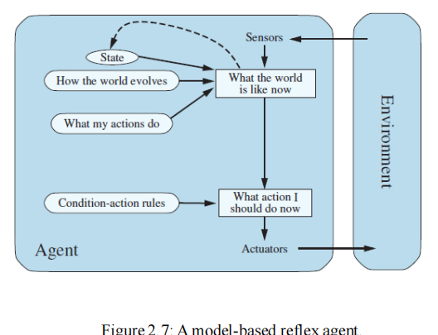
Model-Based Agent
A Model-Based Reflex Agent maintains an internal state (model) to track parts of the environment that are not directly observable.
Uses memory
Stores percept history
Handles partially observable environments
More intelligent than simple reflex agents

Slide 12
Model-Based Agent
When an intelligent agent works in the real world, it must keep updating what it knows about the environment.To do this, the agent needs two types of knowledge stored in its program.
1. Transition Model (How the world changes)
A transition model tells the agent what will happen in the world when it takes an action.
“If I do this, what will happen next?”
Examples:
If the car turns the steering wheel right, the car moves right
If it rains, the camera may get wet
If the robot moves forward, its position changes
This knowledge explains how the world works and changes over time.

Slide 13
Model-Based Agent
2. Sensor Model (How the agent sees the world)
A sensor model tells the agent how the real world appears through its sensors.
“What do my sensors show when something happens?”
Examples:
When the car in front brakes, the camera sees red brake lights
When the camera is wet, the image becomes blurred
A vacuum cleaner sensor detects dirt or no dirt
This knowledge explains how the environment looks to the agent.

Slide 14
Model-Based Agent
Current situation + past memory → Action
Why needed:
World is not always fully visible
Example:
Robot vacuum remembers which rooms are already cleaned
Automated taxi remembers road and traffic conditions
Note - Model-based agent uses memory + rules.
The agent:
Uses previous state
Uses last action
Uses new percept
Uses transition & sensor models
Then it updates its understanding of the world

Slide 15
Goal-Based Agent
A Goal-Based Agent chooses actions to achieve a specific goal, not just reacting to the current situation.
Goal-based agents know what they want to achieve (goal)
They think ahead and plan actions
Knowledge is explicit and flexible
Behavior can be changed by changing the goal only
Example:
Goal: Reach destination
The agent finds different paths if the road is blocked
Important point:
Same situation → different action depending on goal

Slide 16
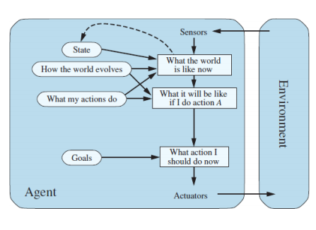
Goal-Based Agent

Slide 17
Reflex-Based Agent VsGoal-Based Agent
Reflex-Based Agent | Goal-Based Agent
Reacts to current percept | Plans actions to reach goal
Uses IF–THEN rules | Uses goals + planning
Less flexible | More flexible
Rules must be rewritten | Only goal is changed
No future planning | Future-oriented

Slide 18
Problem with goal-based agents
A goal only tells the agent whether it has succeeded or not.
Example (Taxi):
Goal: Reach destination
Many routes can reach the destination but
Some routes are faster
Some are safer
Some are cheaper
So, just reaching the goal is not enough.
Problem with goal-based agents
Goal-based agents see only:
Goal achieved (happy)
Goal not achieved (unhappy)
They cannot compare which result is better
This is called a binary decision (yes/no).

Slide 19
Utility-Based Agent
Uses utility function
Chooses best outcome
utility-based agent chooses actions that give the best result, not just reaching the goal.” Which option is better?”
Example: Taxi selects route that is safer, faster, and cheaper, not just any route
Why utility is used:
Goal = yes/no
Utility = how good or bad
Utility-based agent chooses the action with maximum satisfaction.

Slide 20
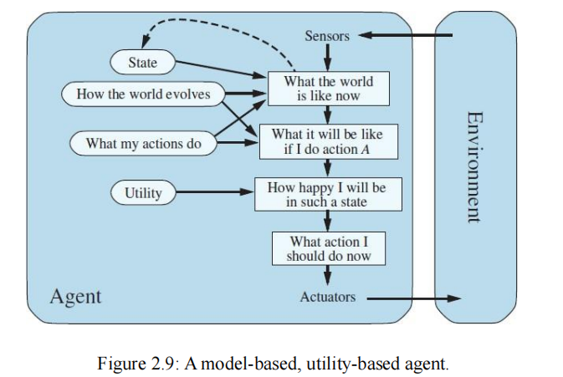
Utility-Based Agent

Slide 21
Learning Agent
Learns from experience
Improves performance
A learning agent improves its behavior by learning from experience.
Learn → Improve → Perform better
Main parts:
Performance element (does the work)
Learning element (learns)
Critic (gives feedback)
Problem generator (tries new things)
Example: Chatbots, Spam filters , Self-driving cars
Note: Learning agent learns from mistakes and improves over time

Slide 22
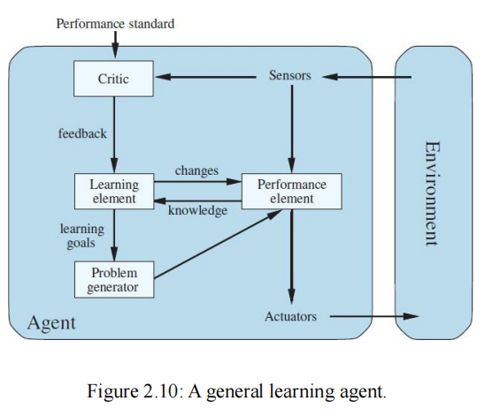
Learning Agent

Slide 23
Environment Types
Observable / Partial
Deterministic / Stochastic
Static / Dynamic
Single / Multi-agent
Discrete / Continuous
Episodic / Sequential
Competitive / Collaborative
Known / Unknown

Slide 24
Fully Observable vs Partially Observable
Fully Observable Environment
The agent can see the complete state of the environment at all times.
No need to remember past information.
Easy to design agents.
Example: Chess – all pieces and moves are visible.
Partially Observable Environment
The agent has limited or noisy sensors.
Some information is missing.
The agent must maintain memory.
Example:
Vacuum cleaner with a local dirt sensor
Self-driving taxi (cannot read other drivers’ intentions)

Slide 25
Deterministic vs Stochastic
Deterministic Environment
The next state is completely predictable.
Same action → same result.
Example: Chess
Stochastic Environment
Outcomes are uncertain or random.
Same action may produce different results.
Example: Self-driving cars (traffic, weather, humans)

Slide 26
Static vs Dynamic
Static Environment
Environment does not change while the agent is thinking.
Example: Crossword puzzle
Dynamic Environment
Environment changes continuously.
Time matters.
Example: Taxi driving

Slide 27
Single vs Multi-agent
Single-Agent Environment
Only one agent operates.
No interaction with other agents.
Example: Crossword puzzle solver
Multi-Agent Environment
More than one agent exists.
Agents may cooperate or compete.
Example: Chess (two agents), Football game (22 agents)

Slide 28
Discrete vs Continuous
Discrete Environment
Finite number of states and actions.
Example: Chess
Continuous Environment
Infinite states and actions.
Values change smoothly.
Example: Taxi driving (speed, location, steering)

Slide 29
Episodic vs Sequential
Episodic Environment
Each action is independent.
No effect on future actions.
Example: Defective product detection
Sequential Environment
Current action affects future outcomes.
Requires planning.
Example: Chess, Taxi driving

Slide 30
Competitive vs Collaborative
Competitive Environment
Agents compete with each other.
One agent’s success is another’s failure.
Example: Chess
Collaborative Environment
Agents work together to achieve a common goal.
Example: Self-driving cars cooperating to avoid accidents

Slide 31
Known vs Unknown
Known Environment
Rules and outcomes are already known.
Example: Board games
Unknown Environment
Agent must learn how the environment works.
Example: Real-world robotics, exploration tasks

Slide 32
Real-Life Examples
1. Self-Driving Cars
Learning agents are widely used in self-driving cars to navigate roads, avoid obstacles, and make real-time driving decisions. These agents learn from driving data to continuously improve safety and performance.
2. Recommendation Systems
Platforms such as Netflix, Amazon, and Spotify use learning agents to recommend movies, products, and music. These agents learn from user preferences, browsing history, and interactions to provide personalized recommendations.
3. Chatbots
Chatbots use learning agents to understand user queries and generate appropriate responses. By learning from past conversations, they improve language understanding, context handling, and response accuracy.

Slide 33
Real-Life Examples
4. Healthcare
In healthcare, learning agents assist in medical diagnosis, treatment planning, and drug discovery. They learn from patient records, medical research, and historical data to support better clinical decisions.
5. Finance and Trading
Learning agents are used in finance for stock market prediction, fraud detection, and algorithmic trading. They analyze market data and historical trends to make informed financial decisions.
6. Gaming
In video games, learning agents control non-player characters (NPCs). These agents adapt to player behavior, learn from gameplay, and create more challenging and engaging gaming experiences.
7. Industrial Automation
Learning agents are applied in industrial environments for process optimization, predictive maintenance, and autonomous control of machines. They learn from sensor data and performance records to increase efficiency and reduce downtime.

Slide 34
Thank You
End of Unit 2

