Slide 1
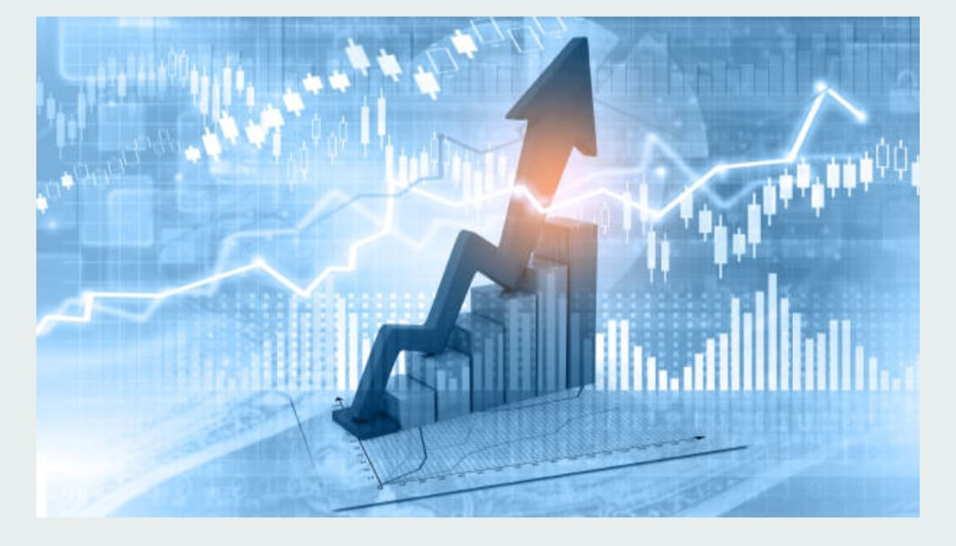

BACHELOR OF TECHNOLOGY in COMPUTER SCIENCE AND ENGINEERING
Submitted by
Mokarala Swetha [228X1A0567]
Munnangi Jayasri Nandha [228X1A0568]
Nagireddy Amara Jyothi Reddy [228X1A0569]
Nelaturi Nagamalli [228X1A0573]

Slide 2
ESTIMATING STOCK PREDICTION USING MACHINE LEARNING

Slide 3
Topics:
Abstract
Objectives
Problem Statement
Introduction
Existed System
Proposed System
Salient Features
Workflow

Slide 4
Topics:
Tech Stack
Module Description
Output
Results
Conclusion
Future Work
Reference

Slide 5
Abstract
The project aims to predict future stock prices using Machine Learning techniques.
Historical stock data is analyzed to identify patterns and market trends.
Algorithms like Random Forest Regressor are used for accurate price estimation.
The model is integrated with a Flask web app for user-friendly interaction and visualization.
Helps investors make data-driven and informed decisions in the stock market.

Slide 6
Objectives
To analyze historical stock market data and identify key patterns or trends
Build an ML model for stock price prediction.
To compare the performance of different ML algorithms like Random Forest, Linear Regression, and LSTM.
Deploy the model using Flask web framework.
Visualize and display predicted prices in a dashboard.
Interactive Charts for user-friendly visual analysis.

Slide 7
Problem Statement
Predicting price trends manually difficult and time-consuming
Data trends are hard to analyze manually.
Need user-friendly prediction tool.
Manual methods may cause errors or inaccurate results.
No integrated tool available for clear visualization and analysis.

Slide 8
Introduction
The stock market plays a vital role in a country's economic growth and investment planning.
Stock market prediction is a complex and uncertain task due to constant market fluctuations.
The main purpose to predict future stock prices using Machine Learning.
This project uses data-driven techniques to estimate future stock prices with improved accuracy.
The goal is to create an intelligent and user-friendly system that supports investors in making better trading decisions.

Slide 9
Existing System
In the existing system, stock prices are predicted manually using historical data and market experience.
Investors often rely on technical charts and human intuition, which may lead to inaccurate predictions.
Traditional methods fail to handle large datasets and complex market fluctuations effectively.
These approaches lack automation and real-time prediction capabilities.
As a result, the decision-making process becomes time-consuming, less reliable, and prone to human error.

Slide 10
Proposed System
The proposed system uses Machine Learning algorithms to accurately predict future stock prices.
It analyzes historical stock data to find hidden patterns and market trends.
The model is integrated with a Flask web application for easy user interaction and real-time predictions.
It provides automated, fast, and data-driven results, reducing human error.
The system helps investors make smarter and informed decisions based on analytical insights.

Slide 11
Salient Features
User-friendly Interface – Simple Flask web app for easy data upload and result viewing.
Real-time Prediction – Instantly generates stock price forecasts after data input.
High Accuracy – Uses advanced ML algorithms like Random Forest for precise predictions.
Data Visualization – Displays graphs and predicted price trends for better understanding.
Scalable and Secure – Can handle large datasets and be integrated with cloud platforms like AWS for reliability.

Slide 12
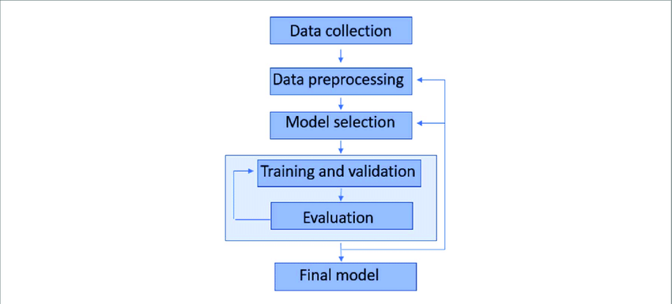
Work Flow

Slide 13
Software & Hardware Requirements
Software Requirements:
Server-side Script – Python 3.11.4
Operating Systems: Windows 11
IDE: VS Code
Libraries used: Numpy,Pandas,Matplotib,Flask and Sklearn
Hardware Requirements:
Processer: 15/Intel Processor
RAM: 8GB
Hard Disk: 128GB

Slide 14
Module: Data Collection
ML depends heavily on data, it is the most crucial aspect that makes algorithm training possible.
There are many popular open sources for collecting the data.
E.g.: kaggle.com, UCI repository, etc.
In this project we have used mock_kaggle.csv data. This data is downloaded from kaggle.com.
Link: Demand Forecasting

Slide 15
Module: Data PreProcessing
Before training the machine learning model, the data uses underwent comprehensive data preprocessing to ensure accuracy and reliability.
Missing values were handled using simple Imputer, outliers were addressed with the capping method, and all numerical Features were scaled using Standard Scaler to standardize the data.
This preprocessing ensured that the input data was clean, consistent, and suitable for effective flood prediction

Slide 16
Module: Model Training
Now that the data is cleaned, it’s time to build the model.
We can train our data on different algorithms
In our project we will be used Random Forest Regression , Decision tree, Random forest, and XgBoost algprithms.
After comparing all this models Random Forest Regression gives best accuracy results,so we finalise this model and we use this model in our project.
So, we are saving the model by model.pkl file using pickle

Slide 17
Module: Application Building
We will be build a web application that is integrated to the model we built.
Building html pages, server-side script
A UI is provided for the uses where they has to enter the values for predictions.
The enter values are given to the saved model and prediction is showcased on the UI.
Flask Integration -Run →Display- Upload CSV → Predict → Display Results.

Slide 18
Output
User uploads CSV → predictions generated instantly.
Results displayed with a 'Predicted Price' column.
Achieved good accuracy using Random Forest Regressor.
Users can see predicted vs. actual stock prices side by side.
Predicted prices displayed in interactive graphs and charts for easy analysis.

Slide 19
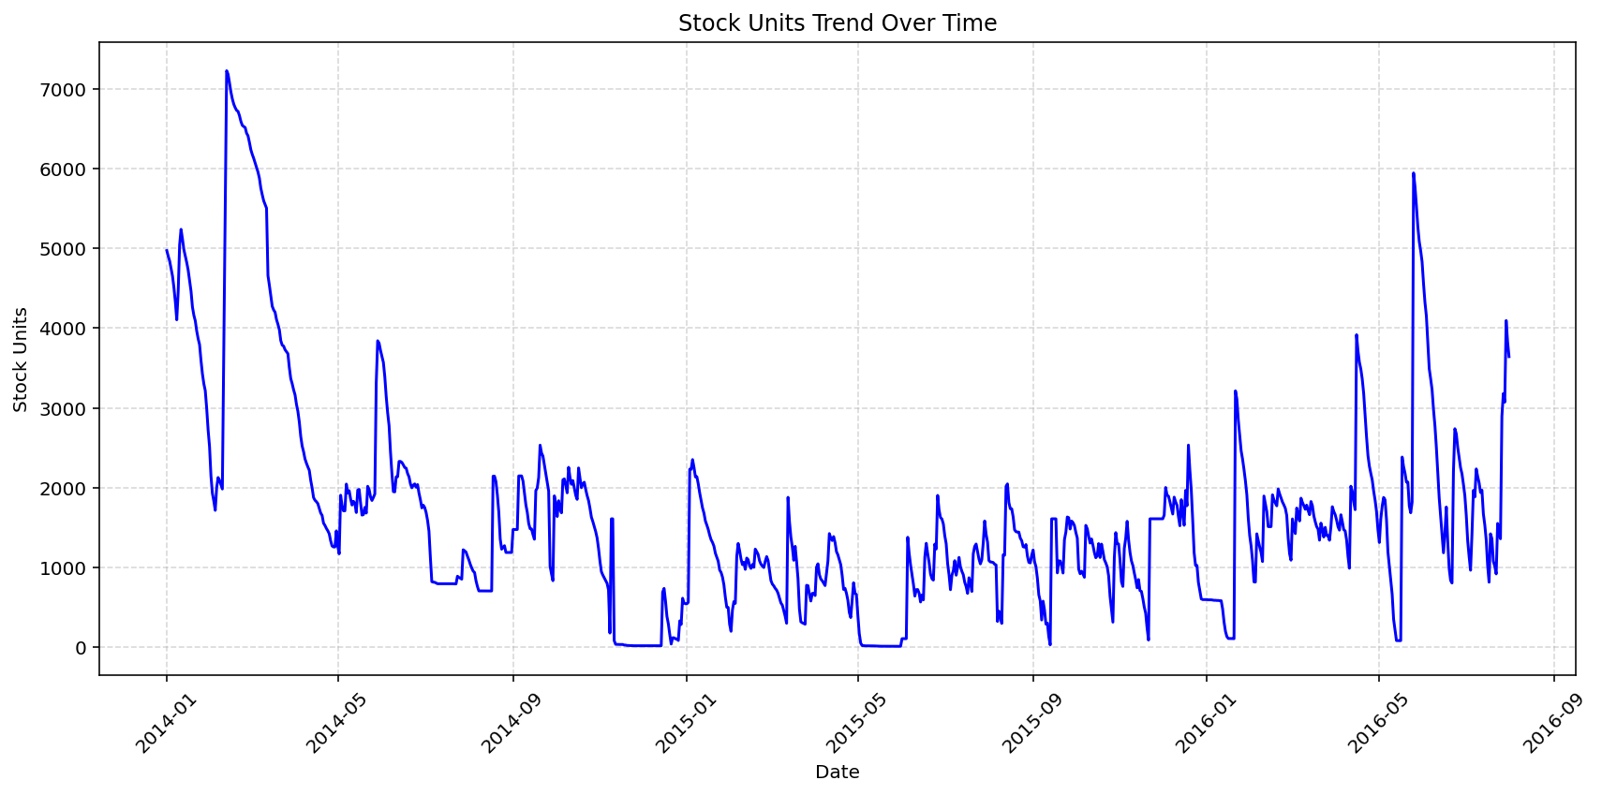
Results

Slide 20
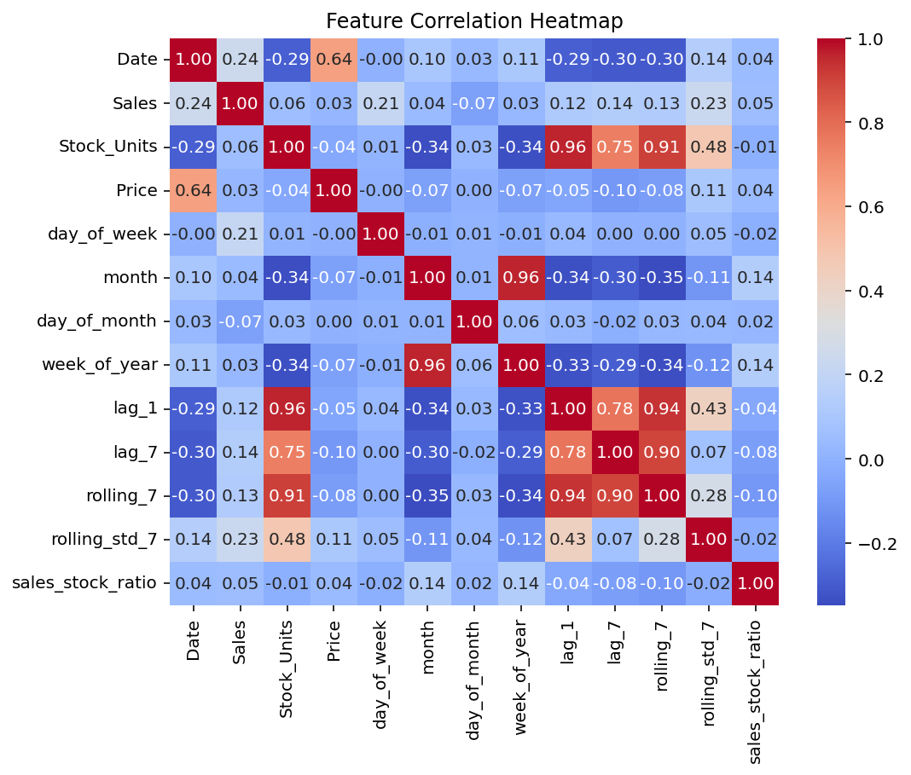
Results

Slide 21
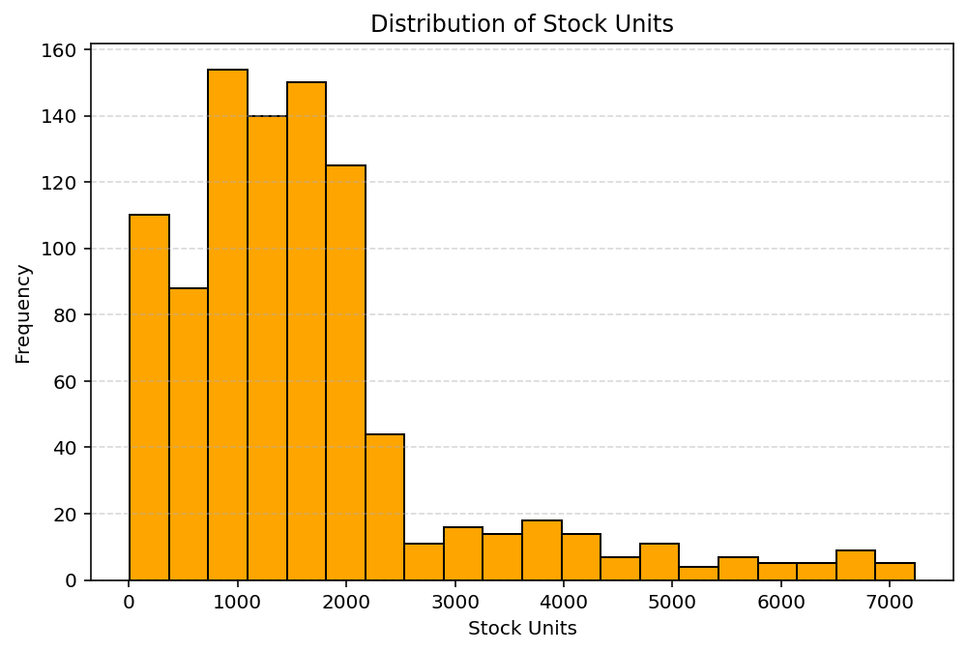

Results

Slide 22
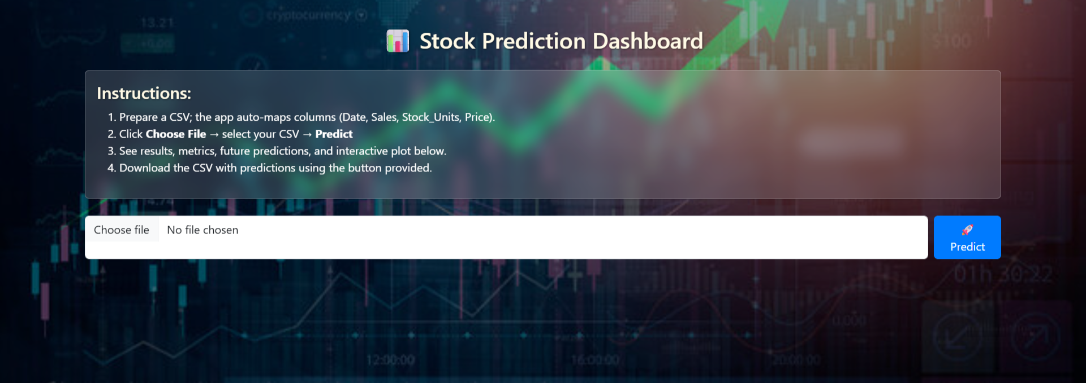
Results

Slide 23
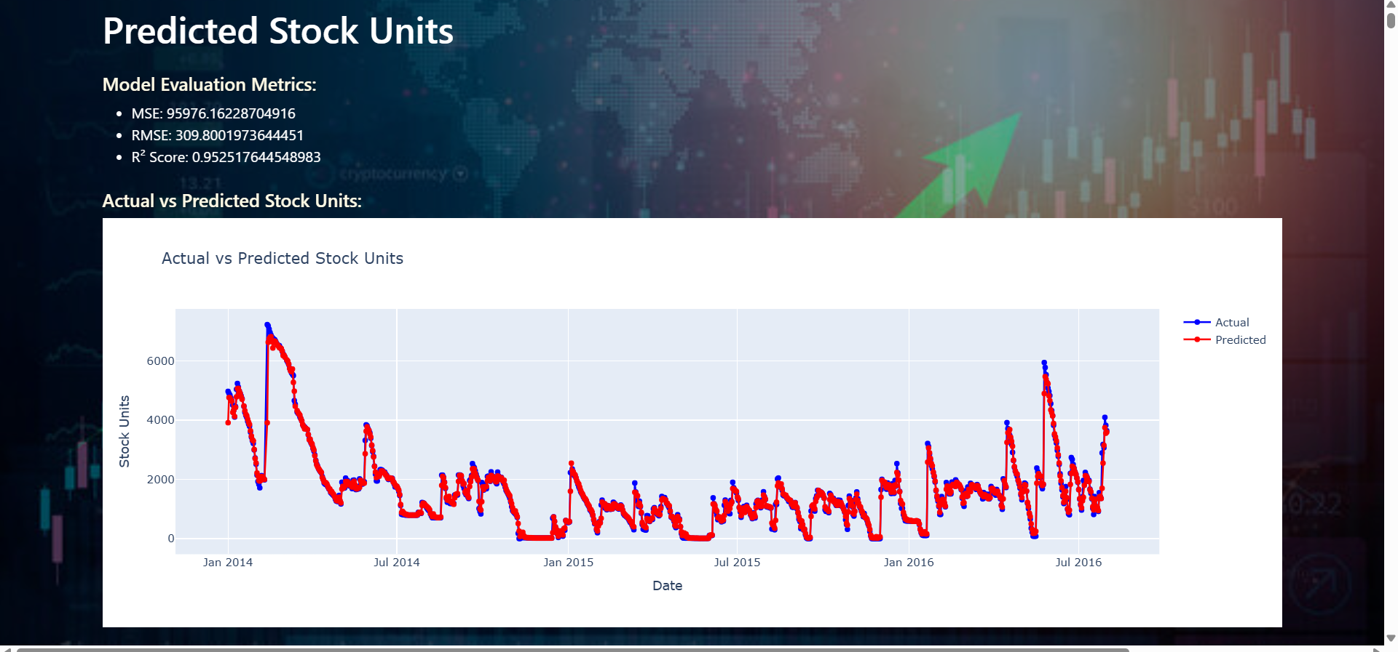
Results

Slide 24
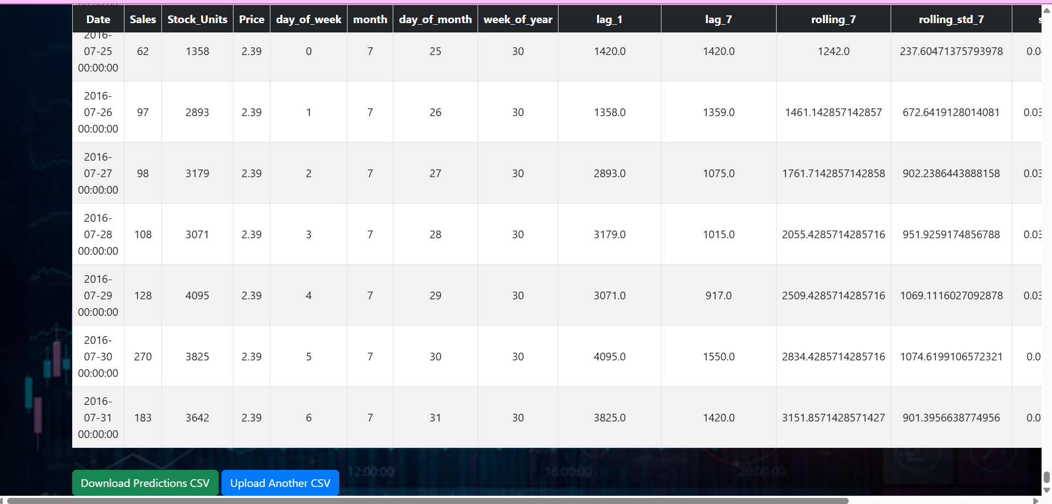
Results

Slide 25
Conclusion
We developed a stock price prediction model using Machine learning Algorithms like Random Forest Regression to analyze and forecast stock trends.
The system helps investors make data-driven decisions instead of relying on assumptions.
Our model processes historical stock data to identify patterns and predict future price movements.
A Flask web interface was created to make the prediction process simple, interactive, and user-friendly.

Slide 26
Future Work
Integrate real-time stock market APIs to fetch and analyze live data continuously.
Implement Deep Learning models like LSTM or GRU for more accurate time-series predictions.
Add a visual dashboard to display graphs, trends, and prediction comparisons dynamically.
Include sentiment analysis using news headlines or social media data to improve prediction reliability.
Deploy the system on cloud platforms (like AWS or Azure) for scalability and global access.

Slide 27
Reference
Kaggle Datasets — https://www.kaggle.com/datasets
Flask Web Framework — https://flask.palletsprojects.com/
Scikit-learn Documentation — https://scikit-learn.org/
“Stock Market Prediction using Machine Learning Algorithms” — IEEE Research Papers, 2022.
“Stock Market Prediction Using Random Forest and Linear Regression” — Elsevier Procedia Computer Science, 2021
GitHub Repositories on Stock Price Prediction using ML — https://github.com/swetha-01-max/Estimating-stock-prediction-.git

Slide 28
Thank you for this opportunity! We’re excited to showcase how our project turns data into smart stock predictions.

