Slide 1
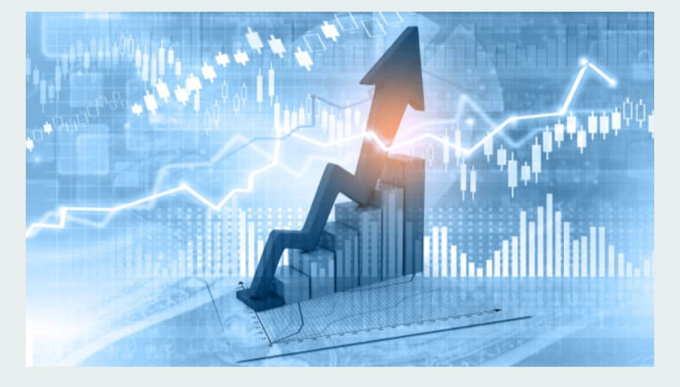

BACHELOR OF TECHNOLOGY in COMPUTER SCIENCE AND ENGINEERING
Submitted by
Mokarala Swetha [228X1A0567]
Munnangi Jayasri Nandha [228X1A0568]
Nagireddy Amara Jyothi Reddy [228X1A0569]
Nelaturi Nagamalli [228X1A0573]

Slide 2
ESTIMATING STOCK PREDICTION USING MACHINE LEARNING

Slide 3
Index:
Introduction
Objectives
Problem Statement
Workflow
Methodology
Tech Stack
Output
Results
Conclusion
Future Work
Reference

Slide 4
Introduction
Purpose: To predict future stock prices using Machine Learning.
Helps investors make better decisions.
Integrated with Flask web app for user interaction.
Provides easy visualization of predicted stock trends.
Enables quick CSV upload and instant prediction results for users.

Slide 5
Objectives
Build an ML model for stock price prediction.
Deploy the model using Flask web framework.
Visualize and display predicted prices in a dashboard.
Interactive Charts for user-friendly visual analysis.

Slide 6
Problem Statement
Predicting price trends manually difficult and time-consuming
Data trends are hard to analyze manually.
Need user-friendly prediction tool.
Manual methods may cause errors or inaccurate results.
No integrated tool available for clear visualization and analysis.

Slide 7
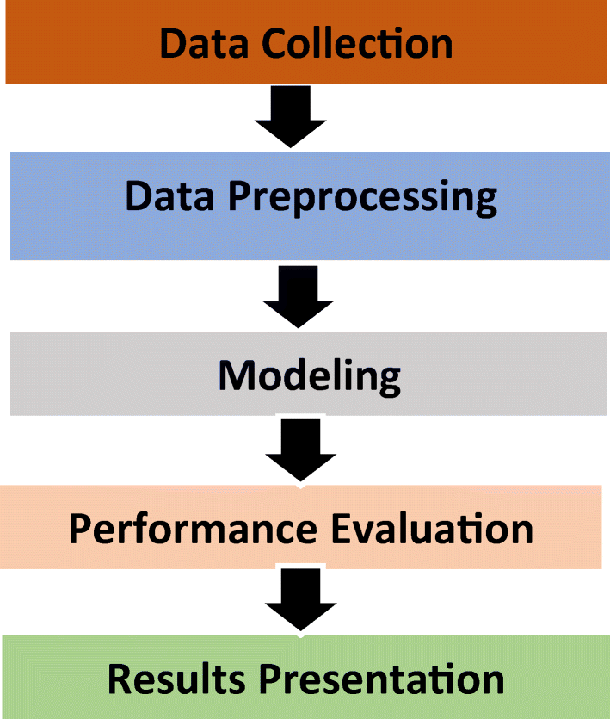

Work Flow

Slide 8
Tech Stack
Server-side Script – Python 3.11.4
Python – Core programming.
Pandas, NumPy,Matplotlib – Data handling.
Scikit-learn – ML model training.
Flask – Web application framework.
HTML, CSS, Bootstrap – Frontend UI design.

Slide 9
Methodology: Data Collection
ML depends heavily on data, it is the most crucial aspect that makes algorithm training possible.
There are many popular open sources for collecting the data.
E.g.: kaggle.com, UCI repository, etc.
In this project we have used mock_kaggle.csv data. This data is downloaded from kaggle.com.
Link: Demand Forecasting

Slide 10
Methodology: Data PreProcessing
Before training the machine learning model, the data uses underwent comprehensive data preprocessing to ensure accuracy and reliability.
Missing values were handled using simple Imputer, outliers were addressed with the capping method, and all numerical Features were scaled using Standard Scaler to standardize the data.
This preprocessing ensured that the input data was clean, consistent, and suitable for effective flood prediction

Slide 11
Methodology: Model Training
Now that the data is cleaned, it’s time to build the model.
We can train our data on different algorithms
In our project we will be used Random Forest Regression , Decision tree, Random forest, and XgBoost algprithms.
After comparing all this models Random Forest Regression gives best accuracy results,so we finalise this model and we use this model in our project.
So, we are saving the model by model.pkl file using pickle

Slide 12
Methodology: Application Building
We will be build a web application that is integrated to the model we built.
Building html pages, server-side script
A UI is provided for the uses where they has to enter the values for predictions.
The enter values are given to the saved model and prediction is showcased on the UI.
Flask Integration -Run →Display- Upload CSV → Predict → Display Results.

Slide 13
Output
User uploads CSV → predictions generated instantly.
Results displayed with a 'Predicted Price' column.
Achieved good accuracy using Random Forest Regressor.
Users can see predicted vs. actual stock prices side by side.
Predicted prices displayed in interactive graphs and charts for easy analysis.

Slide 14
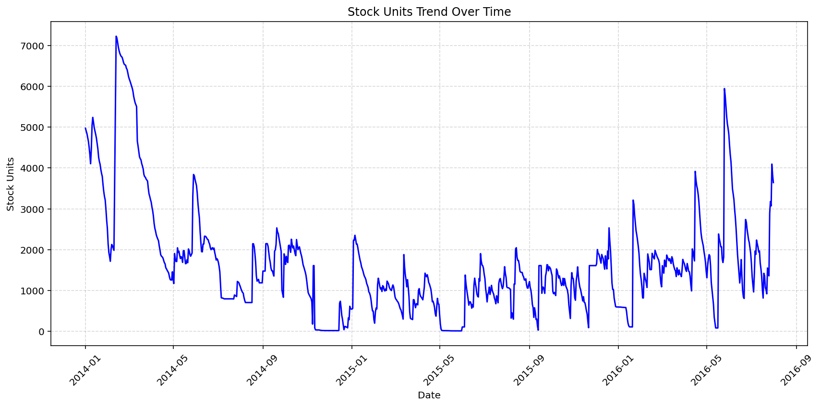
Results

Slide 15
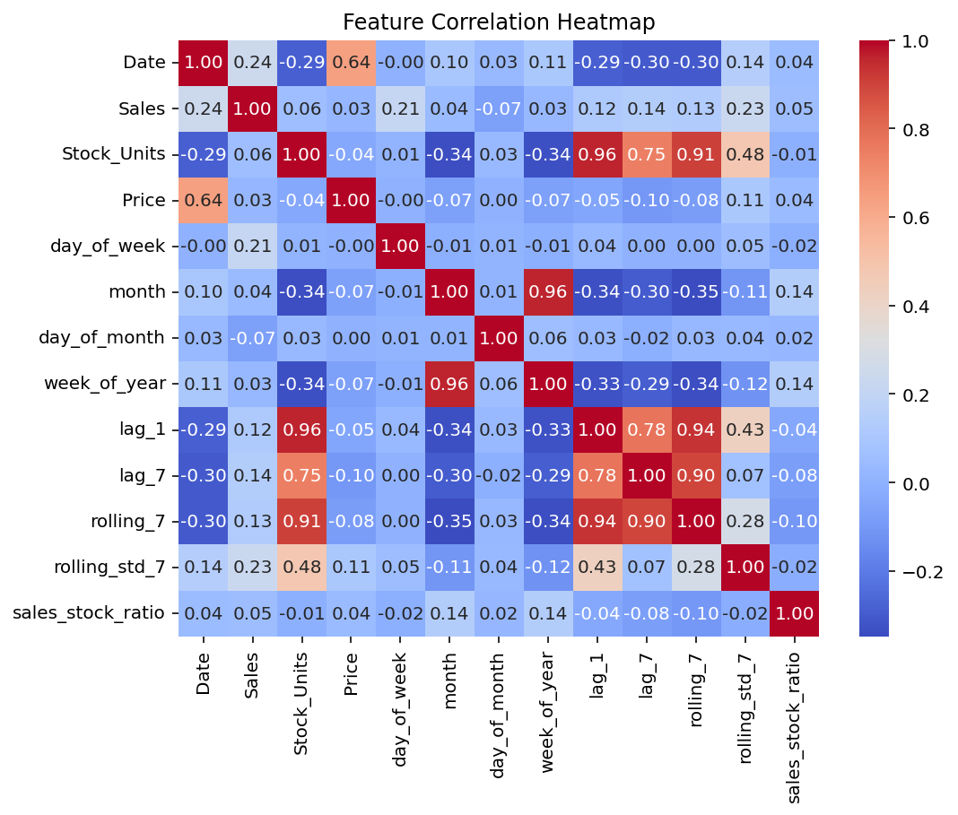
Results

Slide 16
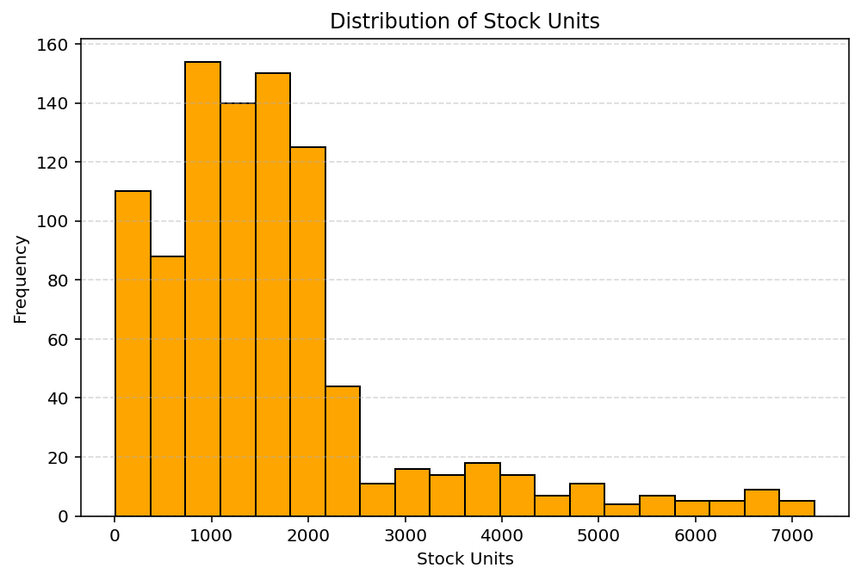
Results

Slide 17
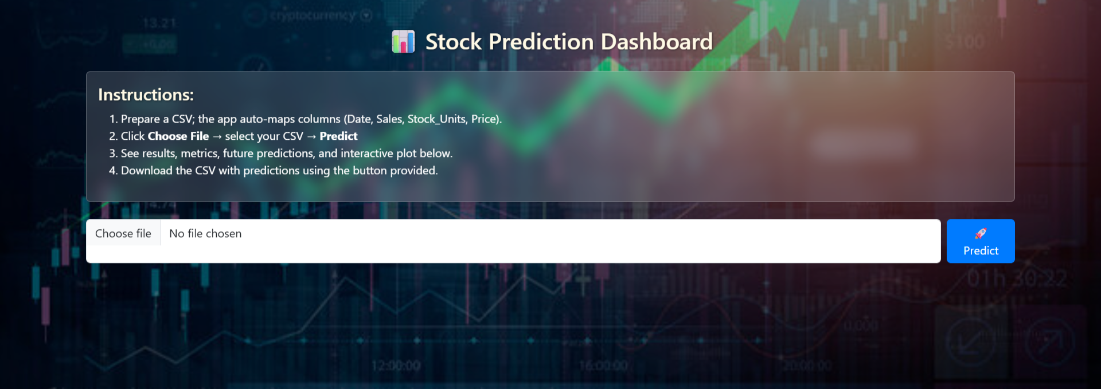
Results

Slide 18
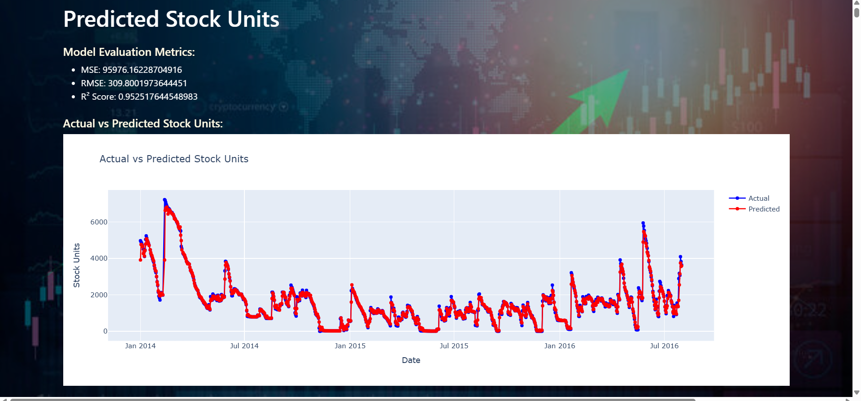
Results

Slide 19
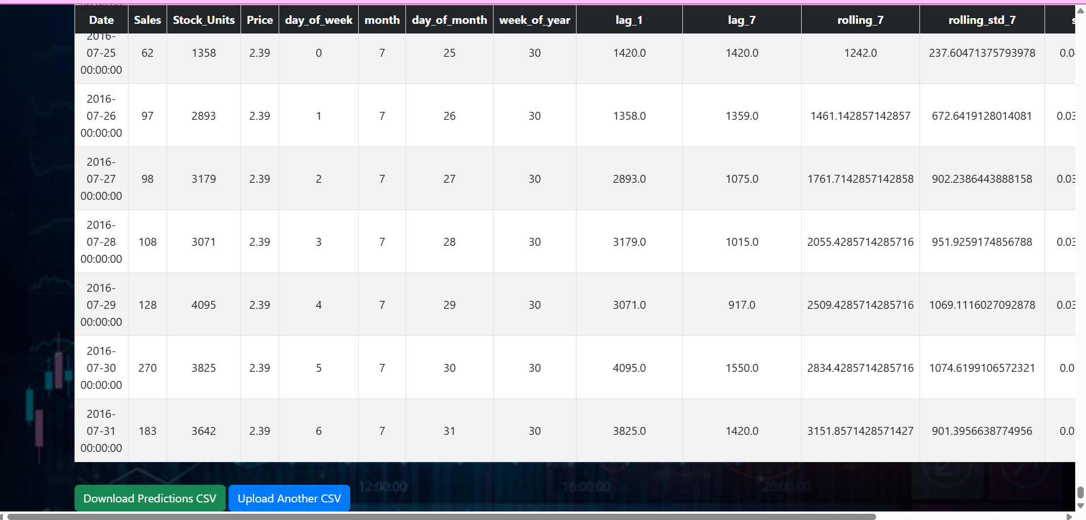
Results

Slide 20
Conclusion
We developed a stock price prediction model using Machine learning Algorithms like Random Forest Regression to analyze and forecast stock trends.
The system helps investors make data-driven decisions instead of relying on assumptions.
Our model processes historical stock data to identify patterns and predict future price movements.
A Flask web interface was created to make the prediction process simple, interactive, and user-friendly.

Slide 21
Future Work
Integrate real-time stock market APIs to fetch and analyze live data continuously.
Implement Deep Learning models like LSTM or GRU for more accurate time-series predictions.
Add a visual dashboard to display graphs, trends, and prediction comparisons dynamically.
Include sentiment analysis using news headlines or social media data to improve prediction reliability.
Deploy the system on cloud platforms (like AWS or Azure) for scalability and global access.

Slide 22
Reference
Kaggle Datasets — https://www.kaggle.com/datasets
Flask Web Framework — https://flask.palletsprojects.com/
Scikit-learn Documentation — https://scikit-learn.org/
“Stock Market Prediction using Machine Learning Algorithms” — IEEE Research Papers, 2022.
“Stock Market Prediction Using Random Forest and Linear Regression” — Elsevier Procedia Computer Science, 2021
GitHub Repositories on Stock Price Prediction using ML — https://github.com/

Slide 23
Thank you for this opportunity! We’re excited to showcase how our project turns data into smart stock predictions.

