Slide 1
Secure data hiding in image using steganography
CAPSTONE PROJECT
Presented By: Swetha E
Student Name : Swetha E
College Name & Department : Rathinam technical campus &SOC

Slide 2
OUTLINE
Problem Statement
Technology used
Wow factor
End users
Result
Conclusion
Git-hub Link
Future scope

Slide 3
Problem Statement
In today's digital world, ensuring data security and confidentiality is essential. While encryption makes data unreadable, it may still draw unwanted attention. Steganography offers a discreet alternative by concealing information within common files, like images, making the hidden data less noticeable.
Encode a text message into an image by subtly adjusting pixel values.
Secure the embedded message with a passcode for restricted access.
Allow retrieval and decoding only when the correct passcode is entered.
Maintain the image’s original appearance with minimal visual alterations.

Slide 4
Technology used
Libraries Used:
cv2 (OpenCV) – Used for image processing (reading, modifying, and saving images).
os – Used to interact with the operating system (opening the encrypted image).
string – Imported but not used in the code (can be removed).
2. Platform Compatibility:
OS: Windows (uses os.system("start encryptedImage.jpg") to open the image).
For Linux/macOS, replace start with xdg-open or open.
Python Version: Works with Python 3.x.

Slide 5
Wow factors
Simple and Lightweight Implementation
Custom Character Mapping for Encoding
Pixel-Based Encoding Approach
Passcode-Based Security Layer
No Visible Alteration to the Image

Slide 6
End users
Those studying data hiding techniques and cryptography.
Useful for learning about steganography without complex tools.

Slide 7
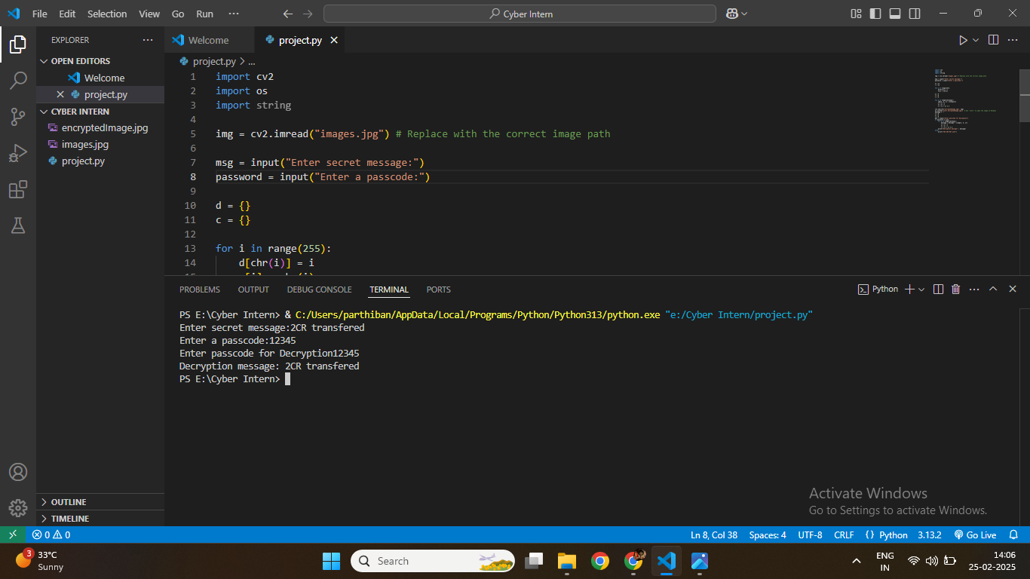
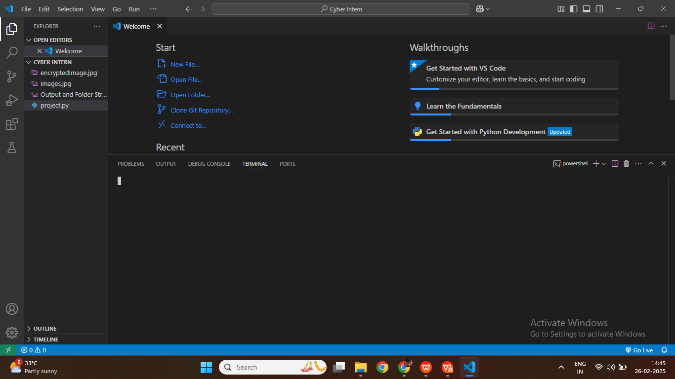
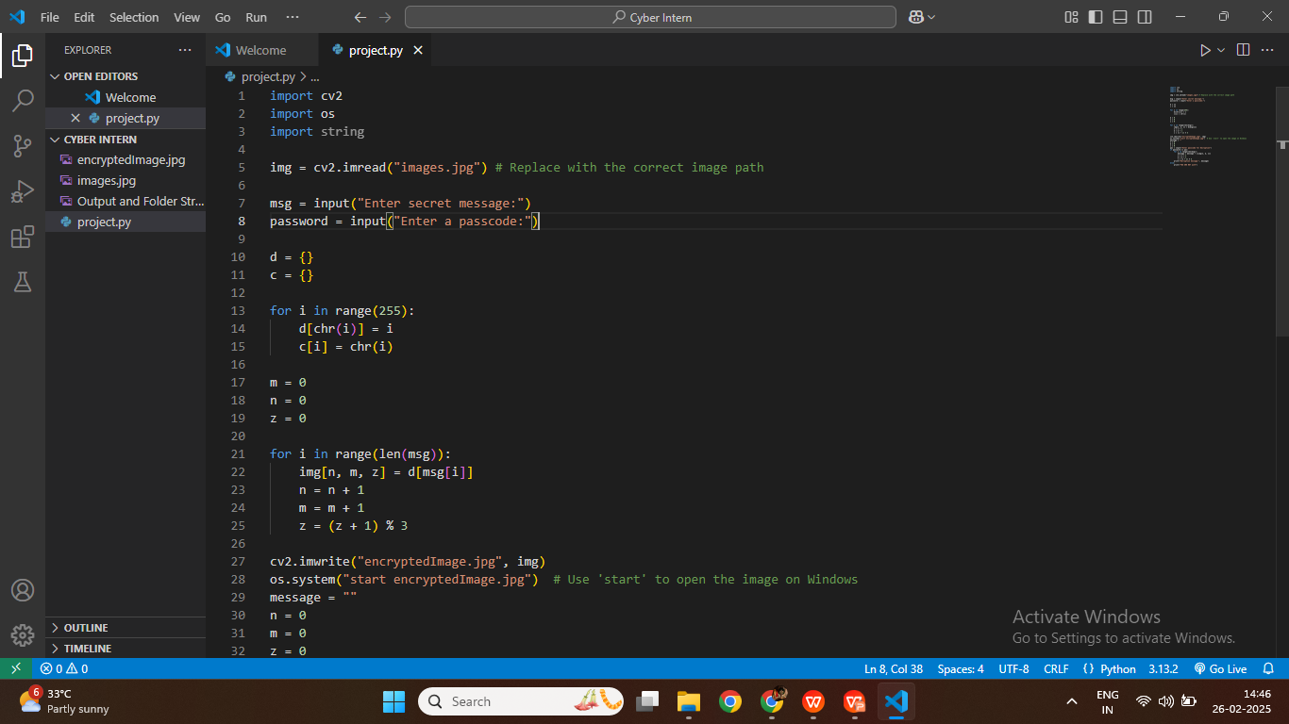
Results
Screenshots of the outcome (min 3)

Slide 8
Conclusion
This steganography project offers an efficient method to conceal and extract hidden messages within images using Python and OpenCV. It is distinguished by its lightweight structure, unique character mapping, pixel-level encoding, and secure passcode protection. This project is ideal for cybersecurity enthusiasts, privacy-focused users, ethical hackers, and students interested in exploring data-hiding techniques.

Slide 9
GitHub Link
https://github.com/swetha-19P138/IBM-SKILLSBUILD-CYBER-SECURITY.git

Slide 10
Future scope(optional)

Slide 11
THANK YOU

