Slide 1

TEAM TITLE : MEDSPOT
TITLE THEME : SOCIAL WELFARE SERVICES
TEAM MEMBERS :
NITHISH S[2127210801071]
SWETHA S[2127210801107]
VIJAYARAGAVAN G[2127210801309]
MENTOR:
Dr. N. DEVI A/P INT

Slide 2
PROBLEM STATEMENT
In today's fast-paced world, accessing quality healthcare services remains a challenge for many individuals due to factors such as geographical barriers, limited resources, and inefficient healthcare systems. Despite advancements in technology, disparities in healthcare access persist, leading to suboptimal health outcomes and increased healthcare costs. There is a critical need for an innovative solution that addresses these challenges by leveraging technology to provide equitable, efficient, and patient-centric healthcare services. This solution should bridge the gap between patients and healthcare providers, empower individuals to take control of their health, and ultimately improve health outcomes on a global scale.

Slide 3
OBJECTIVE
The Revolution of technology has impacted a variety of industries globally, likewise the healthcare industry is also evolving rapidly.
To visit the doctor or a clinic.
To maintain the health but also assist medicine practitioners in delivering care more efficiently and widely.
To decrease the faux doctors and the remedy is hung on their personal locations which contribute to the well-being and health of patients around the Tamil Nadu.

Slide 4
INTRODUCTION
It is an application in which emergency vehicle, drug specialist can arrive to the users location.
It diminishes the time and spares the lives of the people.
Through this application, we can sort donors and find their details in a short period of time.
In this application we have confirmation handle ,by this the issue of the faux specialists will be nullified.
Although it can also handle the complex and sensitive data of doctors and patients.
It also can benefit its users by building an online healthcare app.

Slide 5
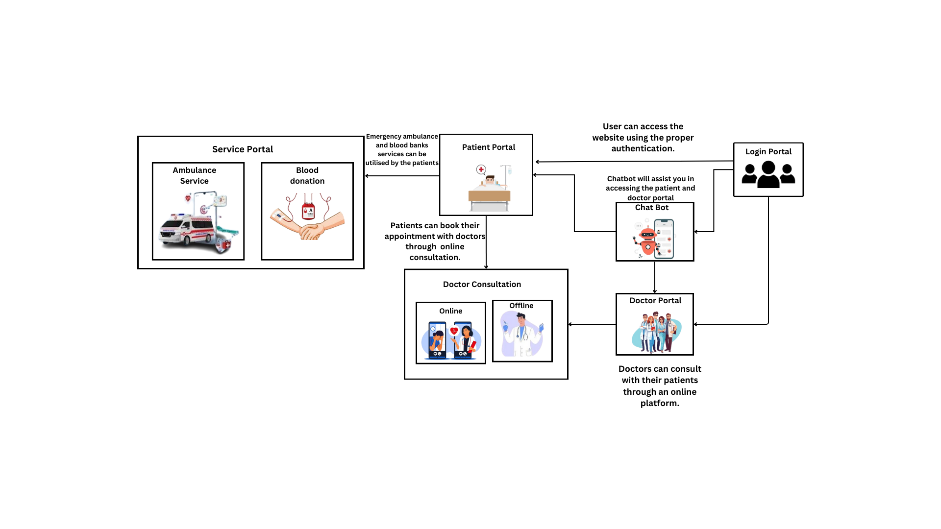
ARCHITECTURE

Slide 6
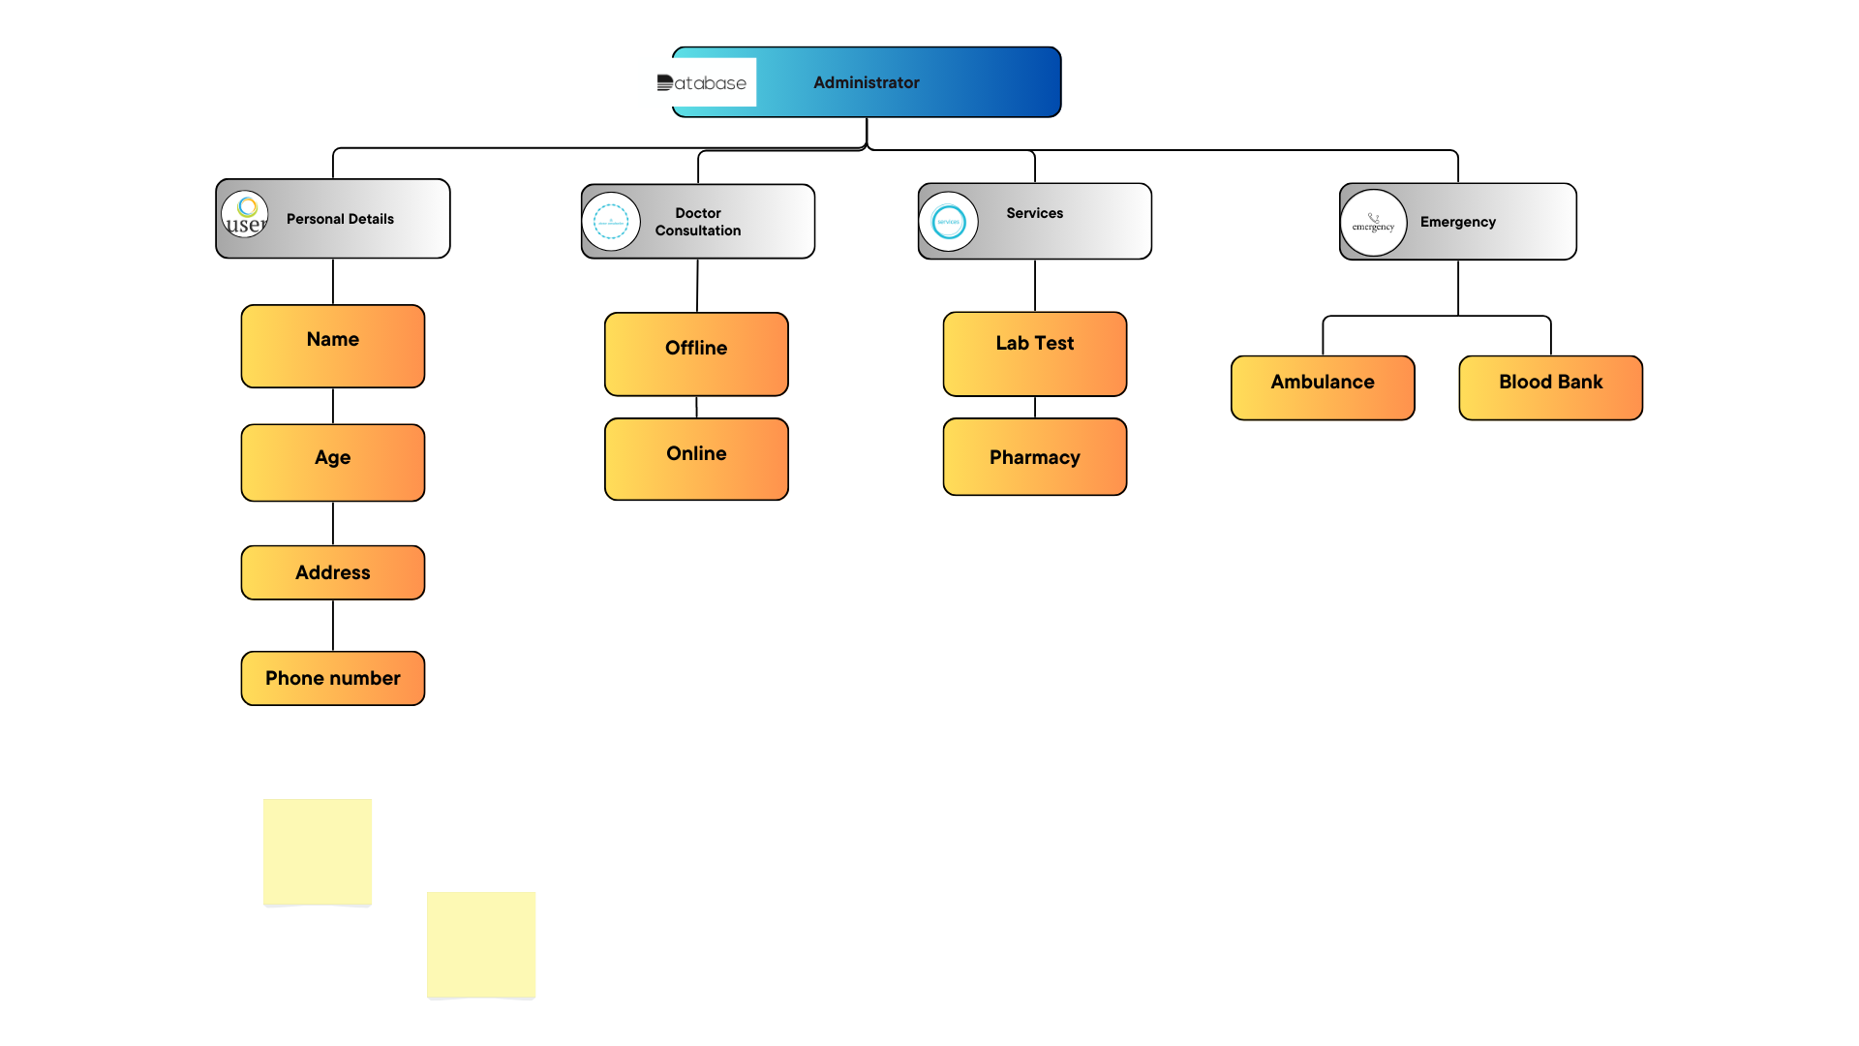
USER MODULE

Slide 7
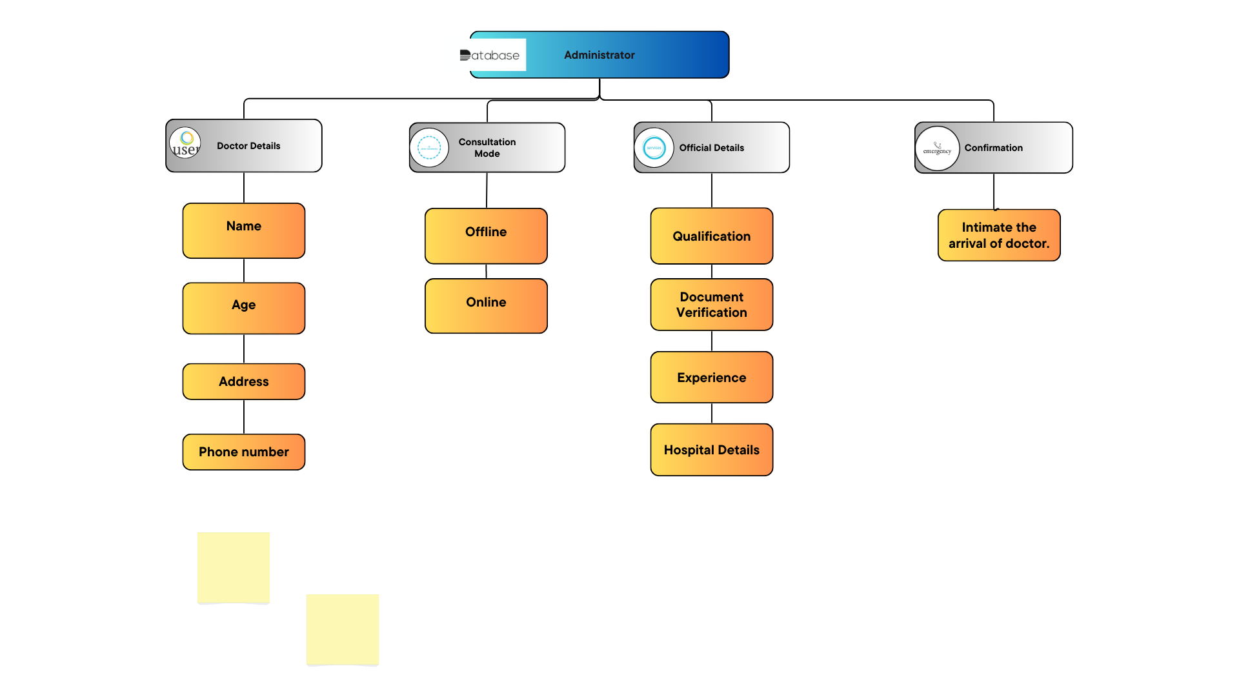
DOCTOR MODULE

Slide 8
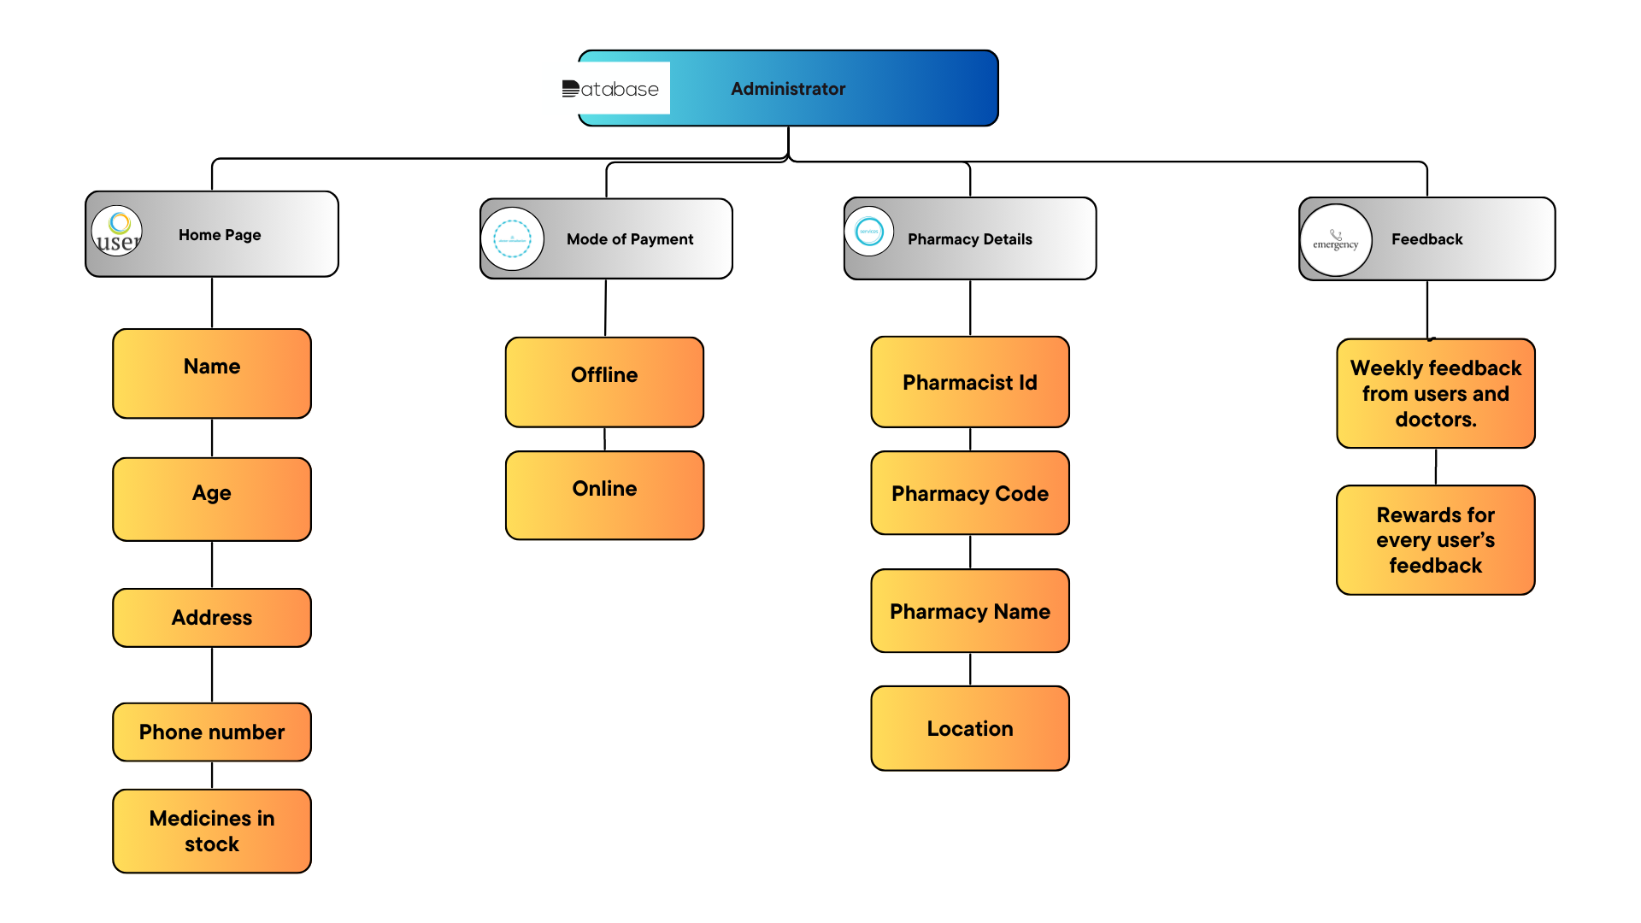
PHARMACY MODULE

Slide 9
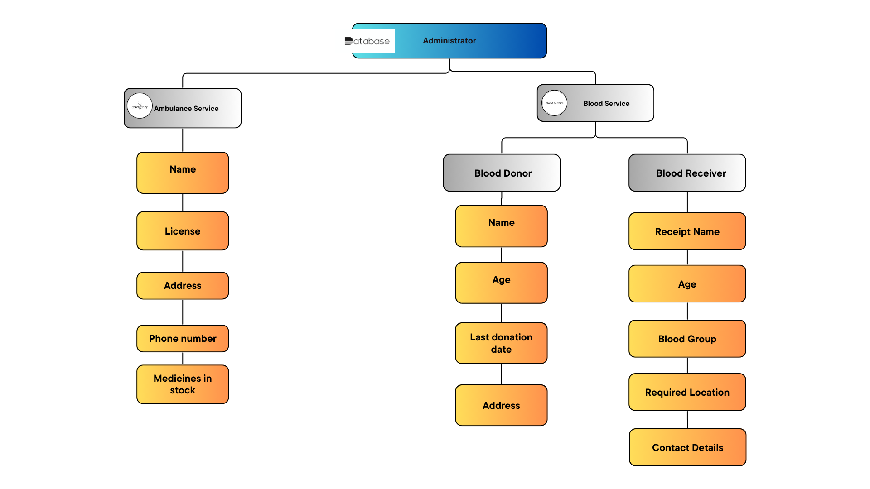
SERVICE MODULE
2/15/2022

Slide 10






TECHNOLOGICAL STACK

Slide 11


Slide 12
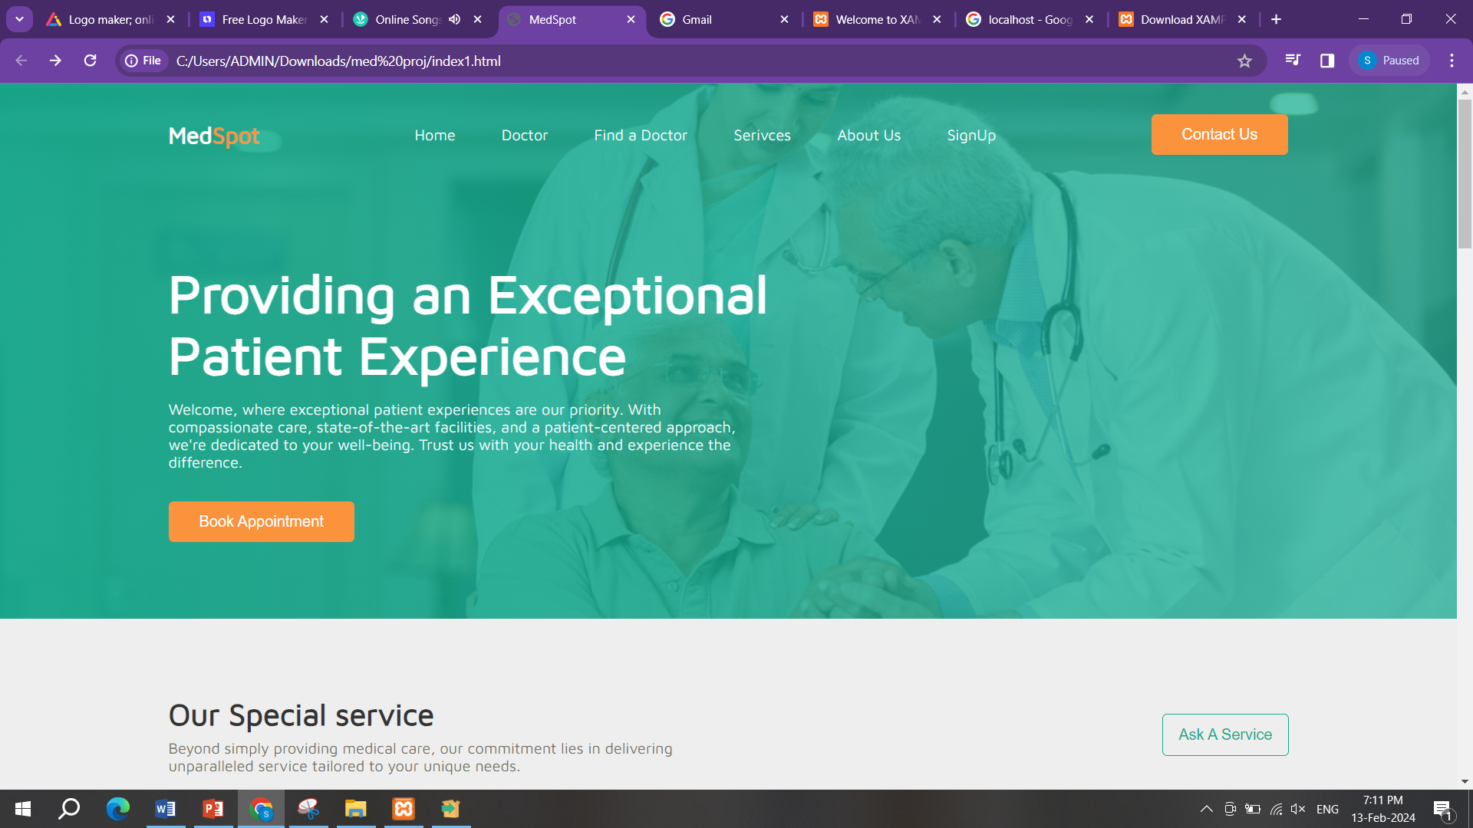
2/15/2022

Slide 13
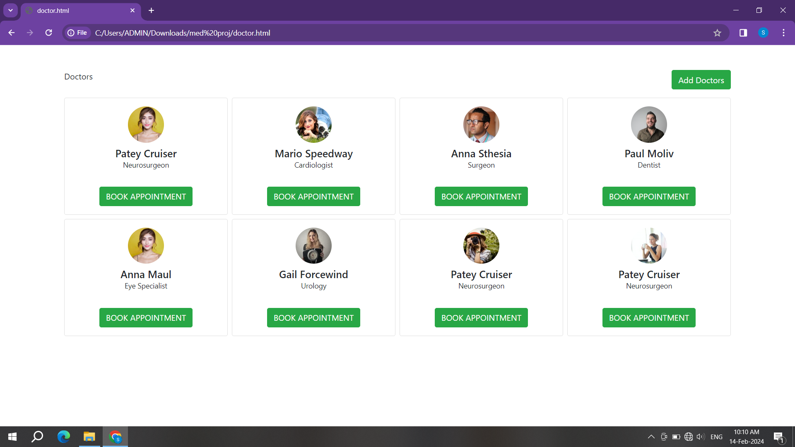
2/15/2022

Slide 14
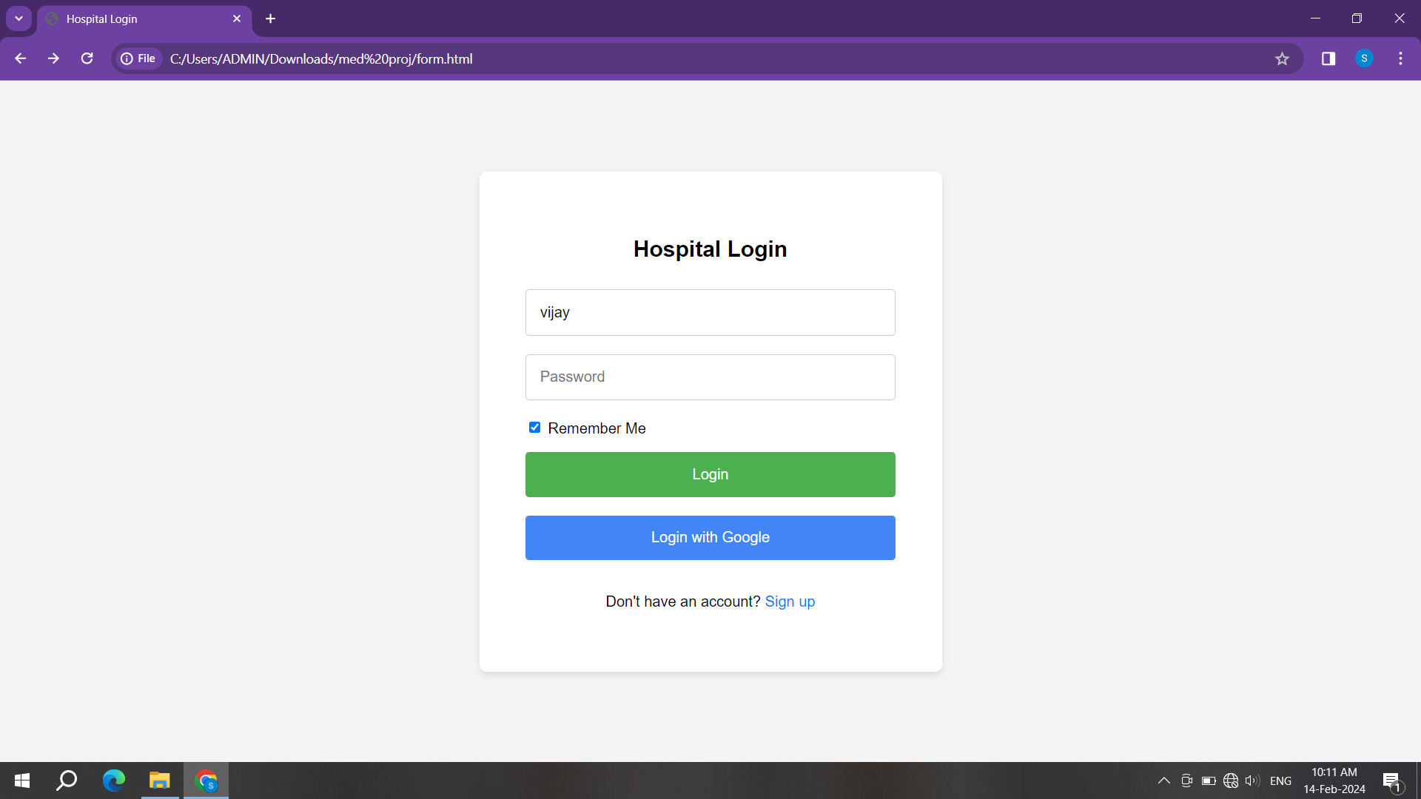
2/15/2022

Slide 15
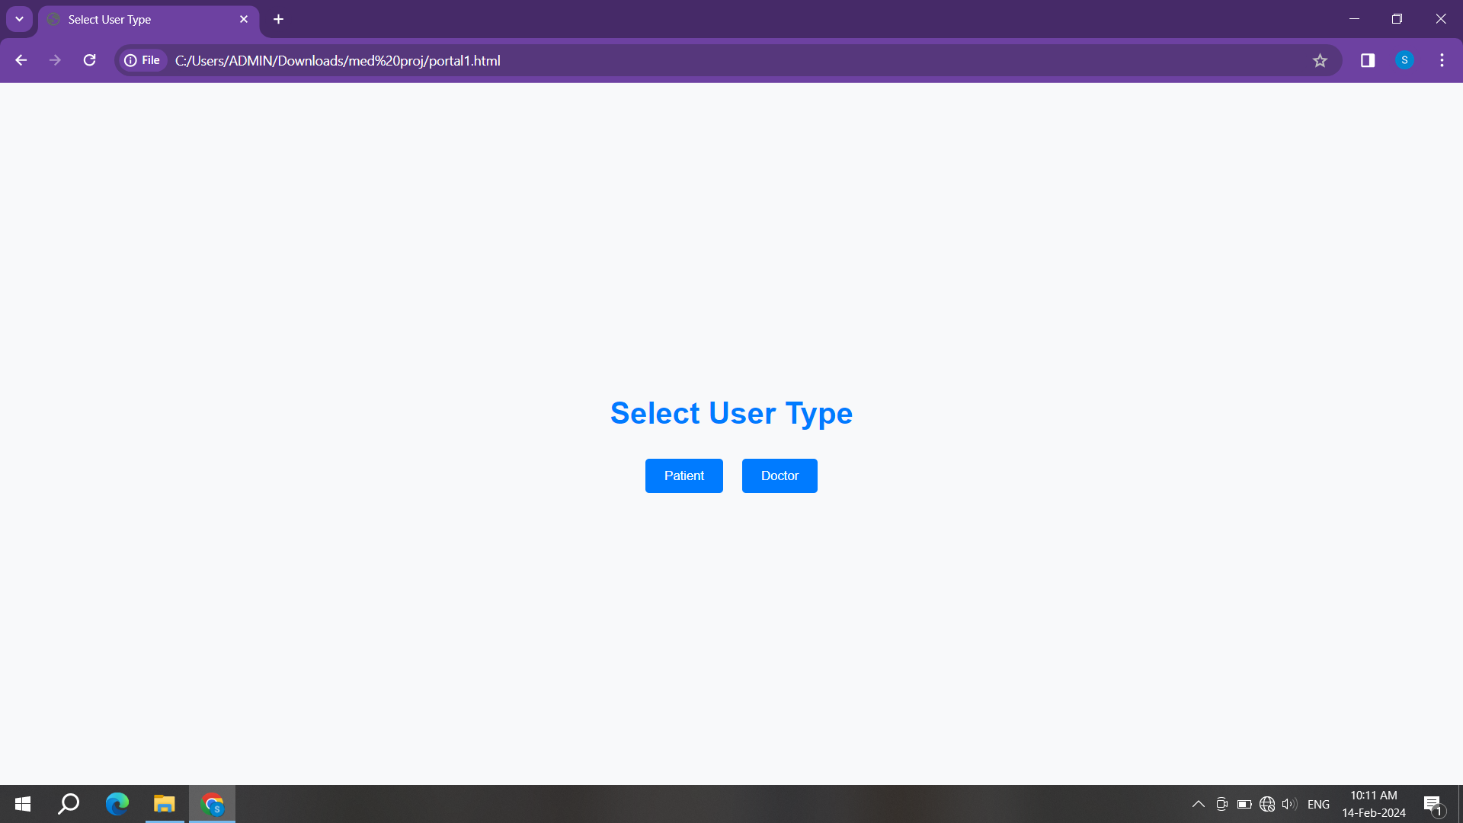
2/15/2022

Slide 16
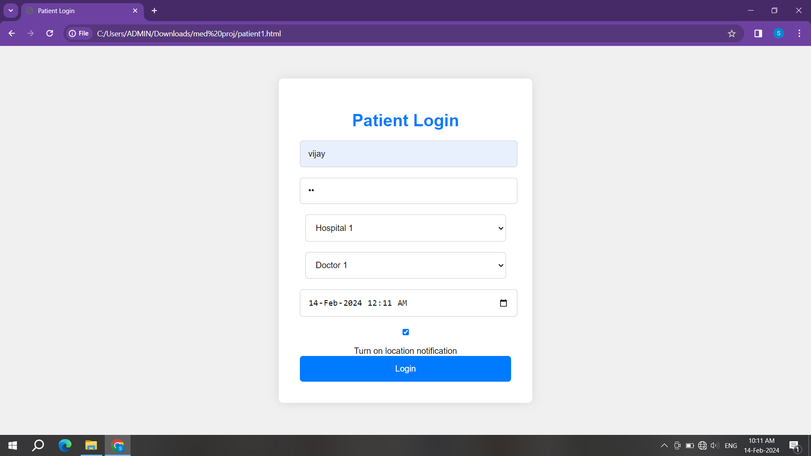
2/15/2022

Slide 17
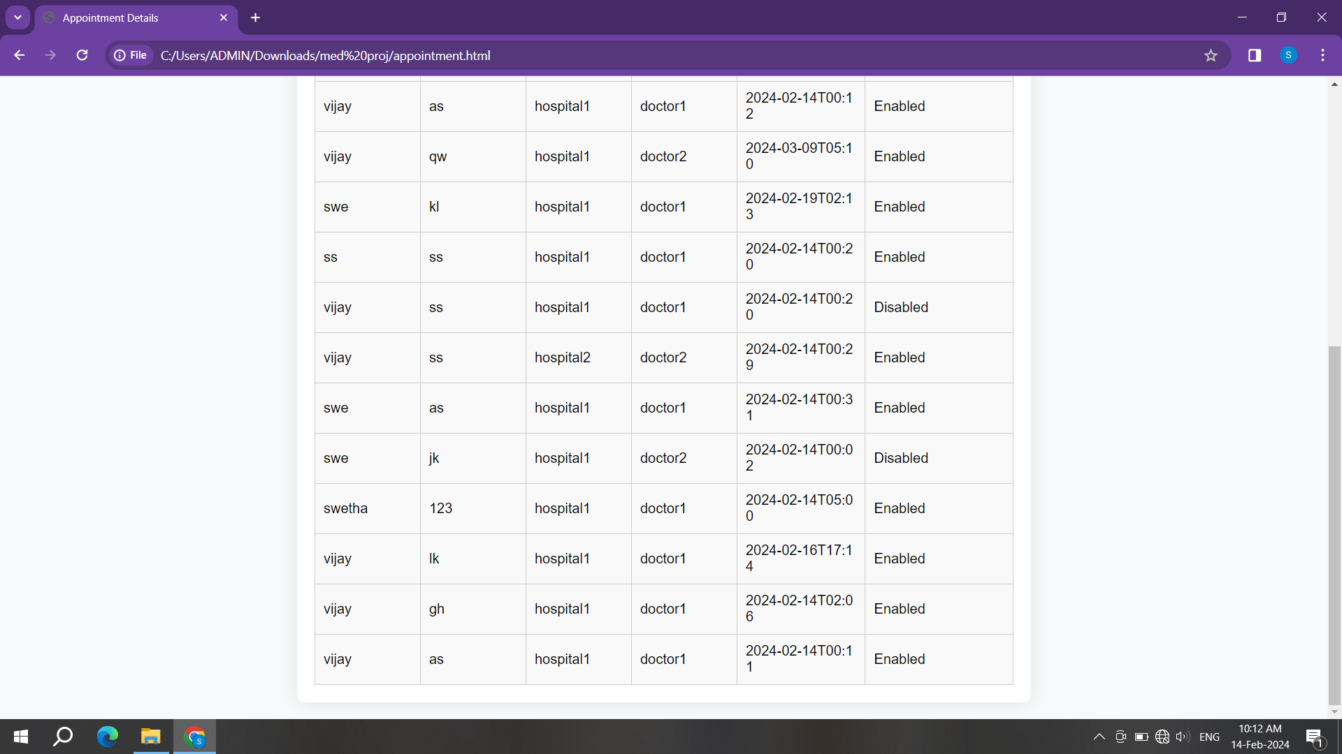
2/15/2022

Slide 18
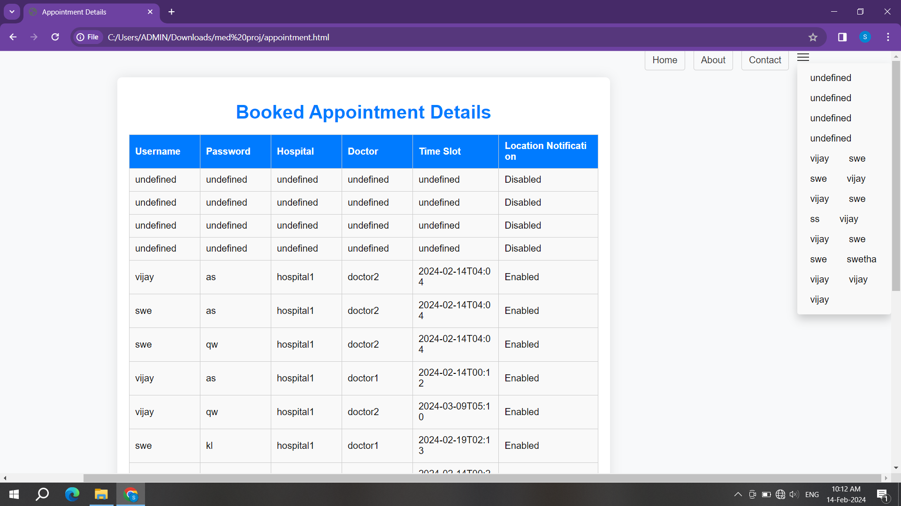
2/15/2022

Slide 19
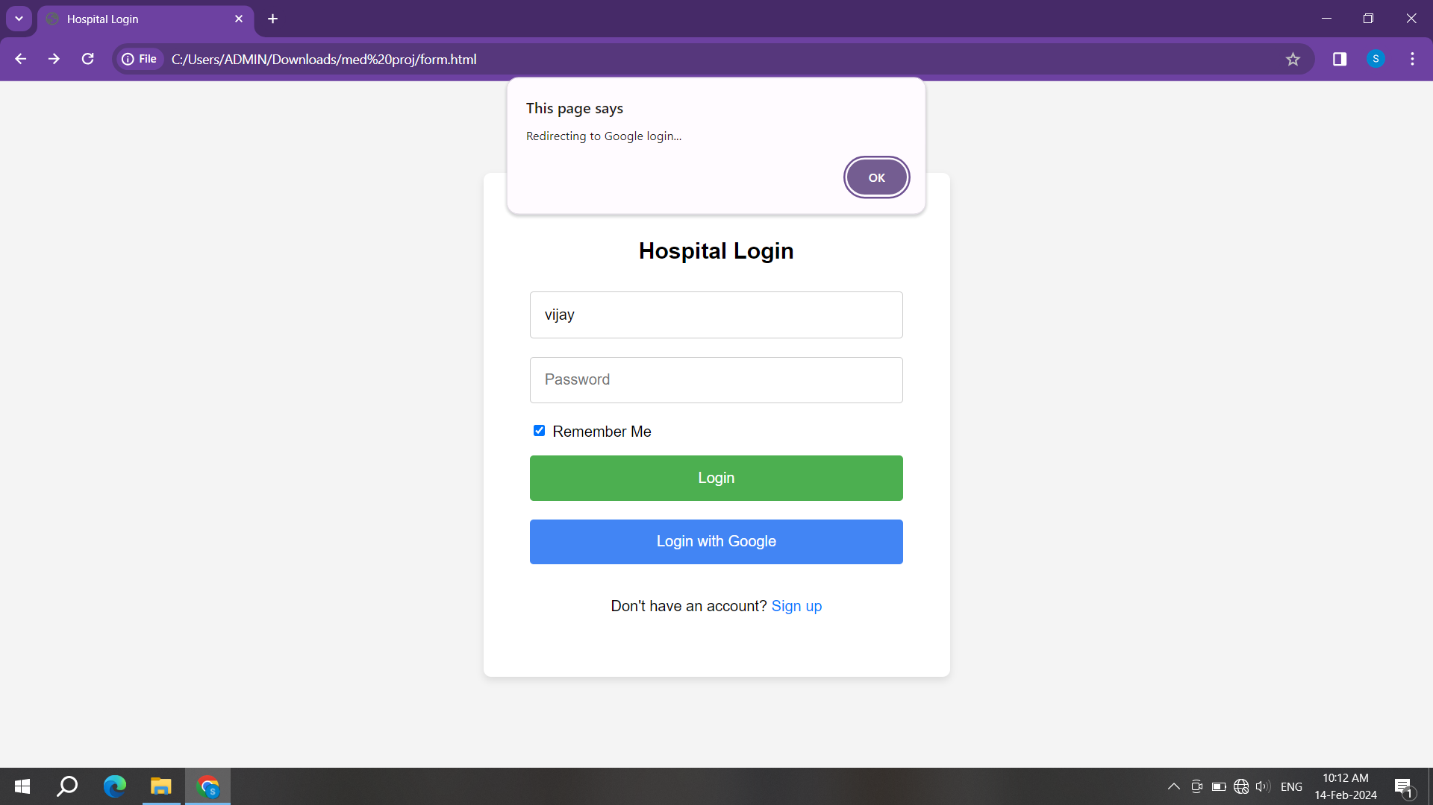
2/15/2022

Slide 20
CONCLUSION
Medspot makes it easy for users to access healthcare services anytime and anywhere, which eliminates the need for physical visits to clinics or hospitals.
The healthcare process can be simplified by users scheduling appointments with healthcare providers, managing their appointments, and receiving reminders.
The app offers features for users to quickly access emergency services, share their location with emergency contacts, and receive timely assistance during medical emergencies.
It offers a comprehensive solution for managing all aspects of healthcare, promoting wellness, and improving access to quality healthcare services for users.

Slide 21
List of Projects
Orphanage Management System
Agam construction website
Pet shop
Personal Portfolio’s
AI lawyer
CalmQuest
2/15/2022

Slide 22
THANK YOU
2/15/2022

