Slide 1
Interactive Sales Dashboard in Tableau
📊 Superstore Dataset | 💼 Business Stakeholders View
👩‍💻 Created by: P V SWETHA

Slide 2
🎯 Objective
• Design an interactive dashboard in Tableau
• Use Superstore dataset from Kaggle
• Include KPIs: Sales, Profit, Profit Margin
• Enable navigation and filtering features

Slide 3
📌 KPIs Selected
Total Sales
Total Profit
Profit Margin
Time Series
Sales vs Target
Profit vs Target

Slide 4
📊 Visualizations
• KPI Cards for Sales, Profit, and Margin
• KPI Comparison Charts
• Time Series Sales Trend Line Chart
• Sales by Region & Product
• Slicers and Filters for interactivity

Slide 5
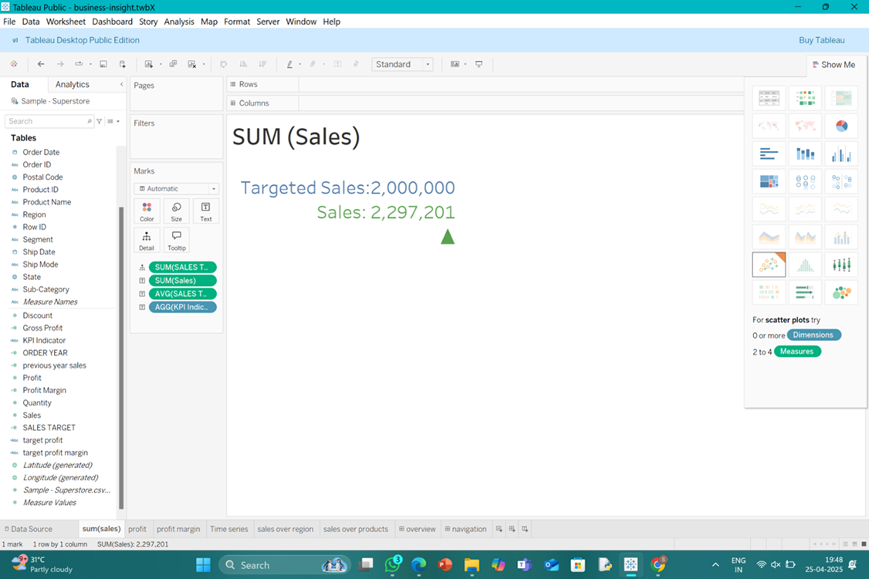
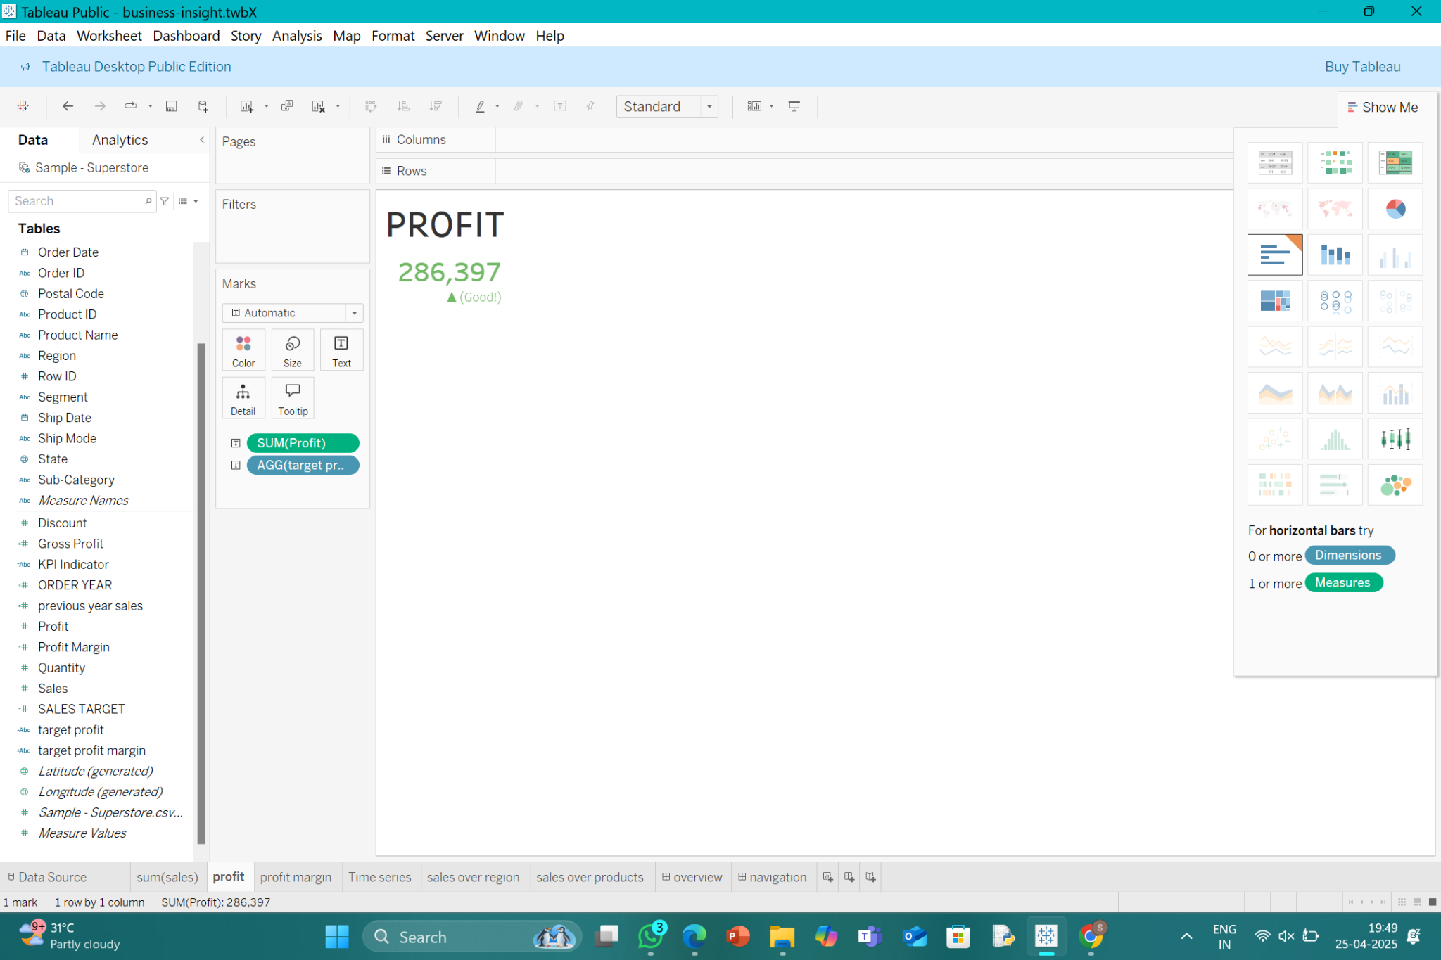
VISUALIZATION
KPI: Sales
KPI: Profit

Slide 6
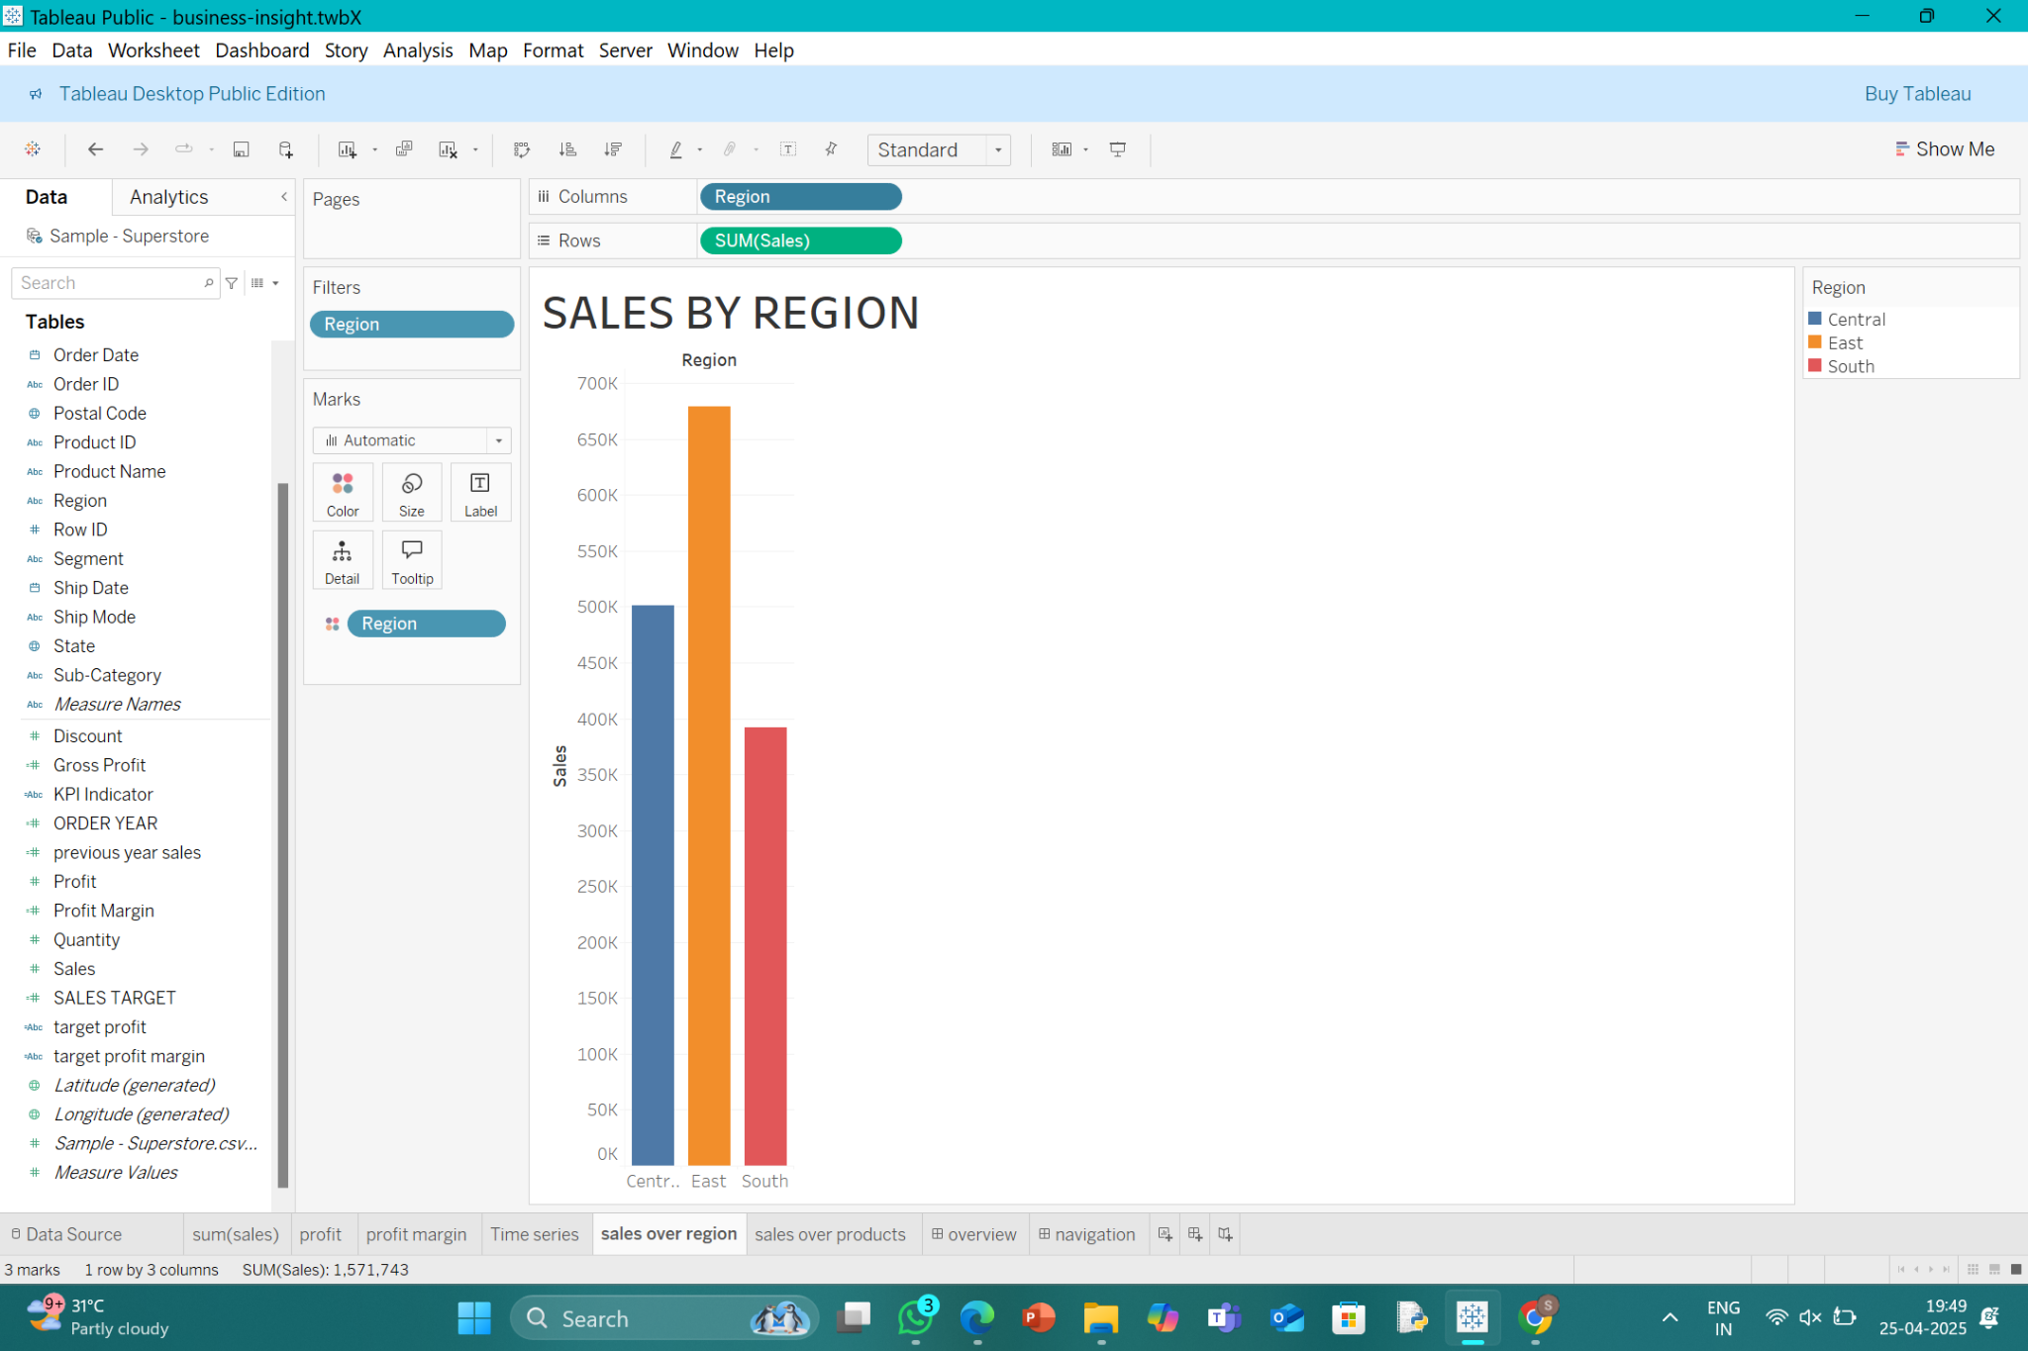
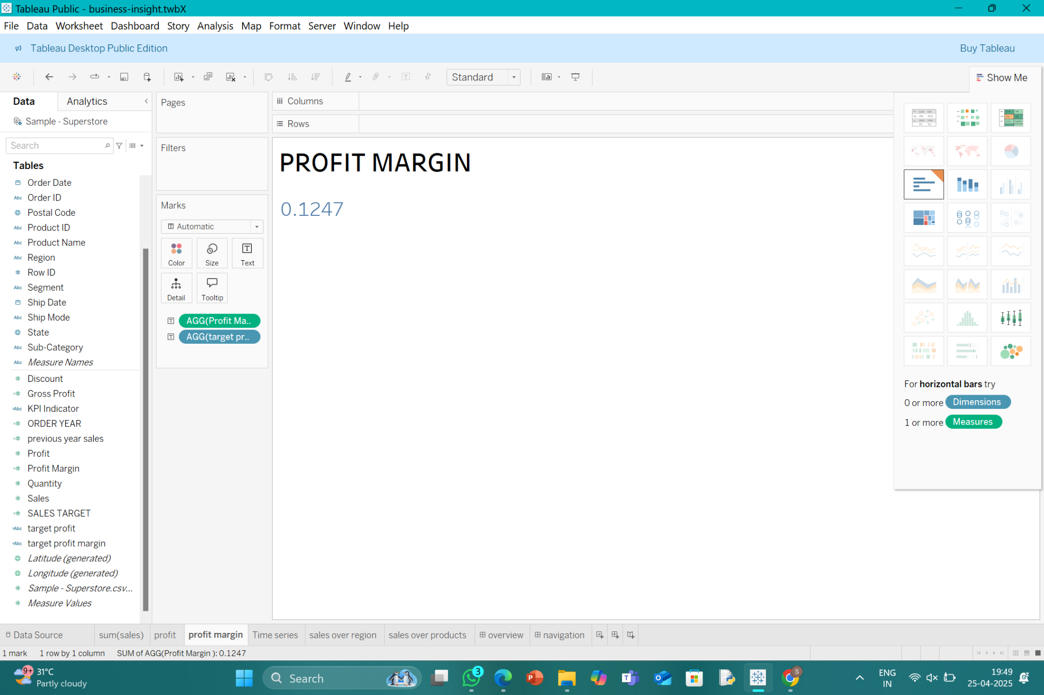
KPI: Profit Margin
Sales by Region

Slide 7
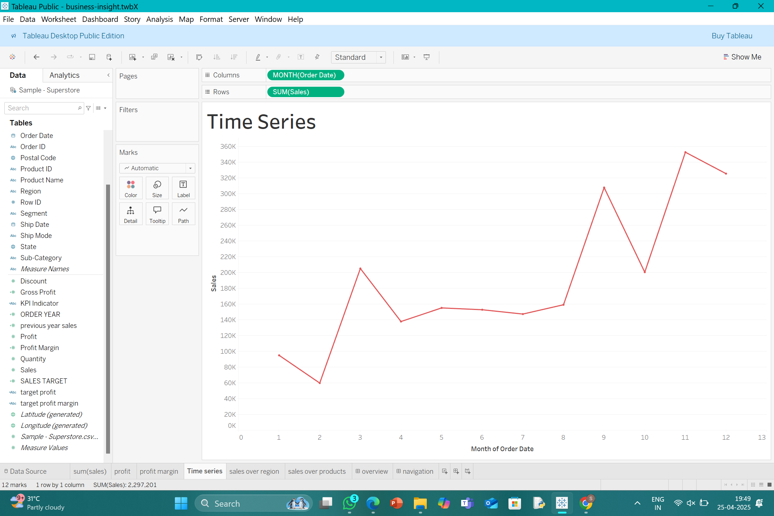
TIME SERIES

Slide 8
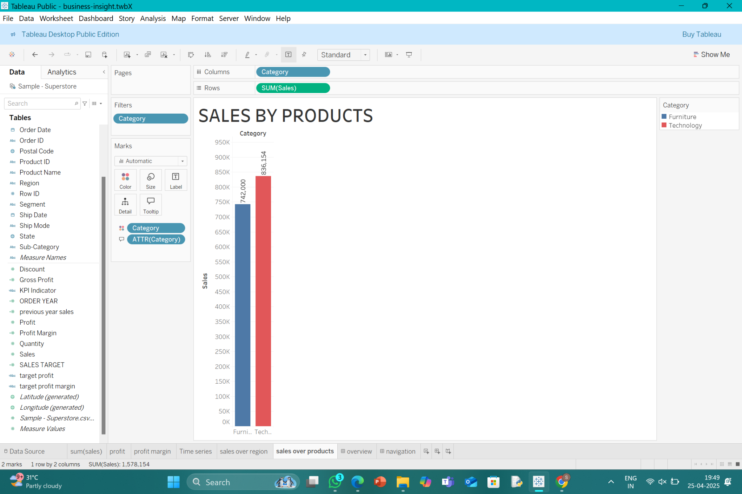
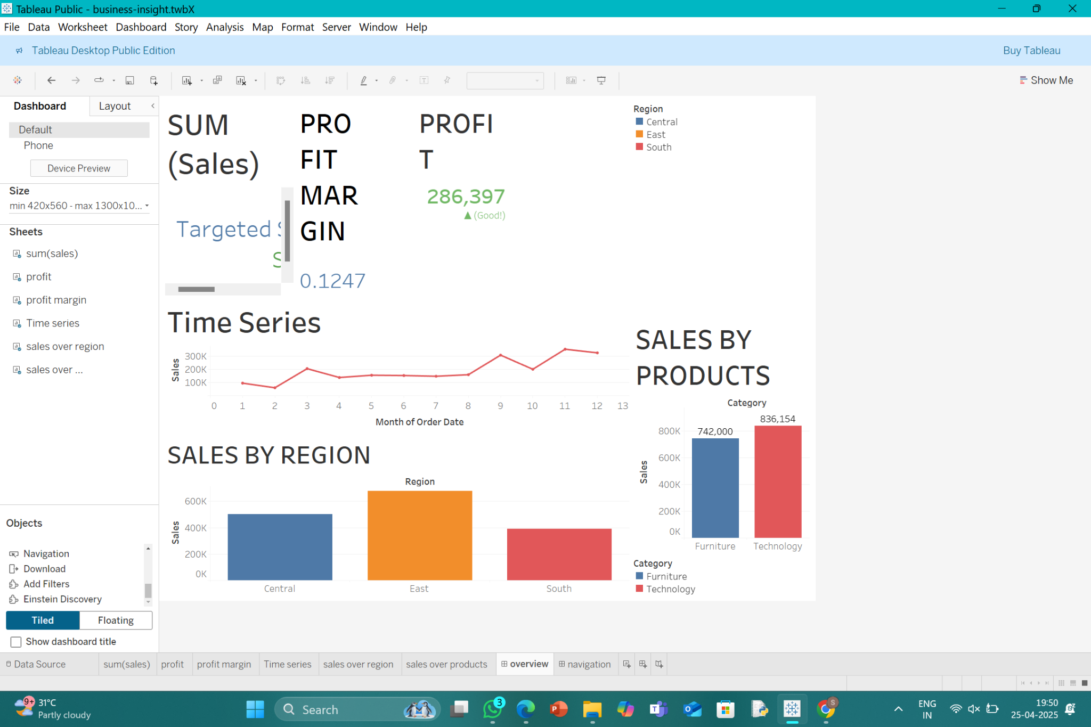
Sales by Product
Overview Dashboard

Slide 9
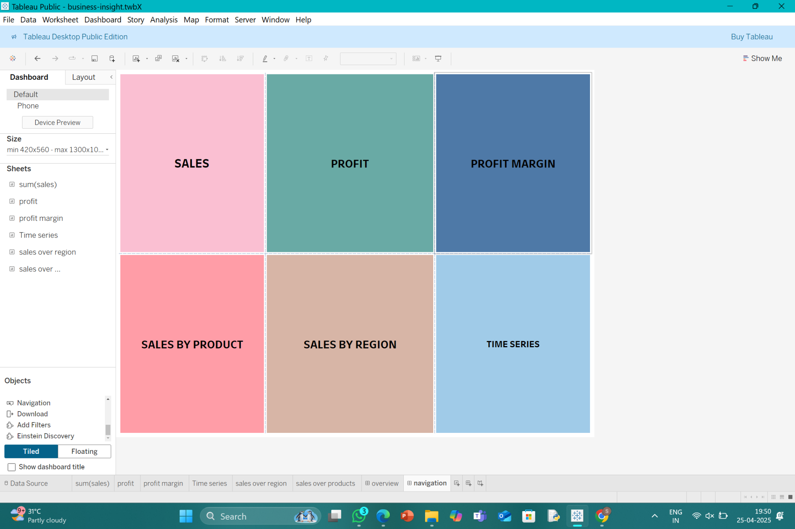
Navigation Menu

Slide 10
🧭 Interactivity Features
• Region, Category and Sub-category filters
• Navigation Buttons for smooth sheet movement
• Color Themes and Hover Tooltips

Slide 11
🔍 Key Insights
• ✅ Sales exceeded target (₹2,297,201 vs ₹2,000,000)
• 💰 Profit is strong (₹286,397 vs ₹250,000)
• 📈 Profit Margin: 0.1247%
• 🗺️ East Region has highest sales
• 🛒 Top Product: Technology related products

Slide 12
✅ Conclusion
• Clear business KPIs highlighted using Tableau
• Dashboard is user-friendly & interactive
• Visuals support business decision making
• Stakeholders can quickly access performance insights

