Slide 1
Federation Overview
v20220316

Slide 2

Objectives
After completing this module, you should be able to:
Describe Federation.
Define the SSO process.
List roles defined by the SSO specification.

Slide 3
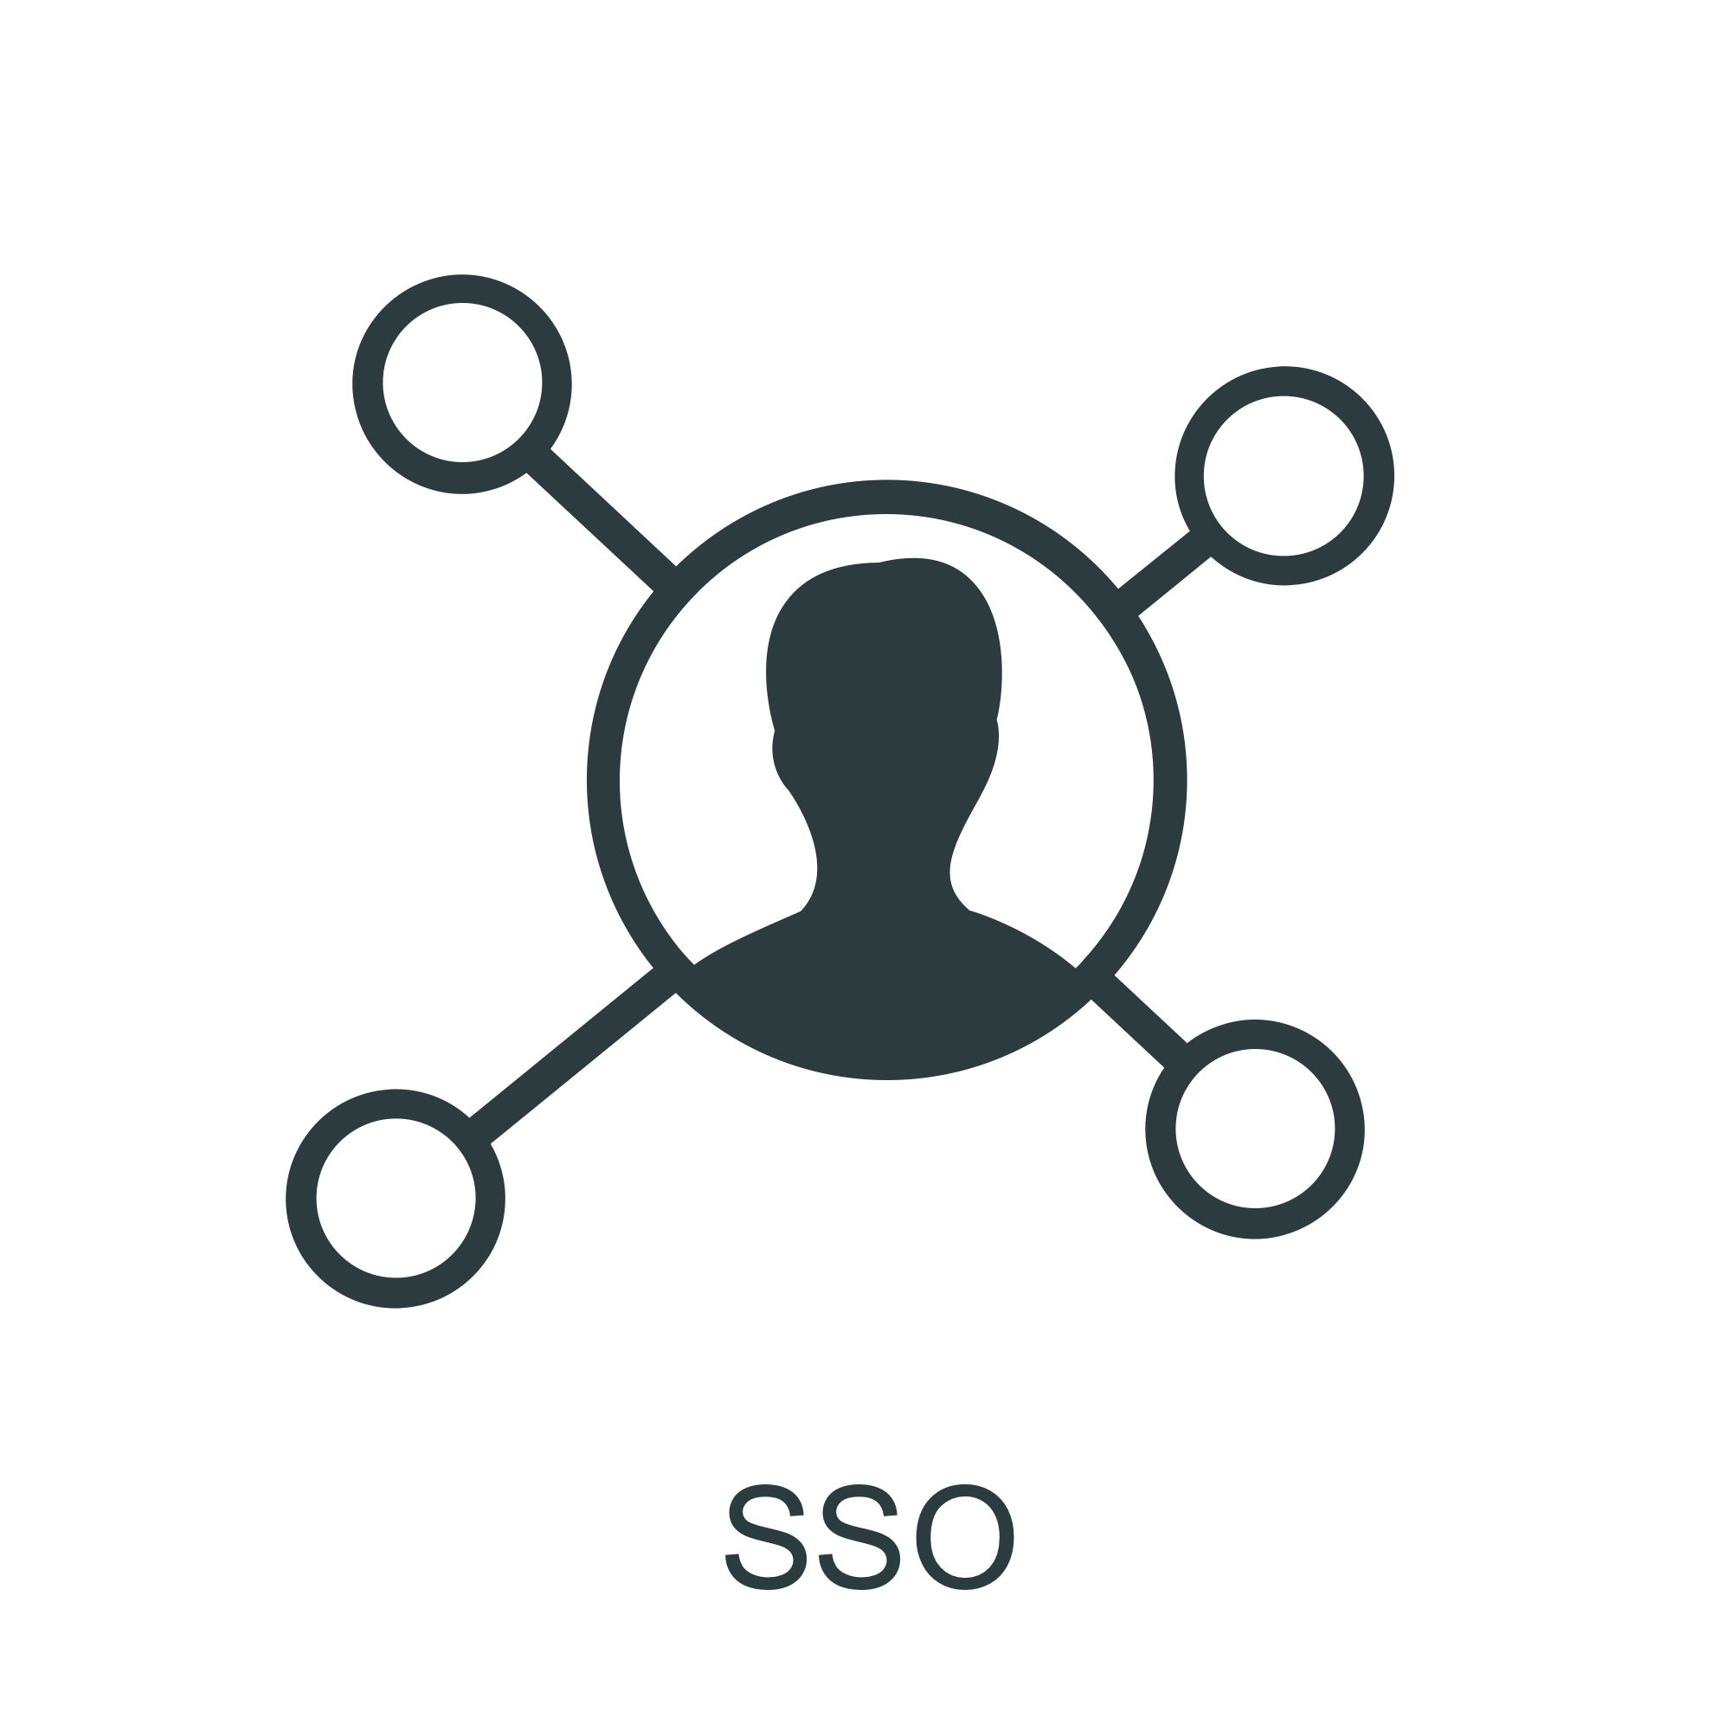
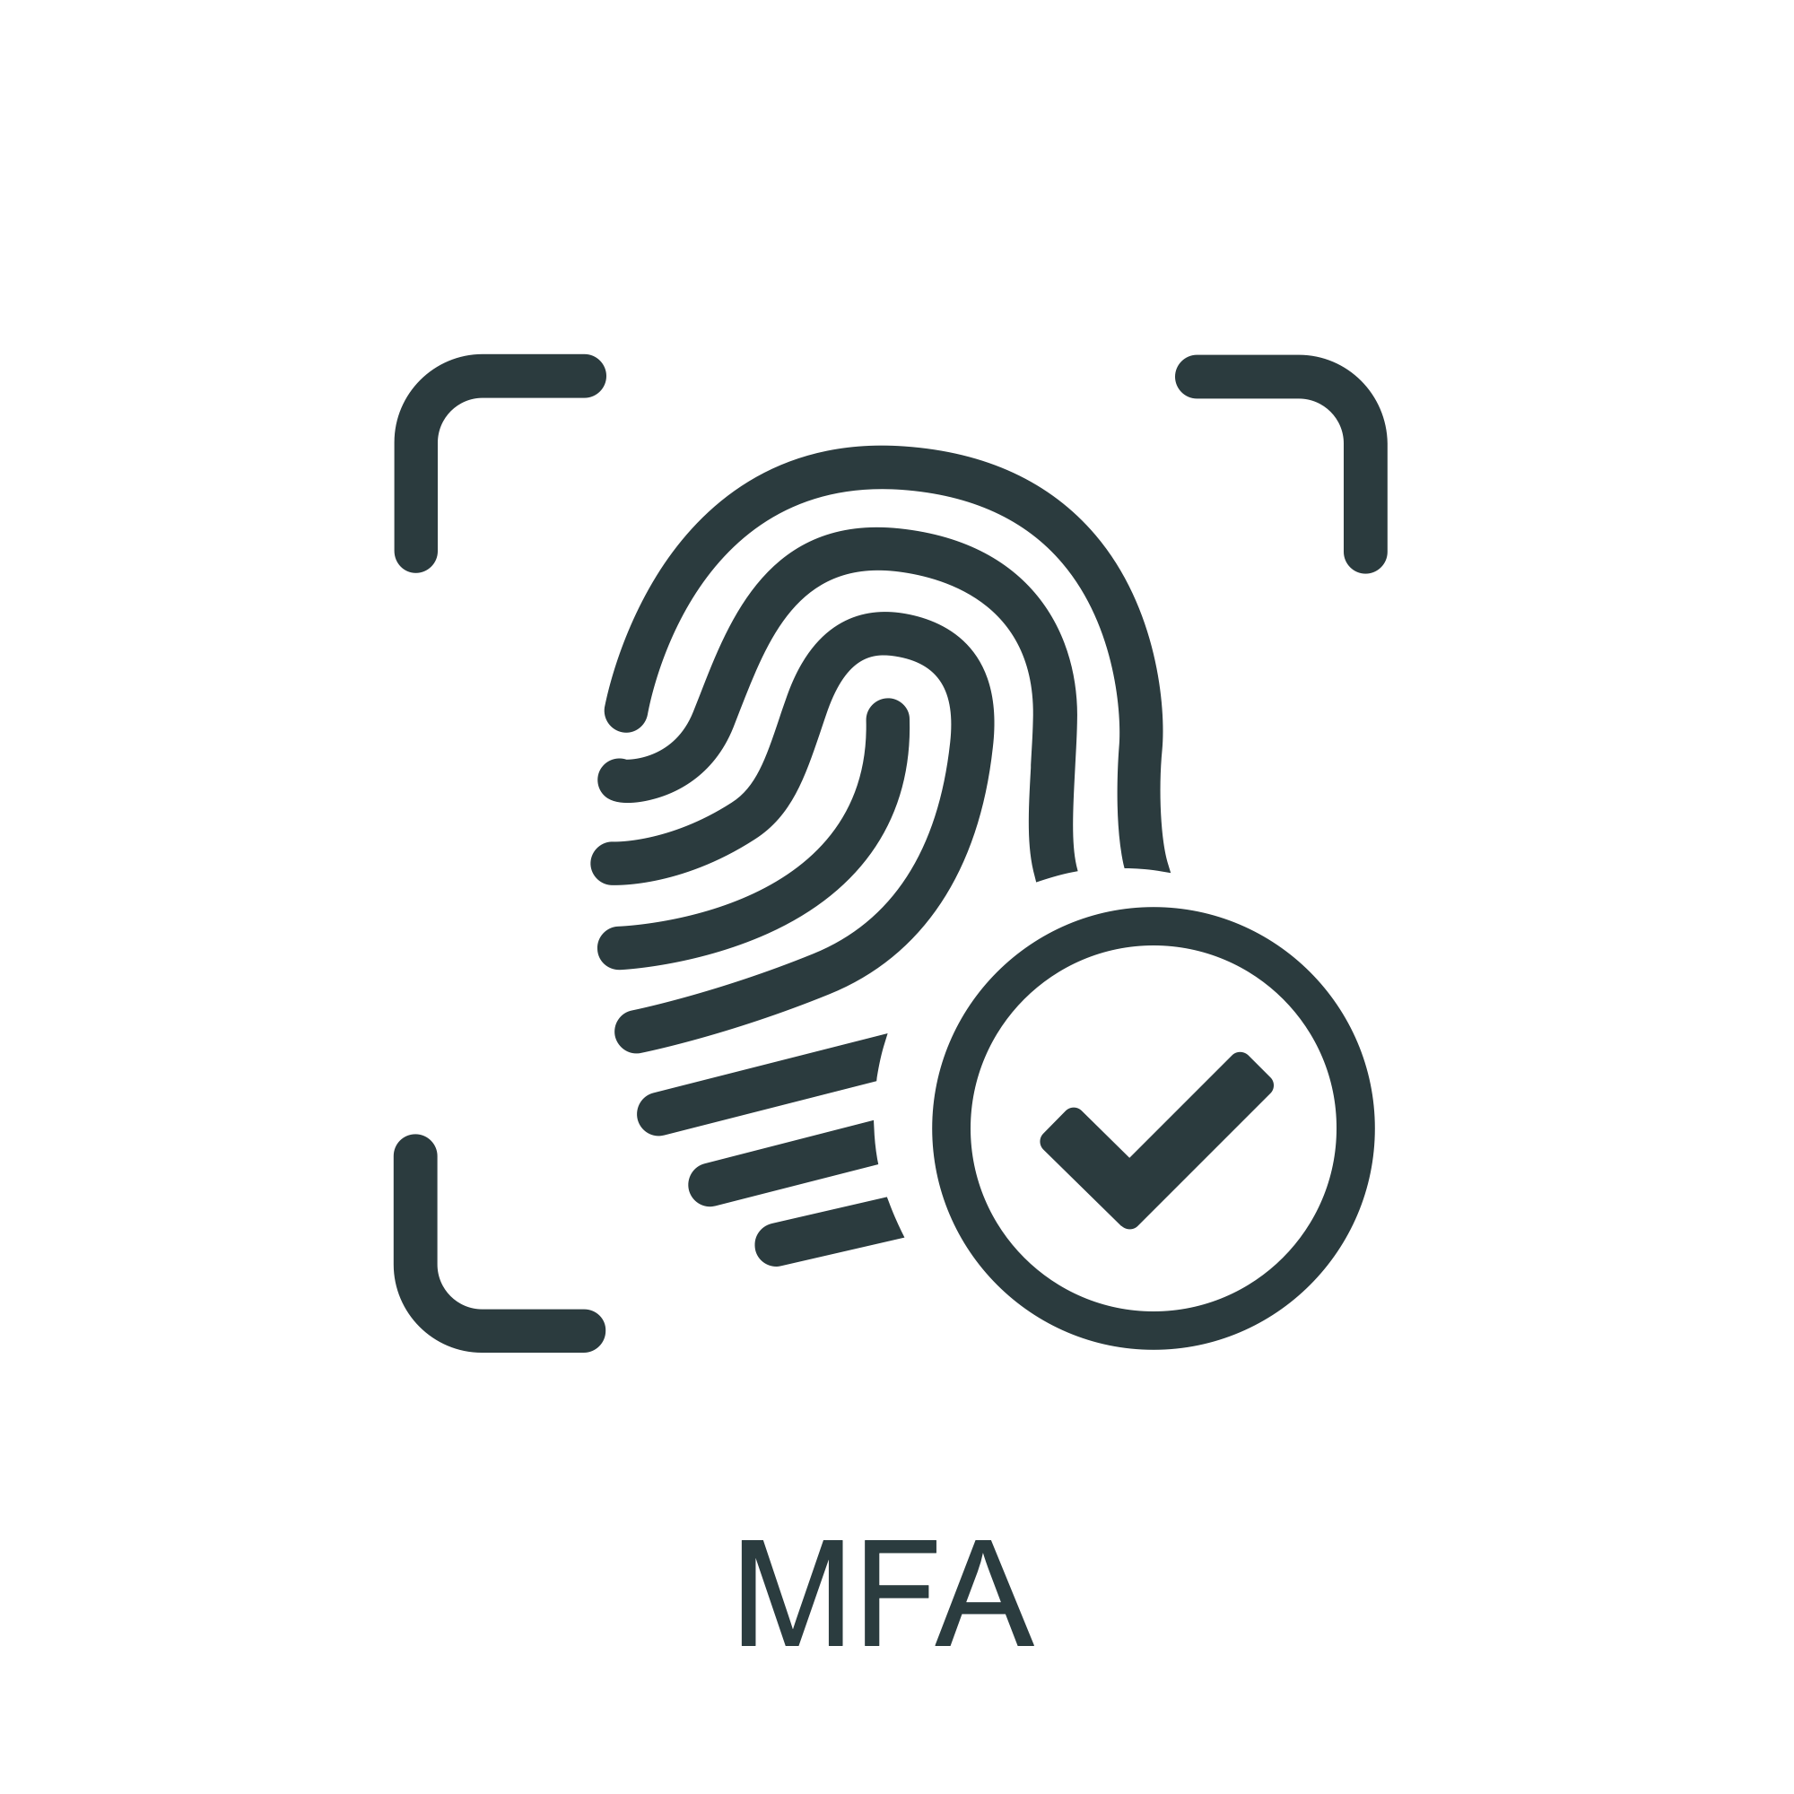
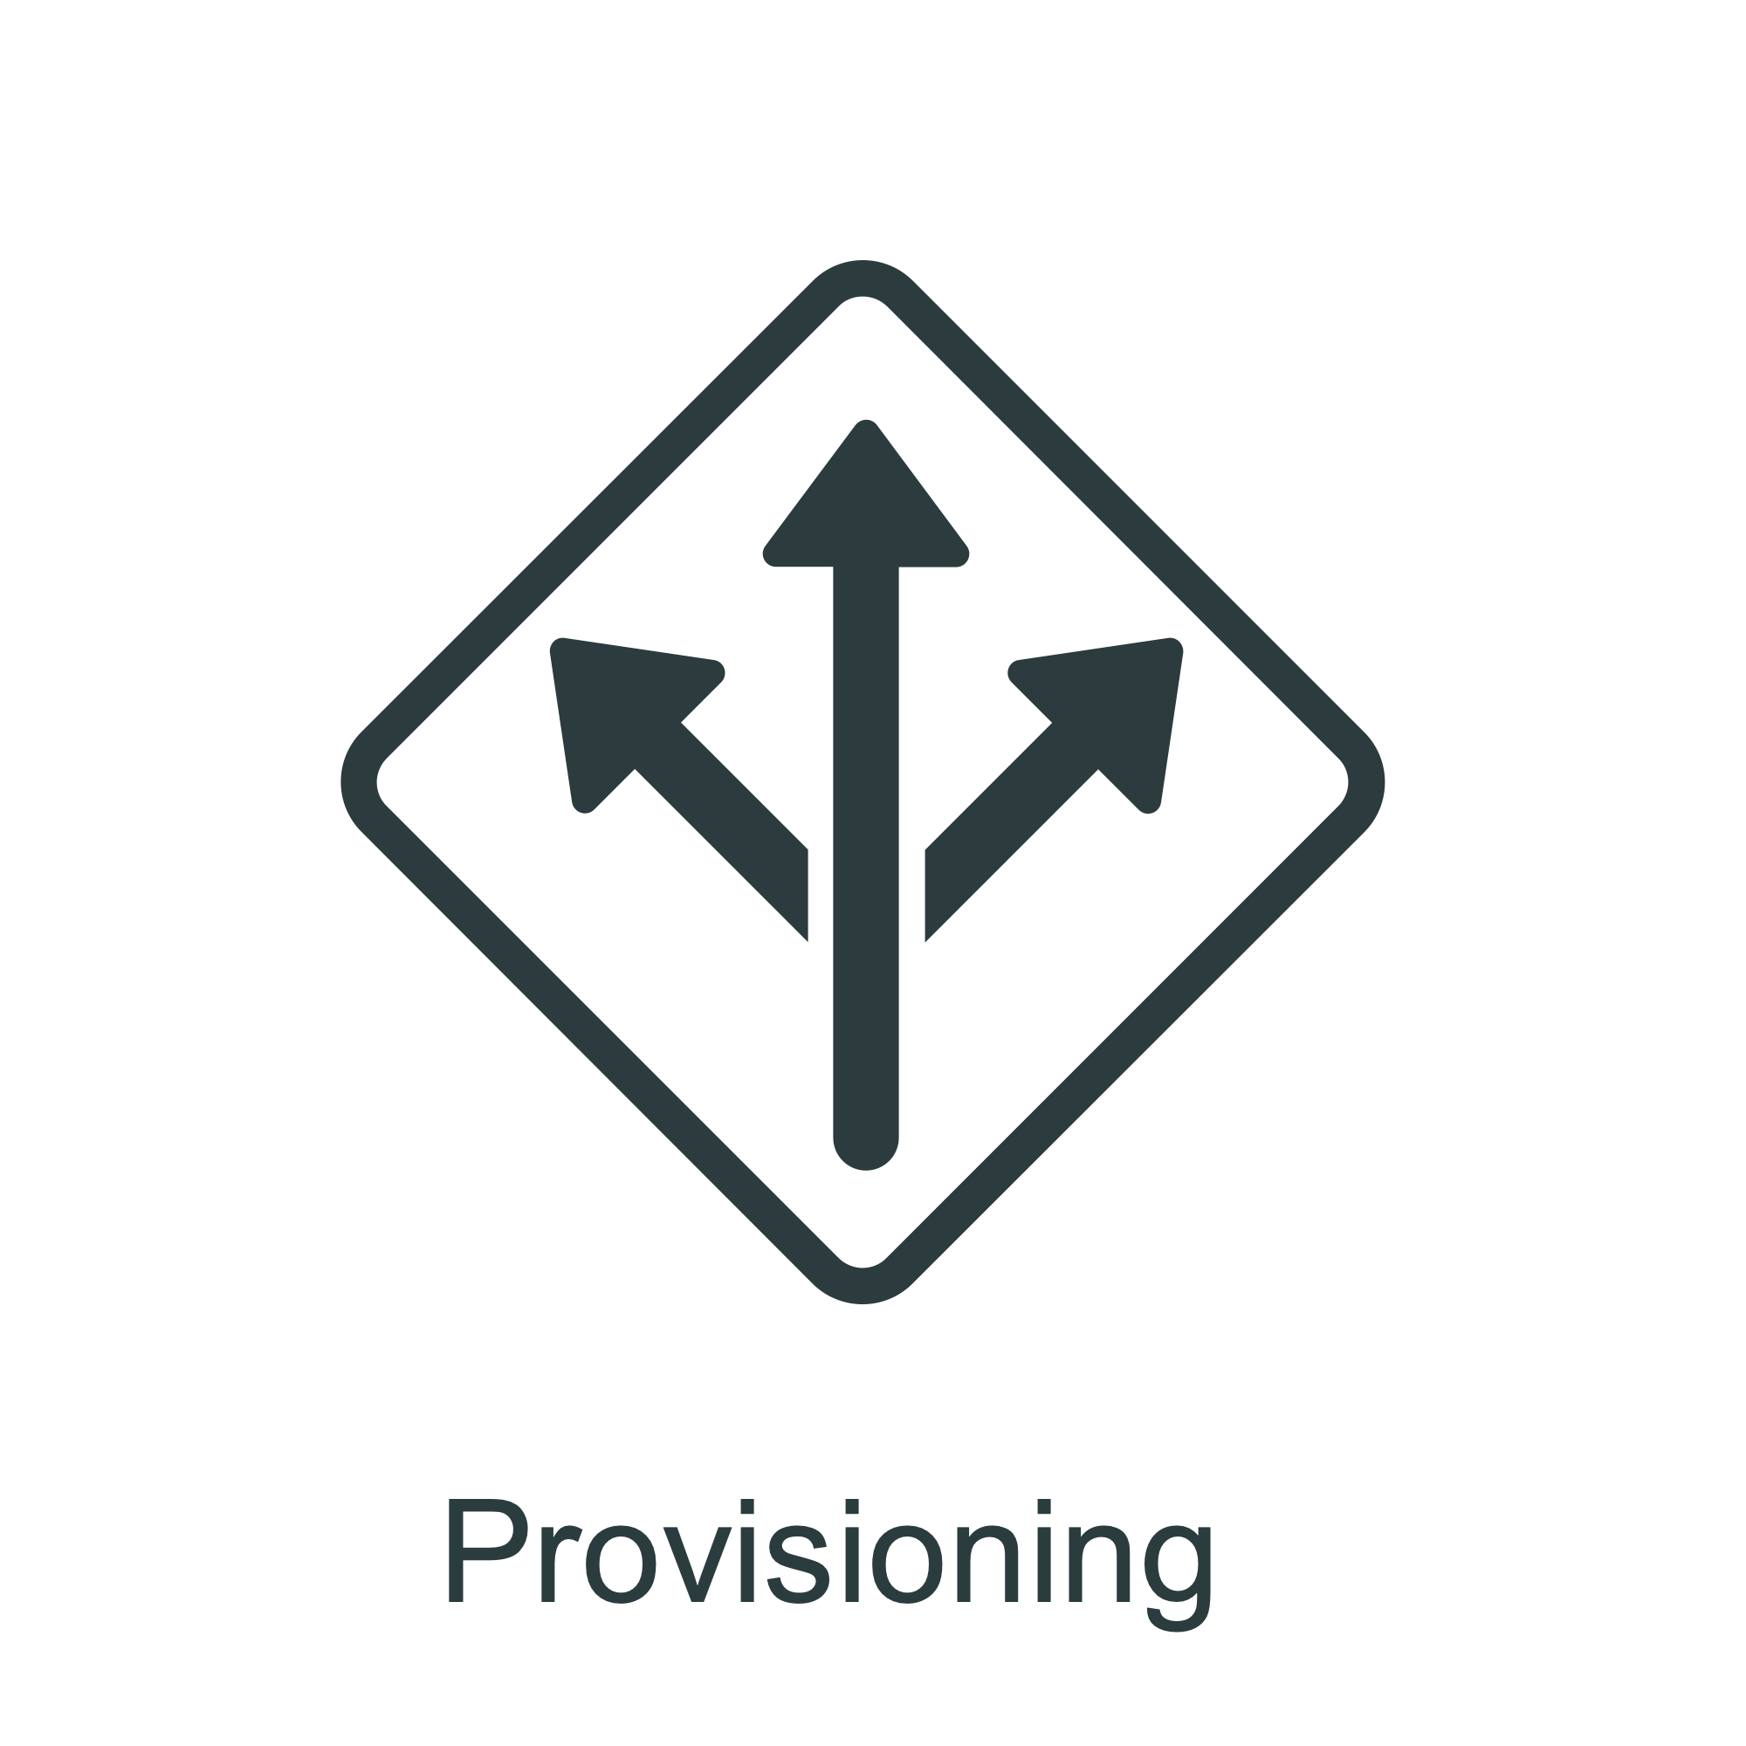
What is Ping Federate?
Identity Federation
Integration of access to applications
Browser-based SSO
OAuth2 and OIDC authorization server
Notes:
Federated identity management (or “identity federation”) enables enterprises to exchange identity information securely across domains, providing browser-based Secure Single Sign-on (SSO)
Federation is also used to integrate access to applications across distinct business units within a single organization.
As organizations grow through acquisitions, or when business units maintain separate user repositories and authentication mechanisms across applications, a federated solution to browser-based SSO is desirable
This cross-domain, identity-management solution provides numerous benefits, ranging from increased end-user satisfaction and enhanced customer relations to reduced cost and greater security and accountability

Slide 4
SSO
What is SSO?
Single login to access multiple applications.
Remove the need to know/remember multiple passwords.
Used in cross-domain access of applications.
Developers use standards to create trusted tokens:
SAML
OAuth2
OIDC
Notes:
Single Sign-on allows the user to log in once and then be granted access to all applications on that domain. Users have one password to access many applications.
For Secure SSO to be achieved, this process needs to be repeated for each application accessed by the user. Various mechanisms can be used to reduce or eliminate the burden of logging in to each application, such as:
Using a centralized authentication store for all applications (i.e. leveraging LDAP and Active Directory for authentication) - the user will have the same username and password for each application however will be expected to log in to each application.
Using a domain trust to establish SSO - this could involve using a protocol like Kerberos to achieve single-sign on when the user is on the corporate network.
Leveraging a Web Access Management (WAM) solution where all applications are protected by an access gateway, the user logs in once to the WAM gateway and gains access to all applications they are entitled to.
Leveraging a shared cookie or token across multiple applications.
Vaulting passwords and replaying them as a user access an application.
To achieve the end goal of SSO between applications, we must replace the password with a trusted token (i.e. a Kerberos ticket or a cookie) or system (i.e. a WAM).

Slide 5
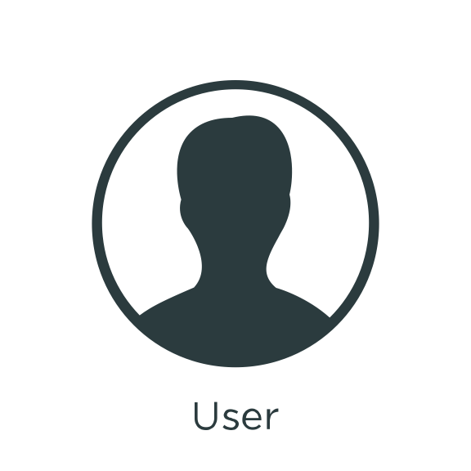
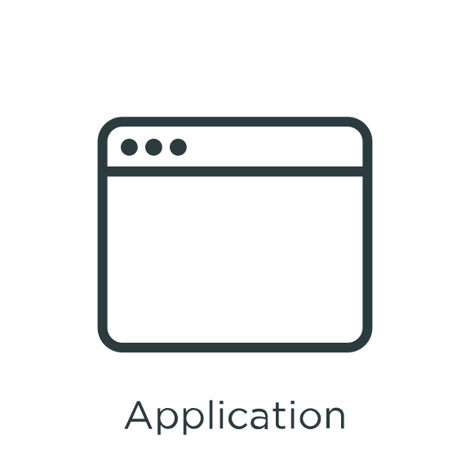
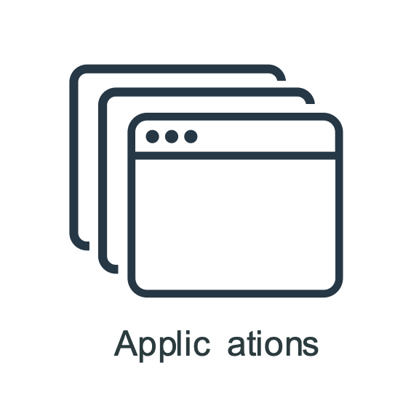
History of SSO
Traditionally:
SSO was done within a single company for internal apps only.
Applications validate the security token against a central server.
External applications still required a separate account and login.
User session is verified against a central source when trying to access an internal application
Notes:
Single sign on states that the user logs in once and has access to all applications on that domain(s). Users have one password to remember. Similar to logging in to Gmail today, the user then has access to applications that Google provides. Examples of connecting from Google by logging in with one password gives admittance to Google Docs, Google Calendar, and Google Drive.
Different applications – Gmail isn’t the same as google docs! – When logged in to the whole google domain a user can access any application within the domain.
Current implementations have been at the enterprise level where some comparable access has been implemented.
Users will log in to enterprise once, and then has access to all these applications.

Slide 6
SSO: Across Multiple Domains
What about SSO outside the enterprise security realm?
SaaS applications provided by third parties:
Payroll applications
Travel organizations
How do you allow users access to everything with a single login?
How do you allow your customers access?
Customer Identity Access Management (CIAM)
Notes:
Give examples of additional applications that corporate users need access to.
Emphasize the need for one password allowing for access to their customized environment
Give real world example from your experience.

Slide 7
Identity Federation
Federation is a trust relationship between two companies.
The user can:
Authenticate to one organization.
Access a resource at another organization.
Employee Organization
Trust Relationship
SaaS Partner
Notes:
Federation is the building of a trust between different organizations. Once trust is defined, then the concept of identity federation, or internet single sign on, which is simplified to SSO is defined.
There is one company (company a) that does the authentication, and one company that has the application (company b).
Company A (ping identity) authenticates and It asks us for our username and password.
Company B (Gmail) grants access to email without asking for Gmail login and password again.
A real life example is if I want to get a passport for my upcoming trip to Australia. If I just go to the passport office and ask for a passport, they’ll request that an accepted form of documentation be provided. Once I have retrieved the accepted documentation and I go to the passport office and submit my application along with proof of citizenship I will receive a passport– only if I get authenticated by the Issuing Passport Agency. I can then travel to Australia with my new passport and gain entry into the country. – then I can bring that passport to Australian customs to gain access to the country. The customs agent will accept my passport because the customs agent trusts the Passport Agency’s government.
How does company know that I’m authenticated? Well, the Passport Agency, right? I brought my passport proving I was authenticated.
It’s the same thing online. Company B, Gmail, needs something to prove we’ve been authenticated. So we give it the digital equivalent of a passport, which is an assertion. And that assertion basically says “I’ve authenticated Bob; he’s my user.” So Ping logs Bob in and makes an assertion, and sends that assertion to Gmail. And just like the customs agent looks at my license and then lets me in, Gmail looks at the assertion and says, okay, well come on in then.
And you can put whatever info you want in the assertion. Just like my passport doesn’t only have my date of birth, it also has my name and address and eye color, an assertion has to have the user id, but it can also have an email address, a name, a role, or whatever else you want.
NOTES IN REAL LANGUAGE:
Federated identity management (or “identity federation”) enables enterprises to exchange identity information securely across domains, providing browser-based SSO. Federation is also used to integrate access to applications across distinct business units within a single organization. As organizations grow through acquisitions, or when business units maintain separate user repositories and authentication mechanisms across applications, a federated solution to browser-based SSO is desirable.

Slide 8
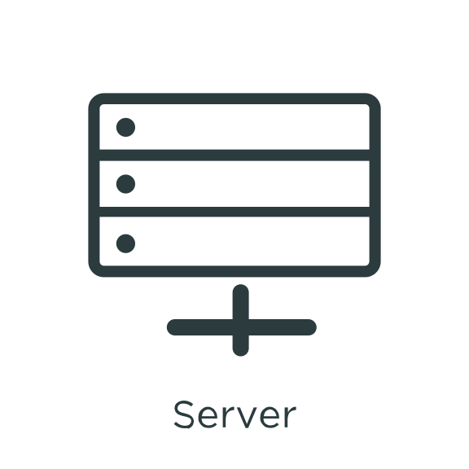
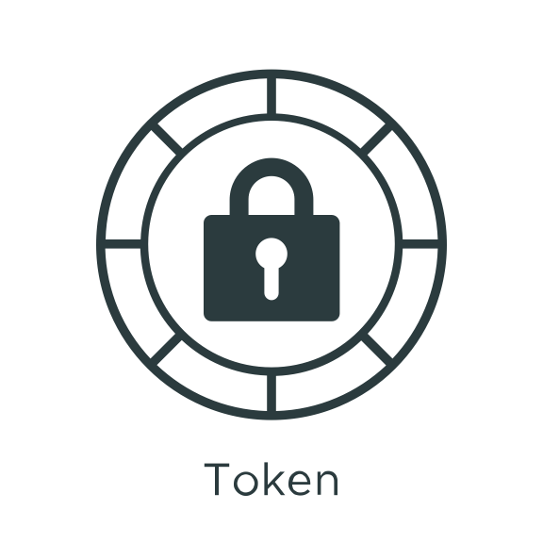
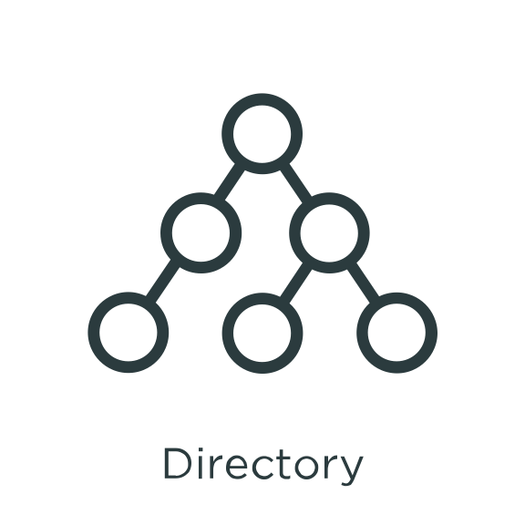
Roles: IdP
The IdP is responsible for:
Authenticating the user.
Sending the target company an assertion or security token:
“This user has already been authenticated”
Federation Server
Outbound
Assertion
Authenticate user
(for example, Active Directory)
Notes:
The IdP is the company doing the authentication.
This is the passport office; the passport agency authenticates and gives me a passport proving it’s checked my photograph and identity.
The same way, the IdP might be your company.
Log in – I put my username and password into PingIdentity.com in the morning, and PingIdentity checks my credentials and then makes an assertion for the session.
“Traveler has been authenticated.”

Slide 9
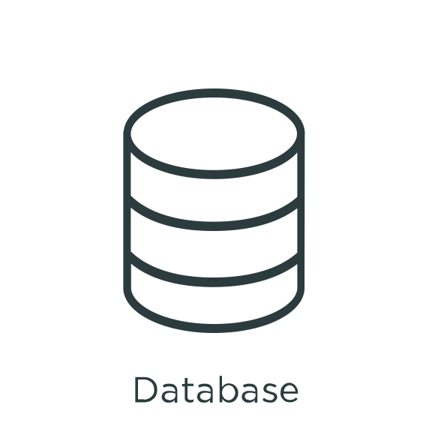
Roles: SP
The SP is responsible for:
Receiving and verifying assertions or security tokens:
“Has already been authenticated”
Providing access to an application or resource.
App
Server
Federation Server
Inbound
Assertion
Database
Server
Notes:
Company B is the service provider (SP). This is the customs agent. I take my passport to him, and he lets me in.
Company B, (SalesForce), they get the assertion containing the user information.
The user information, is then verified and shown to come from a user we trust.
Then they create a session for the user on the application. “Okay, everything checks out, you can come into mail”).

Slide 10
SSO: User’s Perspective
User authenticates to the IdP.
User clicks a link for the target application, for example, Google Mail, and is taken directly there without having to authenticate a second time.
IdP
SP
1. Authenticate
2. In the app
User
Authentication
App
Server
Notes:
Walk to customs agent, present passport.
Posted to salesforce

Slide 11
SSO: Detailed Flow
User requests access to a web application and the IdP verifies the user is authenticated.
IdP
SP
1. Authenticate
User
Authentication
App
Server

Slide 12
SSO: Detailed Flow (cont.)
IdP looks up the user’s attributes, such as username, email, and department.
IdP sends an assertion or security token to the SP.
IdP
SP
3. Send token using standard protocol
1.Authenticate
2. Attribute Lookup
User
Authentication
App
Server
Notes:
Remind students that an assertion is comprised of key information needed to gain access to service provider.
Standards are used by developers to create the appropriate targeted values.
Number 2 is – what are we putting in the assertion?

Slide 13
SSO: Detailed Flow (cont.)
SP receives the assertion or security token with the user’s attributes and creates an application session for the user.
IdP
SP
3. Send token using standard protocol
1.Authenticate
4. User placed into application session
2. Attribute Lookup
User
Authentication
App
Server
Notes:
Walk to customs agent, passport stamped.
Posted to salesforce
Review process to make sure students have a good foundation before moving on to next topic.

Slide 14
Why Use SSO/Federation?
Simplifies Administration:
Reduces number of accounts and passwords to maintain.
Partners manage their own users.
Replaces proprietary solutions with industry standard solutions and protocols.
Increases Security:
Propagates strong authentication.
Reduces identity theft targets.
Extends enterprise security to hosted services.
Protects against password proliferation
Notes:
Contracts with external services (payroll, travel)
Orgs need to share identity information
SP not interested in maintaining your IDs – there’s no way the customs agents would have a list of every single person in the world of legal entry. They just want to be able to get a passport that they trust.
Send you an identity, you accept it and provide the service
Increases security -
From the IdP, the authentication standards are enforced across the SPs.
If you have strong authentication standards, for instance numbers and mixed symbols, or multi factor authentication.
Since you're the one doing the authentication as the IdP
Then you are effectively enforcing that across all your SPs
(Reduce identity theft targets)
Using SaaS, for example, Google or Salesforce
Users always authenticate through your corporate portal or corporate website.
Never authenticate directly with the SP
Actually don't have any idea or knowledge of their user IDs or PWs in those systems.
Can never be phished -
Can't be sent to a fake website which tells them they have to change their Salesforce Password
Clients don't even know their actual password to SalesForce; they always log in through the company portal
Also if left to their own devices, users probably make the same password for everything.
If password is the same for all SPs without federation then if one SP leaks the password, it exposes your access to all the SPs.

Slide 15
SSO Summary
IdP federation server creates and sends assertion.
SP federation server receives and parses assertion.
PingFederate is a federation server.
IdP
SP
Federation Server
Federation Server
User
Authentication
App
Server
Notes:
DOUBLES AS SUMMARY SCREEN.
Recap: IdP is passport office and SP is customs agent.
SAML assertion is the passport.
Federation server. The Passport Agency has the employee that checks my birth certificate and picture, but they don’t make the passport.
The printer does that. Same way, my password is checked against AD, but AD can’t make an assertion.
There’s another part that does.
SP side, goal is entry into country. Country can’t check my ID. Passport Agency checks my ID.
As an example: WebEx meeting doesn’t know what an assertion is; cisco has a federation server to check it.

Slide 16
SP- vs IdP-Initiated SSO
IdP-initiated SSO:
Authenticate at IdP
Assertion sent to SP
SP-initiated SSO:
Start at SP: “Who are you?”
Authentication request to IdP: “Who is this?”
Authenticate at IdP
Assertion sent to SP
Notes:
IdP Init is what we’ve talked about.
Note that 2 and 3 in SP are the same as the IdP side!
SP Init has ONE extra step – that authentication request, that redirect from the SP to the IdP.
I show up first at the bar, and they send me to the DMV to get a license

Slide 17
Section Review
SSO:
Authenticating once and accessing all your applications
IdP:
Authenticates users
Creates and sends assertions
SP:
Receives assertions
Target application
Federation Server:
Handles assertions
IdP: creates and sends
SP: receives and parses
SP- vs IdP-Initiated SSO:
Where does the user start?
SP-Initiated SSO has extra authentication request

