Slide 1
DEPLOYING ANGULAR AND SPRING BOOT ON EKS
SWETHA S
245154
MEENAKSHI SAJEEVAN
245125

Slide 2

What is Amazon EKS?
Amazon Elastic Kubernetes Service (Amazon EKS) is a managed service that you can use to run Kubernetes on AWS without needing to install, operate, and maintain your own Kubernetes control plane or nodes.
EKS runs and scales the Kubernetes control plane across multiple AWS Availability Zones to ensure high availability.
Automatically scales control plane instances based on load, detects and replaces unhealthy control plane instances, and it provides automated version updates and patching for them.
It is integrated with many AWS services to provide scalability and security for your applications.

Slide 3
Features
Managed Kubernetes Clusters
Hybrid Deployments
Use eksctl for launching nodes and single line management
Networking and Security
Load balancing
Serverless Compute
Cost monitoring
Logging

Slide 4
DEPLOYING ON EKS
Steps
Dockerize the Project
Pushing Docker Image To ECR
Create a Cluster and Worker Nodes
Configure kubectl to use Cluster
Deploy Kubernetes Objects On AWS EKS Cluster

Slide 5
Dockerize Angular Application
Create Dockerfile
Commands
docker build -t dockerhub_name/image_name:tag dockerfile_location.
docker ps-To get the list of Docker images.
docker push bharathirajatut/angular-app:latest- To push Docker Image to Docker Hub.
docker run -d -p 80:80 bharathirajatut/angular-app:latest-To run Docker Container.

Slide 6
Dockerizing a Spring Boot Application
Commands
docker build --tag=message-server:latest
docker run -p8887:8888 message-server:latest

Slide 7
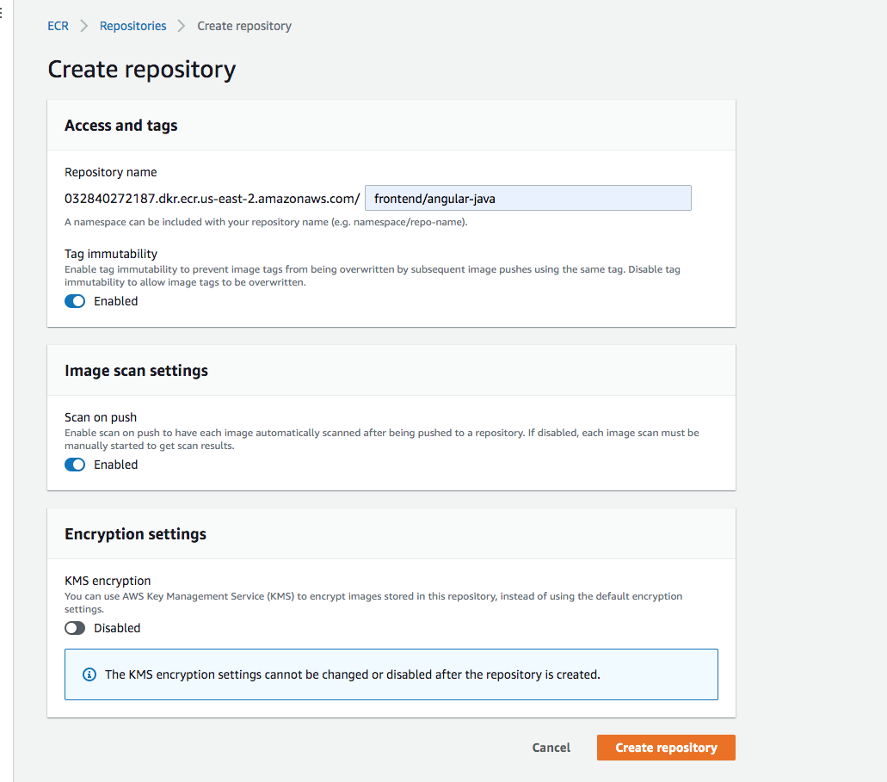
PUSHING DOCKER IMAGE TO ECR

Slide 8
AWS CLI
Command to authenticate to your default registry
aws ecr get-login-password --region us-east-1 | docker login --username AWS --password-stdin aws_account_id.dkr.ecr.us-east-1.amazonaws.com
Command to create a repository
aws ecr create-repository \ --repository-name frontend/angular-java\ --image-scanning-configuration scanOnPush=true \ --image-tag-mutability IMMUTABLE --region us-east-2

Slide 9
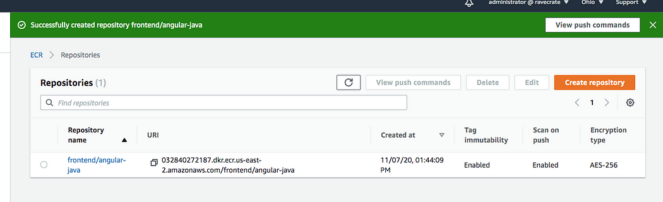

Slide 10
Tagging your local Docker image and Pushing
Tag that image with this repository URI
docker tag java-angular:latest 032840272187.dkr.ecr.us-east-2.amazonaws.com/frontend/angular-java:v1
To push the Docker image into your repository
docker push 032840272187.dkr.ecr.us-east-2.amazonaws.com/frontend/angular-java:v1

Slide 11
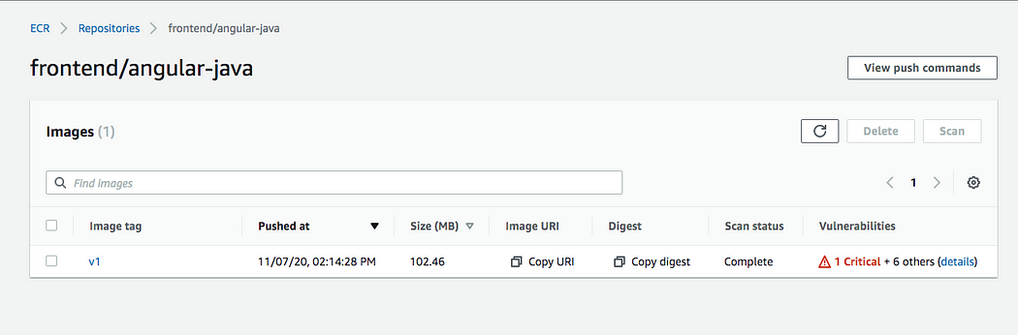

Slide 12
Create a Cluster and Worker Nodes
A cluster is a managed Kubernetes control plane provided by Amazon EKS. It is a centralized system that oversees and controls the operations of your containerized applications.
Worker nodes are the computers (servers) that actually run your containerized applications within the EKS cluster.
Create an AWS EKS cluster with AWS console, SDK, or AWS CLI.
Create a worker node group that registers with EKS Cluster
When the cluster is ready, configure kubectl to communicate with cluster.
Deploy and manage the applications on the cluster

Slide 13
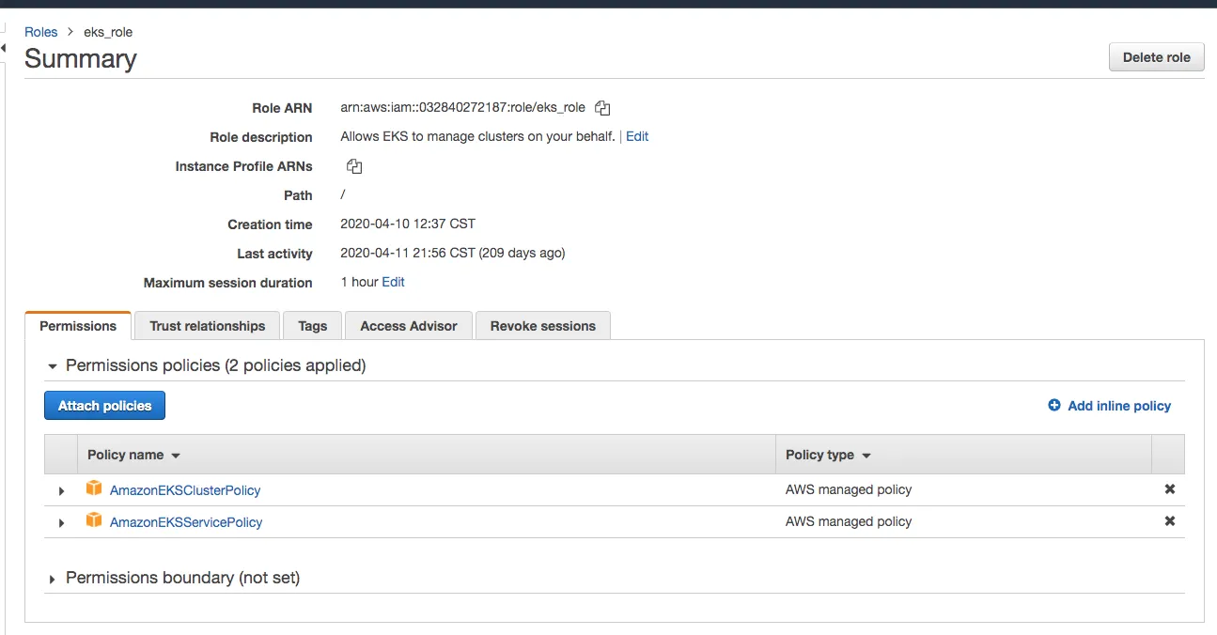
Cluster Creation
Create a role for the EKS to allow Amazon EKS and the Kubernetes control plane to manage AWS resources

Slide 14
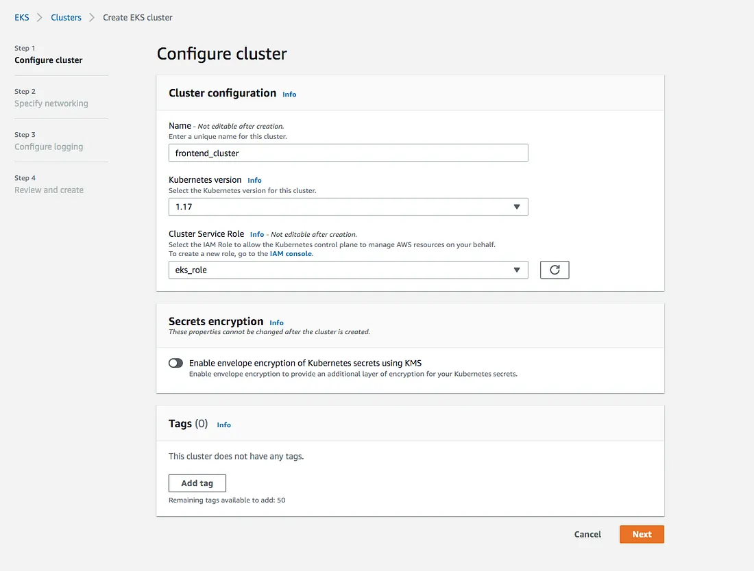
Go to the EKS console and configure the cluster

Slide 15
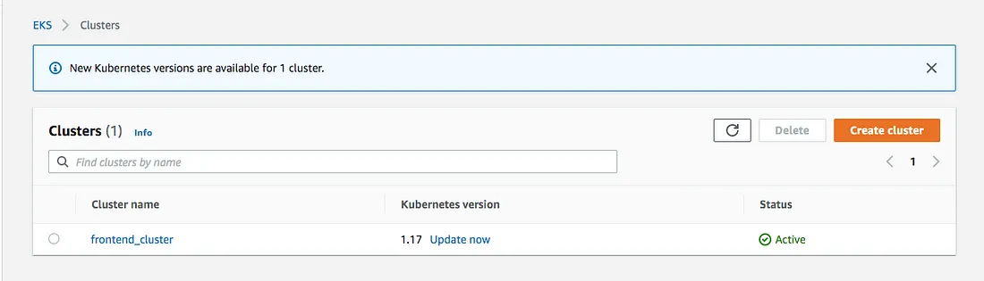

Slide 16
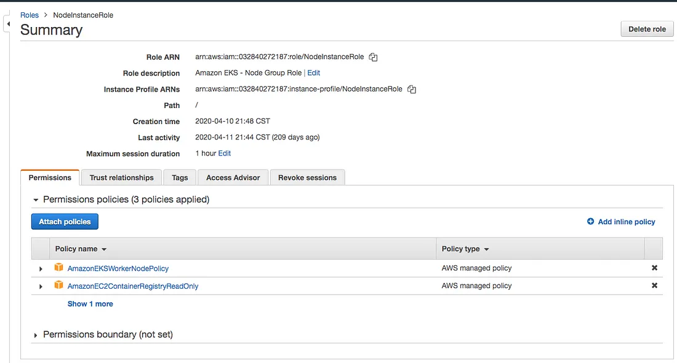
Create Worker Nodes
Create a role called NodeInstanceRole

Slide 17
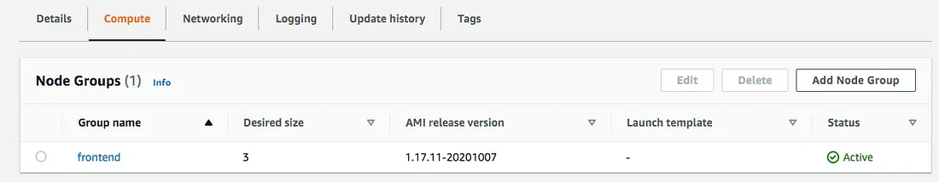
Create node group
Node groups are managed Auto Scaling groups that provide the underlying compute capacity for your Kubernetes workloads.
There are two ways to create a node group:
Using the AWS Management Console
Using AWS CLI
aws eks create-nodegroup --cluster-name <cluster-name> --nodegroup-name <nodegroup-name> --scaling-config file://scaling-config.json --instance-types <instance-types> --ami-type <ami-type> --desired-size <desired-size> --min-size <min-size> --max-size <max-size> --subnet-ids <subnet-ids>

Slide 18
Configure kubectl to use Cluster
install kubectl
install an aws-iam-authenticator.We need this to authenticate the cluster and it uses the same user as AWS CLI is authenticated with.
Use the AWS CLI update-kubeconfig command to create or update kubeconfig for the cluster. Here region-code is us-east-2 and cluster_name is frontend_clutser
aws eks --region region-code update-kubeconfig --name cluster_name

Slide 19
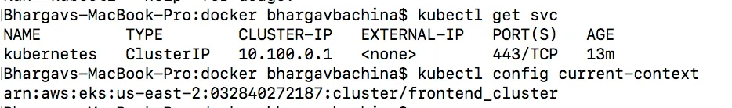
check with these commands.
// get the service kubectl get svc
// get the current context kubectl config current-context
Connected to AWS EKS

Slide 20
Deploy Kubernetes Objects On AWS EKS Cluster
create deployment and service objects and use the image from the AWS ECR.
kubectl create -f manifest.yml
The manifest YAML file, often referred to as a Kubernetes manifest or deployment manifest, is a file that describes the desired state of the resources you want to deploy on your Kubernetes cluster. It typically includes definitions for pods, services, deployments, or any other Kubernetes objects.

Slide 21
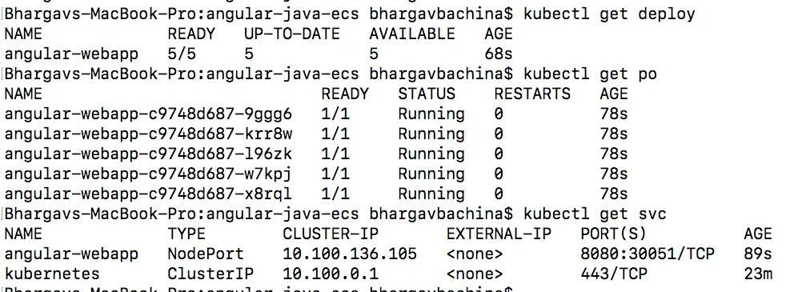
Deploy Kubernetes Objects On AWS EKS Cluster
use these following commands to verify all the objects are in the desired state.
// list the deployment kubectl get deploy
// list the pods kubectl get po// list the service kubectl get svc
all objects are deployed

Slide 22
Summary
Amazon EKS is a managed service that makes it easy for you to run Kubernetes on AWS.
Amazon Elastic Container Registry (ECR) is a fully-managed Docker container registry that makes it easy for developers to store, manage, and deploy Docker container images.
Amazon ECR is integrated with Amazon Elastic Container Service (ECS), simplifying your development to production workflow.
Amazon ECS works with any Docker registry such as Docker Hub, etc.
You have to follow these steps to run apps on the Kubernetes cluster: we need to create an AWS EKS cluster with AWS console, SDK, or AWS CLI. Create a worker node group that registers with EKS Cluster, when your cluster is ready, you can configure kubectl to communicate with your cluster, Deploy and manage your applications on the cluster

Slide 23
THANK YOU

