Slide 1
IMMUTABLE OBJECTS
01

Slide 2
IMMUTABLE OBJECTS
In object-oriented programming and functional programming, an immutable object (unchangeable object) is an object whose state cannot be modified after it is created.
This contrasts with a mutable object(changeable object), which can be modified after it is created.

Slide 3
EXAMPLES OF IMMUTABLE OBJECTS
String : Once a string object is created, it’s value cannot be changed.
Tuple : A tuple is a collection of objects that cannot be modified after creation.
Primitive objects such as int, long, float, double all legacy classes, wrapper class, String class etc.

Slide 4
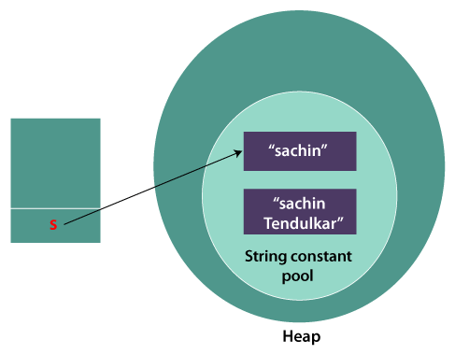
String
String s = “Hello”;
s.concat(”world”);
System.out.println(s);
Output : Hello
-----------------------------------------------------------------------
String s = “Hello”;
String s1=s.concat(”world”);
System.out.println(s1);
Output : Helloworld
Hello
Helloworld

Slide 5
WHY IMMUTABLE OBJECTS
02

Slide 6
BENEFITS OF IMMUTABLE OBJECTS
Thread safety : Immutable objects can be safely shared between multiple threads without fear of race conditions or synchronization issues.
Hashability : Immutable objects can be used as keys in hash tables because their hash value remains constant throughout their lifetime.
Simplified code : Immutable objects eliminate the need to write defensive or protective code to ensure that objects are not modified after creation.
Security : Immutable objects cannot be modified, so they are less vulnerable to security attacks that try to modify objects in unexpected ways.

Slide 7
IMPLEMENTING IMMUTABLE OBJECTS
To create an immutable object, the object’s state must be initialized in the constructor and all fields must be marked as final.
Any methods that change the state of objects should return a new object instead of modifying the existing one.

Slide 8
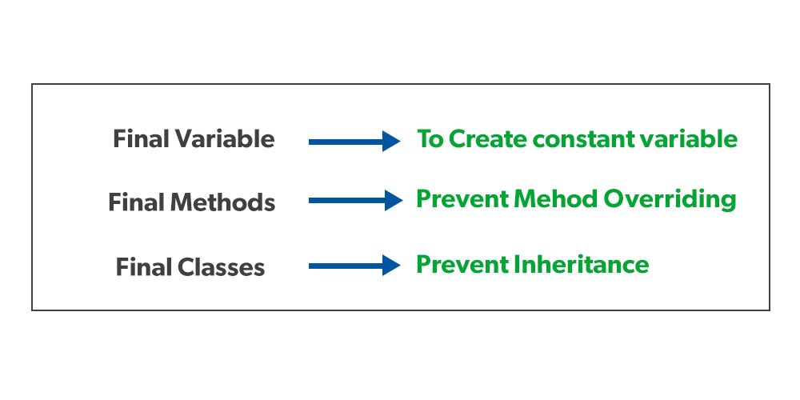
THE FINAL KEYWORD
variables are mutable by default, meaning we can change the value they hold.
By using the final keyword when declaring a variable, the Java compiler won't let us change the value of that variable. Instead, it will report a compile-time error:
final keyword is used in different contexts.

Slide 9
IMMUTABLE CLASS
The following things are essential for creating an immutable class:
Final class, which is declared as final so that it can't be extended.
All fields should be private so that direct access to the fields is blocked.
No Setters
All mutable fields should be as final so that they can not be altered once initialized.

Slide 10
IMMUTABLE CLASS EXAMPLE
public final class Person {
private final String name; private final int age; public Person(String name, int age) { this.name = name; this.age = age; } public String getName() { return name; } public int getAge() { return age; } }
Person person = new Person("Alice", 30);
System.out.println(person.getName()); //Output: Alice System.out.println(person.getAge()); // Output: 30

Slide 11
CONCLUSION
Immutable objects are useful in programming because they simplify code, provide thread safety and allow objects to be used in hash tables.
By making fields as final and creating methods that return new objects instead of modifying existing ones, developers can create their own immutable objects.

