Slide 1
STRINGS IN JAVA
Presented by:
Meera Javad
Team:Metatitans

Slide 2
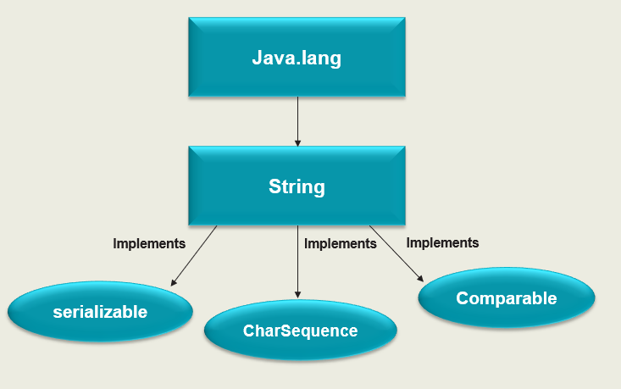
STRINGS
In Java, string is basically an object that represents sequence of char values.
Example: String message =“Hello World!”;
System.out.println(message);

Slide 3
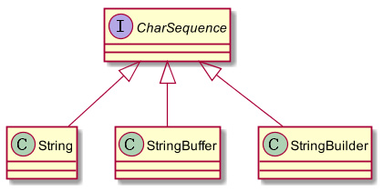
The java.lang.String class is used to create a string object.
There are two ways to create a string object:
String literal: String s=“computer";
New Keyword: String s=new String("Welcome");

Slide 4
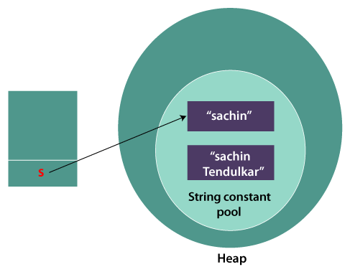
Immutable String in Java
In Java, String objects are immutable.
String s="Sachin";
s.concat(“Tendulkar”);
String s="Sachin";
s=s.concat(" Tendulkar");

Slide 5
Why String objects are immutable in Java?
1.CLASSLOADER
2.THREADSAFE
3.HEAPSPACE

Slide 6
STRING OPERATIONS IN JAVA
Some of the Java string operations are:
compareTo()
concat()
equals()
length()
replace()
substring()
charAt()
contains()

Slide 7
1.compareTo()
If s1 > s2
If s1 < s2,
If s1 == s2
It returns positive number
It returns negative number
It returns 0
Syntax:
public int compareTo(String anotherString)
2.charAt()
The Java String class charAt() method returns a char value at the given index number.
The index number starts from 0 and goes to n-1, where n is the length of the string
Syntax:
public char charAt(int index)

Slide 8
3.concat()
The Java String class concat() method combines specified string at the end of this string.
Syntax:
public String concat(String anotherString)
Example: String s = "Hello ";
s = s.concat("World");
Output: Hello world
4.equals()
The Java String class equals() method compares the two given strings based on the content of the string.
Syntax:
publicboolean equals(Object anotherObject)
Example: String s1="javatpoint“ ;
String s4="python";
System.out.println(s1.equals(s4));//false

Slide 9
5.contains() The Java String class contains() method searches the sequence of characters in this string. Syntax: public boolean contains(CharSequence sequence) Example: String name="what do you know about me"; System.out.println(name.contains("do you know")) 6.length() The Java String class length() method finds the length of a string. Syntax: public int length() Example: String s1="javatpoint"; System.out.println("string length is: "+s1.length()); .

Slide 10
7.replace()
The Java String class replace() method returns a string replacing all the old char or CharSequence to new char or CharSequence.
Syntax:
public String replace(char oldChar, char newChar)
Example: String s1=“computer”
String replaceString=s1.replace(‘u',’e’)
System.out.println(replaceString); //”competer”
8.substring()
The Java String class substring() method returns a part of the string.
Syntax:
public String substring(int startIndex, int endIndex)
Example: String s1=“playstation";
String substr2 = s1.substring(4,11)
System.out.println(substr2); station //

