Slide 1
Uncovering the gaming industry hidden gams.A comprehensive Analysis of video game sales
V.Swetha
G.Sneka
V.Sujatha
C.sumithra

Slide 2
INTRODUCTION
Video gmes are popular all over the world.they are enjoyed by all ages.video gme industry is huge and the spending on video game per year is huge too.sales of different types of games vary widely between countries due to local preferences.

Slide 3
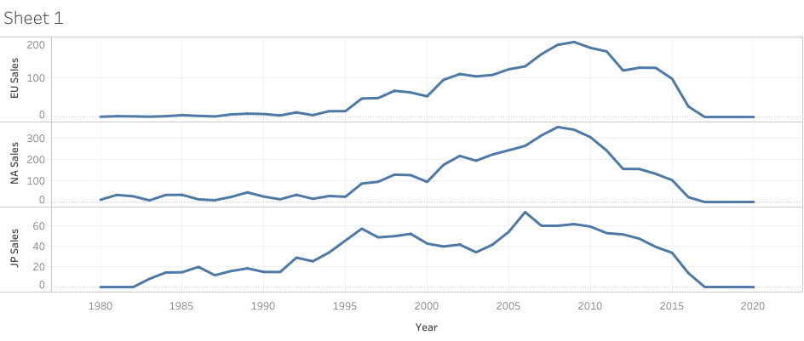

Slide 4
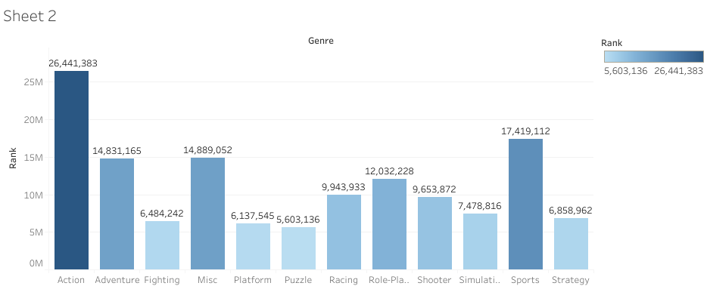

Slide 5
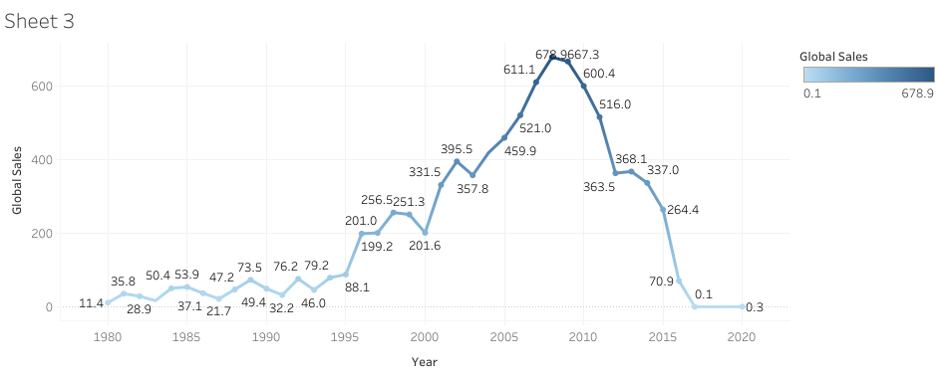

Slide 6


Slide 7
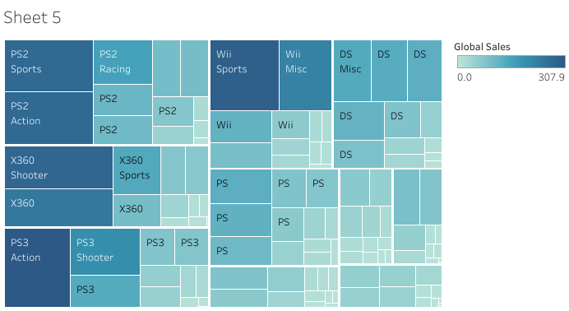

Slide 8
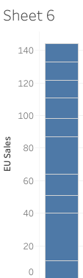

Slide 9
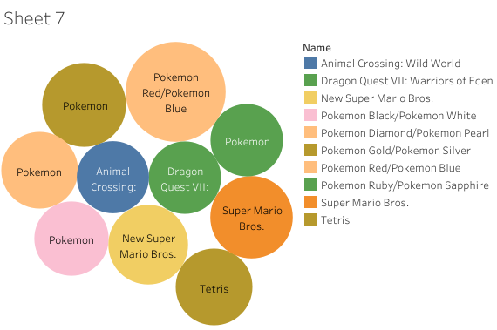

Slide 10
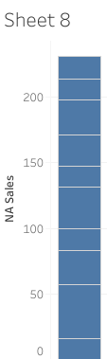

Slide 11
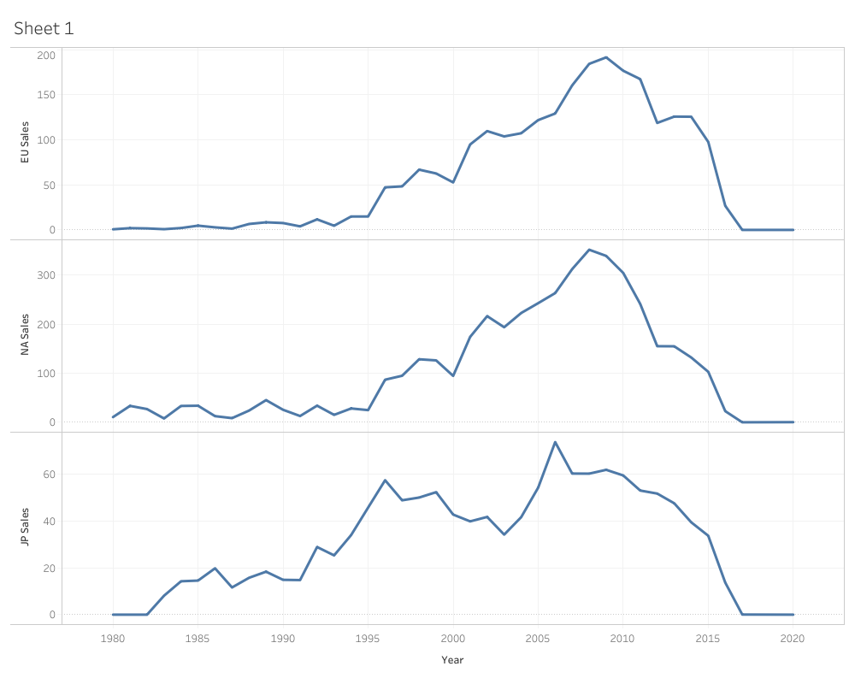

Slide 12
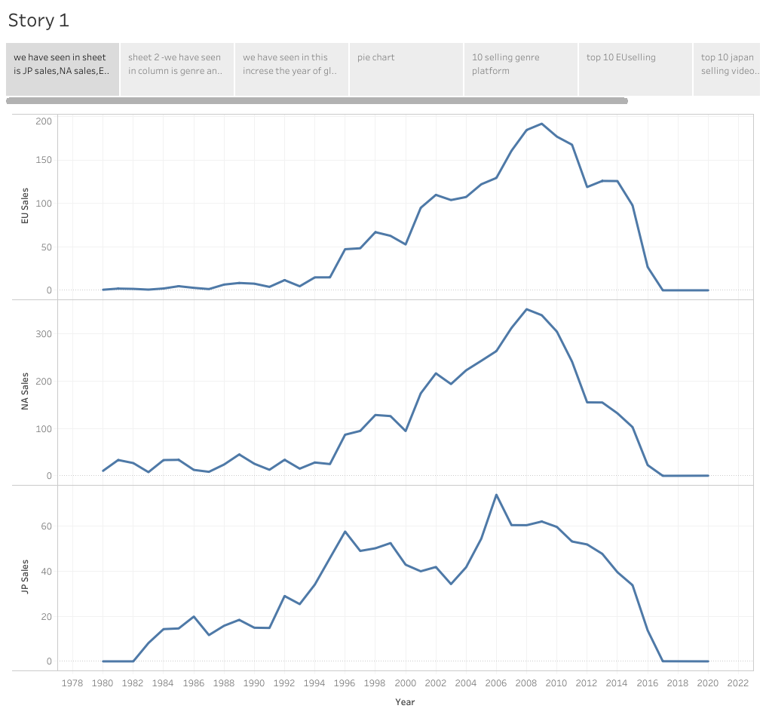

Slide 13
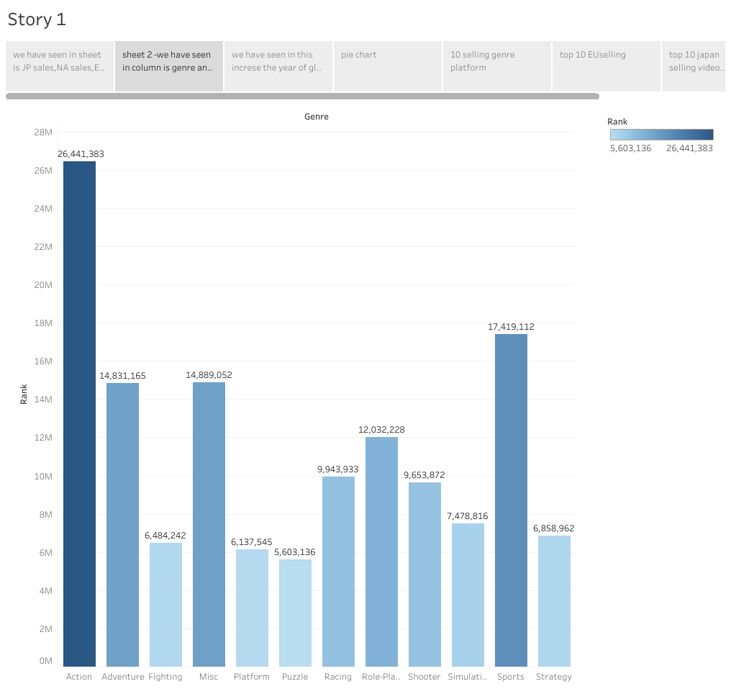

Slide 14
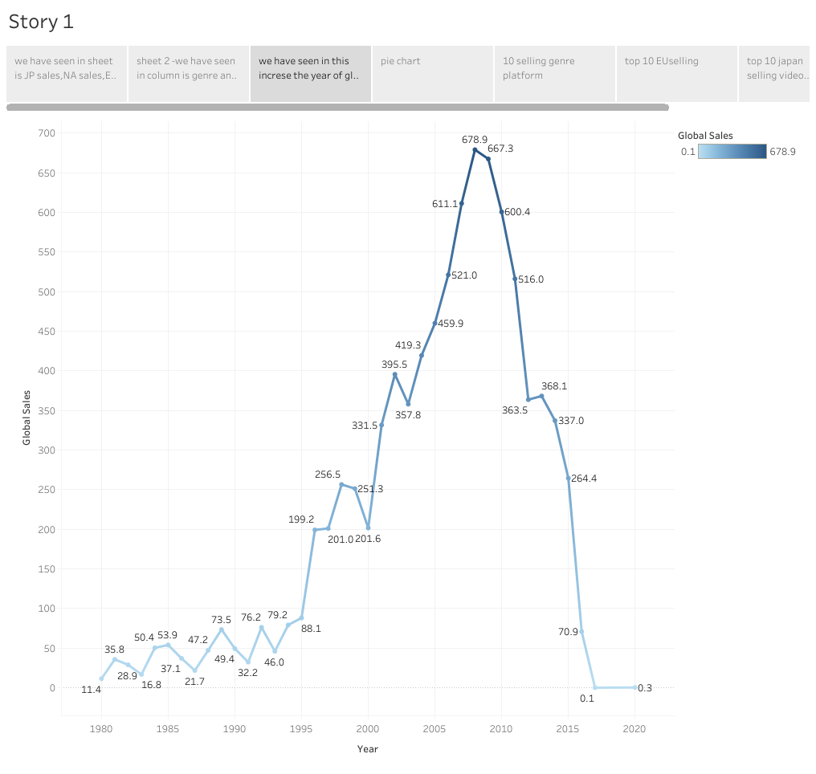

Slide 15


Slide 16
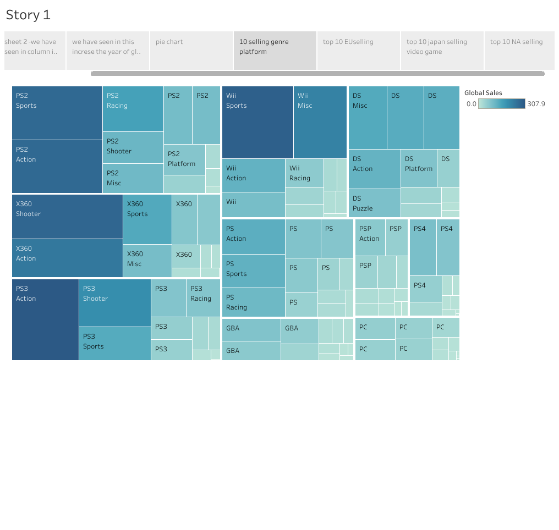

Slide 17
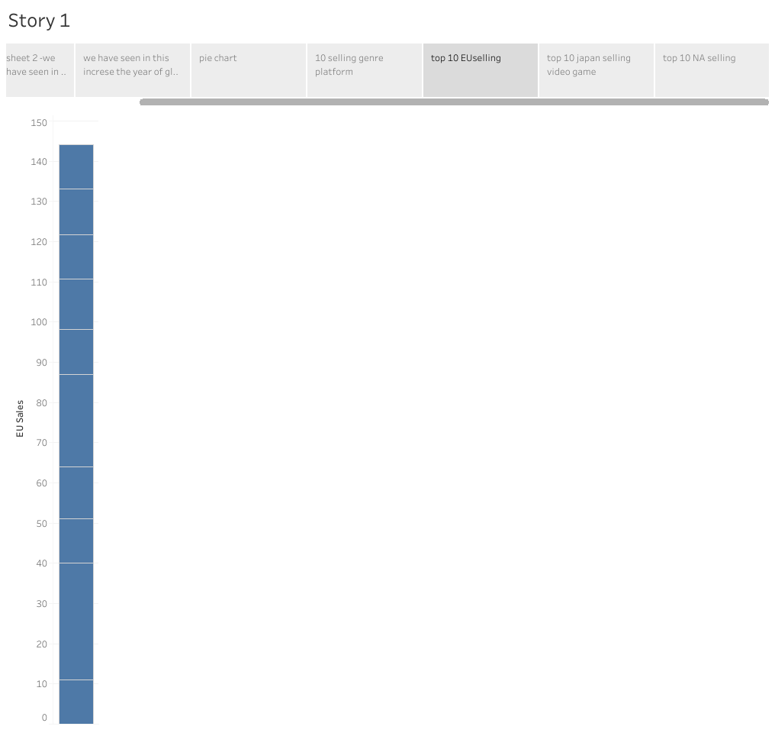

Slide 18
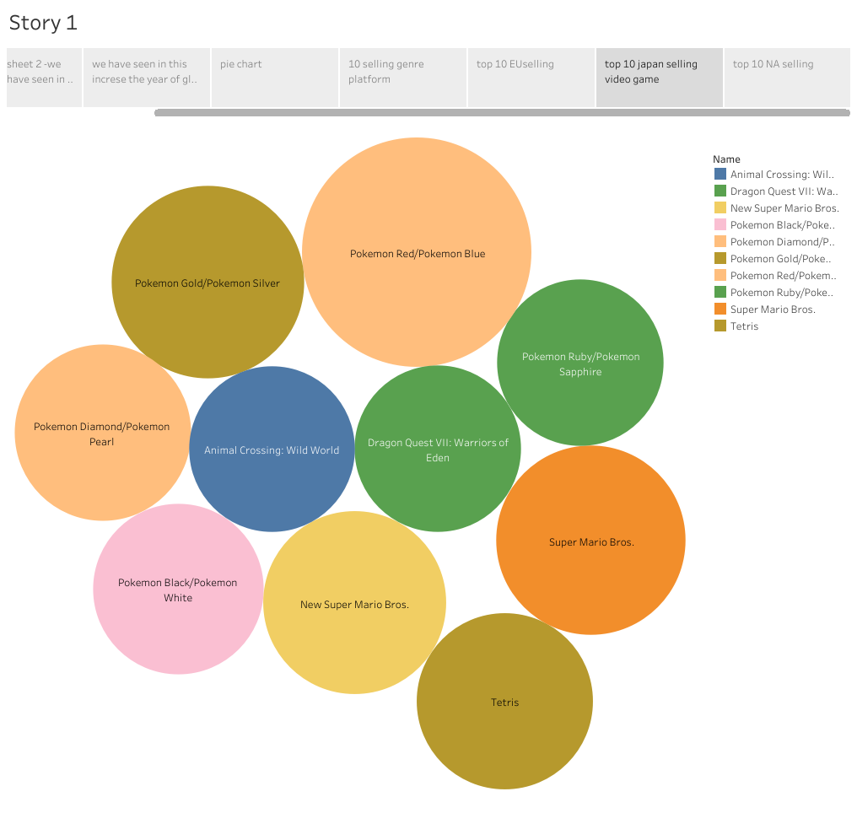

Slide 19


