Slide 1
To connect from terminal or GitBash
ssh -i UbuntuKey.pem ubuntu@ec2-35-154-239-143.ap-south-1.compute.amazonaws.com
$whoami: to verify who is the user
apt-get install openjdk-8-jdk

Slide 2
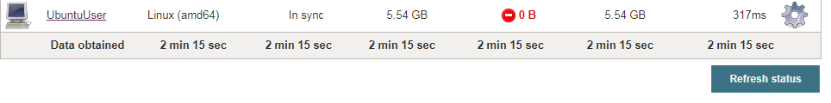
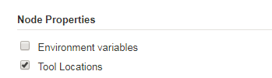
To know the location of git
$which git
/usr/bin/git
Go to Configure of the node

Slide 3
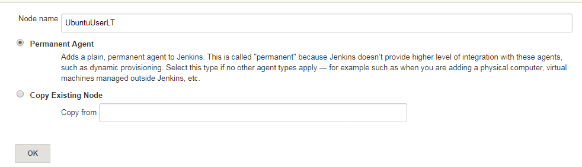
Go to Manage Nodes in Manage Jenkins
Click on New Node

Slide 4
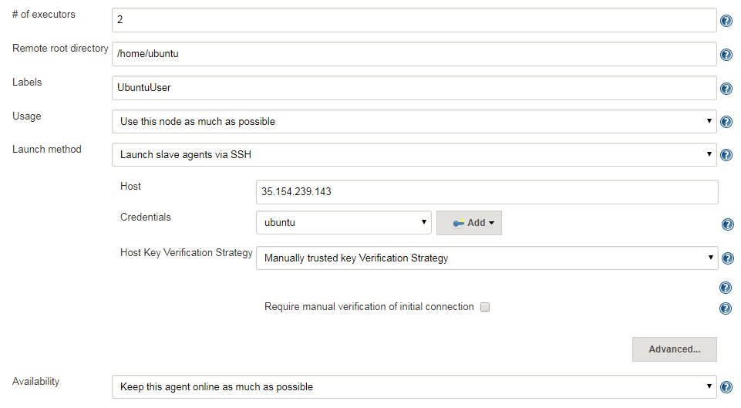

Slide 5
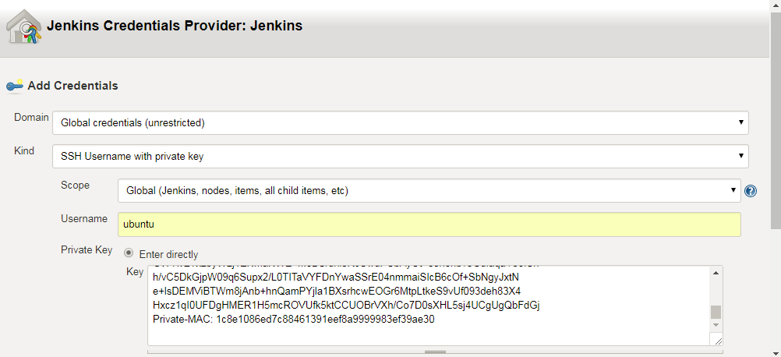

Slide 6
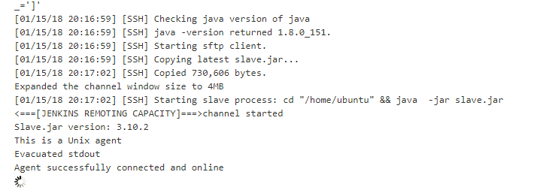
Launch the Agent

Slide 7
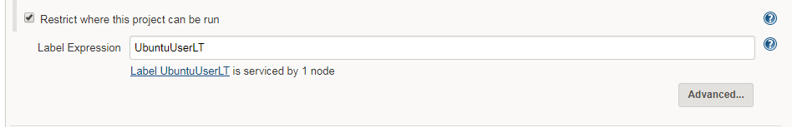
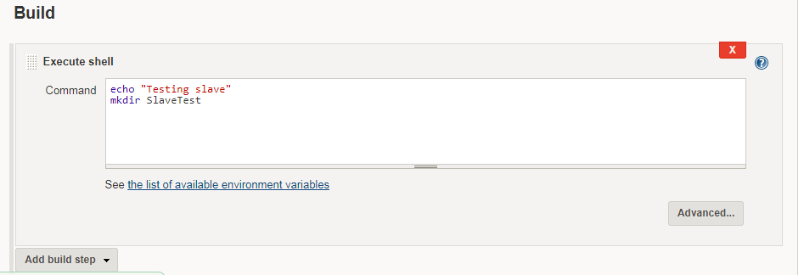
Create a new empty Job and enable Restrict where this project can be run
Then specify the slave lable

Slide 8
And go to Node Properties

Slide 9
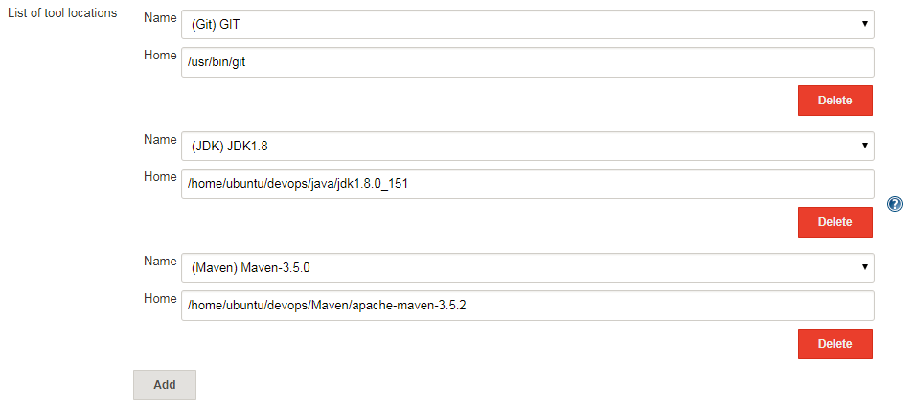
Specify Git , JDK and Maven locations

Slide 10
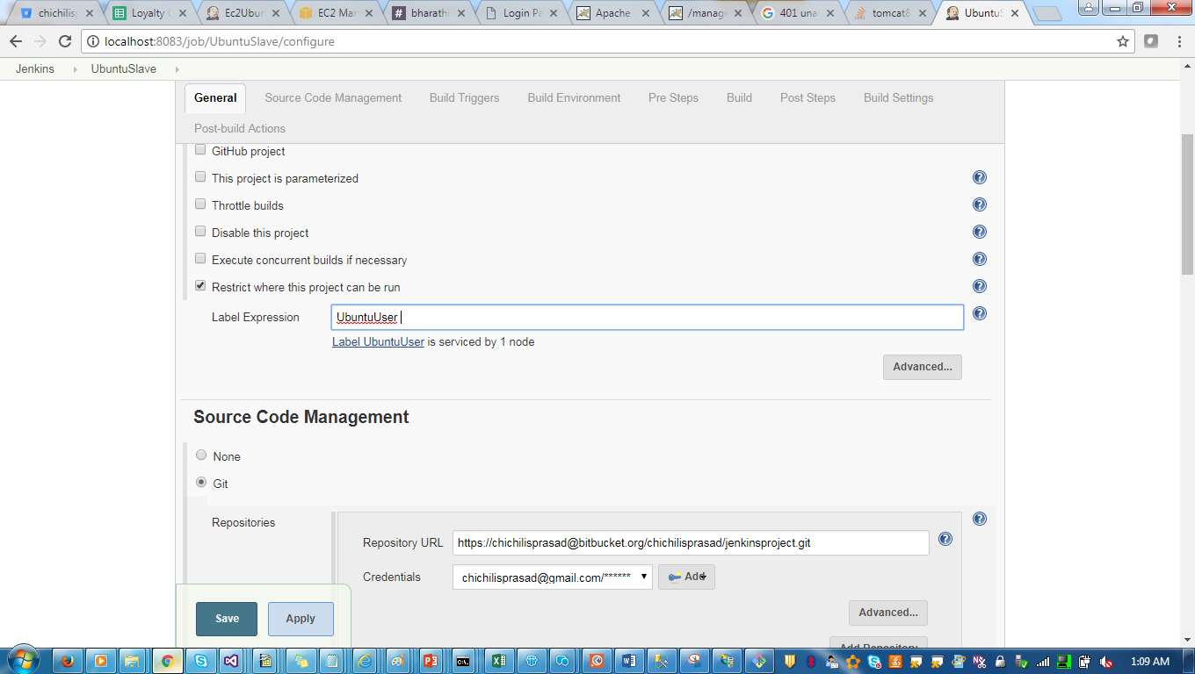
Create a job and enable Restrict where the project can be run.

Slide 11
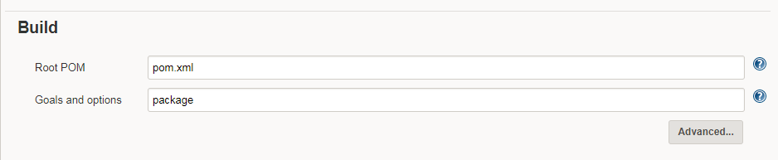

Slide 12
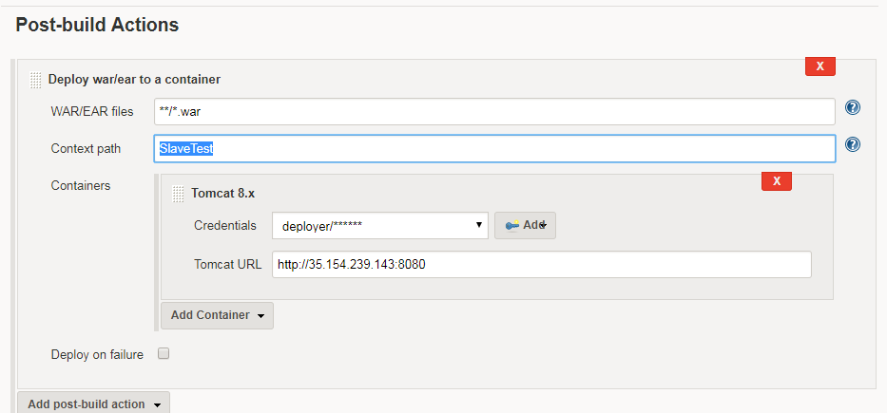
Deploy to tomcat by specifying tomcatURL with slave Ipaddress and tomcat port

Slide 13
Update user in tomcat-user.xml
<user username="deployer" password="deployer" roles="manager-script" />
Shutdown the service and start the service.
Then run the job.

