Slide 1
Deep learning assignment -3
Swetha g
ENG19CS0329
'F' section
DAYANANDA SAGAR UNIVERSITY

Slide 2
Deep neural networks
There are no large programming differences between deep learning and machine learning .
Steps : python library is KERAS
Decide the model if its functional API or sequential API.
Add hidden layers( dense layers )
Compile and remove the errors if any.
Train the model by fit method.
Evaluate the model by predict method.
Deploy model if its accurate to solve our problems.

Slide 3
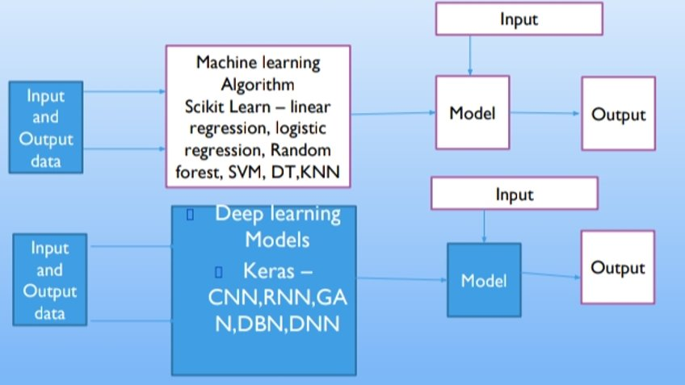

Slide 4
CNN, RNN, GANS
CNN - convolutional neural networks - it is most promising area in computer vision , image recognition , image classification
RNN - recurrent neural networks - they are widely used for prediction and are sequential in nature.
GANS – generative advisory neural network – artificially manufacture output that could easily mistaken for real data

Slide 5
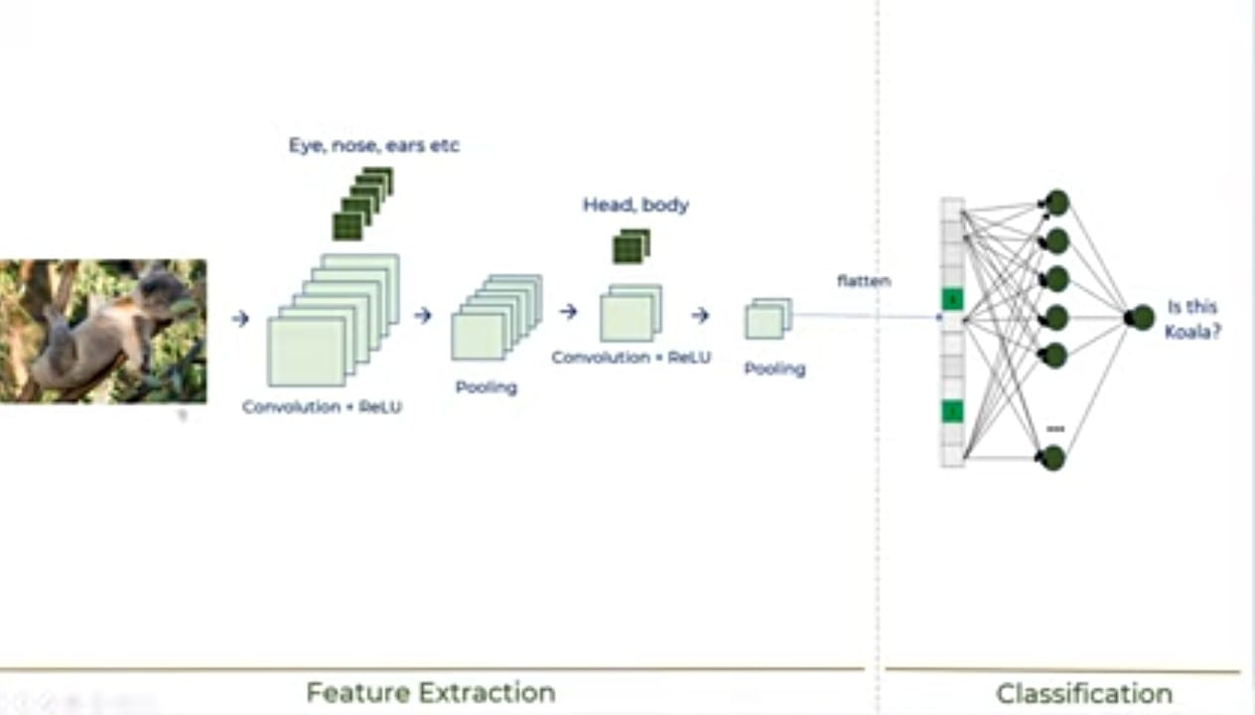
CNN in detail

Slide 6
CRPF layers
C - convolution : it acts like filter/kernel to extract the features of the image.
R - ReLu : it is performed to introduce non-linearity in the model.
P - Pooling : dimensionality reduction or compress features by max or average pooling
F - flattening : obtained feature map is flattened into one dimensional array

Slide 7
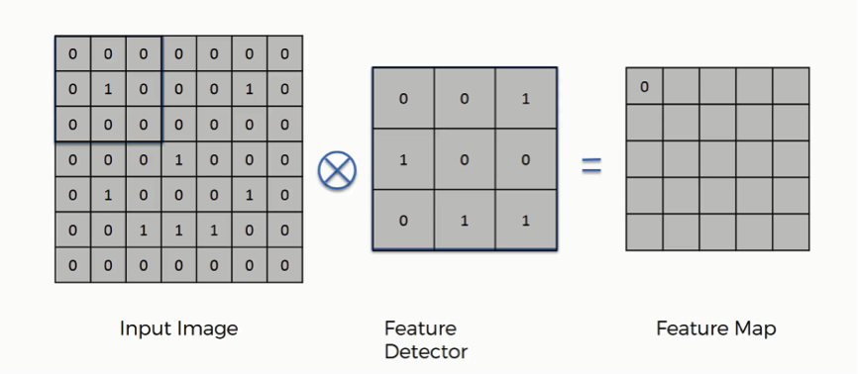
convolution

Slide 8
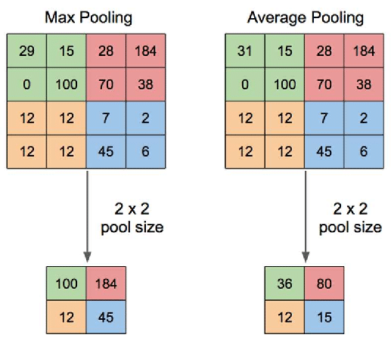
Pooling

Slide 9
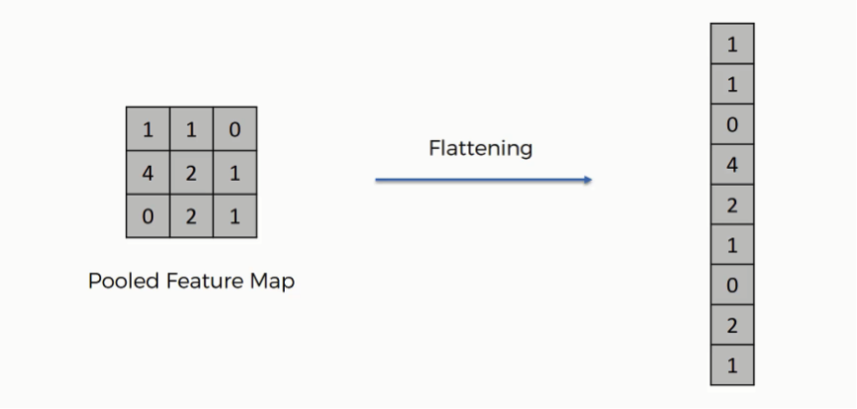
Flattening

Slide 10
Implementing Cnn for hand written digits (mnist) dataset
BASIC steps :
Importing all the libraries.
Loading and transforming the data from MNIST.
Perform normalization.
Build the model.
Define optimizer.
Train model using fit method.
Pass test data to Predict method and check the accuracy.

Slide 11
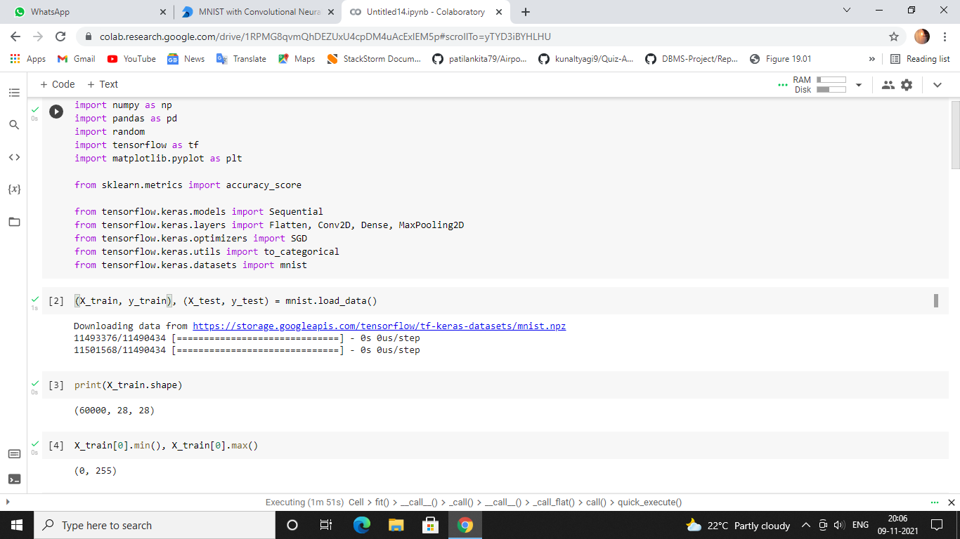

Slide 12
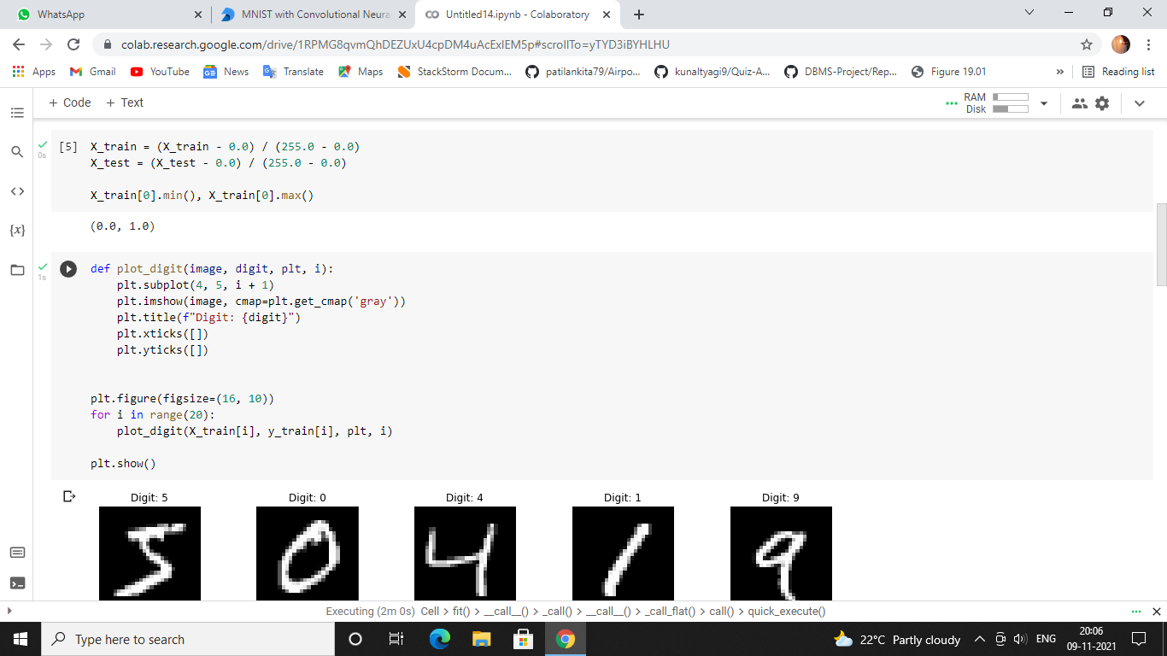

Slide 13
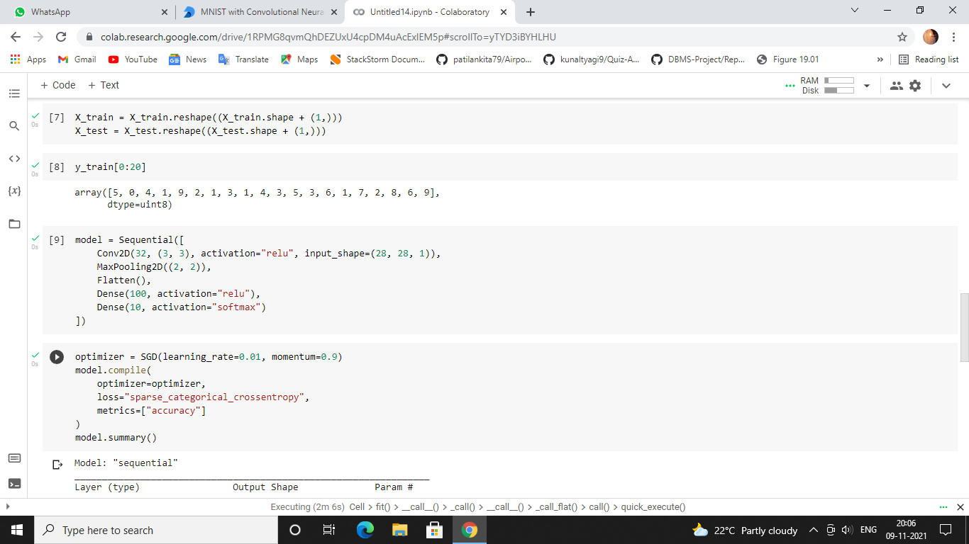

Slide 14
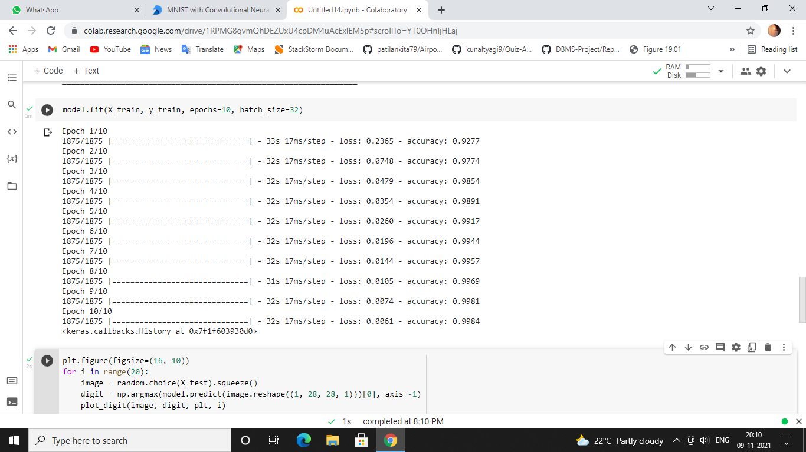

Slide 15
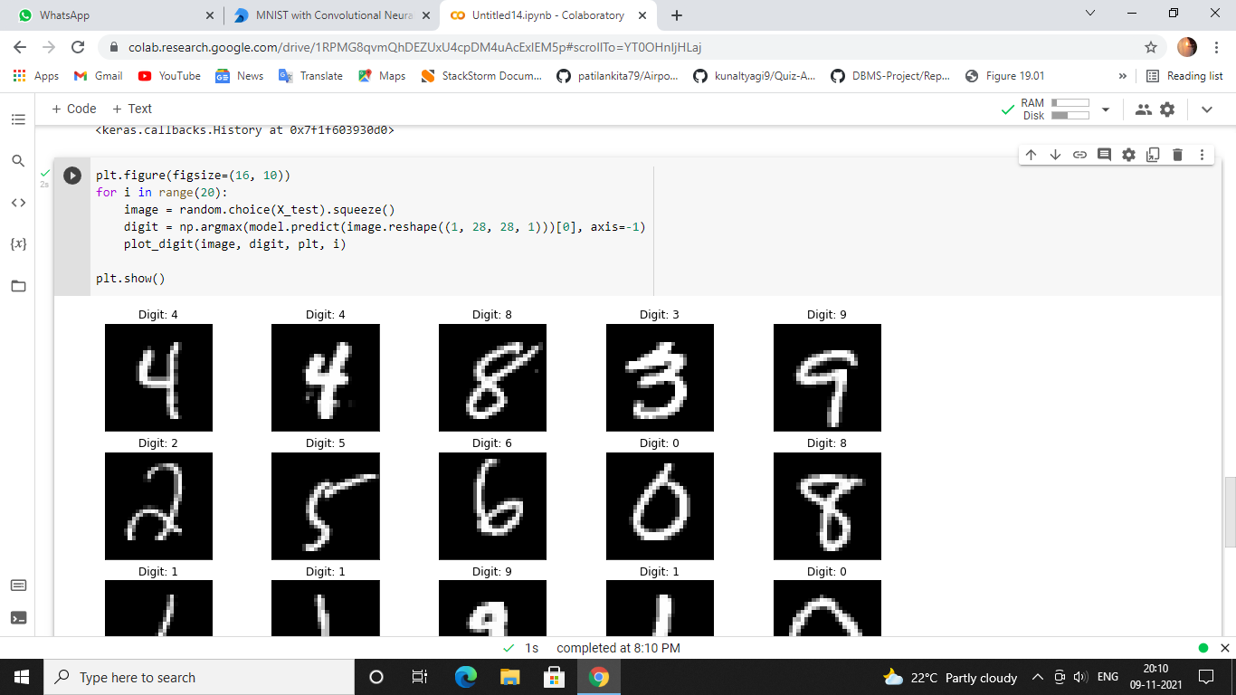

Slide 16
