Slide 1
Using Technical Standards to Support Design
EIN 4245/6905 – Spring 2024
Dr. Wayne Giang
Lecture 37
April 10, 2024

Slide 2
Topics
Technical standards in Human Factors
Robotics related safety standards
Background
Existing standards
Key questions/topics
Notes:
Standards:
OSHA https://www.osha.gov/SLTC/robotics/standards.html
https://www.osha.gov/dts/osta/otm/otm_iv/otm_iv_4.html Word list

Slide 3
Technical Standards
“A technical standard is an established norm or requirement for a repeatable technical task which is applied to a common and repeated use of rules, conditions, guidelines or characteristics for products or related processes and production methods, and related management systems practices.
A technical standard includes definition of terms; classification of components; delineation of procedures; specification of dimensions, materials, performance, designs, or operations; measurement of quality and quantity in describing materials, processes, products, systems, services, or practices; test methods and sampling procedures; or descriptions of fit and measurements of size or strength”
https://en.wikipedia.org/wiki/Technical_standard

Slide 4
Standards Organizations
National:
American National Standards Institute (ANSI)
Advancement of Medical Instrumentation (AAMI)
Human Factors and Ergonomics Society (HFES)
Occupational Safety and Health Administration (OHSA)
National Highway Traffic Safety Administration (NHTSA)
International:
International Organization for Standardization (ISO)
International Electrotechnical Commission (IEC)
International Telecommunication Union (ITU)
Society of Automotive Engineers (SAE)
UL

Slide 5
Examples of Technical Standards in Medical Devices
IEC 62366-1:2015, Medical Devices Part 1: Application of Usability Engineering to Medical Devices
IEC TR 62366-2:2016, Medical Devices Part 2: Applications of Usability Engineering to Medical Devices
IEC 60601-1-6:2010+AMD1:2013 CSV, Medical electrical equipment – Part 1-6: General requirements for basic safety and essential performance – Collateral standard: Usability
ISO 14971:2007, Medical devices – Application of risk management to medical devices
ANSI/AAMI HE75:2009/(R)2018, Human factors engineering – Design of medical devices
AAMI TIR59:2017, Integrating human factors into design controls
AAMI TIR51:2014/(R)2017, Human factors engineering – Guidance for contextual inquiry
AAMI TIR 50:2014/(R)2017, Post-market surveillance of use error management
AAMI TIR49:2013, Design of training and instructional materials for medical devices used in non-clinical environments
Story (2019) Medical Device Human Factors Standards: Finding Them and What They Contain
https://journals.sagepub.com/doi/pdf/10.1177/1071181319631375

Slide 6
Examples of Technical Standards in Surface Transportation
Metrics and Performance:
J2364 – Navigation system usability
J3665 – Task time calculation
J2396 – Eye fixation terms
J2678 – Navigation system access rationale
J2944 – Driving performance definitions
J3151 – Relating distraction to crashes
Automation and ADAS:
J3114 – Automated driving definitions
J2399 – ACC user interface
J2400 – FCW user interface
J2802 – Blind post user interface
J2808 – LDW user interface
J3048 – LKA user interface
Green (2019) SAE Automotive Human Factors Standards: Finding Them and What They Contain
https://journals.sagepub.com/doi/pdf/10.1177/1071181319631373

Slide 7
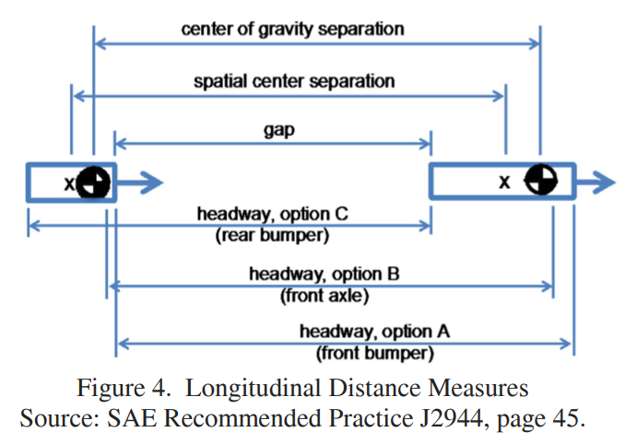
How do we use standards? SAE J2944 Example
SAE J2944 (Driving performance definitions)
Can be used to provide explanations of driving performance metrics that are used and how they are calculated
Lets you reference a set of metrics that are used by many researchers
Example: You are studying road departures. What does roadway mean (paved surface or paved surface + shoulders or entire right of way)? You can cite the specific type of definition used in J2944.
Example (right): Longitudinal distance measures
Green (2019) SAE Automotive Human Factors Standards: Finding Them and What They Contain
https://journals.sagepub.com/doi/pdf/10.1177/1071181319631373

Slide 8
HFES Technical Standards
https://www.hfes.org/publications/technical-standards

Slide 9
Technical Standards in Human-Robot Interaction

Slide 10
Definitions: Robot
https://www.merriam-webster.com/dictionary/robot: a mechanism guided by automatic controls, often repetitive tasks
ISO 8373:2021 (Robots— Vocabulary): actuated mechanism programmable in two or more axes with a degree of autonomy, moving within its environment, to perform intended tasks

Slide 11
Definitions: Industrial Robot
ANSI/RIA (American National Standards Institute) R15.06-2012 (ISO 10218-1:2011): automatically controlled, reprogrammable multipurpose manipulator, programmable in three or more axes, which can be either fixed in place or mobile for use in industrial automation applications
UL 1740 (Standard for Robots and Robotic Equipment): automatically controlled, reprogrammable multipurpose machine, programmable in several degrees of freedom, which can be either fixed in place or mobile
Notes:
Check the roadmap paper and find the numbers

Slide 12
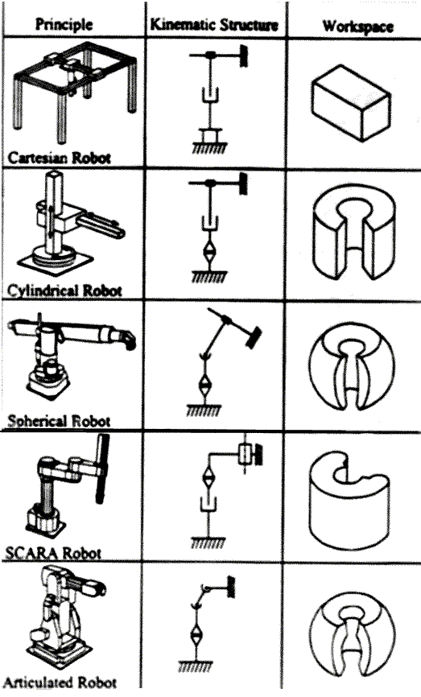
Common Types of Industrial Robots
Cartesian (Gantry)
Cylindrical
Polar/Spherical
SCARA
Articulated
http://www.robot-welding.com/robots.htm

Slide 13
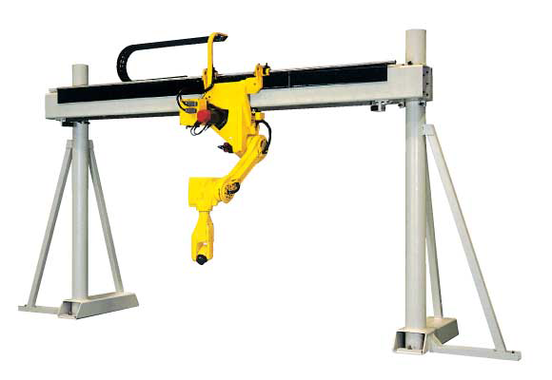
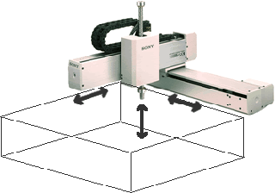
Common Types of Industrial Robots
Cartesian (Gantry)
Cylindrical
Polar/Spherical
SCARA
Articulated
https://www.linearmotiontips.com/what-is-a-cartesian-robot/
Notes:
Cartesian robots, which are also called linear robots or gantry robots, are industrial robots that work on three linear axes that use the Cartesian Coordinate system (X, Y, and Z), meaning they move in straight lines on 3-axis (up and down, in and out, and side to side). Cartesian robots are a popular choice due to being highly flexible in their configurations, giving users the ability to adjust the robot’s speed, precision, stroke length, and size. Cartesian Robots are one of the most commonly used robot types for industrial applications and are often used for CNC machines and 3D printing.

Slide 14
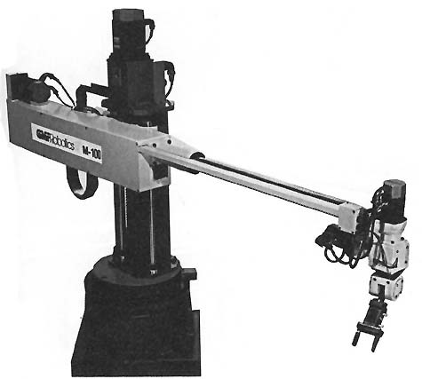
Common Types of Industrial Robots
Cartesian (Gantry)
Cylindrical
Polar/Spherical
SCARA
Articulated
https://www.industrial-electronics.com/industrial-electricity-com/4_Cylindrical_Robots.html
Notes:
Cylindrical Robots have a rotary joint at the base and a prismatic joint to connect the links. The robots have a cylindrical-shaped work envelop, which is achieved with rotating shaft and an extendable arm that moves in a vertical and sliding motion. Cylindrical Robots are often used in tight workspaces for simple assembly, machine tending, or coating applications due to their compact design.

Slide 15
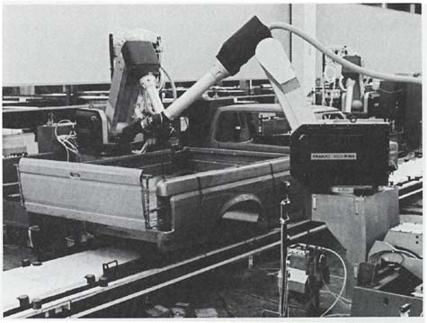
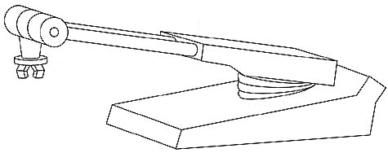
Common Types of Industrial Robots
Cartesian (Gantry)
Cylindrical
Polar/Spherical
SCARA
Articulated
https://www.industrial-electronics.com/industrial-electricity-com/6_Spherical_Robots.html
Notes:
Polar Robots, or spherical robots, have an arm with two rotary joints and one linear joint connected to a base with a twisting joint. The axes of the robot work together to form a polar coordinate, which allows the robot to have a spherical work envelope. Polar Robots are credited as one of the first types of industrial robots to ever be developed. Polar robots are commonly used for die casting, injection molding, welding, and material handling.

Slide 16
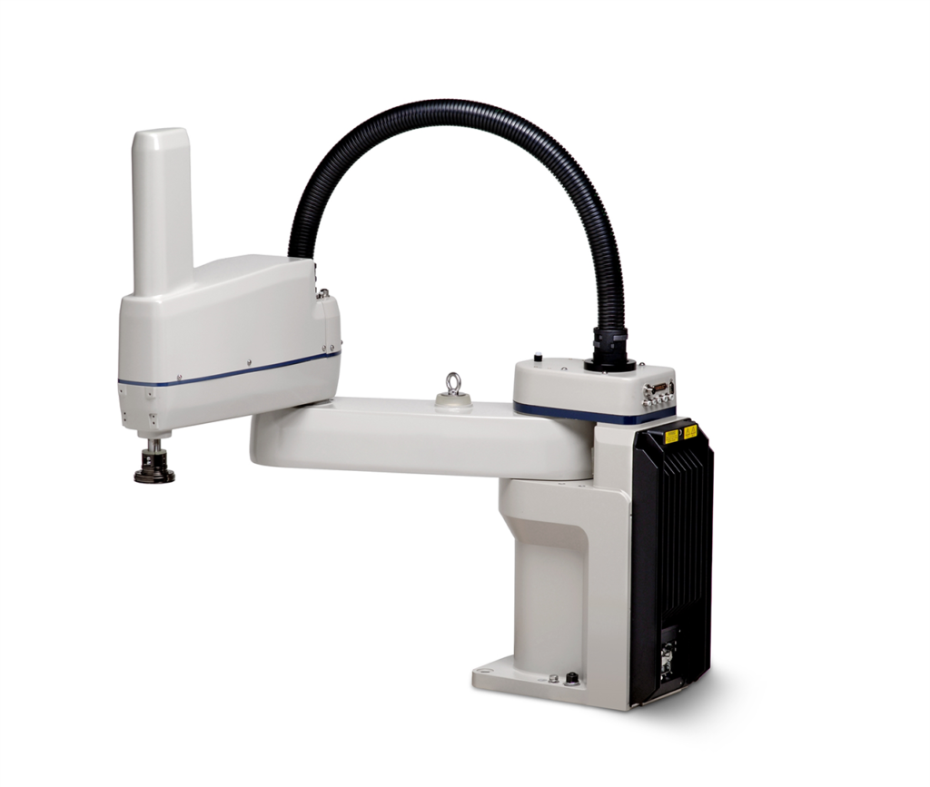
Common Types of Industrial Robots
Cartesian (Gantry)
Cylindrical
Polar/Spherical
SCARA (Selective Compliance Assembly Robot)
Articulated
https://processsolutions.com/what-are-the-different-types-of-industrial-robots-and-their-applications/
Notes:
SCARA robots offer a more complete solution than the Cartesian or Cylindrical. They are all-in-one robots, meaning a SCARA robot is equipped with x, y, z and rotary motion in one package that comes ready-to-go, apart from the end-of-arm tooling. The work envelope is similar to Cylindrical robots but it has more degrees of motion in a radius or arch-shaped space. Applications are also similar to Cylindrical and Cartesian robots, but SCARA robots can move quicker than the other two. They are seen often in biomed applications due to their small work area. Because SCARAs have the easiest integration they seem like the best solution for the majority of applications, but Cartesians are more common because of their level of customization.

Slide 17
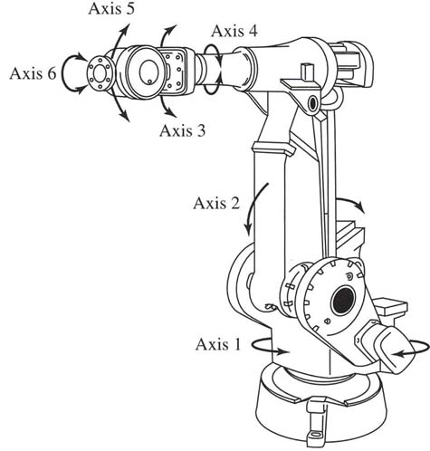
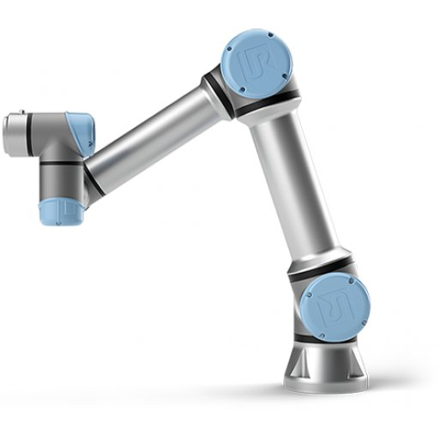
Common Types of Industrial Robots
Cartesian (Gantry)
Cylindrical
Polar/Spherical
SCARA
Articulated
https://www.industrial-electronics.com/industrial-electricity-com/7_Jointed_Spherical.html
Notes:
Articulated Robots mechanical movement and configuration closely resembles a human arm. The arm is mounted to a base with a twisting joint. The arm itself can feature anywhere from two rotary joints up to ten rotary joints which act as axes, with each additional joint or axis allowing for a greater degree of motion. Most Articulated Robots utilize four or six-axis. Typical applications for Articulated Robots are assembly, arc welding, material handling, machine tending, and packaging.

Slide 18
Robot Control
Point-to-point Control
Continuous-path/Continuous Trajectory Control
Force/Torque Control
Intelligent Control
Notes:
1. Point To Point control (PTP)
This control method only controls the position and posture of the end effector of industrial robot at some specified discrete points in the working space. In control, only industrial robots are required to move quickly and accurately between adjacent points, and there is no requirement for the trajectory of the robot to reach the target point. Position accuracy and speed required for motion are two main technical indicators of this control method. This control method has the characteristics of easy realization and low positioning accuracy requirement. Therefore, it is often used in pick and place, handling, spot welding and inserting components on circuit boards, which require only accurate position and posture of the end effector at the target point. This method is relatively simple, but it is very difficult to achieve the positioning accuracy of 2-3um.
2. Continuous Trajectory Control (CP)
This control method is to continuously control the position and posture of the end-effector of industrial robot in the working space. It is required to move in a certain range of accuracy in strict accordance with the predetermined trajectory and speed. Moreover, the speed is controllable, the trajectory is smooth and the motion is smooth to complete the task. The joint of industrial robot moves continuously and synchronously, and its end effector can form a continuous trajectory. The main technical index of this control method is the trajectory tracking accuracy and stability of the end effector position of industrial robots. This control method is usually used in arc welding, spray painting, edge removal and inspection robots.
3. Force (Torque) Control Mode
When assembling and place the workpieces, etc. In addition to the need for accurate positioning, It also requires that the force used be appropriate. In this case, the Force control(servo) mode must be used. The principle of this control mode is basically the same as that of position servo control, But feedback are not position signals. It's a force signal. So the torque sensor must be used in the system. Sometimes adaptive control is also implemented by using the sensing functions such as proximity and sliding.
4. Intelligent Control Mode
Intelligent control of robots is to acquire knowledge of the surrounding environment through sensors. And make corresponding decisions according to their own internal knowledge base
Using intelligent control technology, the robot has strong environmental adaptability and self-learning ability. The development of intelligent control technology depends on the rapid development of artificial intelligence such as artificial neural network, genetic algorithm, genetic algorithm and expert system in recent years. Maybe this control mode will make industrial robots really have the feeling of artificial intelligence. It is also the most difficult to control well. Besides the algorithm, it also depends heavily on the accuracy of components.

Slide 19
Existing Standards - OSHA
No specific OSHA standards for the robotics industry. We list OSHA standards and documents related to robotics.
General Industry (29 CFR 1910)
Subpart J – General Environmental Controls
1910.147, The control of hazardous energy (lockout/tagout)
Subpart O – Machinery and Machine Guarding
1910.211, Definitions
1910.212, General requirements for all machines. States that any machines that creates a hazard must be safeguarded in order to protect the operator and other employees.
Notes:
Robotic Industries Association

Slide 20
Existing Standards - OSHA
Depending on the material being processed, these standards are also applicable （Still Subpart ):
1910.213, Woodworking machinery requirements
1910.215, Abrasive wheel machinery
1910.216, Mills and calenders in the rubber and plastics industries
1910.217, Mechanical power presses
Subpart S – Electrical
1910.333, Selection and use of work practices
Notes:
Robotic Industries Association

Slide 21
Existing Standards – R15.06
American National Standards Institute (ANSI)
R15.06, Industrial Robots and Robot Systems - Safety Requirements. Provides safety requirements for industrial robot manufacture, remanufacture, and rebuild (Part 1); and robot system integration/installation (Part 2). R15.06 (ANSI/RIA R15.06-2012) is the U.S. National Adoption of the ISO 10218-1,2:2011.
RIA TR R15.306-2016 ("TR 306"), Task-Based Risk Assessment Methodology. Describes one method of risk assessment that would comply with the R15.06 requirements.
Notes:
Robotic Industries Association

Slide 22
Existing Standards – R15.06
RIA TR R15.406-2014 ("TR 406"), Safeguarding. Explains how to design a system of safeguards to protect human workers in an industrial environment that also contains robot system(s). TR 406 contains greater detail than the 2012 R15.06 standard.
RIA TR R15.506-2014 ("TR 506"), Applicability of R15.06-2012 for Existing Industrial Robot Applications. The R15.06 standard is forward-looking; that is, its primary topic is the installation of an all-new robot system. TR 506 explains how to take the 2012 R15.06 standard into account for existing robot systems.
Notes:
Robotic Industries Association

Slide 23
Existing Standards – R15.06
RIA TR R15.606-2016 ("TR 606"), Collaborative Robot Safety. Explains safety requirements specific to collaborative robots and robot systems and is supplemental to the guidance in ANSI/RIA R15.06. TR 606 is the U.S. National Adoption of the ISO/TS 15066:2016.
RIA TR R15.806-2018 ("TR 806"), Testing Methods for Power & Force Limited Collaborative Applications. Describes methods to test and verify that the forces exerted by a collaborative robot system remain within the allowable limits described in TR 606 (ISO/TS 15066).
Notes:
Robotic Industries Association

Slide 24
Existing Standards – ANSI
B11.0-2015, Safety of Machinery – General Requirements and Risk Assessment. Applies to new, existing, modified, or rebuilt power-driven machines, not portable by hand while working, used to shape and/or form metal or other materials by cutting, impact, pressure, electrical, or other processing techniques, or a combination of these processes. This can be a single machine, a machine tool, or a machine tool system(s), and may include industrial robot(s) and robot system(s). Also contains guidance on performing risk assessments.
Notes:
Robotic Industries Association

Slide 25
Existing Standards – ANSI
B11.20-2017, Safety Requirements for Integrated Manufacturing Systems. Specifies the safety requirements for the design, construction, set-up, operation, and maintenance (including installation, dismantling and transport) of integrated manufacturing systems, which may include industrial robot(s) and robot system(s).
Notes:
Robotic Industries Association

Slide 26
Existing Standards – ISO
TC 299, Robotics. Develops high quality standards for the safety of industrial robots and service robots to enable innovative robotic product to be brought onto the market. In addition, develops standards in fields like terminology, performance measurement and modularity.
ISO 10218-1: 2011, Robots for industrial environments - Safety requirements - Part 1: Robots. Specifies requirements and guidelines for the inherent safe design, protective measures, and information for use of industrial robots. It describes basic hazards associated with robots and provides requirements to eliminate or adequately reduce the risks associated with these hazards.
Notes:
Robotic Industries Association

Slide 27
Existing Standards – ISO
ISO 10218-2:2011, Robots for industrial environments – Safety requirements – Part 2: Robot systems and system integration. Specifies requirements and guidelines for the safe integration of an industrial robot into a complete robot system, which includes end-effectors and other related equipment. This document describes basic hazards associated with robot systems and provides requirements to eliminate or adequately reduce the risks associated with these hazards.
Notes:
Robotic Industries Association

Slide 28
Existing Standards – ISO
In the U.S., ISO 10218-1,2:2011 has been Nationally Adopted as the single U.S. standard ANSI/RIA R15.06-2012
ISO 10218 does not apply to non-industrial robots although the safety principles established in ISO 10218 may be utilized for these other robots. Examples of non-industrial robot applications include, but are not limited to: undersea, military and space robots; tele-operated manipulators; prosthetics and other aids for the physically impaired; micro-robots (displacement <1 mm); surgery or healthcare; and service or consumer products.
Notes:
Robotic Industries Association

Slide 29
Existing Standards – ISO
ISO/TS 15066:2016, Collaborative Robot Safety. Provides important information about how to implement a collaborative robot system in a manner that maintains safety for the human operator. In the U.S., this ISO TS has been Nationally Adopted as TR 606.
ISO/TR 20218-1:2018, Safety Design for End-effectors. Describes how an industrial robot system should handle and manage end-effectors (end-of-arm tooling or EOAT) to maintain human safety, in either a collaborative or non-collaborative industrial environment.
Notes:
Robotic Industries Association

Slide 30
Existing Standards – ISO
ISO/TR 20218-2:2017, Safety Design for Manual Load/ Unload Stations. Describes how to design a Manual Load/ Unload Station (MLUS) that will be safe and effective for the human worker to use.
Notes:
Robotic Industries Association

Slide 31
Existing Standards – Others
Canadian Standards Association (CSA)
Z434-14, Industrial Robots and Robot Systems. This is the Canadian National Adoption of ISO 10218-1,2:2011.
American Welding Society (AWS)
D16.1M/D16.1, Specification for Robotic Arc Welding Safety. Identifies hazards involved in maintaining, operating, integrating, and setting up arc welding robot systems.
ASME (American Society of Mechanical Engineers)
B56.5 Safety Standard for Automatic Guided Industrial Vehicle and Automated Functions of Manned Industrial Vehicles
Language tailored to vehicles that follow a prescribed path
Notes:
Robotic Industries Association

Slide 32
Existing Standards - Others
EN 1525 (European Standards) Safety of industrial trucks. Driverless trucks and their systems
EN1526 Safety of industrial trucks. Additional requirements for automated functions on trucks
ISO3691-4 Driverless industrial trucks and their systems (committee draft)
ISO 13482:2014 Safety requirements for personal care robots
Type 1.2: Mobile servant robot with manipulator
Specifically excludes industrial robots

Slide 33
Key Issues: Safety Strategies
Traditional industrial robot safety
Separation of operator from hazards
Fencing, light curtains
AGV safety
Well-defined paths
Awareness means
Bumpers, scanners
Training

Slide 34
Key Issues
Mobility
Integrated vs. isolated controllers
Requirements
Components
Interfaces
System

Slide 35
Key Questions
New standard vs. modifications to existing standards
Framework for decision
Notes:
This slide can be linked to the book

Slide 36
Key Questions: Scope
What is ‘industrial’?
Manufacturing only?
Distribution?
Commercial?
Mobility environment
Airborne
Waterborne (on/under)
Indoor/outdoor
Mobility modality: wheels, tracks, legs

Slide 37
Key Questions: HRI
How to deal with human-robot interaction
Trained personnel vs. ‘the public’
Grocery stores
Stockroom vs. stocking shelves
Hospitals

Slide 38
Strategies
Framework for decision on new standard vs. revising related standards
Committee members reviewing related standards
May consider workload of committees responsible for related standards
Related standards: base of people familiar with requirements vs
New standard: one stop shop for requirements

Slide 39
Strategies
Use profiles, e.g.
Material handling with load/unload
Processing large parts
Simultaneous vs. independent motion
Arm only moves when base doesn’t
Coordinated arm/base motion

