Slide 1
Placement Eligibility Streamlit Application
C.Swetha
Batch no: MDE-105 (DATA SCIENCE-WEEKDAY)
Notes:
Introduce yourself and briefly say this project is an end-to-end data application.

Slide 2
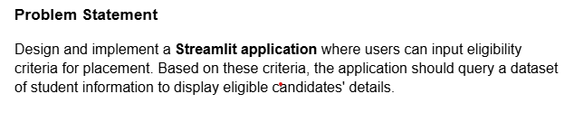
Problem Statement
Manual evaluation is inefficient
Need structured filtering
Need insights
Notes:
Explain why this problem matters in real-world placements.

Slide 3
Business use cases
PLACEMENT MANGEMENT
STUDENT PERFORMANCE TRACKING
INTERACTIVE ANALYTICS

Slide 4
Solution Overview
Data-driven system
Dynamic filtering
Insights dashboard
Notes:
Explain your solution approach at a high level.

Slide 5
Architecture
Faker → CSV → DB → SQL → Streamlit
Notes:
Explain the pipeline flow clearly.

Slide 6
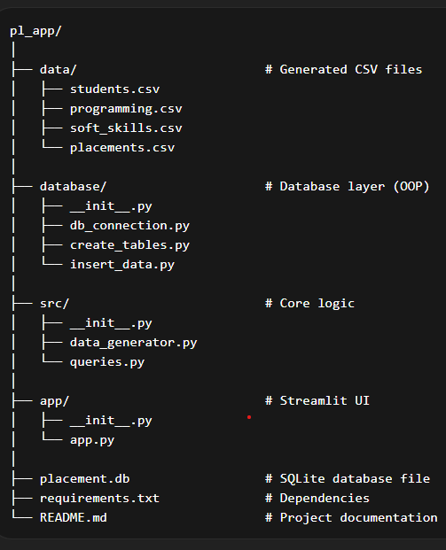
project file structure

Slide 7
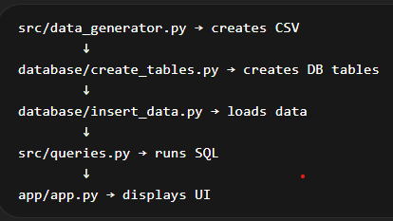
project flow

Slide 8
Data Generation
Used Faker
Generated 500 records
Multiple tables
Notes:
Explain how you simulated real-world data.

Slide 9
Database Design
4 tables
Foreign keys(STUDENT_ID)
Normalized schema
Notes:
Explain student_id linking and normalization.

Slide 10
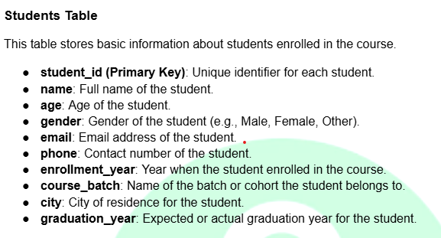
SCHEMA

Slide 11
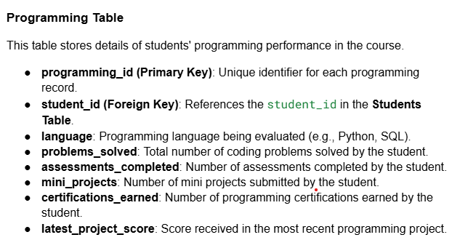
SCHEMA

Slide 12
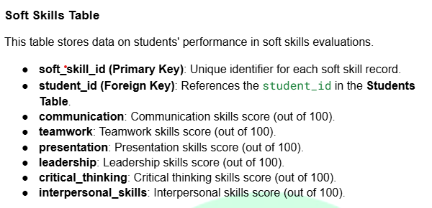
SCHEMA

Slide 13
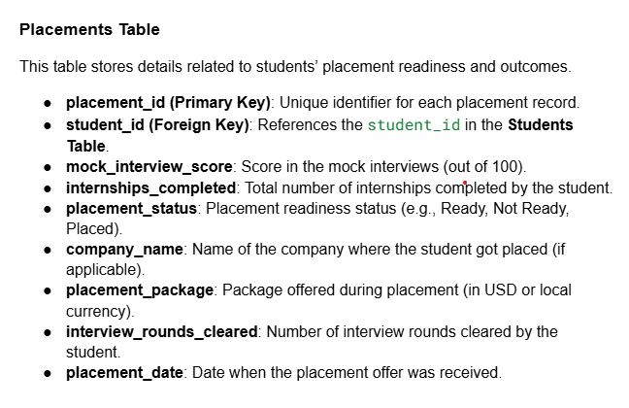
SCHEMA

Slide 14
Data Insertion
Used Pandas
Bulk insert
Efficient pipeline
Notes:
Explain why pandas is better than manual insert.

Slide 15
SQL Queries
10 queries
JOIN, GROUP BY
Notes:
Explain types of queries you implemented.

Slide 16
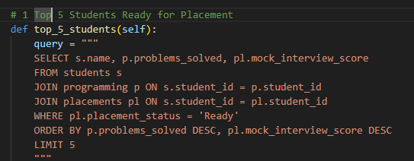
QUERY_1

Slide 17
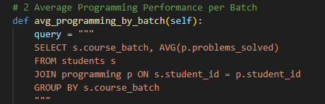
QUERY_2

Slide 18
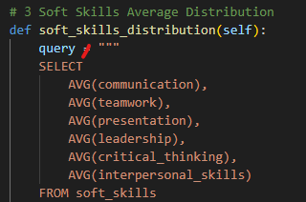
QUERY_3

Slide 19
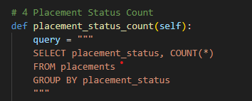
QUERY_4

Slide 20
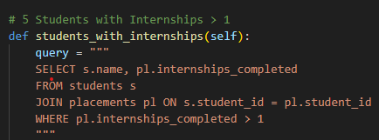
QUERY_5

Slide 21
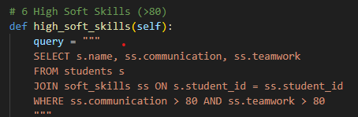
QUERY_6

Slide 22
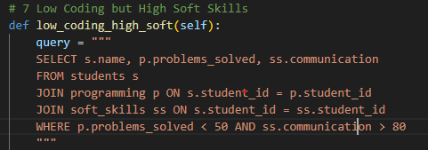
QUERY_7

Slide 23
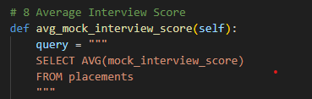
QUERY_8

Slide 24
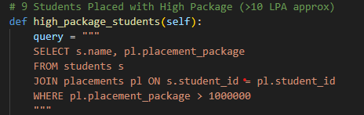
QUERY_9

Slide 25
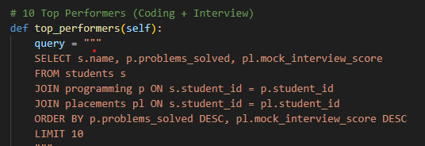
QUERY_10

Slide 26
Key Insights
Top students
Batch performance
Placement stats
Soft skills distribution
Students with internship
High soft skills
Average interview score
Low coding and high soft skills
Highest package
Top performers
Notes:
Explain what insights you extracted.

Slide 27
Streamlit UI
Interactive dashboard
Filters
Real-time results
Notes:
Explain how users interact with app.

Slide 28
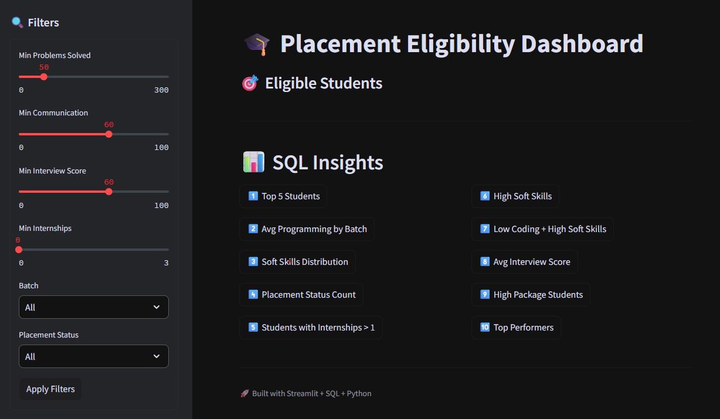
STREAMLIT DASHBOARD

