Slide 1
IMPLEMENTATION OF K-MEANS CLUSTERING
For Intrusion Detection System
A Comparative Study
By
Swetha Botta
UID: 120377631
Course: ENPM693 CY01

Slide 2
INTRODUCTION TO INTRUSION DETECTION SYSTEM
Intrusion detection systems are crucial for identifying and preventing cyber threats in today's digital landscape.
As cyber attacks continue to evolve, traditional signature-based detection methods are often inadequate.
Anomaly-based intrusion detection using machine learning algorithms offers a more proactive and adaptive approach.
Machine learning models can learn from data and detect patterns that deviate from normal behavior, enabling the identification of previously unknown attacks.

Slide 3
CLUSTERING IN INTRUSION DETECTION SYSTEM
Clustering is a data analysis technique that groups similar data points together based on specific characteristics or features.
Benefits: Clustering helps in identifying patterns and anomalies in network traffic, enabling proactive threat detection and effective incident response.
Introduction to K-Means clustering: K-Means clustering is a popular unsupervised machine learning algorithm used for clustering data points into distinct groups.

Slide 4
K-MEANS CLUSTERING ALGORITHM
The K-means clustering algorithm is a popular unsupervised learning technique used for anomaly detection.
It works by partitioning the data into K clusters based on similarity.
The algorithm iteratively assigns data points to the nearest cluster centroid and updates the centroids until convergence.
Advantages: Simple and efficient, scales well to large datasets, and can handle numerical data.
Limitations: Sensitive to initial centroid positions, assumes spherical clusters, and requires specifying the number of clusters (K) in advance.

Slide 5
Applications of K-Means In IDS:
Network Traffic Monitoring:Cluster network traffic data to identify anomalous patterns.Detect distributed denial-of-service (DDoS) attacks, port scans, etc.
Malware Detection:Cluster executable files or malware samples based on their characteristics.Identify new or unknown malware variants
Insider Threat Detection: Cluster user behavior patterns to detect insider threats or policy violations
Fraud Detection: Cluster financial transactions to detect fraudulent activities
Cybersecurity Analytics: Cluster security logs and events for anomaly detection and threat intelligence

Slide 6



Workflow
Data
Data Visualization(Confusion Matrix)
K-Means Modeling
Finding optimum no.of clusters

Slide 7
Principal Component Analysis
PCA is a statistical technique used for dimensionality reduction.
To reduce the dimensionality of high-dimensional data:High-dimensional data can be computationally expensive and prone to the curse of dimensionality.
PCA helps reduce the number of features while preserving the most important information.
By reducing the dimensions to 2 or 3, PCA allows for better visualization and understanding of the data structure.
PCA can be used as a preprocessing step to improve the performance and efficiency of other machine learning algorithms, such as clustering, classification, and regression.

Slide 8
Dataset Description
A widely-used benchmark dataset for intrusion detection systems
Contains network traffic data collected from simulated military network environment
It contains 41 features in total along with both numeric and categorical data.
Examples: duration, protocol type, service, bytes transferred, flags, error rates, etc.
Data Preprocessing:
Selected relevant features: protocol_type, attack, src_bytes, dst_bytes
Converted 'attack' column to binary (normal=0, anomaly=1)
One-hot encoded categorical features
Normalized numerical features

Slide 9
IMPLEMENTATION

Slide 10
Methodology
Feature selection: Chose relevant features (protocol_type, attack, src_bytes, dst_bytes) for the intrusion detection task.
Binary encoding: Converted the 'attack' column to binary (normal=0, anomaly=1) for easier interpretation.
One-hot encoding: Transformed categorical features (protocol_type) into numerical format using one-hot encoding.
Train-test split: Split the dataset into training and testing sets for model evaluation.
Normalization: Scaled numerical features using StandardScaler to ensure equal feature importance.
Hyperparameter tuning is crucial for optimizing the performance of machine learning models.Used RandomizedSearch to find the best hyperparameters.

Slide 11
Model Implementation
Fitted the K-means model with the best hyperparameters on the training data.
Predicted clusters for both training and testing data using the fitted model.
Created separate data frames for normal and anomaly data based on the predicted clusters.

Slide 12
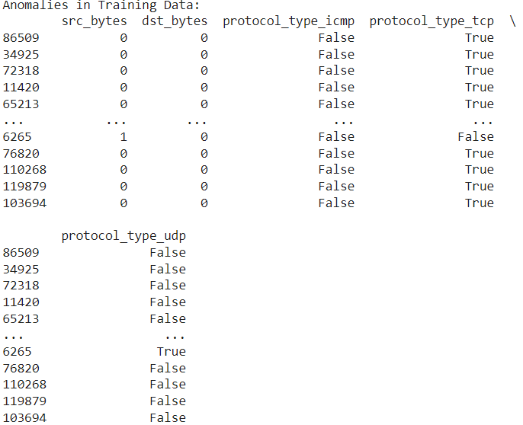
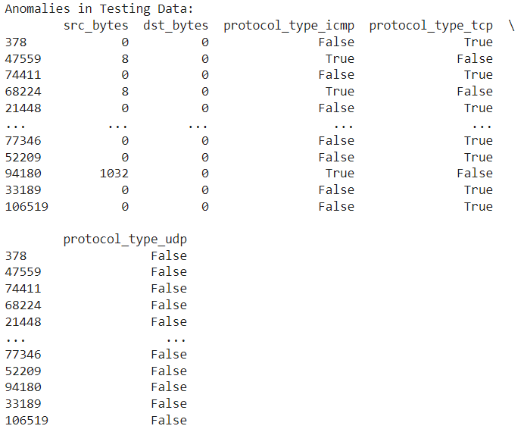
Results(With and Without PCA):

Slide 13
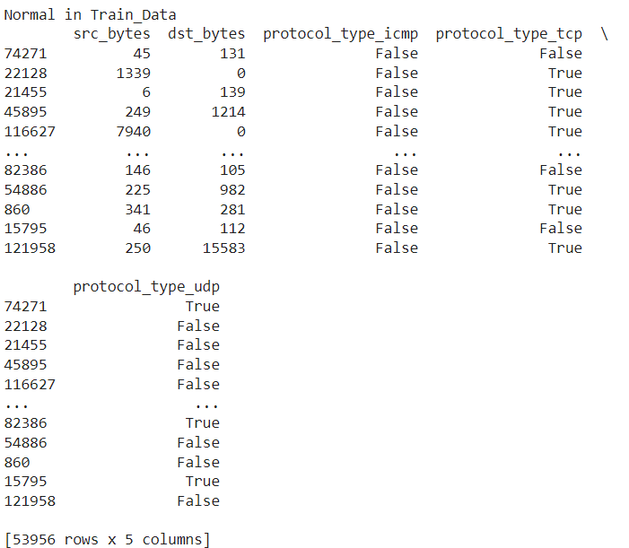
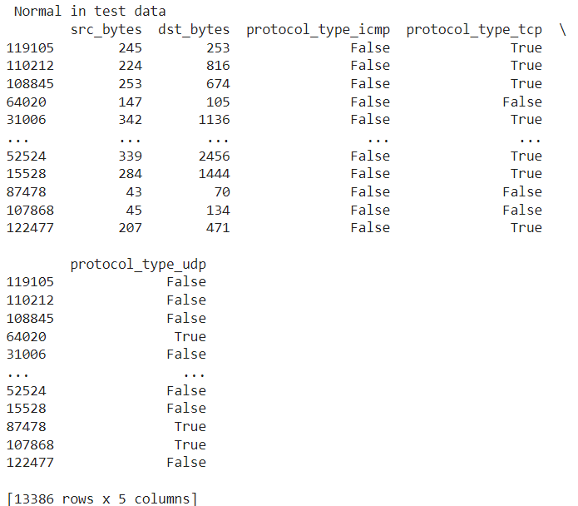
Results(With and Without PCA):

Slide 14
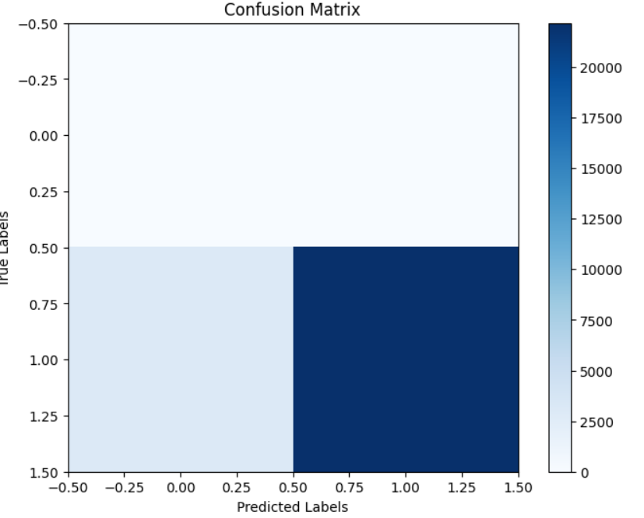
Results(With and Without PCA):
Confusion matrix: A tabular representation of the
model's predictions vs. actual labels.
True Positives (TP): Anomalies correctly identified
True Negatives (TN): Normal instances correctly identified
False Positives (FP): Normal instances misclassified as anomalies
False Negatives (FN): Anomalies misclassified as normal

Slide 15
Computational Complexity
Time complexity of K-means: O(n * k * i * d)
n: number of samples, k: number of clusters, i: number of iterations, d: number of features
For the given dataset and best hyperparameters, the time complexity is:

Slide 16
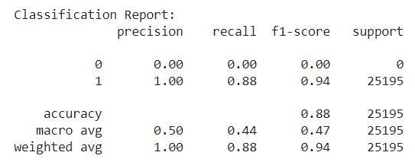

Computational Complexity
Accuracy measures overall correctness, precision measures true positives out of predicted positives.
Recall measures true positives out of actual positives.
F1-score balances precision and recall, and classification report provides a detailed breakdown of performance metrics for each class.

Slide 17
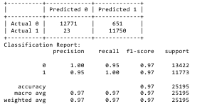
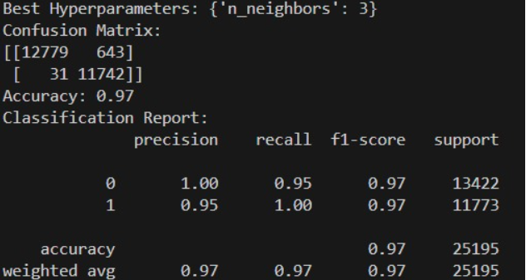


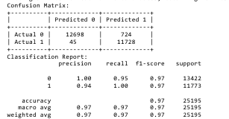
Computational Analysis
K-NN
Random-Forest
Isolation Forest
Identifies anomalies based on the distance to their nearest neighbors.
Ensemble of decision trees, works well with high-dimensional data.
Isolates anomalies by explicitly isolating them instead of profiling normal instances.
without pca
without pca
with pca
with pca

Slide 18
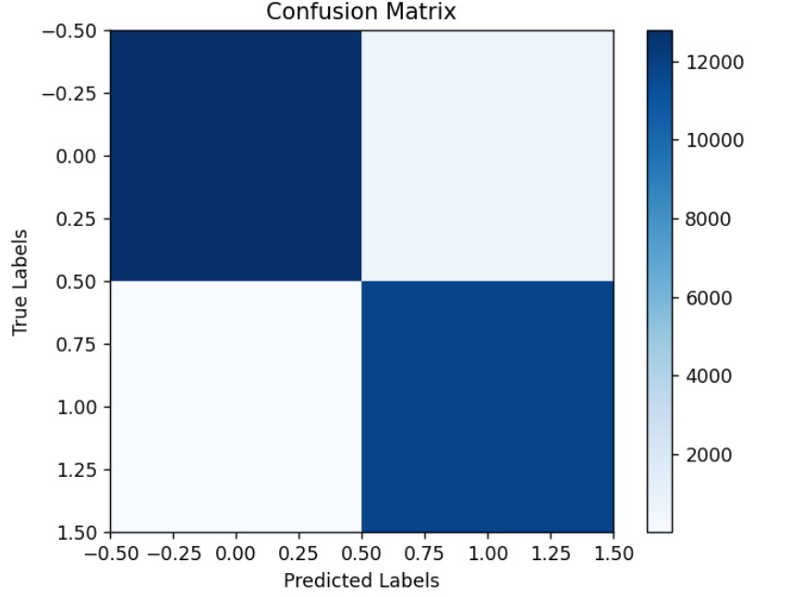
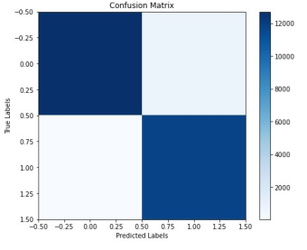
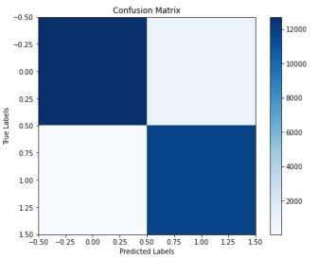
Computational Analysis without pca:
K-NN
Random-Forest
Isolation Forest

Slide 19
Computational Analysis with pca:
K-NN
Random-Forest
Isolation Forest

Slide 20
REFERENCES
https://www.kaggle.com/datasets/hassan06/nslkdd/data
https://www.researchgate.net/publication/332741848_Implementation_of_K-Means_Clustering_for_Intrusion_Detection
https://github.com/llSourcell/k_means_clustering/blob/master/kmeans.py
CODE REPO: https://github.com/swethabotta/IDS_Using_KMEANS

Slide 21
Discussion on Alternatives
K-Means: Effective for large datasets, but requires prior knowledge of the number of clusters to be used, and it may not function well with non-globular clusters.
KNN: Simple to use and easy to comprehend, but it struggles with high-dimensional data and is sensitive to changes in parameters.
Isolation Forest: Helpful for both local and global anomaly identification, but dependent on parameters and dataset qualities.
Random Forest: Resistant to high-dimensional data, but less interpretable and computationally costly.
A trade-off analysis is required since the choice of algorithm depends on variables including interpretability, dimensionality, noise, outliers, and computer resources.

Slide 22
CONCLUSION
Ensemble methods:Combine K-means with other anomaly detection algorithms,Leverage strengths of multiple models for improved performance
Interpretability and Explainability:Develop methods to interpret learned cluster representations,Enhance explainability for better understanding of anomalies
Adaptive and Online Learning: Develop online or incremental versions of K-mean.Adapt to concept drift and evolving attack patterns
Handling High-Dimensional Data: Use sparse data representation for efficient computation
Potential improvements: Combine with other techniques, explore alternative distance measures, and develop incremental versions for real-time detection.

Slide 23
THANKYOU!

