Slide 1
Future Sales Prediction Name: CT .Swetha Reg.no:912421104049

Slide 2
INTRODUCTION:
One of the most common methods used to predict sales is
regression analysis. This method involves using historical
sales data to train a model that can predict future sales. The
model can take into account factors such as past sales,
Marketing Campaigns and economic indicators to make its predictions

Slide 3
DATA SOURCE
DATA SOURCE
One of the most common methods used to predict sales is regression analysis. This method involves using historical sales data to train a model that can predict future sales. The model can take into account factors such as past sales, marketing campaigns, and economic indicators to make its predictions.
Datalink:
https://www.kaggle.com/datasets/chakradharmattapalli/future-sales-prediction

Slide 4
FEATURE ENGINERRING
Feature Engineering is the process of creating new features or transforming existing features to improve the performance of a machine-learning model. It involves selecting relevant information from raw data and transforming it into a format that can be easily understood by a mode

Slide 5


Slide 6
MODEL TRAINING
Model training is the phase in the data science development lifecycle where Practitioners try to fit the best combination of weights and bias to a machine learning algorithm to minimize a loss function over the prediction range. methods used to predict sales is regression analysis. This method involves using historical sales data to train a model that can predict future sales. The model can take into account factors such as past sales, marketing campaigns, and economic indicators to make its predictions.

Slide 7
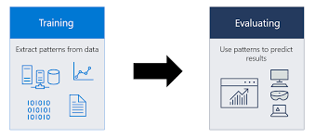

Slide 8
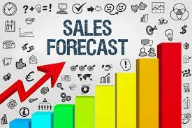

Slide 9
PREDICTING SALES
Predicting Sales Forecasting the monthly sales with LSTM Assess historical trends Examine sales from the previous year. Break the numbers down by price, product, rep, sales period, and other relevant variables. Build those into a “sales run rate,” which is the amount of projected sales per sales period. This forms the basis of your sales forecast.

Slide 10
What is predicting sales of a product?
Use affordable market research techniques
• Ask your sales team. Sales representatives know your market intimately, including what your competitors are doing. …
• Seek other sources of intelligence. ...
• Consider primary research. …
• Start with a pilot project. ...
• Monitor your results and adjust

Slide 11
This series of articles was designed to explain how to use Python in a simplistic way to fuel your company’s growth by applying the predictive approach to all your actions.
It will be a combination of programming, data analysis, and machine learning.
I will cover all the topics in the following nine articles:
1-Know Your Metrics
2-Customer Segmentation
3-Customer Lifetime Value Prediction
4-Churn Prediction

Slide 12
Predicting next purchase date
6- Predicting Sales
7- Market Response Models
8- Uplift Modeling
9- A/B Testing Design and Execution
Articles will have their own code snippets to make you easily apply them. If you are super new to programming, you can have a good introduction for Python and Pandas(a famous library that we will use on everything) here. But still without a coding introduction, you can learn the concepts, how to use your data and start generating value ou

Slide 13
SALES FOR FORCASTING METHOD
Not all sales forecasting methods are created equal. Here are a few of the most common ways to forecast sales. We've also included some examples to further illustrate each sales forecasting method.

Slide 14
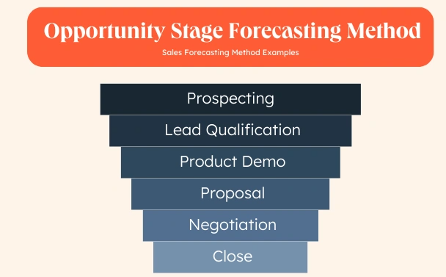

Slide 15
PROGRAM:
Import tensorflow astf
this model is built
From tensorflow import keras
the model
List_row,date,traffic =
get_data (‘/home/abh/Documents/Python/Untitled Folder/Sales_dataset’)
Output:
Original data set for sales data for 5 years

Slide 16
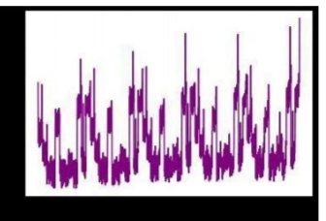

Slide 17
History = model.fit(
X =
[inp_day,inp_mon,inp_year,inp_week,inp_hol,inp7,inp_prev,inp_se ss],
Y = out,
Batch_size=16,
Steps_per_epoch=50,
Epochs = 15,
Verbose=1, Shuffle =False ) #all the inputs were fed into the model and
training was completed
Output: def conversion(week,days,months,years,list_row):

Slide 18
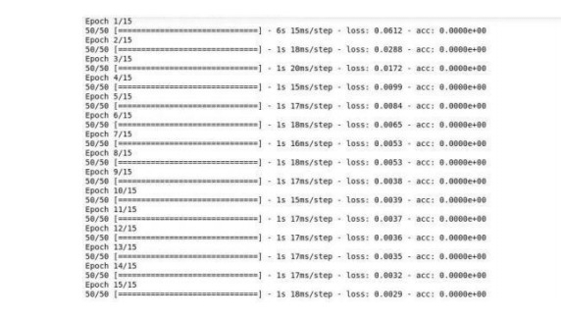

Slide 19
Import pandas aspd # to extract data from dataset(.csv file)
Import csv #used to read and write to csv files
Import numpy asnp #used to convert input into
numpy arrays to be fed to the model
Import matplotlib. Pyplot asplt
sales forecasting
#to plot/visualize sales data and
..................Column Break..................

Slide 20
#lists have been defined to hold different inputs Inp_day = []
Inp_mon = []
Inp_year = []
Inp_week=[]
Inp_hol=[]
Out = [] #converts the days of a week(Monday,Sunday,etc.) into one hot vectors and stores themasa dictionary
Week1 = number_to_one_hot(week)
#list_row contains primary inputs
For row in list_row:
#Filter out date from list_row

Slide 21
D = row[0]
#the date was split into three values date, month and year.
D_split=d.split(‘/’) If
d_split[2]==str(year_all[0]): prevents use of the first year data to ensure each input contains previous year data as we
continue

Slide 22
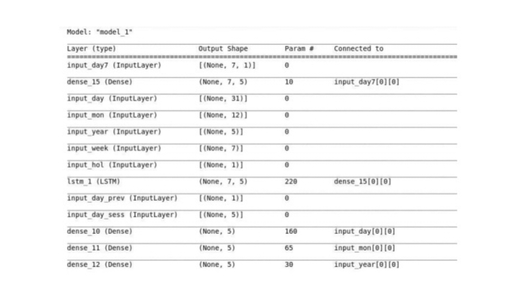
Output:

Slide 23
Input_hol = Input(shape=(inp_hol.shape[1],),name = ‘input_hol’)
Input_day7 = Input(shape=(inp7.shape[1],inp7.shape[2]),name = ‘input_day7’)
Input_day_prev = Input(shape=(inp_prev.shape[1],),name = ‘input_day_prev’)
Input_day_sess = Input(shape=(inp_sess.shape[1],),name = ‘input_day_sess’)

Slide 24
X5 = Dense(5, activation=’relu’)(input_hol)
X_6 = Dense(5, activation=’relu’)(input_day7)
X__6 = LSTM(5,return_sequences=True)(x_6)
X6 = Flatten()(x__10)
X7 = Dense(5, activation=’relu’)(input_day_prev)
X8 = Dense(5, activation=’relu’)(input_day_sess) ccc

Slide 25
C = concatenate([x1,x2,x3,x4,x5,x6,x7,x8])
Layer1 = Dense(64,activation=’relu’)©
Outputs =
Dense(1, activation=’sigmoid’)(layer1)

Slide 26
Model (inputs=[input_day,input_mon,input_year,input_week,input_
hol,input_day7,input_day_prev,input_day_sess], outputs=outputs)
Model.summary(

Slide 27
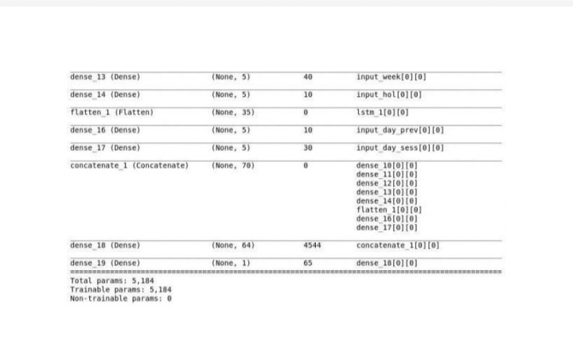
Output:

Slide 28
Evaluation
The most traditional way of sales performance evaluation is to look at the past sales data and the present sales data and make comparisons. It can quickly be seen how well they meet their targets, how their sales figures have risen or fallen, and whether their sales performance is in line with the company as a whole. What is the need for evaluating sales performance? Evaluation is also required for proper sales planning. A periodic evaluation of performance discloses their relative performance which is needed by the management to make suitable changes in their different assignment as to different territory, products or buyers.

Slide 29
Conclusion
The phase 5 submission about future sales prediction done successfully

