Slide 1
Future Sales Prediction - Guidelines
AGENDA
Data Source
Data Preprocessing
Feature Engineering
Model Selection
Model Training
Evaluation

Slide 2
Problem Definition:
The problem is to develop a predictive model that uses historical sales data to forecast future sales for a retail company. The objective is to create a tool that enables the company to optimize inventory management and make informed business decisions based on data driven sales predictions. This project involves data preprocessing, feature engineering, model selection, training, and evaluation.

Slide 3
FUTURE SOURCE PREDICTION
Sales forecasting is the process of estimating future revenue by predicting how much of a product or service will sell in the next week, month, quarter, or year. At its simplest, a sales forecast is a projected measure of how a market will respond to a company's go-to-market efforts.

Slide 4
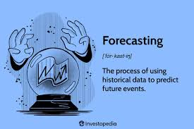
FORECASTING

Slide 5
DATA SOURCE
One of the most common methods used to predict sales is regression analysis. This method involves using historical sales data to train a model that can predict future sales. The model can take into account factors such as past sales, marketing campaigns, and economic indicators to make its predictions.

Slide 6

DATA SOURCE

Slide 7
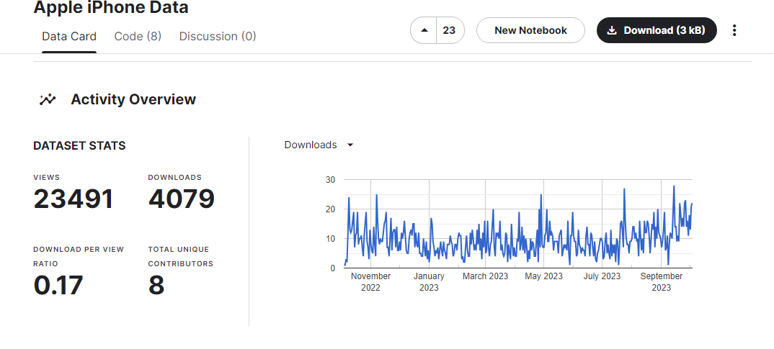
DATASET ABOUT APPLE IPHONE

Slide 8
Data Preprocessing
Data preprocessing is an important step in the data mining process. It refers to the cleaning, transforming, and integrating of data in order to make it ready for analysis. The goal of data preprocessing is to improve the quality of the data and to make it more suitable for the specific data mining task.

Slide 9
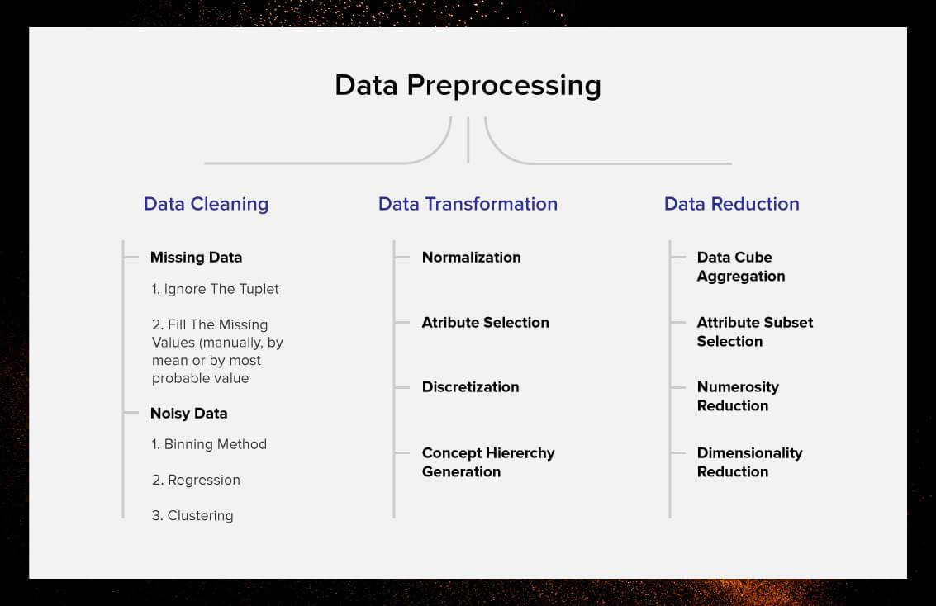
DATA PREPROCESSING

Slide 10
Feature Engineering
Feature Engineering is the process of creating new features or transforming existing features to improve the performance of a machine-learning model. It involves selecting relevant information from raw data and transforming it into a format that can be easily understood by a model

Slide 11
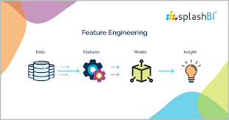
FEATURE ENGINEERING

Slide 12
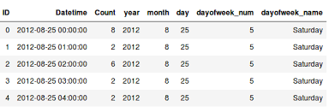
DATA ABOUT DAY OF WEEK

Slide 13
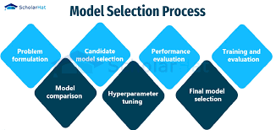
Model Selection Model selection is the task of selecting a model from among various candidates on the basis of performance criterion to choose the best one.

Slide 14
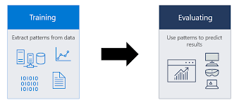
Model Training
Model training is the phase in the data science development lifecycle where practitioners try to fit the best combination of weights and bias to a machine learning algorithm to minimize a loss function over the prediction range.

Slide 15
EVALUATION
Root Mean Squared Error
EXAMPLE PROGRAM
Root Mean Squared Error (RMSE)and Mean Absolute Error (MAE) are metrics used to evaluate a Regression Model. These metrics tell us how accurate our predictions are and, what is the amount of deviation from the actual values.
import pandas as pd from sklearn.linear_model import LinearRegressionsal_data={"Exp":[2,2.2, 2.8, 4, 7, 8, 11, 12, 21, 25], "Salary": [7, 8, 11, 15, 22, 29, 37 ,45.7, 49, 52]}#Load data into a pandas Dataframe df=pd.DataFrame(sal_data) df.head(3)

Slide 16
THANKYOU

