Slide 1
AtliQ Consumer Goods Analytics
SWETHA C S

Slide 2
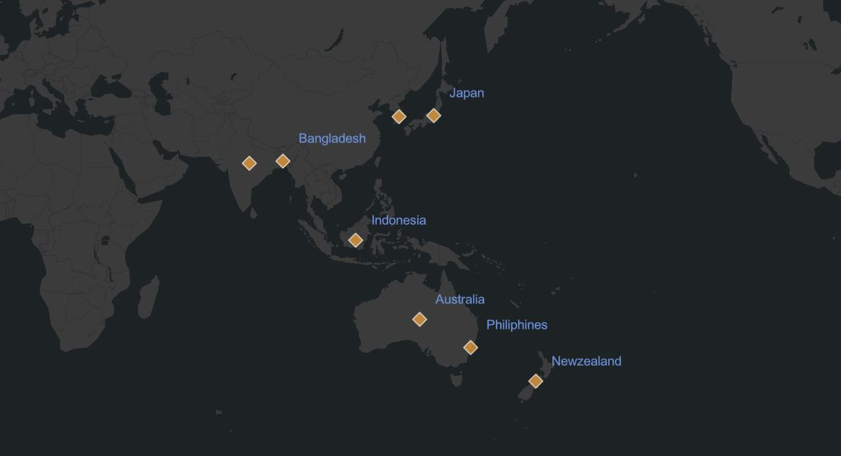
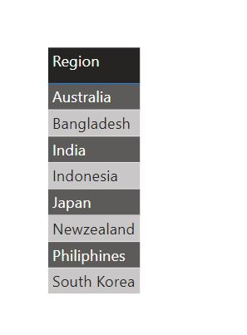
Request 1 : Provide the list of markets in which customer "Atliq Exclusive" operates its business in the APAC region.
select distinct market
from dim_customer
where customer like "%Atliq Exclusive%"
and region="APAC"
order by market;

Slide 3
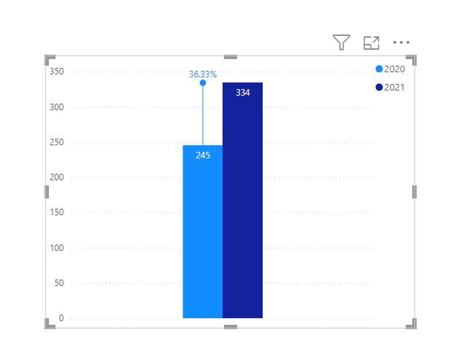
Request 2 : What is the percentage of unique product increase in 2021 vs. 2020?
drop temporary table if exists summary;
create temporary table summary(
with
cte1 as(
select
count(distinct product_code) as unique_products_2020
from fact_sales_monthly where fiscal_year=2020
),
cte2 as(
select
count(distinct product_code) as unique_products_2021
from fact_sales_monthly where fiscal_year=2021
)
select * from cte1 cross join cte2
);
select
*,
unique_products_2021-unique_products_2020 as increase_in_2021,
(unique_products_2021-unique_products_2020)*100/unique_products_2020
as percentage_chg
from summary;

Slide 4
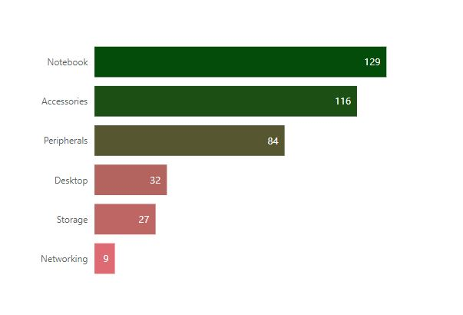
Request 3 : Provide a report with all the unique product counts for each segment and sort them in descending order of product counts.
select
segment,
count(distinct product_code) as product_count
from dim_product
group by segment
order by product_count desc

Slide 5
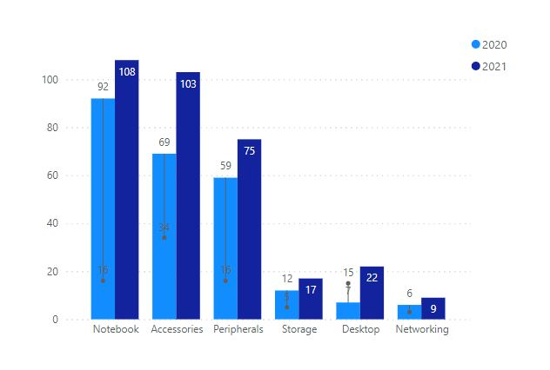
Request 4 : Which segment had the most increase in unique products in 2021 vs 2020?

Slide 6
drop temporary table if exists summary;
create temporary table summary(
with cte1 as(
select
segment as segment_2020, count(distinct product_code) as unique_products_2020
from fact_sales_monthly join dim_product using(product_code)
where fiscal_year=2020 group by segment),
cte2 as(
select
segment as segment_2021, count(distinct product_code) as unique_products_2021
from fact_sales_monthly join dim_product using(product_code)
where fiscal_year=2021 group by segment)
select * from cte1 join cte2 on cte1.segment_2020=cte2.segment_2021 );
select
segment_2020 as segment, unique_products_2020, unique_products_2021,
unique_products_2021-unique_products_2020 as increase_in_2021
from summary order by increase_in_2021 desc;

Slide 7
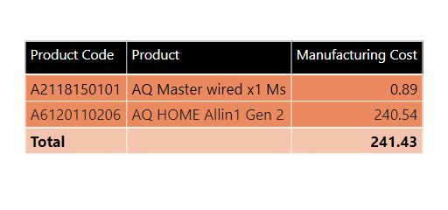
Request 5: Get the products that have the highest and lowest manufacturing costs.
select
product_code,
product,
manufacturing_cost
from fact_manufacturing_cost
join dim_product using(product_code)
where
manufacturing_cost in
((select max(manufacturing_cost)
from fact_manufacturing_cost),
(select min(manufacturing_cost) from fact_manufacturing_cost))

Slide 8
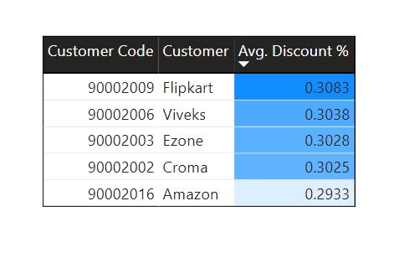
Request 6: Generate a report which contains the top 5 customers who received an average high pre_invoice_discount_pct for the fiscal year 2021 and in the Indian market.
SELECT
customer_code,
customer,
avg(pre_invoice_discount_pct) as average_discount_percentage
FROM gdb023.fact_sales_monthly
join fact_pre_invoice_deductions p
using(customer_code,fiscal_year)
join dim_customer c
using(customer_code)
where
fiscal_year=2021 and
market="India"
group by customer_code
order by average_discount_percentage desc
limit 5

Slide 9
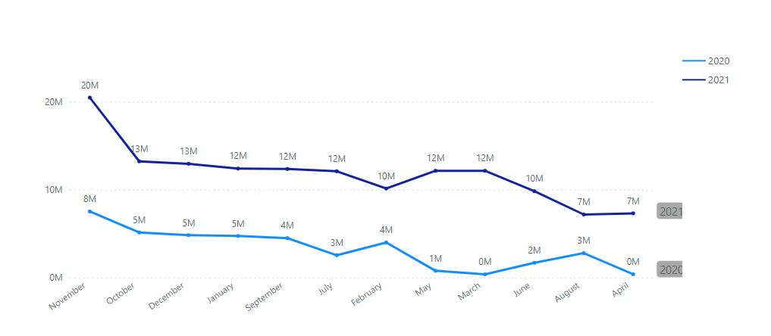
Request 7 : Get the complete report of the Gross sales amount for the customer “Atliq Exclusive” for each month . This analysis helps to get an idea of low and high-performing months and take strategic decisions.

Slide 10
with
cte1 as
(SELECT
*,
monthname(date) as month,
(sold_quantity) * gross_price as gross_amount
FROM gdb023.fact_sales_monthly
join fact_gross_price
using(product_code,fiscal_year)
join dim_customer
using(customer_code)
where customer="Atliq Exclusive")
select
fiscal_year,
month,
sum(gross_amount) as gross_sales_amount
from cte1
group by fiscal_year,month

Slide 11
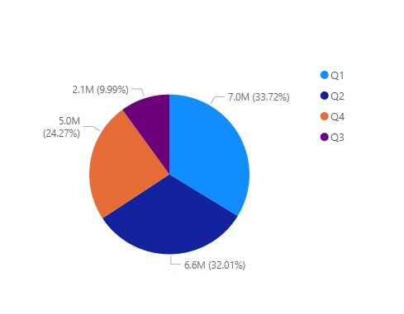
Request 8 In which quarter of 2020, got the maximum total_sold_quantity?
with cte as(
select
*,
concat("Q",quarter(date_Add(date, interval 4 month))) as quarter
from fact_sales_monthly
where fiscal_year=2020)
select
quarter,
sum(sold_quantity) as total_sold_quantity
from cte
group by quarter
order by total_sold_quantity desc

Slide 12
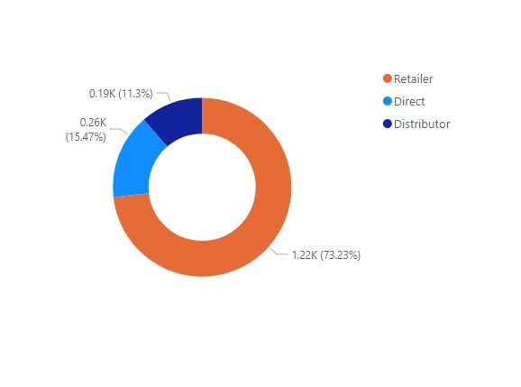
Request 9 Which channel helped to bring more gross sales in the fiscal year 2021 and the percentage of contribution?
with cte as(
select
channel,
sum((sold_quantity * gross_price))/1000000 as gross_sales_mln
from fact_sales_monthly fs
join fact_gross_price
using(product_code,fiscal_year)
join dim_customer
using(customer_code)
where fs.fiscal_year=2021
group by channel)
select
*,
gross_sales_mln*100/sum(gross_sales_mln)
over() as pct_contribution
from cte
order by pct_contribution desc

Slide 13
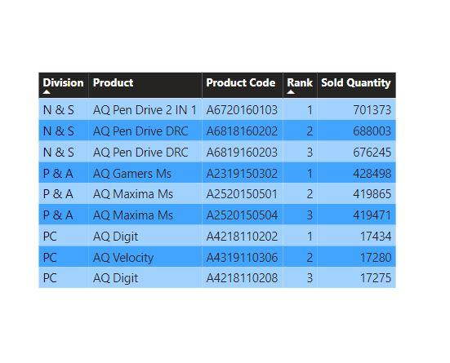
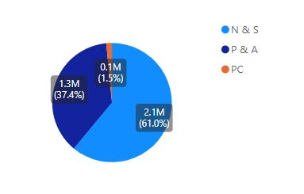
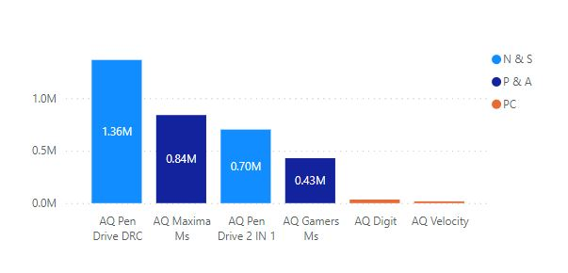
Request 10 Get the Top 3 products in each division that have a high total_sold_quantity in the fiscal_year 2021?

Slide 14
with cte as
(select
division,
product_code,
product,
sum(sold_quantity) as total_sold_quantity,
dense_rank() over(partition by division order by sum(sold_quantity) desc) as rank_order
from fact_sales_monthly s
join dim_product p
using(product_code)
where fiscal_year=2021
group by product_code)
Select *
from cte
where rank_order<=3

Slide 15
THANK YOU

