Slide 1

Bayes' Theorem:
Bayes' theorem is also known as Bayes' Rule or Bayes' law, which is used to determine the probability of a hypothesis with prior knowledge. It depends on the conditional probability.
The formula for Bayes' theorem is given as:
Where,
P(A|B) is Posterior probability: Probability of hypothesis A on the observed event B.
P(B|A) is Likelihood probability: Probability of the evidence given that the probability of a hypothesis is true.
P(A) is Prior Probability: Probability of hypothesis before observing the evidence.
P(B) is Marginal Probability: Probability of Evidence.

Slide 2
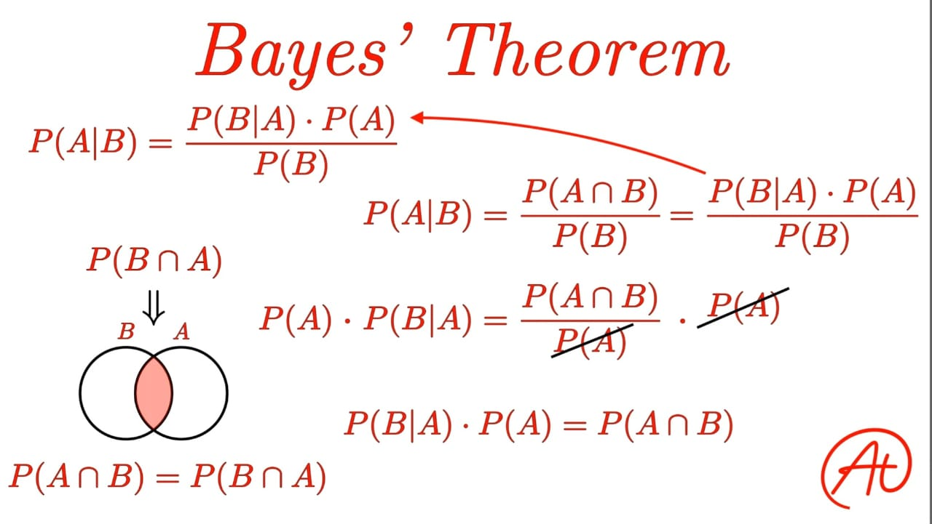
Multiply both sides by P(A)

Slide 3
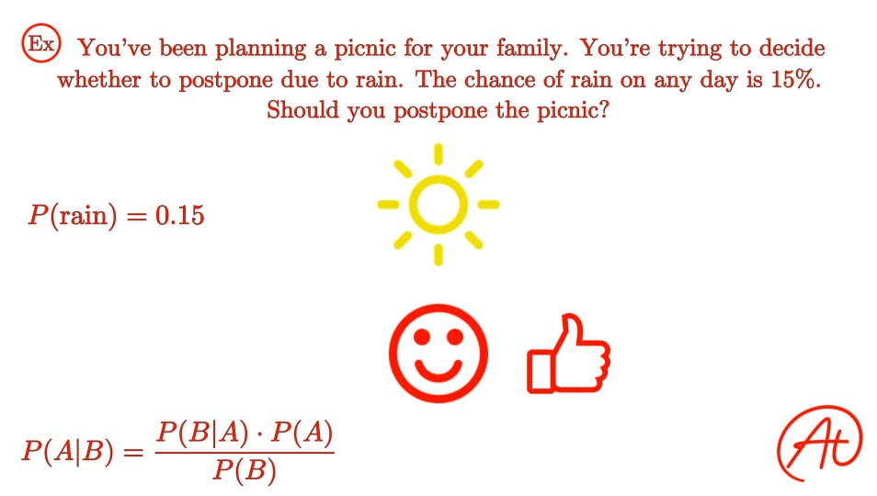

Slide 4
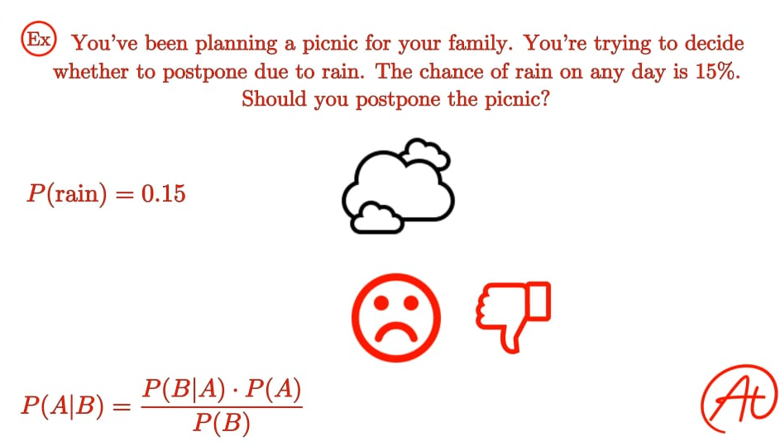

Slide 5
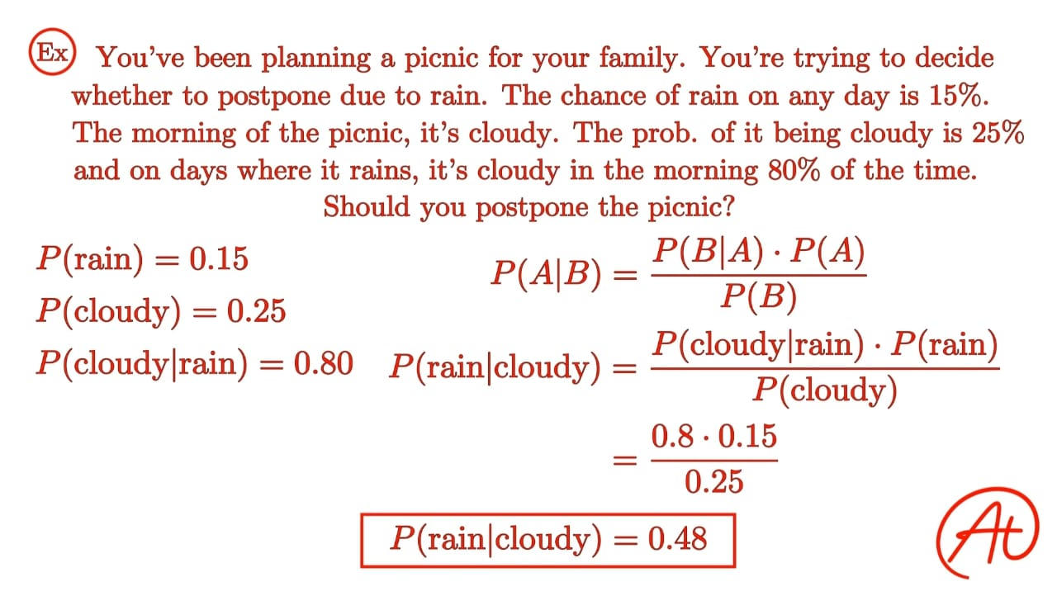

Slide 6
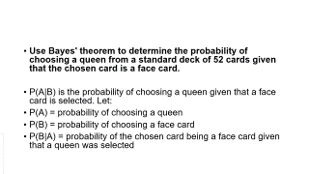
Use Bayes' theorem to determine the probability of choosing a queen from a standard deck of 52 cards given that the chosen card is a face card.
P(A|B) is the probability of choosing a queen given that a face card is selected. Let:
P(A) = probability of choosing a queen
P(B) = probability of choosing a face card
P(B|A) = probability of the chosen card being a face card given that a queen was selected

Slide 7
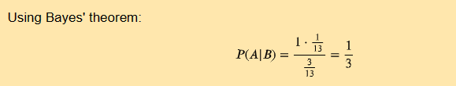
There are 52 cards in a standard deck, 40 of which are not face cards, 12 of which are face cards, and 4 of which are queens. Thus:
P(A) = 4/52 = 1/13
P(B) = 12/52 = 3/13
P(B|A) = 1

Slide 8
Naive Bayes algorithm is a supervised learning algorithm, which is based on Bayes theorem and used for solving classification problems.
It is mainly used in text classification that includes a high-dimensional training dataset.
Naive Bayes Classifier is one of the simple and most effective Classification algorithms which helps in building the fast machine learning models that can make quick predictions.
It is a probabilistic classifier, which means it predicts on the basis of the probability of an object.
Some popular examples of Naive Bayes Algorithm are spam filtration, Sentimental analysis, and classifying articles.

Slide 9
Why is it called Naive Bayes?
The Naive Bayes algorithm is comprised of two words Naive and Bayes, Which can be described as:
Naive: It is called Naive because it assumes that the occurrence of a certain feature is independent of the occurrence of other features. Such as if the fruit is identified on the bases of color, shape, and taste, then red, spherical, and sweet fruit is recognized as an apple. Hence each feature individually contributes to identify that it is an apple without depending on each other.
Bayes: It is called Bayes because it depends on the principle of Bayes' Theorem.

Slide 10
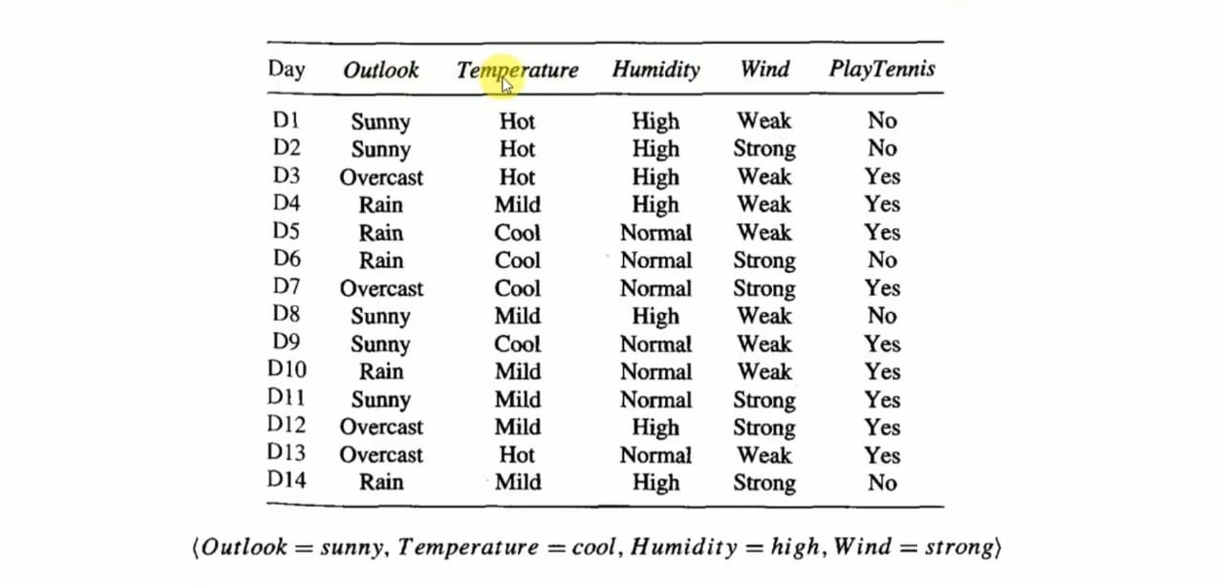
Example1

Slide 11
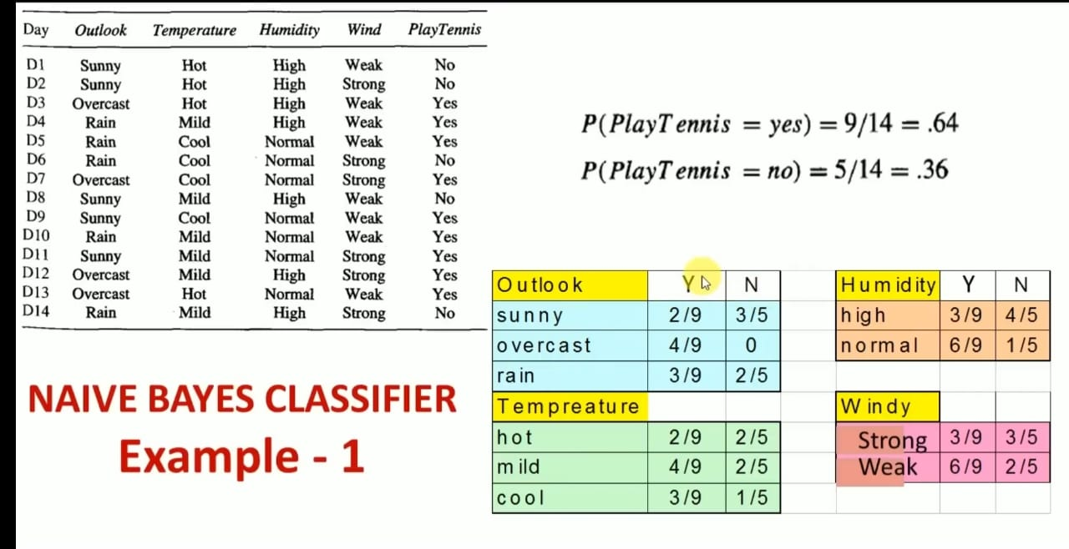
Prior probability
Likelihood probability

Slide 12
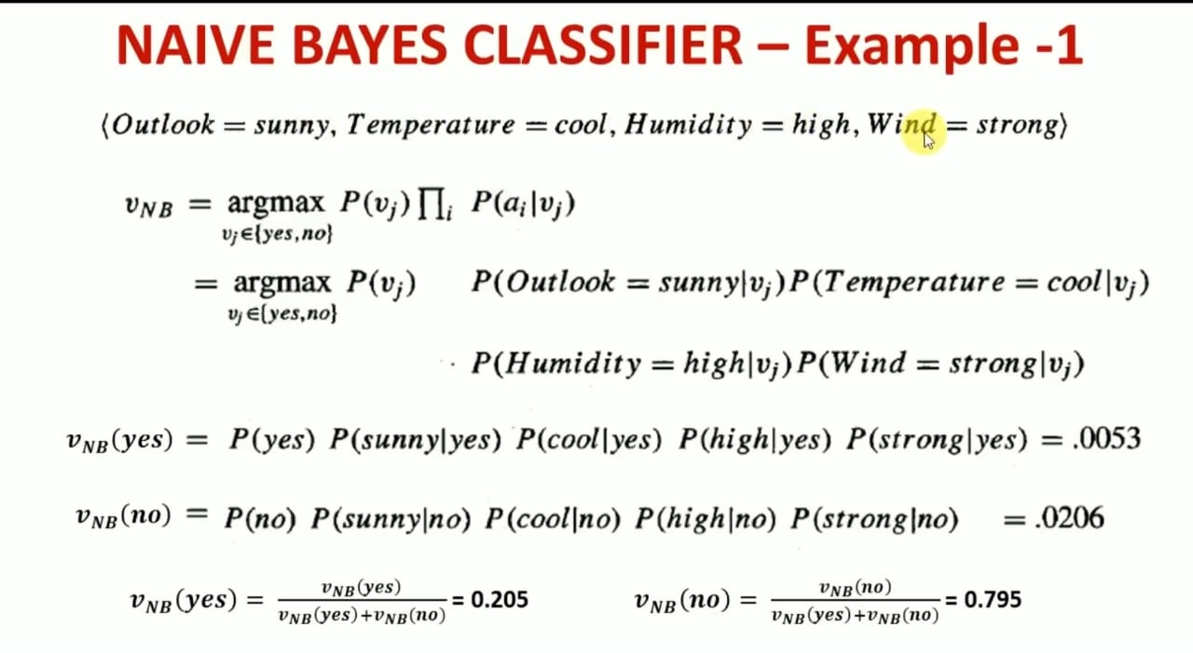
ai= set of attributes, vj= possible outcome

Slide 13
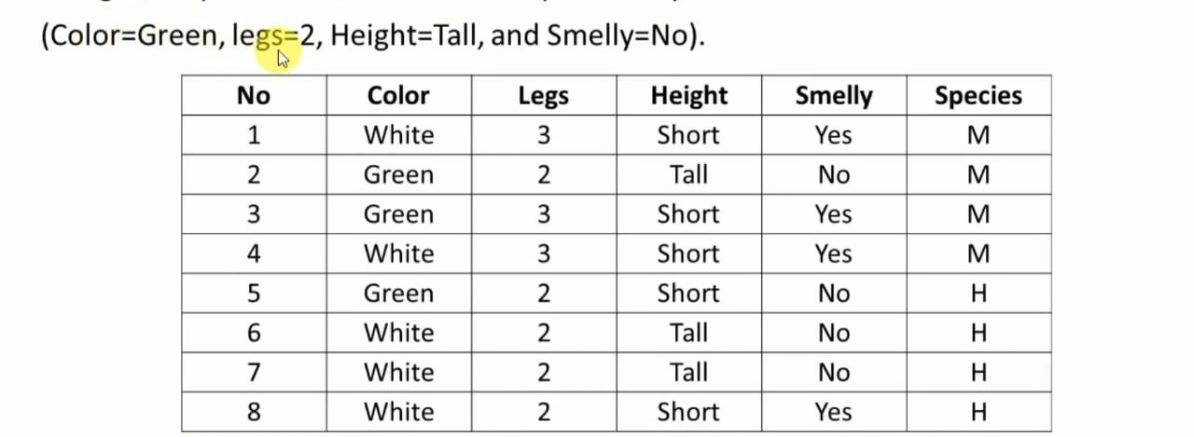
Example-2

Slide 14
Brute force Bayes concept learning
The learner considers some set of candidate hypotheses H and is interested in finding the most probable hypothesis h E H given the observed data D (or at least one of the maximally probable if there are several).
Any such maximally probable hypothesis is called a maximum a posteriori (MAP) hypothesis
Bayes theorem calculates the probability of each possible hypothesis and outputs the most probable one.

Slide 15
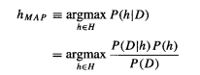
We can determine the (maximum a posteriori )MAP hypotheses by using Bayes theorem to calculate the posterior probability of each candidate hypothesis. More precisely, we will say that MAP is a MAP hypothesis provided

Slide 16
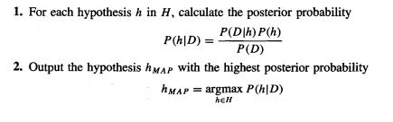
BRUTE-FORCE MAP LEARNING algorithm

Slide 17
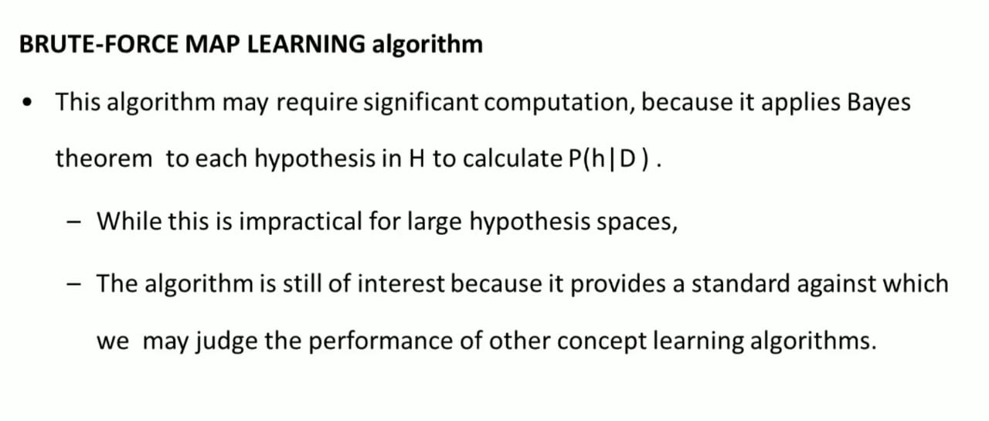

Slide 18
To calculate P(h) and P(D1h), some assumptions are needed
1. The training data D is noise free (i.e., di = c(xi)).
2. The target concept c is contained in the hypothesis space H
3. We have no a priori reason to believe that any hypothesis is more probable than any other.

Slide 19
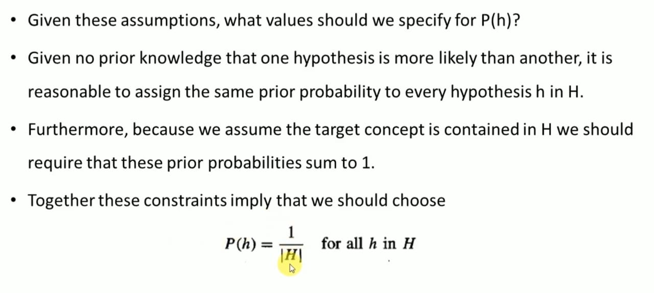

Slide 20

Since we assume noise-free training data, the probability of observing classification di given h is just 1 if di = h(xi) and 0 if di = h(xi)

Slide 21
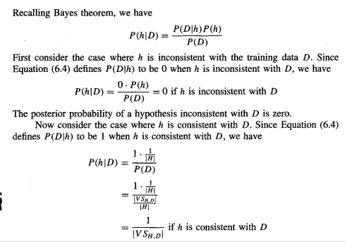

Slide 22
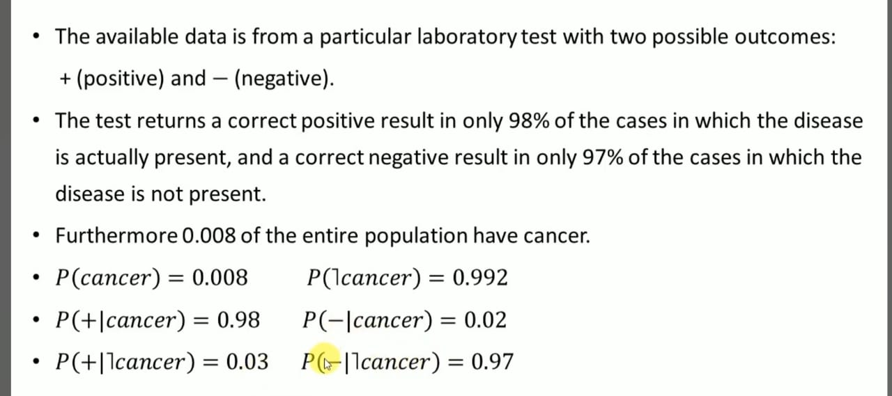
How to use naive bayes to check whether the patient has cancer or not

Slide 23
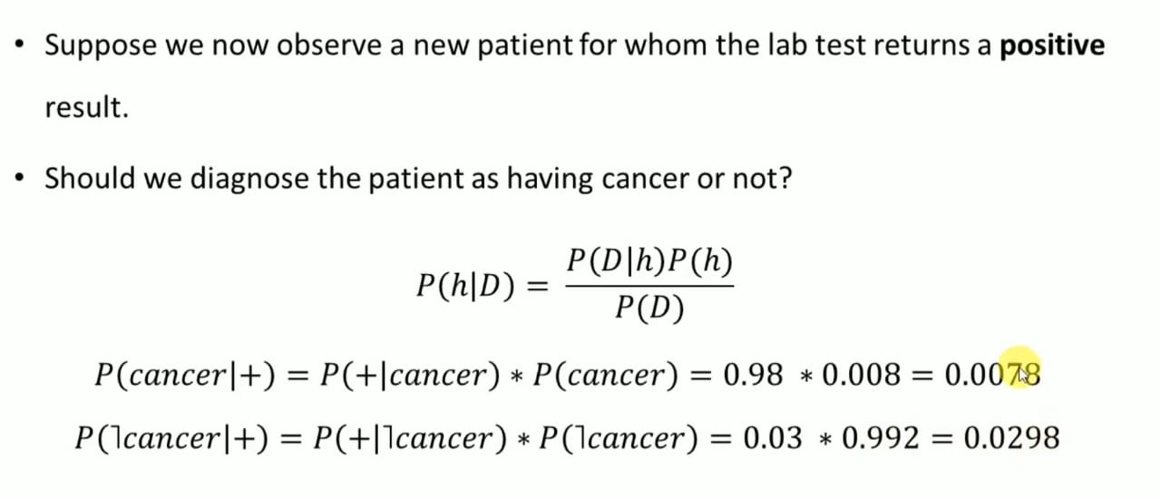

Slide 24
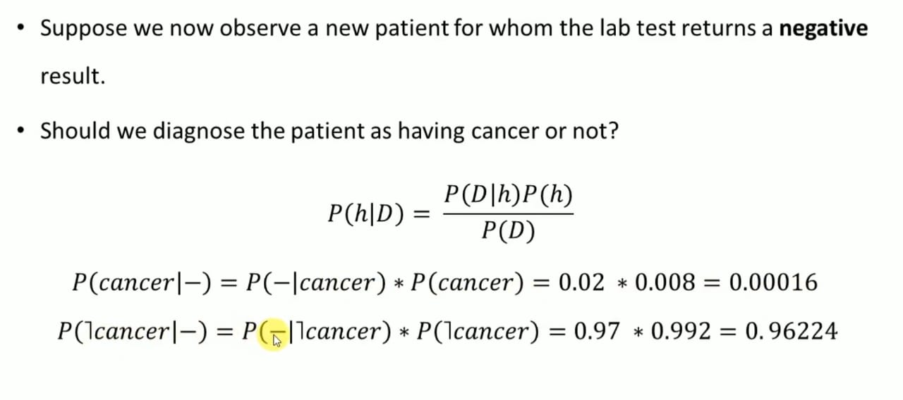

Slide 25
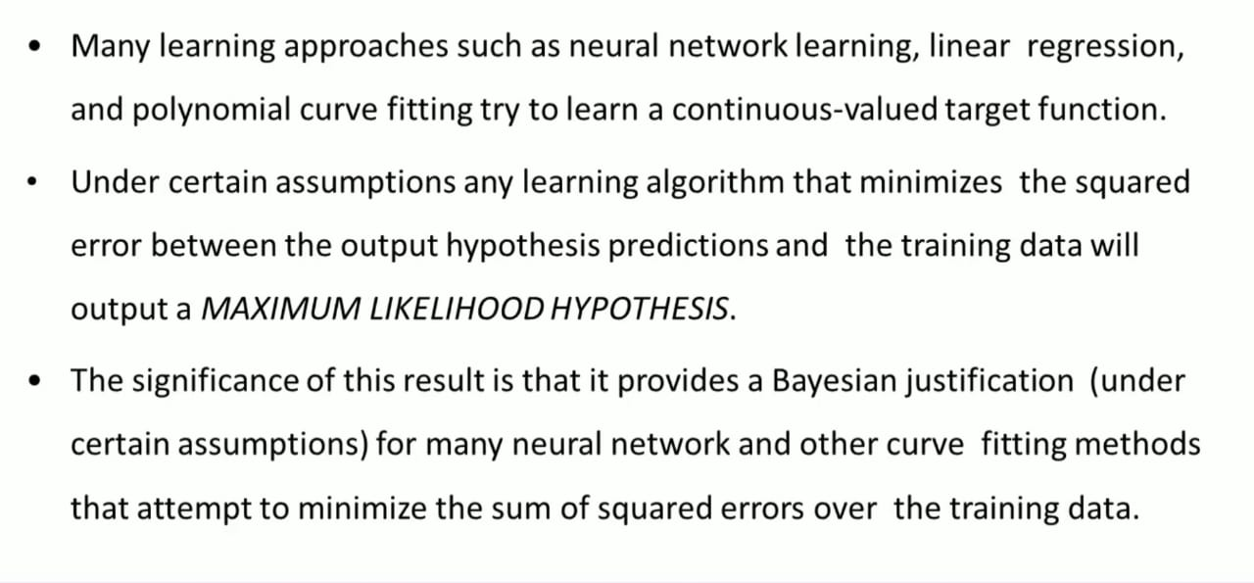
Maximum likelihood and least squared error hypothesis
directly not possible with bayes

Slide 26
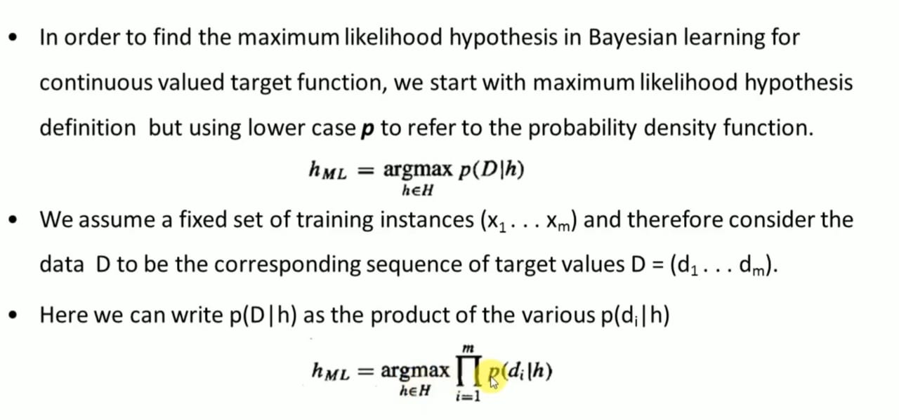

Slide 27
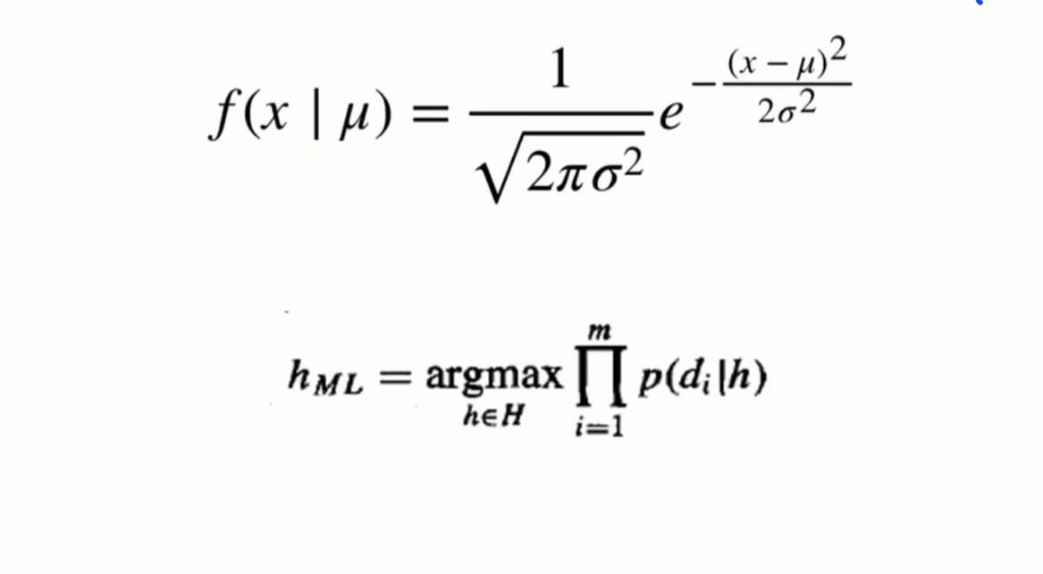
If the target values are normally distributed , the probability density function is
Input mean
Standard deviation

Slide 28
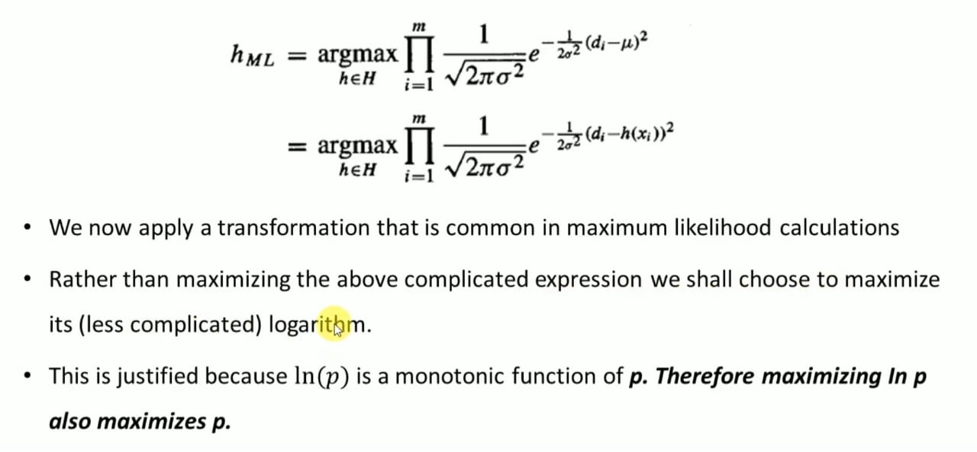

Slide 29
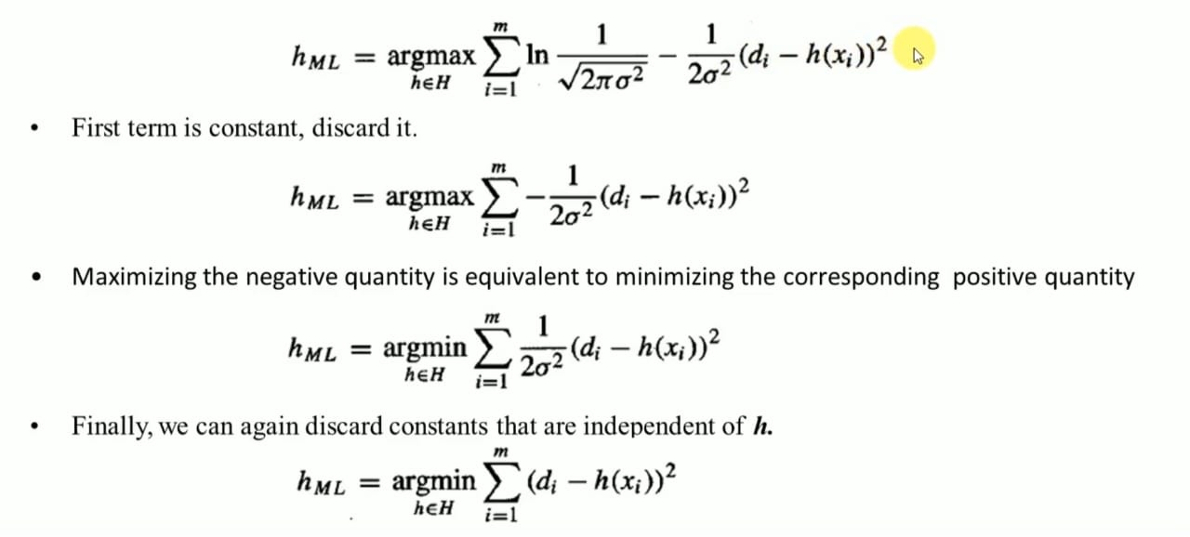

Slide 30
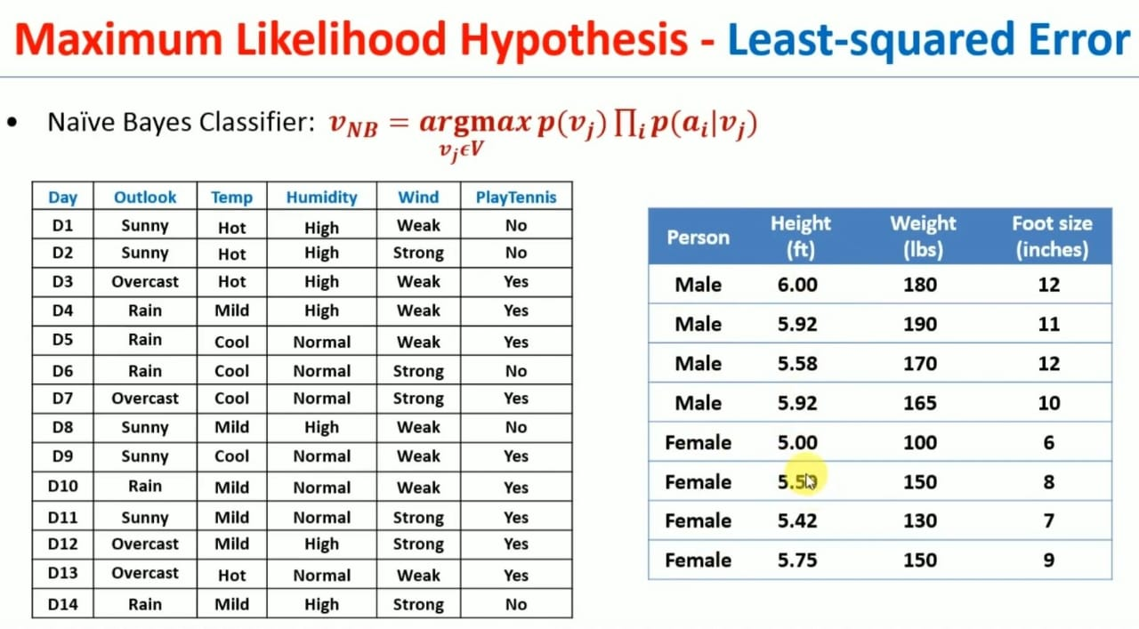

Slide 31
Bayesian Belief network
It represents the joint probability distribution for a set of variables.
2 important concepts
Directed acyclic graph(DAG)
Conditional probability table(CPT)

Slide 32
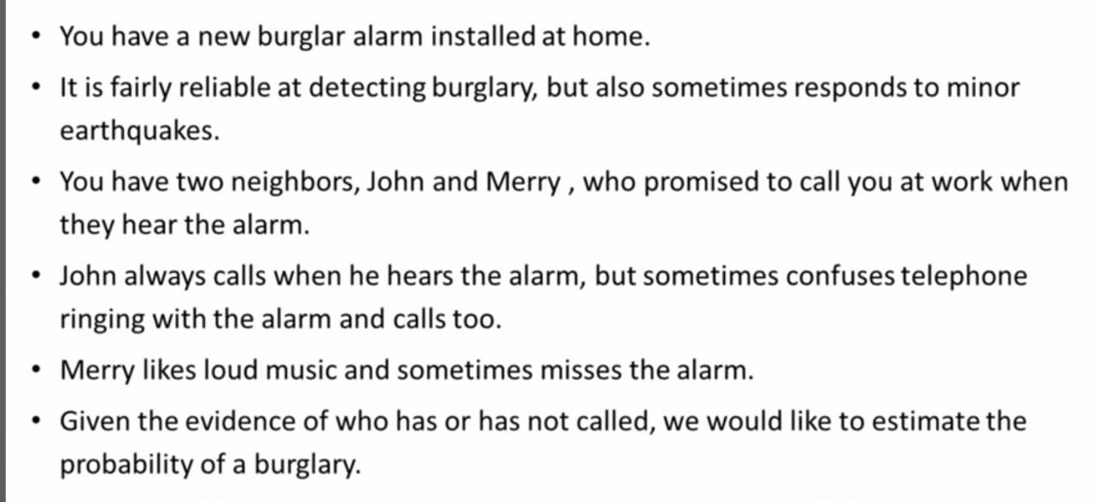
Bayesian Belief network

Slide 33
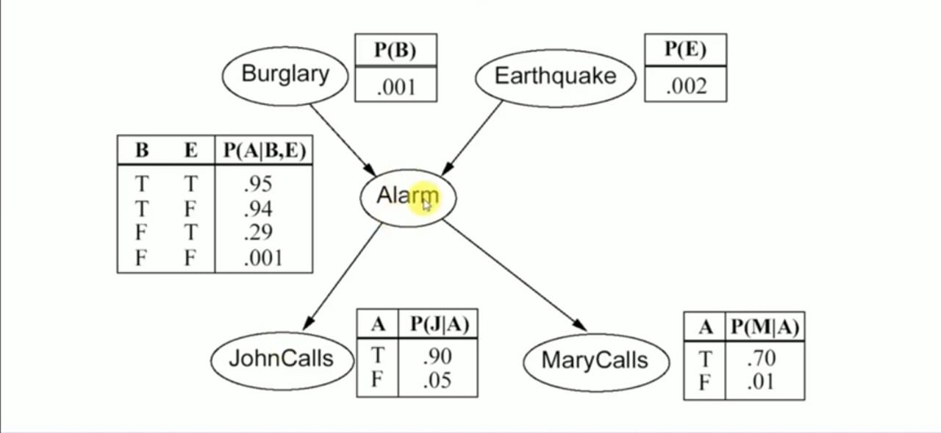

Slide 34
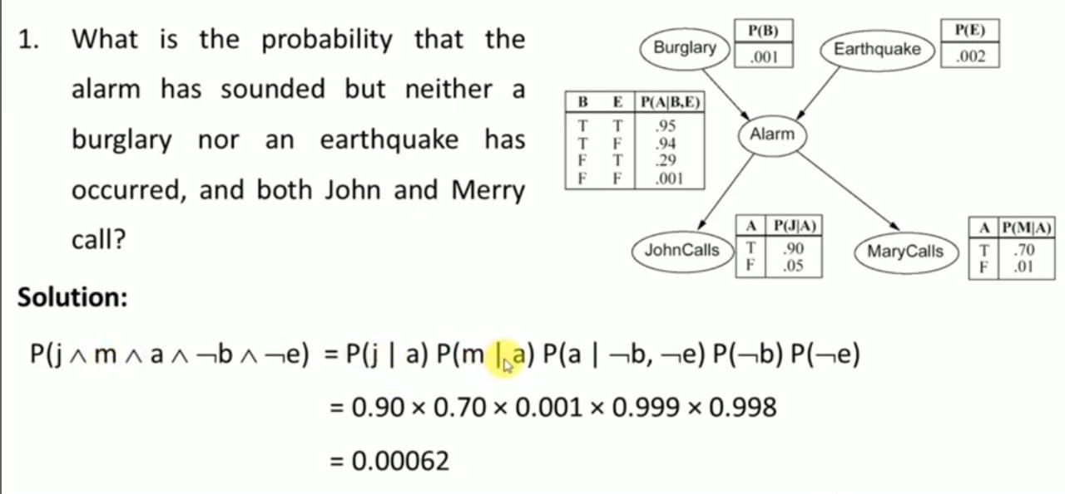

Slide 35
