Slide 1


CLIMATE ASSISTANT HELP

Slide 2
CLIMATE CREW TEAM
D. SAI SWETHA
PROJECT NAME
CLIMATE HELP ASSITANCE

Slide 3
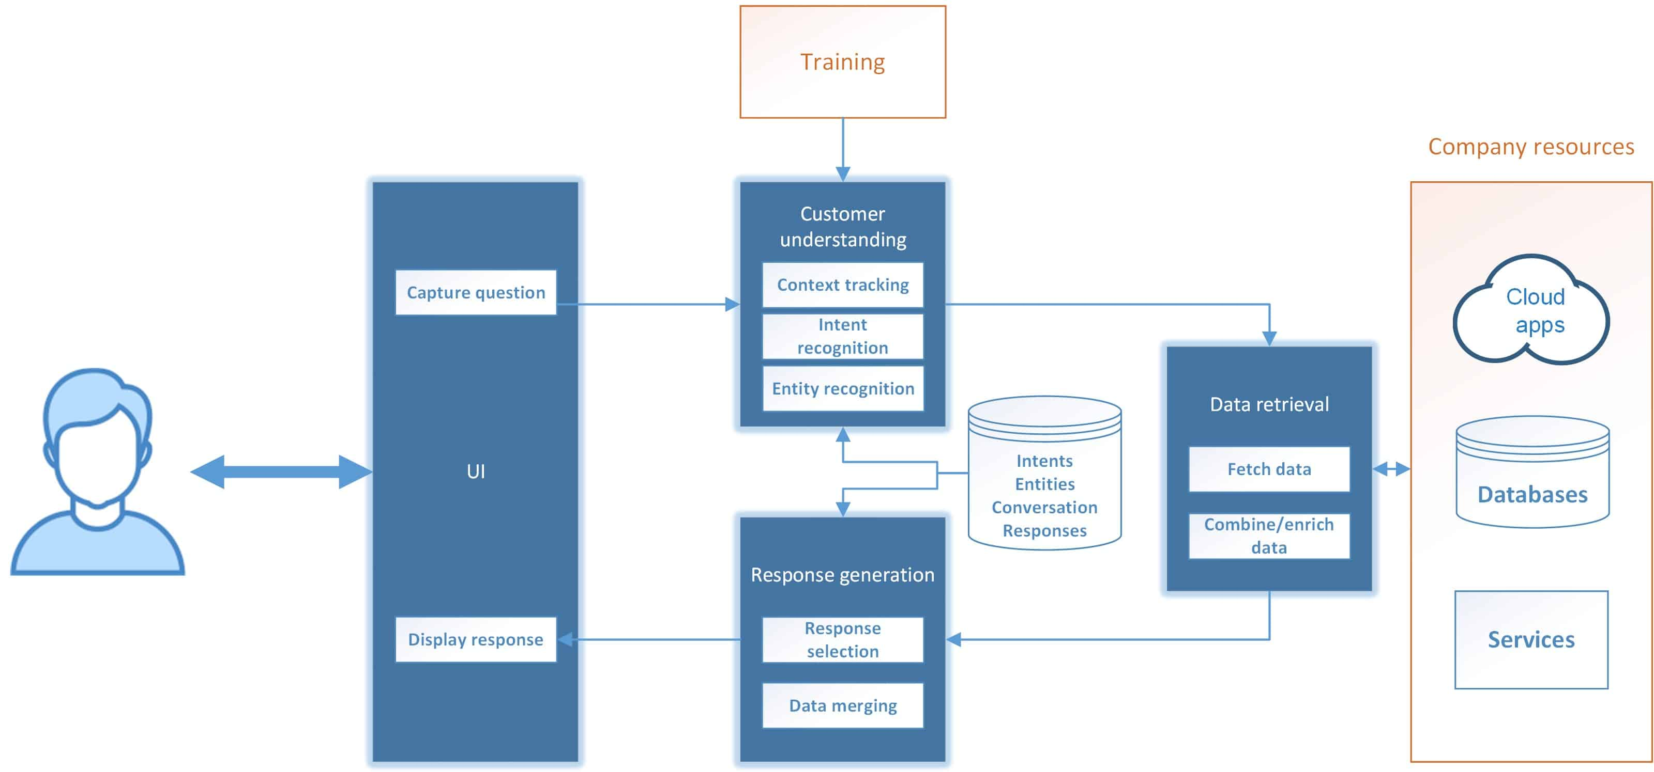
CHATBOT ARCHITECTURE

Slide 4

CHARTBOT ASSISTANT Awareness

Slide 5
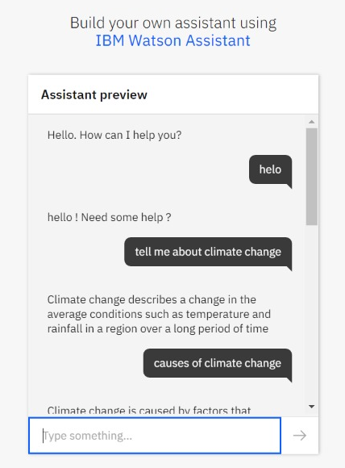
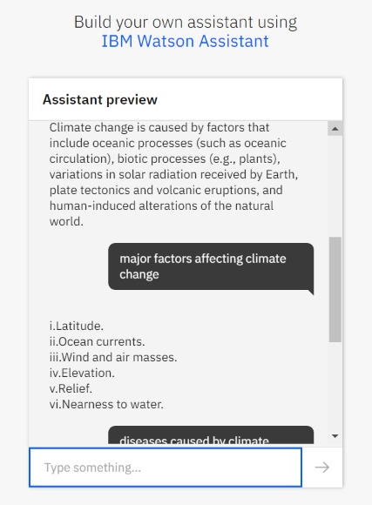

Slide 6
The terms climate change and global warming are often used interchangeably, but climate change refers to both the rise in global temperatures because of human activities and the many impacts this rise has on the planet - such as more intense and frequent droughts and storms, melting glaciers and ice sheets, rising sea levels, warming seas, and ocean acidification.
How the Assistant Works?
The three main components of Watson Assistant are Intents, Entities, and Dialog. Intents are sets of user examples to train Watson Assistant. They represent the questions that a user might ask. Entities are dictionaries of keywords and patterns, and the Dialog is the flow of the conversation, where we can build nodes and link them to our intents and entities to design and handle the conversation. Each assistant has its intents and entities, and we trained the assistant using common words among different dialects to make it understand questions.

Slide 7
SOURCE CODE
https://web-chat.global.assistant.watson.cloud.ibm.com/preview.html?region=eu-gb&integrationID=4248ee88-7f56-4acc-ad1d-f5fd3bf6a31d&serviceInstanceID=abf0722a-101c-4fec-bd6e-799933aab6a9

