Slide 1
Retail Demand Forecasting & Inventory Optimization
End-to-end mini-project | October 2026
PGDM Big Data Analytics & DBMS Project
Faculty: Dr. Butchi Babu Muvva
Tools: PostgreSQL • DBeaver • Python • Databricks/Delta Lake • Power BI • GitHub

Slide 2
Business Problem & Objectives
Retail demand varies by product, store and date; weak visibility can lead to overstock or stock risk.
Explore sales and inventory patterns, create a reproducible baseline forecast, and support data-informed replenishment review.
Demonstrate the flow from source data → database → processing → analytics → dashboard.

Slide 3
Dataset Profile
6,000 rows and 16 fields
2024-01-01 to 2024-02-29 | 5 stores | 20 products
Revenue: ₹13,969,230.40 | Units sold: 141,189
Data is synthetic/simulated; no public source URL was supplied. Estimated unmet demand is not verified lost sales.

Slide 4
Technical Workflow
1. Python: profile, clean, visualize and evaluate a baseline model.
2. PostgreSQL: store dimensions/fact data and run analytical SQL through DBeaver.
3. Databricks: PySpark transformations in Bronze/Silver/Gold Delta layers (workspace execution to be verified).
4. Power BI: KPIs, trends, product/category comparisons, inventory-risk table and slicers.
5. GitHub: version-controlled source, report, notebooks, outputs and evidence.

Slide 5
Python Analytics
Data quality: schema, missing cells, duplicate rows and date coverage.
Exploratory charts: daily revenue, category revenue, top products, weekday demand.
Random Forest baseline with chronological holdout on the latest 20% of dates.
Metrics: MAE, RMSE and MAPE on non-zero actuals; treat as illustrative due to short synthetic history.

Slide 6
Database & Big Data Processing
PostgreSQL schema includes product/store dimensions, staging table and sales fact table.
SQL queries summarize KPIs, city/category revenue, daily trends, top products, stock risk and promotion comparisons.
Databricks notebook writes Bronze raw data, Silver cleaned data and Gold BI-ready aggregates to Delta paths.
Capture actual DBeaver and Databricks execution evidence before submission.

Slide 7
Dashboard & Business Questions
KPIs: Revenue, Units Sold, Estimated Unmet Demand, Estimated Gross Profit.
Visuals: daily revenue trend, category revenue, top products, weekday demand and inventory-risk table.
Slicers: Date, City, Category, Store and Promotion.
Static PNGs are previews; build and save an actual interactive Power BI .pbix if feasible.

Slide 8
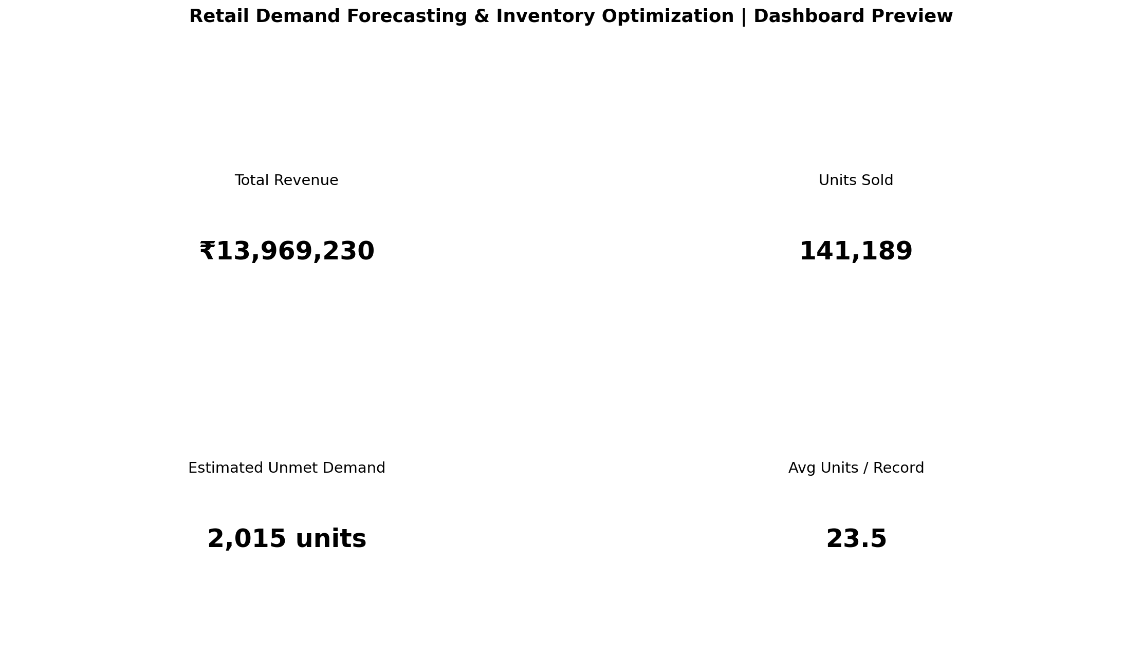
Dashboard Preview (Static)

Slide 9
Findings & Recommendations
Review products/stores with low closing stock and estimated unmet demand before replenishment decisions.
Use product/category and weekday patterns to guide review of reorder points and safety stock.
Treat promotion comparisons as descriptive associations, not proof of causal lift.
Validate forecast performance with longer history, stockout labels, lead times, holidays and repeated backtests.

Slide 10
Limitations & Next Steps
Only 60 days of simulated observations; annual seasonality cannot be established.
Unmet demand is estimated/simulated, not independently validated.
Tool execution must be evidenced from the student’s PostgreSQL, Databricks and Power BI environments.
Next: capture genuine screenshots, verify row totals across tools, add team contribution details, and publish the repository.

Slide 11
GitHub & Submission Checklist
Upload README, data dictionary, SQL scripts, Python notebook, Databricks export, Power BI evidence, report and presentation.
Do not commit passwords, tokens, credentials or confidential data.
Repository includes source code and static previews; actual .pbix and live execution screenshots must be added if required.
Final submission date in the supplied faculty guide: 28 October 2026.

