Slide 1


BLOCKCHAIN FOR HEALTH DATA SECURIT AND TRANSPARENCY PROJECT VIVA VOCE PERSENTATION Submittted by NAME: SWETHA G REG NO: 2023551056 II MSC Computer Science Alagappa University
Under the guidance of
Dr. T. MEYYAPPAN M.Sc., M.B.A. M.Tech., M. Phil.
Ph.D,Senior Professor and Chairperson
DEPARTMENT OF COMPUTER SCIENCE
ALAGAPPA UNIVERSITY

Slide 2
ABSTRACT:
The current solution in healthcare for storing and sharing medical records is the ElectronicHealth Record (EHR) which is highly sensitive.
The majority of EHR data sharing is still done through mail because shortage of trustable and reliable health data sharing mechanism.
This leads to significant delays in the patient’s treatment Blockchain has the potential to improve healthcare by putting the patient at the center of the system and enhancing health data protection and interoperability

Slide 3
INTRODUCTION:
The healthcare industry has witnessed rapid advancements in digital technologies, yet the secure and efficient exchange of medical records remains a critical challenge.
Electronic Health Records (EHRs) are the standard method for storing patient information.
However, due to concerns regarding data privacy, security, and lack of trustable data-sharing frameworks, many healthcare providers still rely on traditional methods like physical mail to share sensitive medical information.

Slide 4
This results in delays in diagnosis, treatment, and overall patient care.
Blockchain technology has emerged as a promising solution to these challenges, offering a decentralized and transparent system that ensures data integrity, confidentiality, and secure access control.

Slide 5
SYSTEM ANALYSIS:
HARDWARE SPECIFICATION:
System | PentiumIV2.4GHz
HardDisk | 40GB.
Monitor | 15inchVGAColor.
Mouse | LogitechMouse.
Ram | 512MB
Keyboard | Standard Keyboard

Slide 6
SOFTWARE SPECIFICATION:
OperatingSystem | WindowsXP
Platform | PYTHONTECHNOLOGY
Tool ▪ | Python 3.6
FrontEnd | Pythonanaconda script
BackEnd | Spyder

Slide 7
Existing System:
An EHR is an electronic version of a patient’s medical details. In current times, EHR is used to share patients’ medical records across various hospitals.
EMR contains a patient’s medical diagnoses, allergies, history, treatment, and laboratory reports.
The healthcareIT standards that are used in EHR are Fast Healthcare Interoperability Resources (FHIR) and Health Level 7(HL7) to transfer clinical data between various applications that are used by different healthcare providers.

Slide 8
Proposed System:
Blockchain has the potential to improve health care by putting the patient at the center of the system and enhancing health data protection and interoperability
It is highly efficient in the case when various participants want to access the same database. Thus, blockchain can minimize a lot of resources and costs to access the same database securely..

Slide 9
Module Description:
HOSPITAL REGISTRATION:
The Hospital Registration Module is a critical component in the system that enables healthcare institutions such as hospitals, clinics, and diagnostic centers to securely register and join the blockchain network.
This module ensures that only verified and trusted organizations can participate in accessing and managing patient data, preserving the integrity and confidentiality of
the health records.

Slide 10
KeyFunctionsand Features:
Secure On boarding Process
Role Assignment
Blockchain Enrollment
Smart Contract Integration
Login Credentials Generation

Slide 11
CUSTOMER REGISTRATION:
This module ensures that every patient has a unique identity, enabling them to manage their electronic health records (EHRs) and control access to theirpersonal data.
During registration, the system collects essential information such as the patient’s name, date of birth, contact number, email, and government-issued ID.

Slide 12
Robust validation checks are implemented to ensure the authenticity and uniqueness of the submitted data, including email verification and password strength policies.
Once the registration formis successfully submitted and verified, the user is assigned the “Patient” role in the system.

Slide 13
Advantage:
One of the major advantages of blockchain.
It stores data cryptographically encrypted via distributed and decentralized way in peers.
The next benefit of blockchain is immutability.
Automated smart contracts speed up insurance claims processing and reduce fraud.

Slide 14
Disadvantage:
It is a more energy-efficient version of PoW.
The disadvantage here is the monopoly, whenit comesto both technological and economic aspects of the scheme, the main stake holder has full influence and authority.
The transactions do not need several confirmations. (For example, in Bitcoin’sPoW
Confirmations will take anywhere from 10 to 60 minutes depending on how many individuals have to confirm the new block).

Slide 15
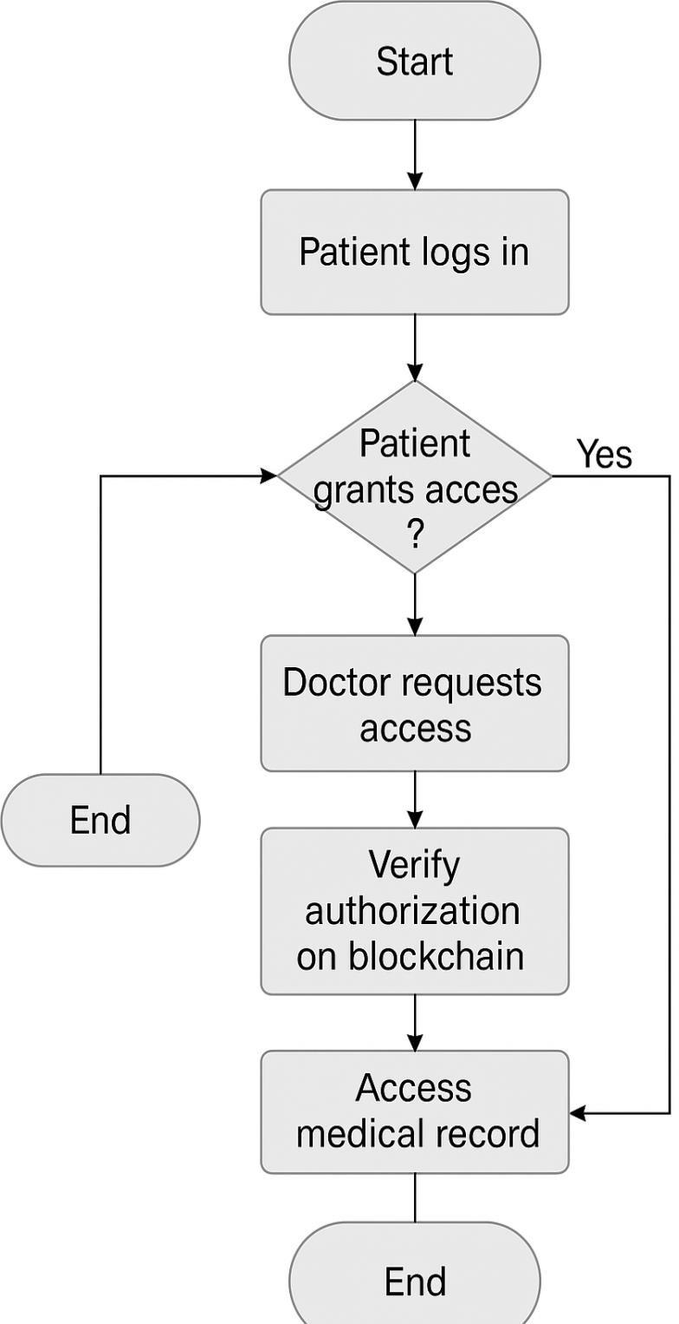
FLOWCHART :

Slide 16
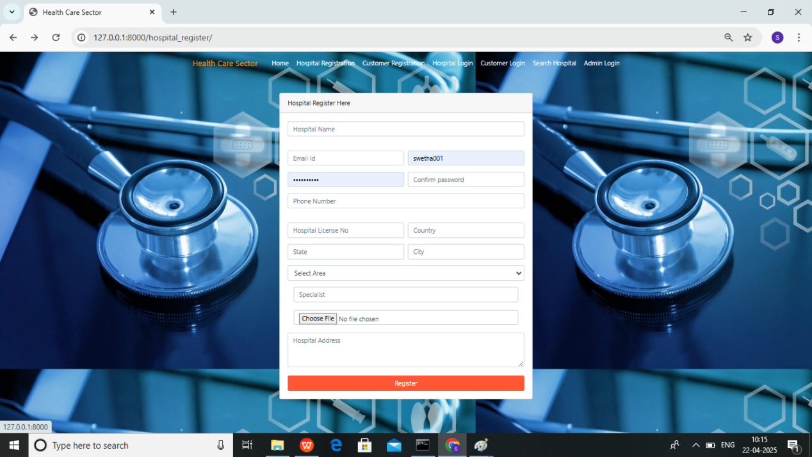
SCREENSHOT:

Slide 17
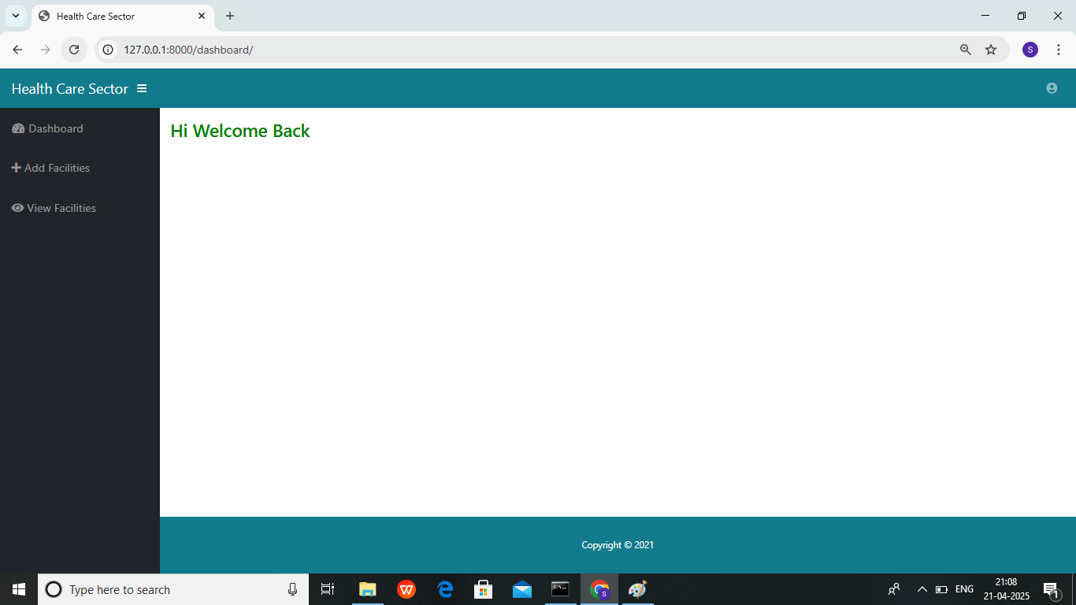

Slide 18
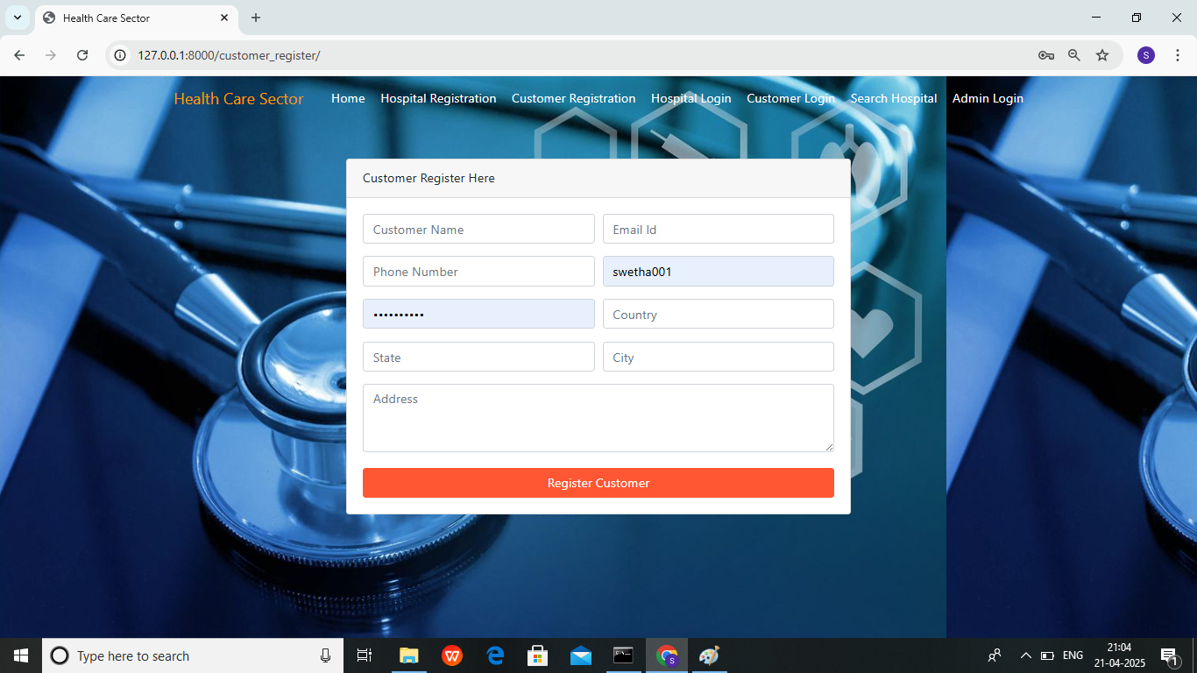
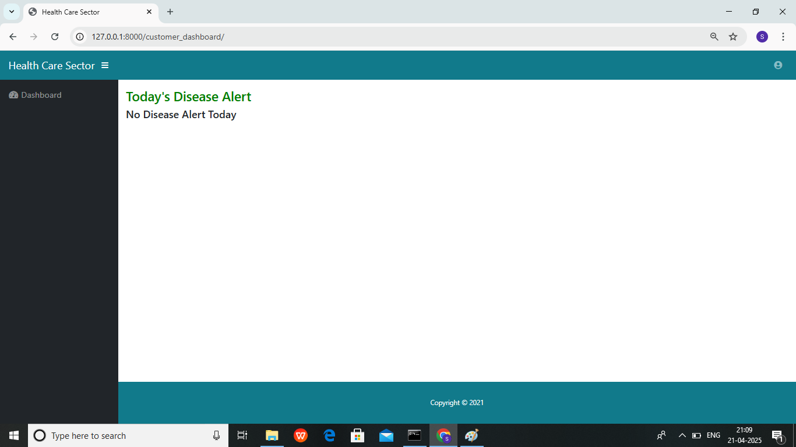

Slide 19
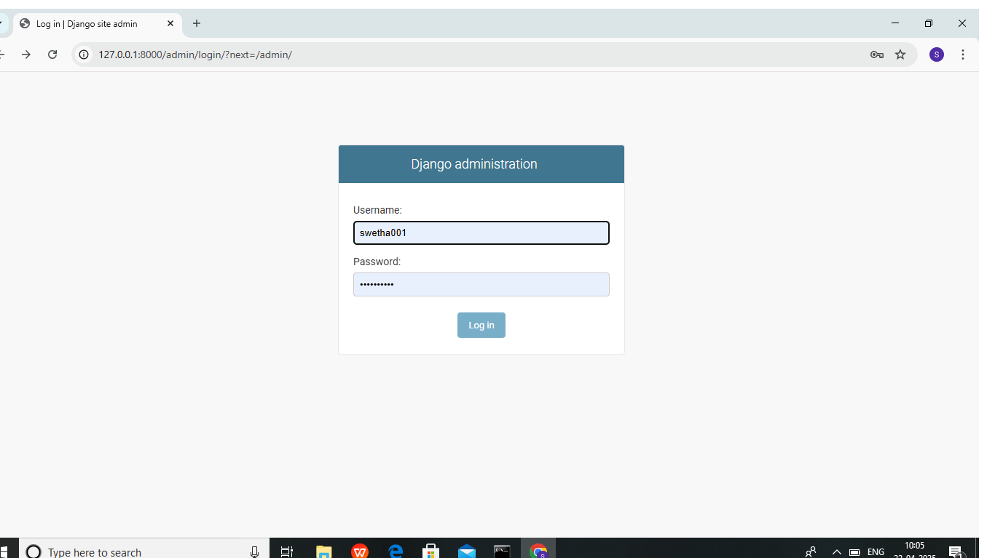

Slide 20
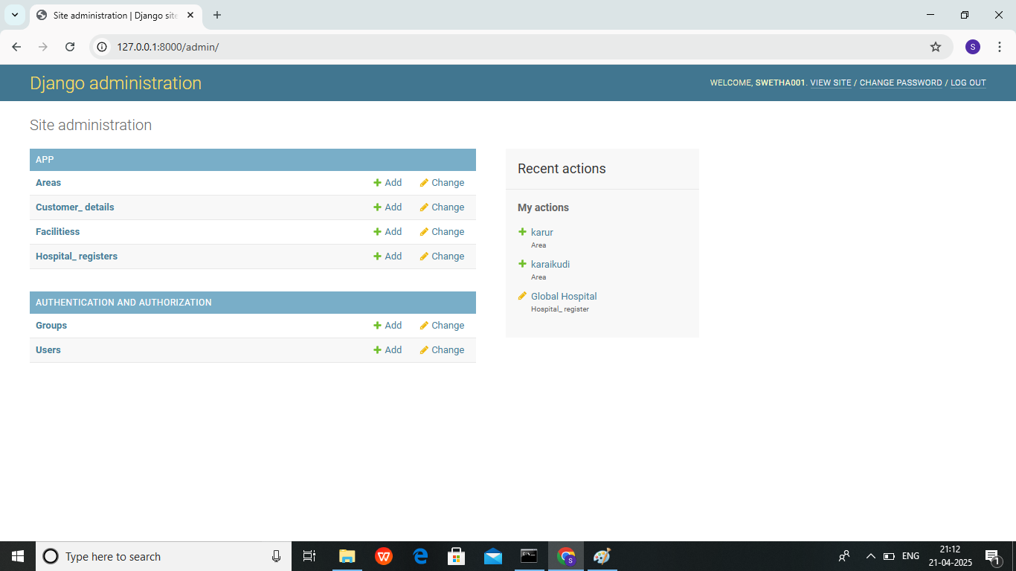

Slide 21
THANK YOU

