Slide 1
6G AI-Based Secure Channel Estimation
End-to-end implementation — dataset, multi-agent PHY intelligence, digital twin, attack mitigation, dashboard, and 3GPP-aligned evaluation
3GPP TR 38.901 · TS 38.211 · TR 38.843 · TR 38.811 · Nokia RAN1 R1-2506757 · O-RAN RIC
StrongHER | Swetha Kerahalli | System Architect, MI RRD AS Algo Innov

Slide 2
Agenda
1. Problem and 3GPP-aligned opportunity 2. Architecture: ten agents + digital twin + O-RAN mapping 3. Synthetic dataset (≥60k) from CDL/TDL, NTN, THz, RIS 4. Train / validation / test of every model 5. LS vs MMSE vs AI ensemble — NMSE, BER, SE 6. Security classification and autonomous mitigation 7. Digital twin visualizations and closed loop 8. Dashboard, chatbot, knowledge sources, next steps

Slide 3
The 6G CSI problem
• LS/MMSE break under THz blockage, RIS, ultra-massive MIMO, NTN Doppler • Pilot overhead explodes as Nt × Nr and bandwidth grow • No native CSI prediction → reactive, not proactive RAN • Pilot contamination, jamming, spoofing, poisoning, adversarial CSI • Need an AI-native, self-securing channel intelligence plane aligned with Rel-18/19/20 (TR 38.843) and 6G RAN1 studies

Slide 4
Multi-agent architecture
Channel Agent CNN+LSTM+Transformer+GNN ensemble CSI estimate CSI Prediction Reduce pilots when forecast accuracy is high Security Agent Multi-class attack detection (RF) + IsolationForest Mitigation Agent Pilot reassign / beam switch / hop / trust / FL retrain Beam Agent Spatial beam index from SNR, Doppler, array size Mobility Agent Predictive handover from velocity + neighbor RSRP Optimization Spectral efficiency vs pilot overhead Digital Twin Fidelity-gated policy validation Explainability Permutation importance for operator trust Orchestrator Global policy fusion for Near-RT RIC

Slide 5
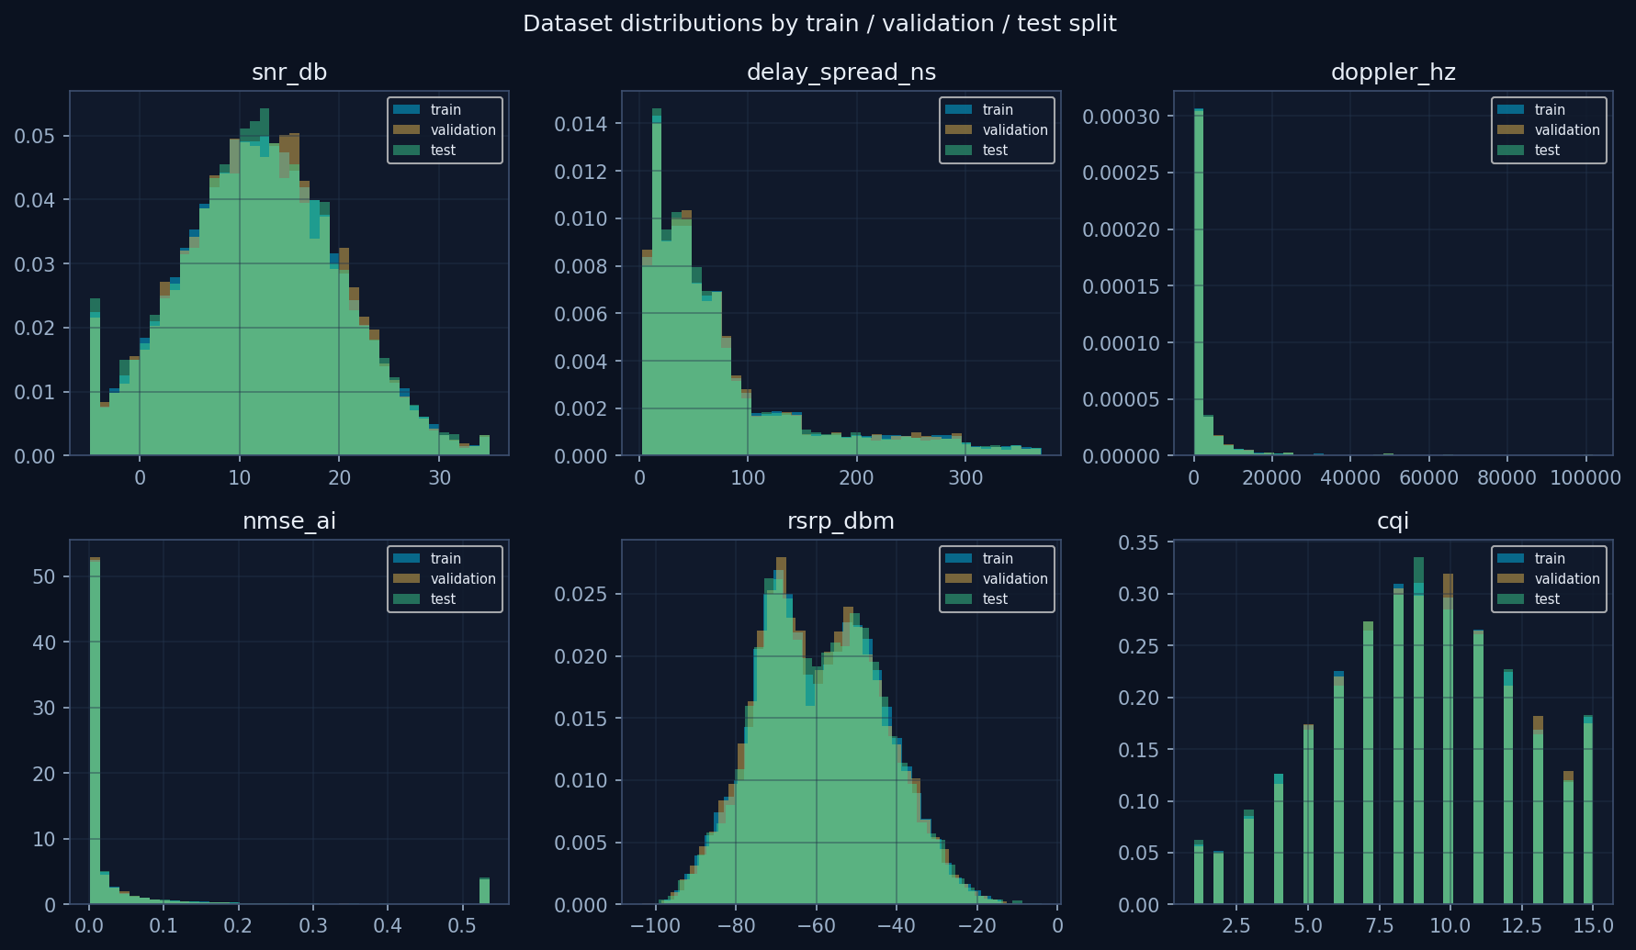
3GPP-aligned synthetic dataset
45500 train · 9750 validation · 9750 test (≥ 60,000 rows)

Slide 6
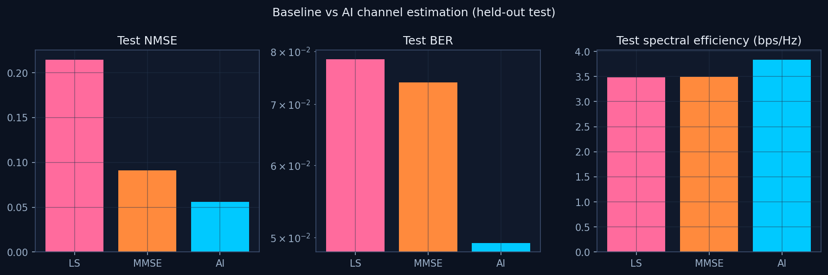
LS vs MMSE vs AI — test NMSE / BER / SE
NMSE Δ 38.24% BER Δ 33.36% SE Δ 9.78%

Slide 7
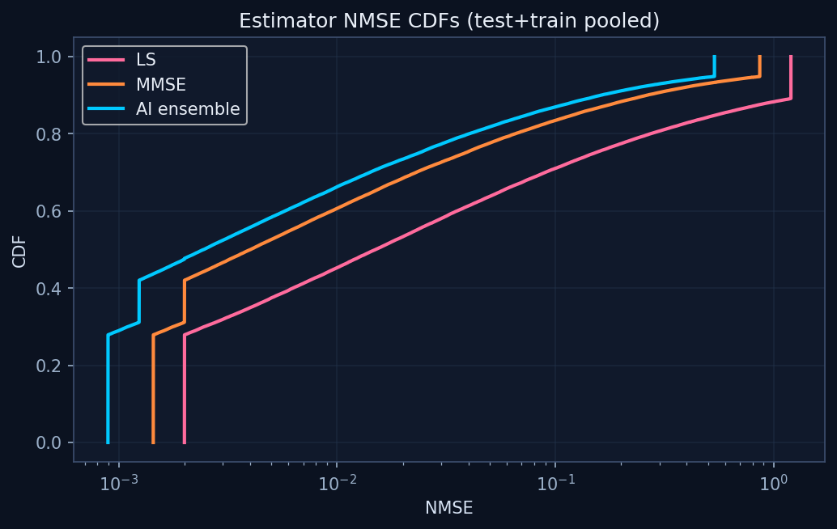
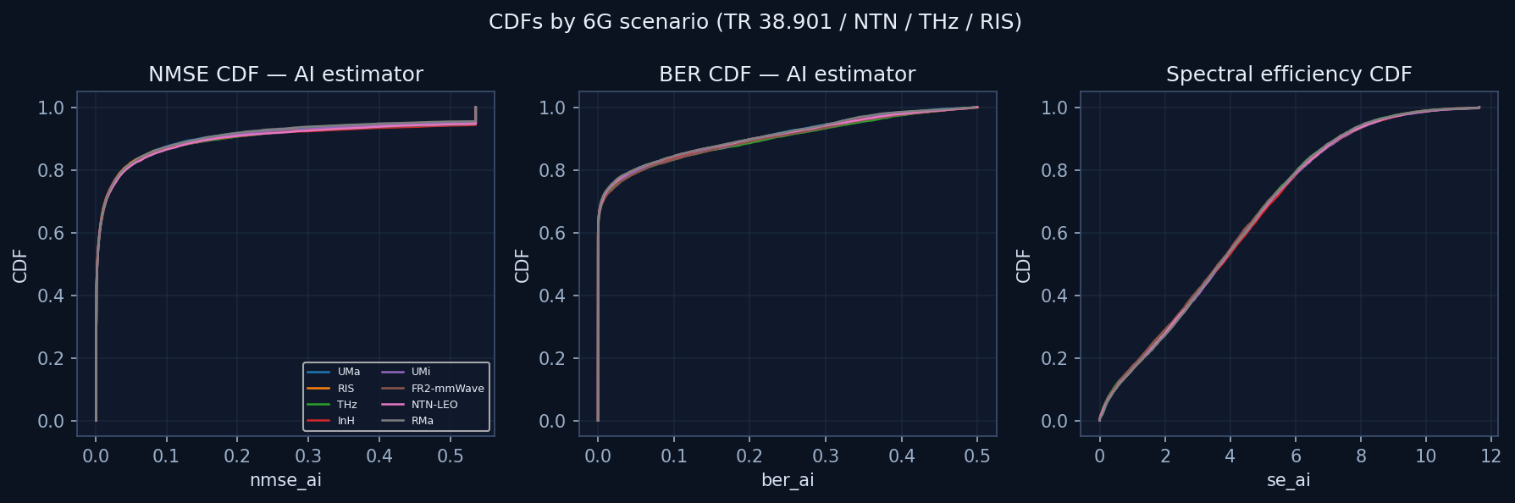
Estimator NMSE CDFs and scenario CDFs

Slide 8
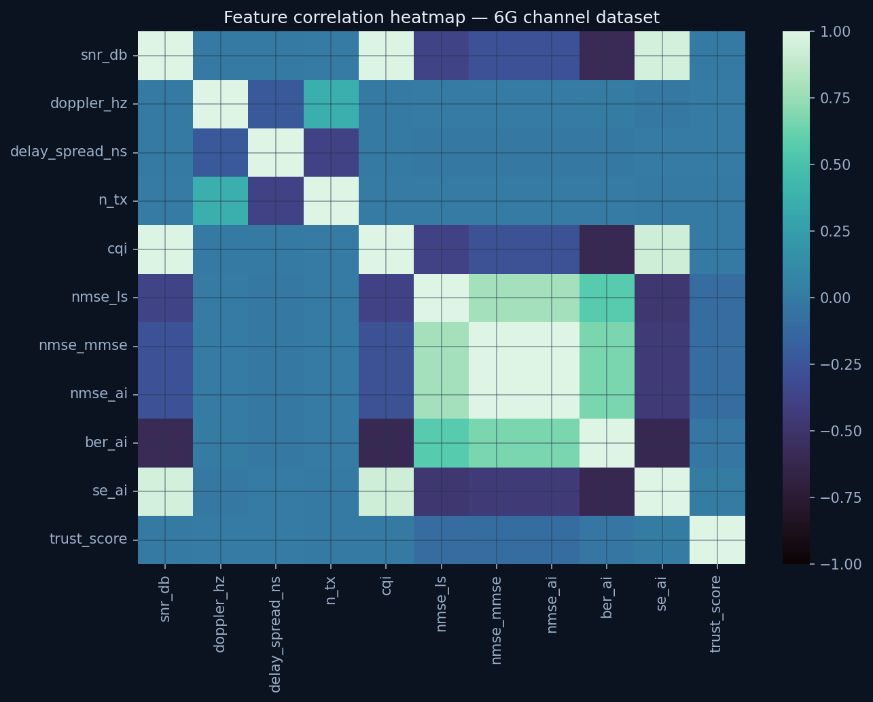
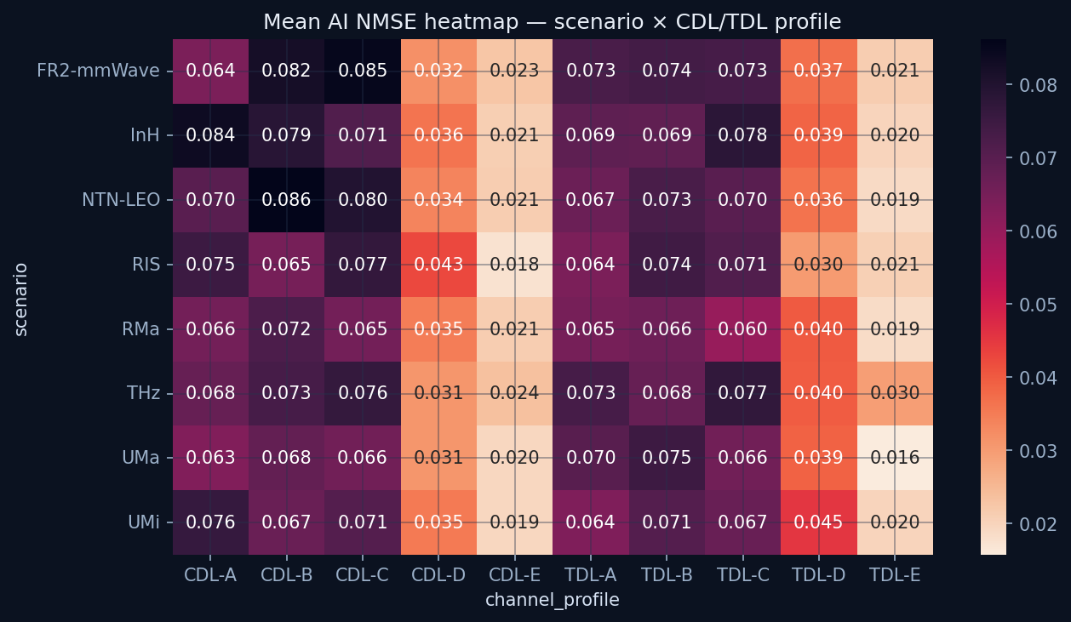
Heatmaps — correlation and scenario × profile NMSE

Slide 9
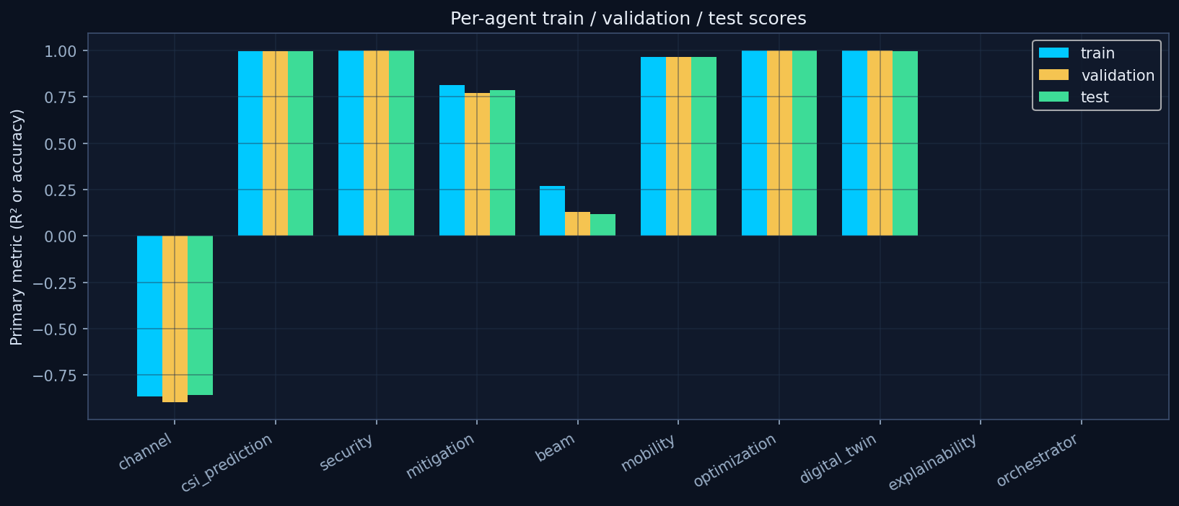
Train / validation / test by agent

Slide 10
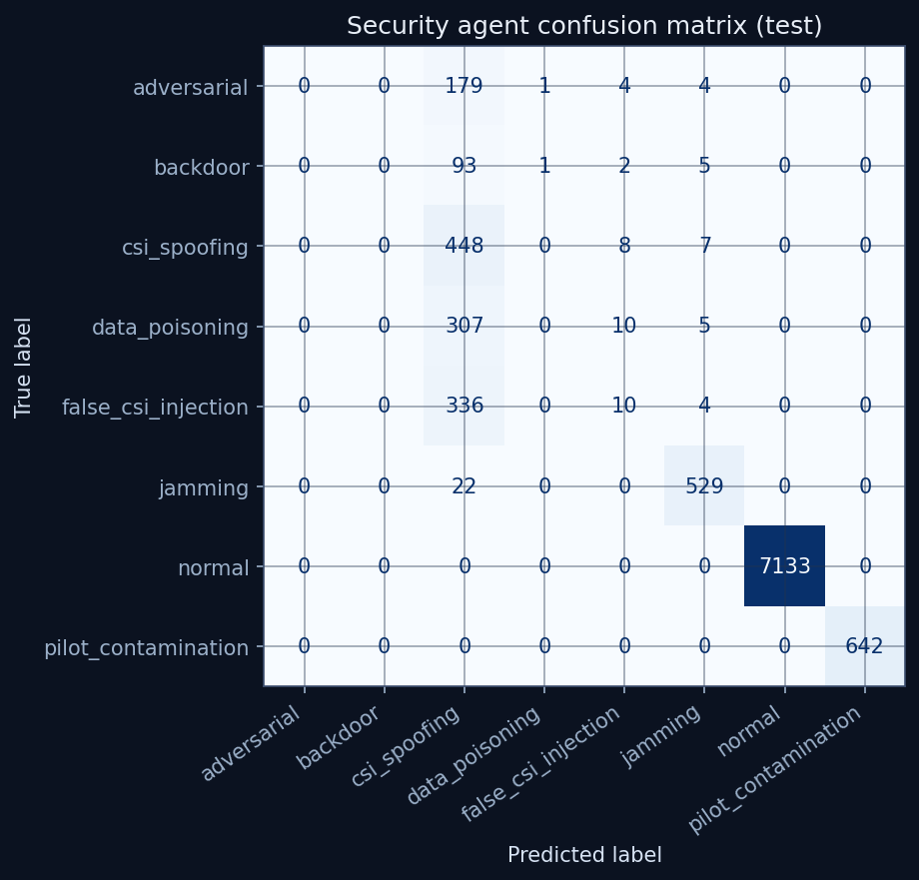
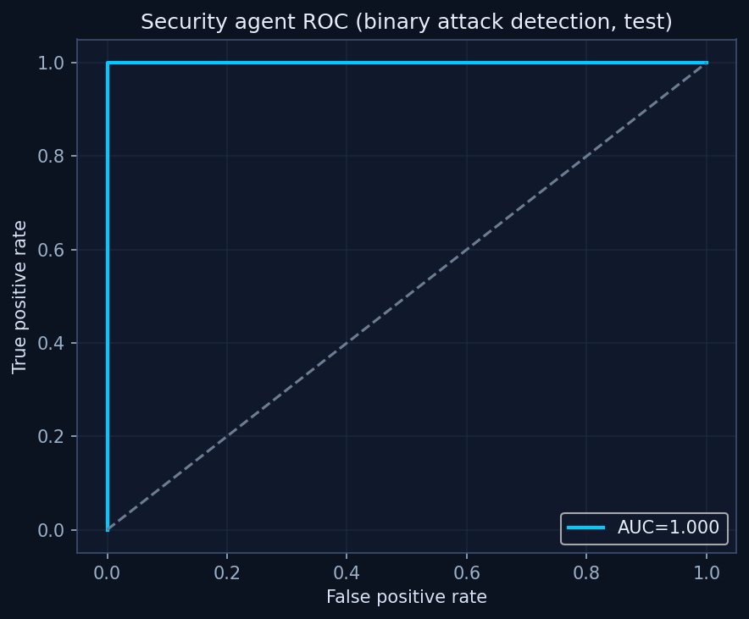
Security agent — classification, ROC, scatter

Slide 11
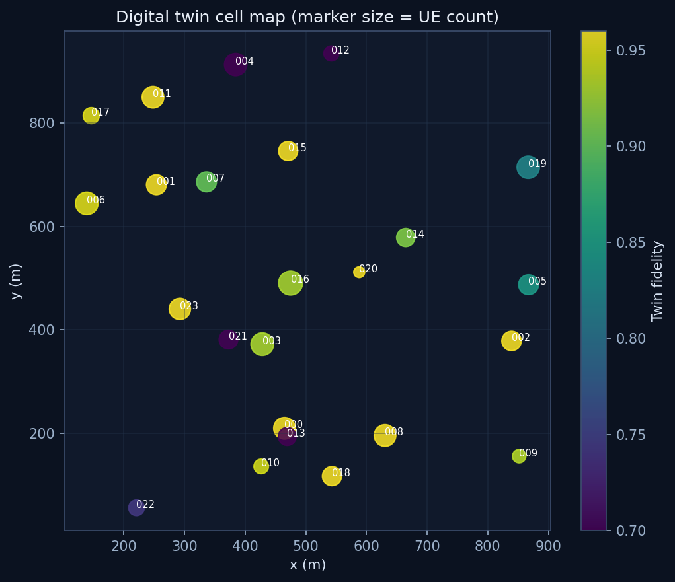
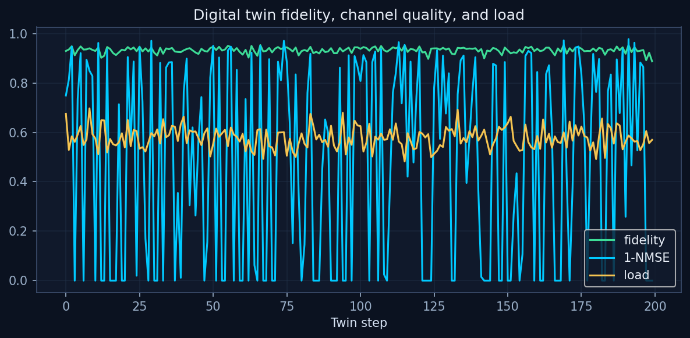
Digital twin — cell map and fidelity loop

Slide 12
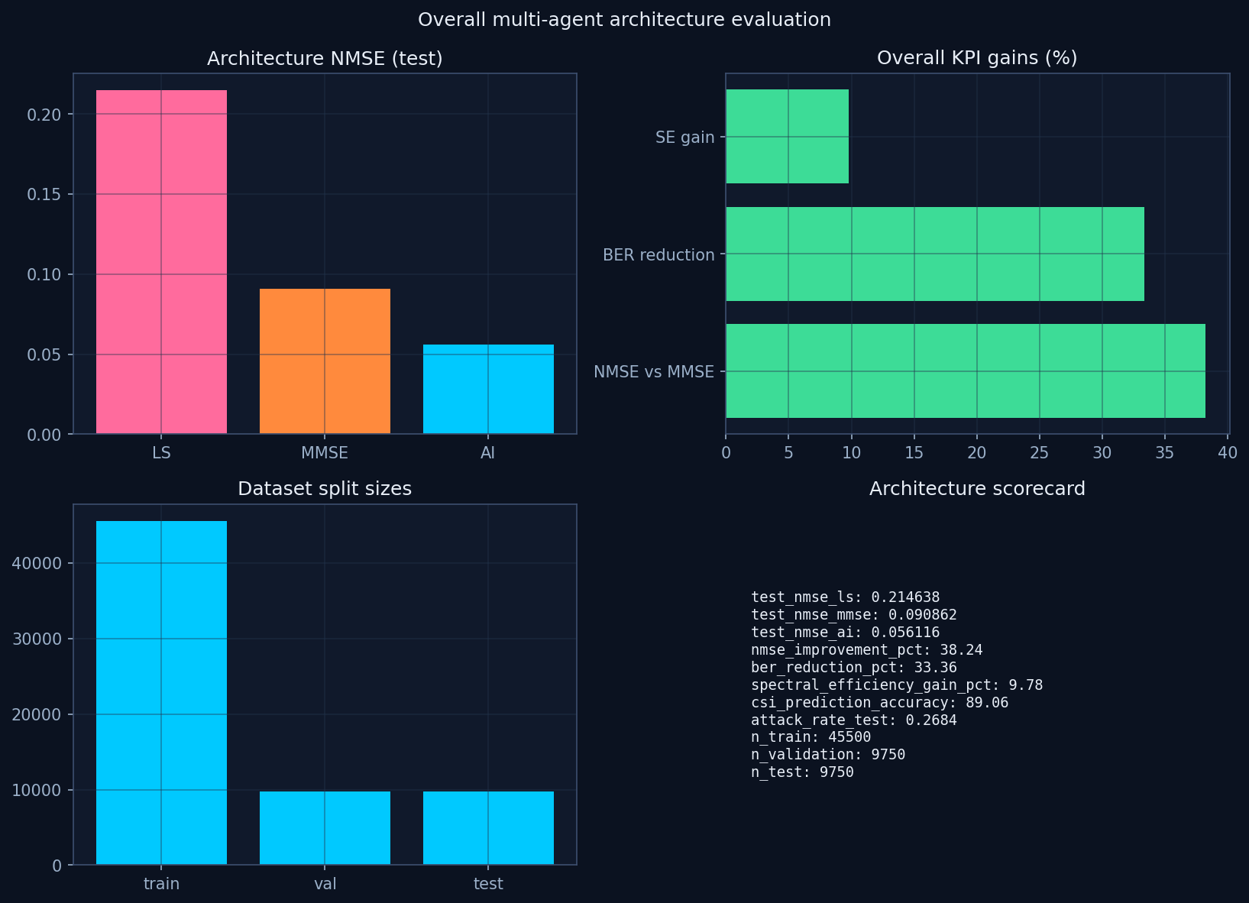
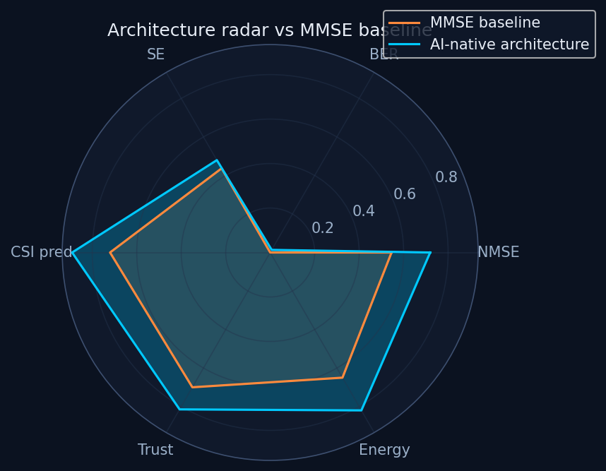
Overall architecture evaluation

Slide 13
Knowledge sources
3GPP.org TR 38.901 CDL/TDL · TS 38.211 DMRS/CSI-RS · TR 38.843 AI/ML AiF · TR 38.811 NTN System Insights CFAM RP003187 DMRS channel estimation (5GMax / 5G_L1_2794) SharePoint R1-2506757 6G AI/ML use cases · PHY AI radio deep dive · RAN1#126 · RAN4#120 Confluence EE spaces queried (NRAC, RFSW); no indexed hits on this client CCFK Nokia CSF dashboard components (Autonomous RAN pattern) agent-shim clone blocked on scm.cci.nokia.net auth — local shim adapter provided

Slide 14
Run the platform
cd Swetha_StrongHER_projects/6G_AI_Channel_Estimation/code pip install -r requirements.txt python scripts/run_end_to_end.py python scripts/run_api_server.py Dashboard http://localhost:8090/dashboard API http://localhost:8090/docs Slides docs/6G_AI_CE_E2E_Implementation.pptx

Slide 15
AI-native, self-securing 6G channel intelligence
Accurate CSI · Predicted CSI · Detected attacks · Mitigated threats Twin-validated policies · O-RAN ready
Nokia confidential — StrongHER internal use

