Slide 1
Multi Agentic AI-Native Autonomous RAN and Air Interface for 6G Networks
Swetha Kerahalli, System Architect, MI RRD AS Algo Innov Bengaluru

Slide 2
Agenda
Introduction
Details
Final Deliverables
Problem Statement
Proposed Solution

Slide 3
Problem Statement
Current 5G and Open RAN deployments still rely heavily on predefined policies, static optimization rules, centralized controllers, and human-assisted operations.
The limitations include:
Dynamic traffic patterns exceeding optimization capabilities.
Massive IoT density creating scheduling complexity.
THz communication introducing highly dynamic channel conditions.
Integrated TN-NTN architectures increasing mobility complexity.
Ultra-low latency applications requiring real-time adaptation.
Energy consumption becoming a major operational concern.
Increasing complexity of network slicing and service orchestration.
Traditional optimization methods become computationally infeasible because many RAN optimization problems belong to NP-hard optimization classes.
How can multiple autonomous AI agents collaboratively optimize scheduling, resource allocation, mobility, energy efficiency, security, beam management, and air interface adaptation in real-time while ensuring network stability, scalability, explainability, and trustworthiness in 6G environments?

Slide 4
Proposed Solution
The proposed framework aims to:
Develop a Multi-Agent AI-Native RAN architecture where specialized agents autonomously manage scheduling, radio resource allocation, security, mobility, energy consumption, network slicing, and air-interface adaptation.
The system must learn continuously from network observations, coordinate actions among agents, and optimize both local and global objectives using reinforcement learning, graph neural networks, federated learning, foundation models, and digital twins.

Slide 5
Project Overview
Item | Description
Project Title | Multi-Agentic AI-Native Autonomous RAN and Air Interface with Autonomous Security Intelligence for 6G Networks
Research Area | 6G Wireless Communications, AI-Native Networks, O-RAN, Multi-Agent AI, Security Intelligence
Duration | 4 Months
Standards Alignment | 3GPP Release 18, Release 19, Release 20, O-RAN
Deployment Target | Near-RT RIC, Non-RT RIC, SMO, AI-Native Air Interface
Final Goal | Autonomous, Self-Healing, Self-Securing, AI-Native 6G RAN

Slide 6
Month 1: Research, Architecture Design and Dataset Preparation
Week | Activity | Detailed Tasks | Deliverables
Week 1 | Literature Review | Study 3GPP Rel-18/19 AI-RAN, O-RAN, AI-Native Air Interface, Digital Twin | Literature Survey Report
Week 1 | Requirement Analysis | Define KPIs, Use Cases, Constraints | Requirement Specification Document
Week 2 | Architecture Design | Design AI-Native Air Interface, Multi-Agent Architecture, Security Architecture | High-Level Architecture
Week 2 | Agent Identification | Define Scheduler, Resource, Mobility, Security, Energy, QoE, Slice Agents | Agent Design Document
Week 3 | Dataset Planning | Identify required RAN, Mobility, Security, Energy datasets | Dataset Requirement Document
Week 3 | Data Collection | Collect telecom KPI data and logs | Raw Dataset Repository
Week 4 | Technology Stack Finalization | Select AI, O-RAN, MLOps, Digital Twin Tools | Technology Stack Document
Week 4 | Project Review | Architecture Review and Design Freeze | Month-1 Review Report

Slide 7
Month 1 Deliverables
Deliverable | Description
Literature Review | AI-RAN, O-RAN, 6G Research Survey
System Architecture | Complete End-to-End Architecture
Dataset Design | Data Sources and Features
Technology Stack | Software and Hardware Selection

Slide 8
Month 2: AI Agent Development
Week | Activity | Detailed Tasks | Deliverables
Week 1 | Scheduler Agent Development | Develop PPO/DQN-based scheduler | Scheduler Agent V1
Week 1 | Resource Agent Development | Develop spectrum and power allocation agent | Resource Agent V1
Week 2 | Mobility Agent Development | Implement mobility prediction and handover optimization | Mobility Agent V1
Week 2 | Security Agent Development | Develop threat detection and prediction modules | Security Agent V1
Week 3 | Energy Agent Development | Implement energy optimization and sleep-mode logic | Energy Agent V1
Week 3 | QoE Agent Development | Develop QoE prediction and optimization framework | QoE Agent V1
Week 4 | Initial Training | Train all agents independently | Trained AI Models
Week 4 | Baseline Evaluation | Evaluate each agent separately | Baseline Evaluation Report

Slide 9
Month 2 Deliverables
Deliverable | Description
Scheduler Agent | Autonomous Scheduling
Resource Agent | Spectrum and Resource Optimization
Mobility Agent | Handover Optimization
Security Agent | Threat Intelligence
Energy Agent | Power Optimization
QoE Agent | User Experience Optimization

Slide 10
Month 3: Multi-Agent Integration and Digital Twin Development
Week | Activity | Detailed Tasks | Deliverables
Week 1 | Digital Twin Development | Build RAN Twin, User Twin, Security Twin | Digital Twin Platform
Week 1 | Knowledge Graph Development | Build telecom ontology and graph relationships | Knowledge Graph
Week 2 | Multi-Agent Framework | Develop collaboration framework among agents | Multi-Agent Controller
Week 2 | Agent Communication | Implement agent-to-agent communication | Collaboration Engine
Week 3 | Federated Learning | Develop distributed training framework | Federated Learning Framework
Week 3 | Knowledge Integration | Integrate Knowledge Graph with AI Agents | Knowledge-Aware Agents
Week 4 | Integrated Training | Train all agents collaboratively | Integrated Multi-Agent Model
Week 4 | Validation | Validate in Digital Twin Environment | Validation Report

Slide 11
Month 3 Deliverables
Deliverable | Description
Digital Twin | Virtual Telecom Network
Knowledge Graph | Telecom Intelligence Layer
Multi-Agent Framework | Collaborative AI System
Federated Learning | Distributed Learning Platform
Integrated AI Platform | Complete Multi-Agent Solution

Slide 12
Month 4: O-RAN Integration, Evaluation and Final Demonstration
Week | Activity | Detailed Tasks | Deliverables
Week 1 | O-RAN Integration | Integrate agents into Near-RT RIC and Non-RT RIC | xApps and rApps
Week 1 | SMO Integration | Integrate with Service Management and Orchestration | SMO Framework
Week 2 | Closed-Loop Automation | Implement Observe-Analyze-Predict-Plan-Act-Learn | Autonomous Loop
Week 2 | KPI Monitoring | Setup monitoring and observability framework | Monitoring Dashboard
Week 3 | Benchmarking | Compare with PF, RR, SON, Static Allocation | Benchmark Report
Week 3 | Performance Testing | Stress Testing and Scalability Validation | Performance Report
Week 4 | Final Demonstration | End-to-End Autonomous Network Demo | Demo Platform
Week 4 | Documentation & Publication | Prepare paper, patent, whitepaper | Final Report

Slide 13
Month 4 Deliverables
Deliverable | Description
O-RAN xApps | Scheduler, Resource, Mobility, Security xApps
O-RAN rApps | AI Model Management, Analytics
Autonomous Platform | Closed-Loop AI-Native RAN
Benchmarking Report | KPI Comparison Results
Final Demonstration | End-to-End Working System
Research Publications | Paper, Patent, Whitepaper

Slide 14
End-to-End Workflow Table
Phase | Input | Processing | Output
Requirements Definition | Use Cases, KPIs | Analysis | Requirements Document
Data Collection | RAN/Core/Security Data | Collection | Raw Dataset
Data Engineering | Raw Dataset | Cleaning, Labeling | Feature Store
Knowledge Graph | Feature Data | Ontology Creation | Telecom KG
Digital Twin | Network Data | Virtual Modeling | Twin Environment
Scheduler Agent | CQI, SINR | RL Training | Scheduling Policy
Resource Agent | Spectrum Data | RL Optimization | Resource Policy
Mobility Agent | Mobility Data | Prediction Models | Handover Policy
Security Agent | Threat Data | Threat Intelligence | Security Policy
Energy Agent | Energy Data | Optimization | Energy Policy
Multi-Agent Learning | Agent Outputs | Collaboration | Global Policy
Federated Learning | Local Models | Aggregation | Global Model
O-RAN Integration | Policies | xApps/rApps | O-RAN Deployment
Closed-Loop Operation | Network KPIs | Observe→Learn | Autonomous Optimization

Slide 15
Final Deliverables Summary
Category | Deliverables
Architecture | AI-Native Autonomous RAN Architecture
AI Models | Scheduler, Resource, Mobility, Security, Energy Agents
Intelligence Layer | Knowledge Graph + Federated Learning
Digital Twin | Complete Telecom Digital Twin
O-RAN Components | Near-RT RIC xApps, Non-RT RIC rApps
Security | Autonomous Security Intelligence Framework
Evaluation | KPI and Benchmarking Reports
Publications | IEEE Paper, Whitepaper, Patent
Final Outcome | AI-Native Autonomous 6G RAN Prototype

Slide 16
Target KPIs
KPI | Baseline | Target
Throughput | Existing RAN | +20% to +30%
Latency | Existing RAN | -20% to -40%
Energy Consumption | Existing RAN | -25% to -40%
Security Detection Accuracy | Conventional IDS | >95%
Handover Success Rate | Current Networks | >98%
QoE Improvement | Baseline QoE | +20% to +30%
Slice Efficiency | Baseline | +20% to +25%
Automation Level | Semi-Automated | >90%
OPEX Reduction | Existing Network | 20% to 40%

Slide 17
Recommended Tool Selection for the Project
Module | Recommended Tool
Scheduler Agent | PyTorch + RLlib
Resource Allocation Agent | PyTorch + RLlib
Mobility Agent | PyTorch + Transformers
Security Agent | PyTorch Geometric + Suricata or any security algorithms
Digital Twin | NVIDIA Omniverse / NS-3
Knowledge Graph | Neo4j
Federated Learning | Flower
Multi-Agent Framework | PettingZoo + RLlib or Agentic Platforms like AWS or relative
O-RAN Integration | O-RAN SC Near-RT RIC
KPI Monitoring | Prometheus + Grafana
MLOps | Kubeflow + MLflow
Air Interface | Sionna + MATLAB 5G Toolbox
End-to-End Simulation | NS-3 + OAI + O-RAN SC

Slide 18
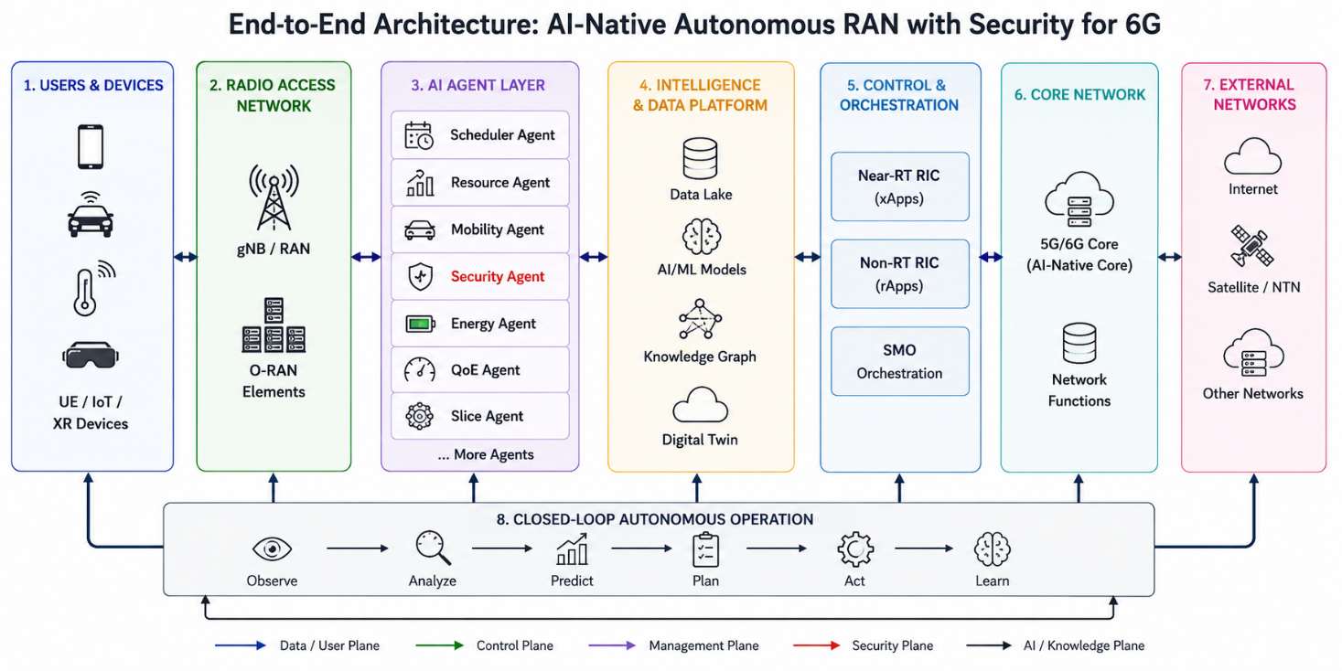

Slide 19
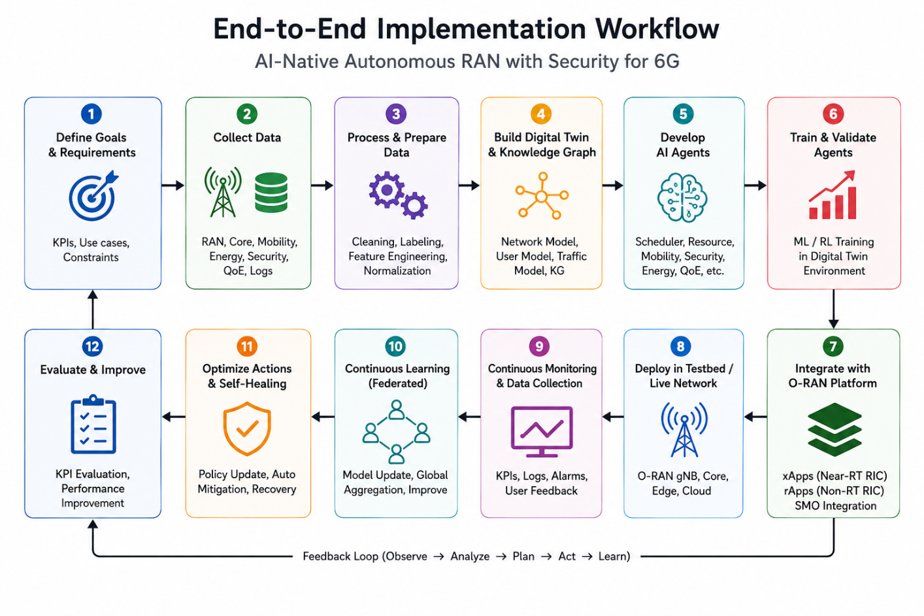

Slide 20
Final Deliverables
Documentation
Complete Architecture Design
Dataset Repository
Performance Evaluation Report
Benchmarking Report
Technical Whitepaper (If required)
IEEE Conference Paper (If required)
Outputs
Trained AI models
Synthetic dataset
Threat detection framework
Quantum-safe module
Simulation plots
Software Deliverables
AI-Native Air Interface Framework
Scheduler Agent
Resource Allocation Agent
Mobility Agent
Security Agent
Energy Agent
Digital Twin Platform
Knowledge Graph Engine
Federated Learning Framework
Multi-Agent Coordination Engine
O-RAN xApps
O-RAN rApps

Slide 21
Key References
3rd Generation Partnership Project Release 19 and emerging Release 20 AI/ML studies for RAN automation.
O-RAN Alliance AI-enabled RIC, xApps, rApps, and SMO specifications.
International Telecommunication Union IMT-2030 (6G) Framework and Usage Scenarios.
Next G Alliance Roadmap to 6G and AI-Native Network Vision.
European Telecommunications Standards Institute ENI (Experiential Networked Intelligence) specifications.
Reinforcement Learning: An Introduction.
Multi-Agent Reinforcement Learning.
Wireless Communications research papers on AI-native air interfaces, semantic communications, GNN-based RAN optimization, and digital-twin-driven autonomous networking published in IEEE Communications Magazine, IEEE JSAC, IEEE TWC, IEEE Network, IEEE Communications Surveys & Tutorials, and ACM MobiCom.

Slide 22
Implementation

Slide 23
Member | Role | Architecture Ownership | Workflow Ownership | Final Deliverables
Swetha, Harsimran, Unnimaya | AI-Native Air Interface and Scheduler Agent Lead | AI-Native Air Interface, Scheduler Agent | Steps 2,3,5,6 | Scheduler Agent, AI PHY/MAC Models
Swetha, Harsimran, Unnimaya | Resource Allocation, Mobility and QoE Lead | Resource Agent, Mobility Agent, QoE Agent | Steps 2,3,5,6 | Resource Allocation Agent, Mobility Agent
Swetha, Mohit, Ayushi | Security Intelligence and Federated Learning Lead | Security Agent, Security Plane | Steps 2,3,5,6,10,11 | Security Intelligence Platform
Swetha, Karthik, Ayushi | Digital Twin, Knowledge Graph and Data Platform Lead | Digital Twin, Knowledge Graph, Data Platform | Steps 3,4,9,10 | Digital Twin Framework
Swetha, Mohit, Karthik | O-RAN Integration, Multi-Agent Orchestration and System Lead | Near-RT RIC, Non-RT RIC, SMO, Multi-Agent Orchestration | Steps 1,7,8,12 | End-to-End Integrated Platform

Slide 24
Category | Detailed Responsibilities
Primary Ownership | AI-Native Air Interface, PHY/MAC Intelligence, Scheduler Agent
3GPP Relevance | AI-assisted CSI Feedback, AI Beam Management, AI Link Adaptation, AI-Native Air Interface (Rel-18/19/20)
Data Collection | Collect CQI, SINR, RSRP, RSRQ, CSI, MCS, PRB Utilization, Throughput Metrics
Data Engineering | Create scheduling features, radio quality indicators, traffic priority features, beam-level features
AI-Native Air Interface | Develop AI-based Channel Estimation, Neural Receivers, Semantic Communications, AI Link Adaptation
Scheduler Agent Development | Develop PRB allocation engine, traffic prioritization engine, QoS-aware scheduler
AI Models | PPO, DQN, Transformer-based Scheduling, CNN-based PHY Intelligence
Digital Twin Support | Validate scheduler decisions inside Digital Twin
O-RAN Integration | Deploy Scheduler xApp in Near-RT RIC
KPI Evaluation | Throughput, Latency, Spectral Efficiency, PRB Utilization, Fairness Index
Deliverables | AI-Native PHY Framework, Scheduler Agent, Scheduling Dashboard, KPI Report
Category | Detailed Responsibilities
Primary Ownership | Resource Agent, Mobility Agent, QoE Agent
3GPP Relevance | RRM, Handover Optimization, Mobility Robustness Optimization, AI-assisted Mobility
Data Collection | Collect Mobility Traces, Cell Load, Spectrum Usage, UE Position Data, Handover Events
Data Engineering | Mobility Feature Extraction, Resource Utilization Features, QoE Feature Engineering
Resource Agent Development | Spectrum Allocation, Power Control, Carrier Aggregation Optimization, MIMO Stream Selection
Mobility Agent Development | Handover Prediction, Cell Reselection, Mobility Forecasting
QoE Agent Development | User Experience Prediction, Application-Aware Optimization
AI Models | MADDPG, PPO, LSTM, Transformer, Graph Neural Networks
Digital Twin Support | Simulate mobility and resource allocation scenarios
O-RAN Integration | Deploy Resource and Mobility xApps
KPI Evaluation | Handover Success Rate, Cell Throughput, Spectrum Efficiency, QoE Improvement
Deliverables | Resource Allocation Engine, Mobility Agent, QoE Agent, Mobility Analytics Dashboard

Slide 25
Category | Detailed Responsibilities
Primary Ownership | Security Agent, Security Intelligence Plane, Federated Learning
3GPP Relevance | Network Security, AI Security, Zero Trust, Security Automation
Data Collection | Collect IDS Logs, Firewall Logs, Security Events, Attack Traces, Authentication Logs
Data Engineering | Threat Feature Extraction, Attack Classification Labels, Security Knowledge Base
Threat Prediction Module | Predict cyber attacks before occurrence
Threat Detection Module | Detect Jamming, Spoofing, DDoS, Rogue gNB, Pilot Contamination
Threat Mitigation Module | Auto Isolation, Slice Protection, Resource Quarantine
Self-Healing Module | Automatic Recovery and Service Restoration
Federated Learning | Local Training, Global Aggregation, Privacy Preservation
AI Security | Model Poisoning Detection, Adversarial Attack Detection
AI Models | Autoencoders, Variational Autoencoders, GNN, Transformer, Isolation Forest
O-RAN Integration | Deploy Security xApp and Security Analytics rApp
KPI Evaluation | Detection Accuracy, False Positives, Recovery Time, Security Score
Deliverables | Security Intelligence Platform, Federated Learning Framework, Security Dashboard

Slide 26
Category | Detailed Responsibilities
Primary Ownership | Digital Twin, Knowledge Graph, Data Platform, AI Repository
3GPP Relevance | Network Digital Twin (NDT), Data Analytics, Network Automation
Data Collection | Aggregate RAN, Mobility, Security, Energy, QoE Data
Data Engineering | Data Cleaning, Feature Store Creation, Metadata Management
Digital Twin Development | Create RAN Twin, UE Twin, Mobility Twin, Security Twin, Energy Twin
Network Modeling | Create Virtual Representation of Network Components
Knowledge Graph Development | Build Telecom Ontology and Network Relationship Graph
Root Cause Analysis | Support Explainability and Autonomous Troubleshooting
AI Repository | Manage Trained Models, Policies, Configurations
Streaming Platform | Manage Kafka/Spark/Flink Pipelines
Monitoring | KPI Collection, Event Correlation, Telemetry Processing
AI Models | Graph Neural Networks, Graph Analytics, Ontology Reasoning
O-RAN Support | Provide Digital Twin and Knowledge Services to RIC
KPI Evaluation | Prediction Accuracy, Twin Fidelity, Graph Accuracy
Deliverables | Digital Twin Platform, Knowledge Graph Engine, Data Lake, Analytics Dashboard
Category | Detailed Responsibilities
Primary Ownership | O-RAN Architecture, Multi-Agent Controller, End-to-End Integration
3GPP Relevance | O-RAN RIC, Intent-Based Management, Autonomous Networks, AI-RAN
Requirements Management | Define KPIs, Use Cases, Network Objectives
System Architecture | Own overall end-to-end architecture
O-RAN Integration | Near-RT RIC, Non-RT RIC, SMO Integration
xApp Deployment | Scheduler xApp, Resource xApp, Mobility xApp, Security xApp
rApp Deployment | Analytics rApp, Policy Management rApp, AI Training rApp
Multi-Agent Framework | Inter-Agent Communication, Policy Sharing, Coordination Engine
Closed-Loop Automation | Observe → Analyze → Predict → Plan → Act → Learn
Intent Management | Convert Operator Intent into Policies
Deployment | Containerization, Kubernetes Deployment
Monitoring | Platform Health Monitoring, Resource Monitoring
Benchmarking | Compare against RR, PF, SON, Traditional Security
KPI Evaluation | Automation Level, OPEX Reduction, SLA Compliance
Deliverables | Multi-Agent Controller, O-RAN Platform, End-to-End Integrated Solution, Final Demonstration

Slide 45
End frame

Slide 46
Copyright and confidentiality
The contents of this document are proprietary and confidential property of Nokia. This document is provided subject to confidentiality obligations of the applicable agreement(s).
This document is intended for use by Nokia’s customers and collaborators only for the purpose for which this document is submitted by Nokia. No part of this document may be reproduced or made available to the public or to any third party in any form or means without the prior written permission of Nokia. This document is to be used by properly trained professional personnel. Any use of the contents in this document is limited strictly to the use(s) specifically created in the applicable agreement(s) under which the document is submitted. The user of this document may voluntarily provide suggestions, comments or other feedback to Nokia in respect of the contents of this document ("Feedback"). Such Feedback may be used in Nokia products and related specifications or other documentation. Accordingly, if the user of this document gives Nokia Feedback on the contents of this document, Nokia may freely use, disclose, reproduce, license, distribute and otherwise commercialize the feedback in any Nokia product, technology, service, specification or other documentation.
Nokia operates a policy of ongoing development. Nokia reserves the right to make changes and improvements to any of the products and/or services described in this document or withdraw this document at any time without prior notice.
The contents of this document are provided "as is". Except as required by applicable law, no warranties of any kind, either express or implied, including, but not limited to, the implied warranties of merchantability and fitness for a particular purpose, are made in relation to the accuracy, reliability or contents of this document. NOKIA SHALL NOT BE RESPONSIBLE IN ANY EVENT FOR ERRORS IN THIS DOCUMENT or for any loss of data or income or any special, incidental, consequential, indirect or direct damages howsoever caused, that might arise from the use of this document or any contents of this document.
This document and the product(s) it describes are protected by copyright according to the applicable laws.
Nokia is a registered trademark of Nokia Corporation. Other product and company names mentioned herein may be trademarks or trade names of their respective owners.

Slide 47
Please delete this slide if document is uncontrolled
Revision history and metadata
Document ID: Document Location: Document Type: Organization:
Version | Description of changes | Date | Author | Owner | Status | Reviewed by | Reviewed date | Approver | Approval date

