Slide 1
Big Data Analytics – Project Proposal
Swetha Krishnakumar (sxk151530)

Slide 2
Executive Summary
Data is often considered to be the crown jewels of an organization.
It can be used in myriad ways to run the business, market to customers, forecast sales, measure performance, gain competitive advantage, and discover new business opportunities
A convergence of new technologies and market dynamics has opened a new frontier for information management and analysis
This new wave of computing involves data with far greater volume, velocity, and variety than ever before.
Big Data, as it is called, is being used in ingenious ways to predict customer buying habits, detect fraud and waste, analyze product sentiment, and react quickly to events and changes in business conditions.

Slide 3
Executive Summary (..continued)
Most companies already use analytics in the form of reports and dashboards to help run their business.
Big Data, however, doesn’t follow this structured model.
The streams are all different and it is difficult to establish common relationships. But with its diversity and abundance come opportunities to learn and to develop new ideas – ideas that can help change the business
To run the business, you organize data to make it do something specific; to change the business, you take data as-is and determine what it can do for you. These two approaches are more powerful together than either alone
An organization should strive to create a unified information architecture – one that enables it to leverage all types of data, as situations demand, to promptly satisfy business needs
This is the approach taken by a large worldwide bank. They are using a common information architecture design to drive both their real-time trading platforms and their batch reporting systems

Slide 4
Executive Summary (..continued)
Like many new information technologies, big data can bring about dramatic cost reductions, substantial improvements in the time required to perform a computing task, or new product and service offerings
Each benefit choice has implications for the leadership of the big data initiative and the way that benefits are managed
The primary value from big data comes not from the data in its raw form, but from the processing and analysis of it and the insights, products, and services that emerge from analysis
The level of competitive advantage obtained from Big Data initiatives could drastically change the business landscape and position organizations for sustained growth

Slide 5
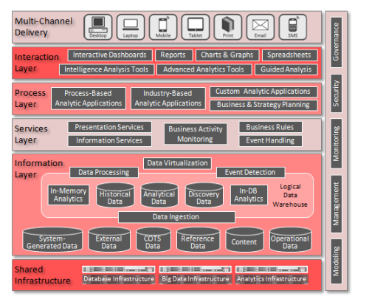
Technical Architecture
The shared infrastructure layer includes the hardware and platforms on which the Big Data and Analytics components run
The Services Layer includes components that provide or perform commonly used services
The Information Layer includes all information management components, i.e. data stores, as well as components to capture, move, integrate

Slide 6
Technical Architecture
The Process Layer represents components that perform higher level processing activities
The Information Layer includes all information management components, i.e. data stores, as well as components to capture, move, integrate
Dimensional data models and OLAP cubes are generally used for structured data analysis
Information is accessed via common channels such as JDBC/ODBC, Web Services (WS*), REST, custom APIs, and adapters
Data quality management guides the flow of data into and through the LDW to protect the integrity and consistency of each area. It manages data cleansing, where appropriate, and enables the system to advertise data quality metrics so that consumers are aware of the quality of the data they are using

Slide 7
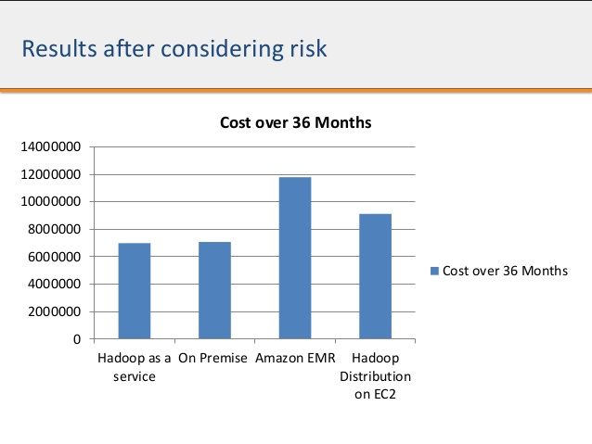
Total Cost of Ownership
The cost for a mature enterprise-grade distribution of Hadoop is less than $1,000/terabyte. For 15 TB, the total cost of ownership might go up to $15,000/terabyte.
Estimated cost of ownership for various services might be around 8M after 5 years if we go for Hadoop as a service.
The total cost of ownership considers into account the cost of system, hardware (on premise), resources, maintenance.

Slide 8
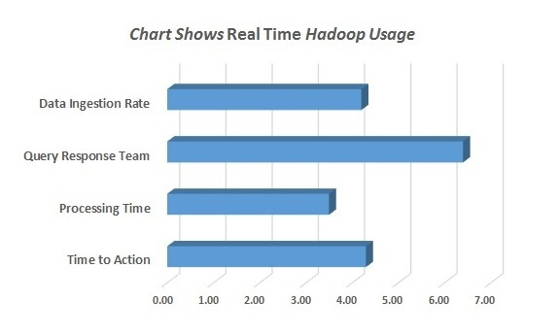
Return on Investment
Hadoop can really make companies more efficient by preventing corruption and frauds while processing data in real time. Also, Hadoop can help companies work realistically by processing customer feeds too.
From the diagram, we can see that the processing time of the system is very less. This gives a good return on investment for the total cost spent on the system.

Slide 9
Big Data Vendors
 | HortonWorks | Cloudera | MapR | Altiscale | Databricks | AmazonEMR | Quabole
Product Summary | Open Source Hadoop | Open Source Hadoop | Open Source Hadoop | Big Data in Dedicated Cloud Service | Standalone Spark Service | Big Data in AWS Cloud | Cross – platform Big Data Service
Deployment Model | Hosted | Hosted | Hosted | Cloud | Cloud | Cloud | Cloud
Setup | Manual | Manual | Manual | Automatic | Automatic | Automatic | Automatic
Scalability | Fixed Cluster | Fixed Cluster | Fixed | Manual Scaling | Manual Scaling | Manual Scaling | Automatic
Data Store | On-Premises | On-Premises | On-Premises | Data Cloud | AWS | AWS | AWS,Azure

Slide 10
Vendor Comparison
All the 3 big players - Cloudera, MapR and Hortonworks use the core Hadoop framework and bundle it for enterprise use. The features offered as a part of core distribution by these vendors include support service and subscription service model
Cloudera, MapR and Hortonworks are all mid-sized companies with their premium paid customers increasing over time and with partnership ventures across different industries
There is no migration cost involved if the vendor is in cloud (AWS, Azure, Google Cloud)
All the three Hadoop distributions have stood the test of time ensuring stability and security to meet business needs.
The setup cost might be huge but it is a one time cost
I recommend Databricks / AmazonEMR / Quabole since all these run on cloud and they don’t need lot of maintenance efforts.

Slide 11
Benefits/Savings
Dialogue with consumers
Re-develop your products
Perform risk analysis
Keeping your data safe
Create new revenue streams
Customize your website in real time
Reducing maintenance costs

Slide 12
Cost Details – Cloud Setup
 | 1TB PER YEAR | 15TB PER YEAR | 15 TB FOR 5 YEARS
Infrastructure | $19,200 | $288,000 | $1,440,000
Software | $7,500 | $9,000 | $45,000
Human Resources | $30,000 | $35,000 | $175,000
Hardware | N/A | N/A | N/A
Maintenance | $4,000 | $6,700 | $9,000
Total Annual | $60,700 | $338,700 | $1,669,000

Slide 13
Cost Details – On Premise
 | 1TB PER YEAR | 15TB PER YEAR | 15 TB FOR 5 YEARS
Infrastructure | $15,200 | $290,000 | $1,450,000
Software | $7,500 | $9,000 | $45,000
Human Resources | $30,000 | $35,000 | $175,000
Hardware | $5,000 | $9,000 | $11,000
Maintenance | $4,000 | $6,700 | $9,000
Total Annual | $61,700 | $349,700 | $1,690,000

Slide 14
Software Solution
Choosing the right analytics platform and provider really comes down to how to store, manage and analyze massive amounts of data safely, effectively, and, above all, affordably
A traditional on-premise Hadoop platform tends to be quite expensive. After all, it is a physical platform requiring large numbers of servers, a large facility to house them, and large amounts of electricity to run them
In contrast, cloud storage requires no expensive on-site hardware or support. In addition, companies that implement with Hadoop in the cloud providers have the benefit of purchasing access to a fully scalable storage and analytics platform while only paying for what they use
On-premise platforms come with hard limits on storage capacity and performance, all due to their physical nature. With a cloud platform, there is total scalability, meaning that companies can access unlimited storage space on demand

Slide 15
Software Solution
The drawback of on-premise platforms is that they come with set limitations regarding how quickly and easily data may be accessed. By using a cloud-based Hadoop platform, data can be accessed anytime from anywhere including on smartphones and tablets through an Internet connection
When it comes to security, on-premise Hadoop platforms have a well-deserved reputation for excelling in this area. After all, sensitive data can safely be kept behind the corporate firewall. In contrast, the idea of storing sensitive information offsite with a cloud provider can make corporate business executives a bit nervous
However, today’s cloud service providers typically adhere to modern cloud security protocols such as built-in encryption, to protect data during transfer and at rest

Slide 16
References
http://www.oracle.com/technetwork/topics/entarch/oracle-wp-big-data-refarch-2019930.pdf
http://www.slideshare.net/Hadoop_Summit/w-325230-cjha
http://www.oracle.com/technetwork/topics/entarch/articles/oea-big-data-guide-1522052.pdf
http://www.cooladata.com/blog/true-cost
https://www.dezyre.com/article/cloudera-vs-hortonworks-vs-mapr-hadoop-distribution-comparison-/190
https://www.qubole.com/resources/article/cloud-vs-on-premise-hadoop/

Slide 17



