Slide 1
E-Commerce Transaction analysis
Group 8
Anuja
Daxta
Giridharan
Ranjit
Swetha
Yasin

Slide 2

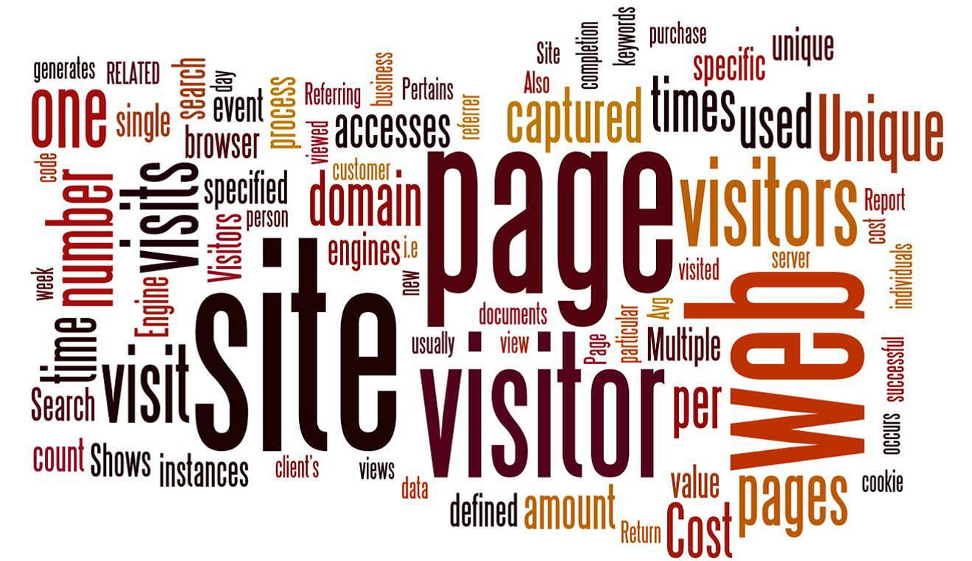
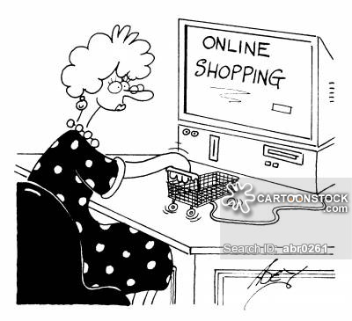
Introduction

Slide 3
Introduction
How does Web Analytics help E-Commerce?
Evolution of Universal Analytics
Power of Enhanced E-Commerce
Understanding the transactions associated
What are my out of the box features I can use to unlock insights on online medium?

Slide 4
HOW E-COMMERCE TRACKING WORKS IN GOOGLE ANALYTICS
Visitor Completes a transaction
Store, Process and Collect the transaction details
Display a confirmation page and push data to GA Server
GA server processes the transaction details and directs the processed metrics to your GA Account.
Perform reporting on top of metrics received from the server.

Slide 5
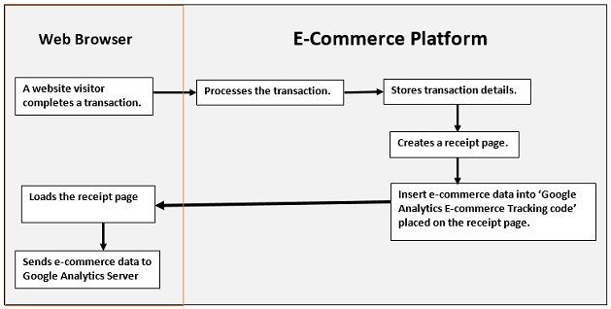
HOW E-COMMERCE TRACKING WORKS IN GOOGLE ANALYTICS

Slide 6
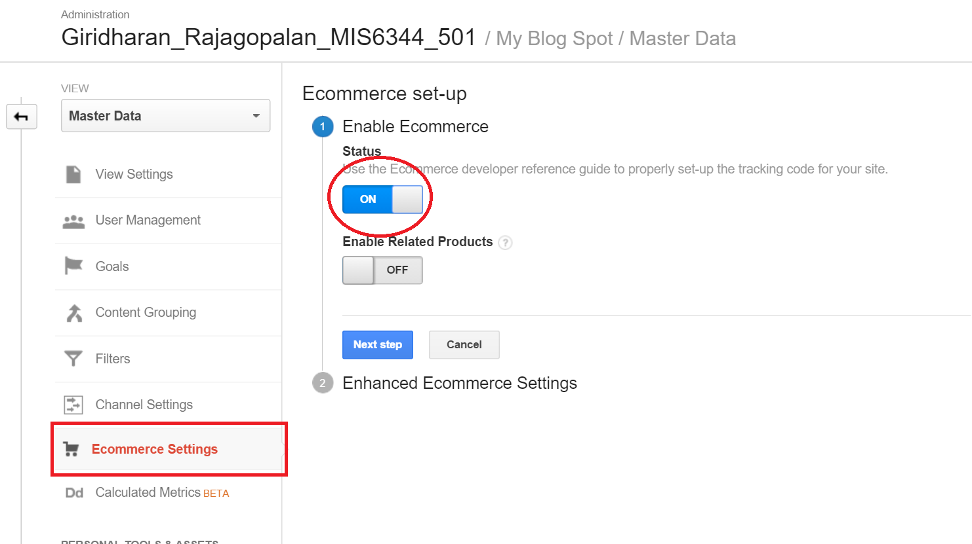
Setting up E-Commerce Tracking
Navigate to your view and select E-commerce Settings.

Slide 7
Setting up E-Commerce Tracking
JavaScript Tagging(3 major Methods)
_addTrans()
_addItem()
_trackTrans()
All basic information related to a single transaction
Track activities of each items placed in your shopping cart
After Successful purchase push purchase details to GA Server

Slide 8
Types of Reports
Standard Reports
Overview Report
Product Performance Report.
Enhanced Ecommerce Reports
Shopping Behavior Analysis
Checkout Behavior Analysis
Sales Performance Report
Transaction Report
Time to Purchase Report
Product List Performance Report
Internal Promotion
Order Coupon
Product Coupon
Affiliated Code

Slide 9
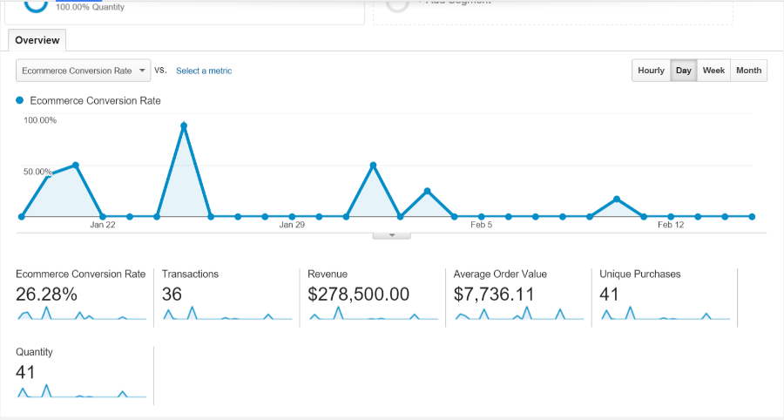
E-Commerce OVERVIEW REPORT
Provides key information at a glance.
Provides Statistics on revenue and orders.
Some important metrics:
Revenue
Ecommerce Conversion Rate
Transactions
Average Order Value

Slide 10
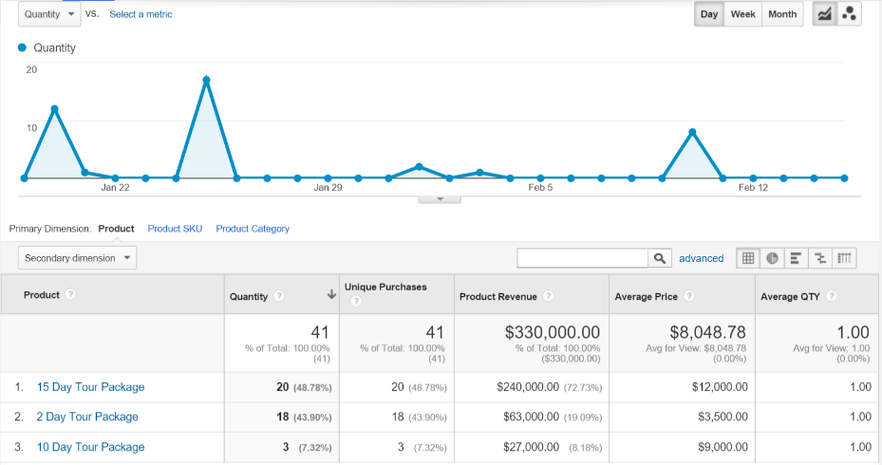
Product performance report
Summarizes the performance of each and every individual product.
Revenue listed by each product, quantity sold, average pricing and average quantity of product.
Trends of each products and their associated revenue can be identified.

Slide 11
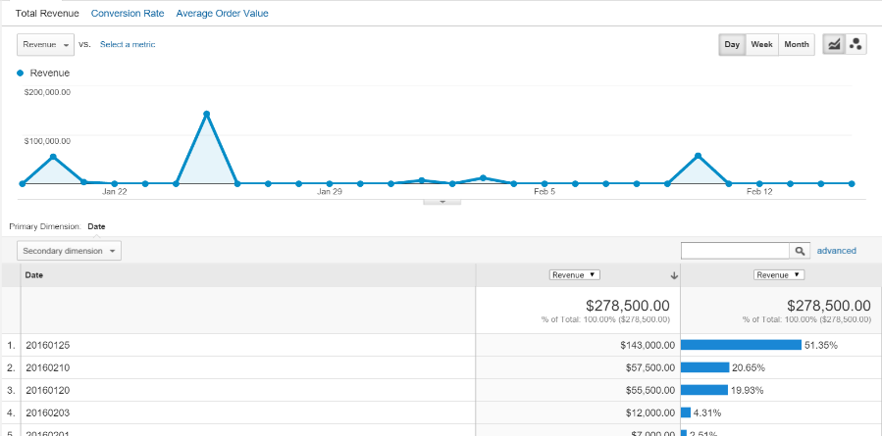
Sales performance report
Sales metrics over a defined period of time.
To evaluate how your sales has turned to your planned marketing strategies.
Some important metrics:
Total Revenue
Conversion Rate
Average Order Value

Slide 12
Transaction report
Transaction details are summarized
Monitors all parameters in terms of Transaction ID
Some important metrics:
Revenue
Tax
Shipping
Quantity by Transaction ID

Slide 13
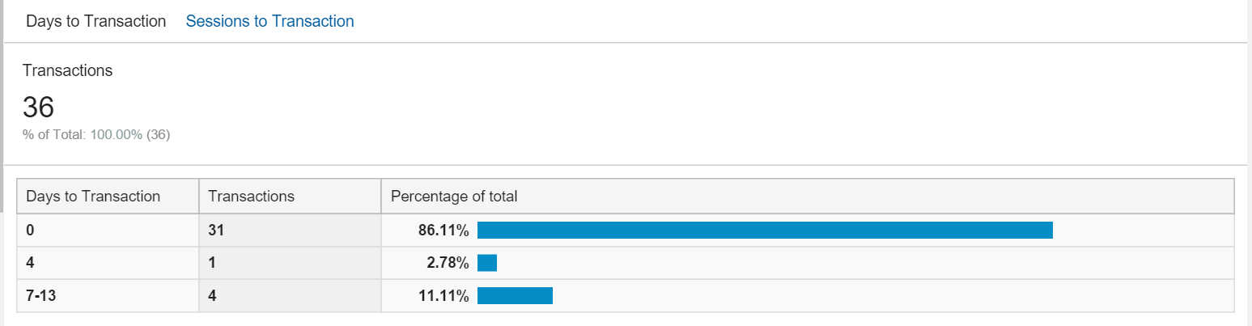
Time to purchase report
gives the idea about the product buying decision cycle
In this case roughly 86% of the visitors convert within the first visit and 11% needs 7-13 visits to come to a buying decision

Slide 14
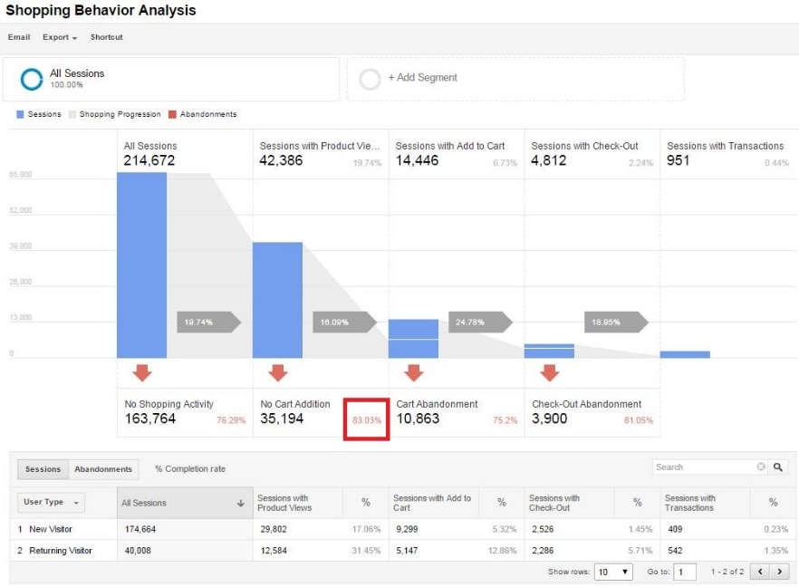
Shopping behavior analysis
Keeps track of the session count at each stage of the funnel
How many sessions have reached the next level?
Drop out rate at each stage of the funnel to create process improvement.

Slide 15
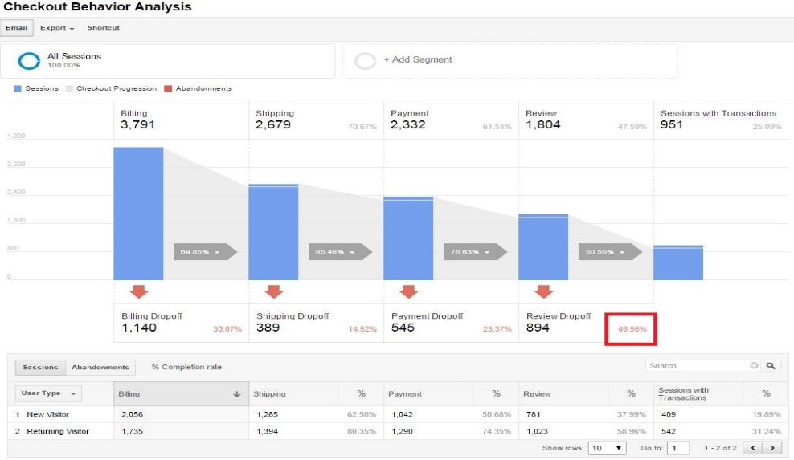
CHECKOUT behavior analysis
Reveals user actions when they move through the checkout process
The slope indicates how many users have checked out for mentioned payment steps.
High Abandoned rate as displayed in example(~49.6%) reveals insight into the process improvements area after performing Unit Testing.

Slide 16
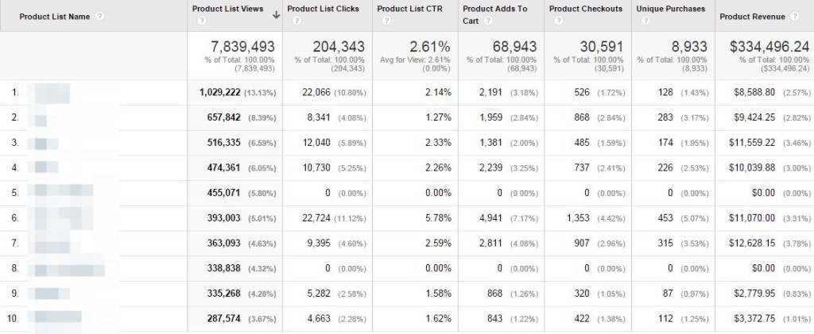
Product List Performance Report
enables you to measure the sales impact of grouping products together
The three main ways to group product lists are:
Categories,
Search Results,
Related Products

Slide 17
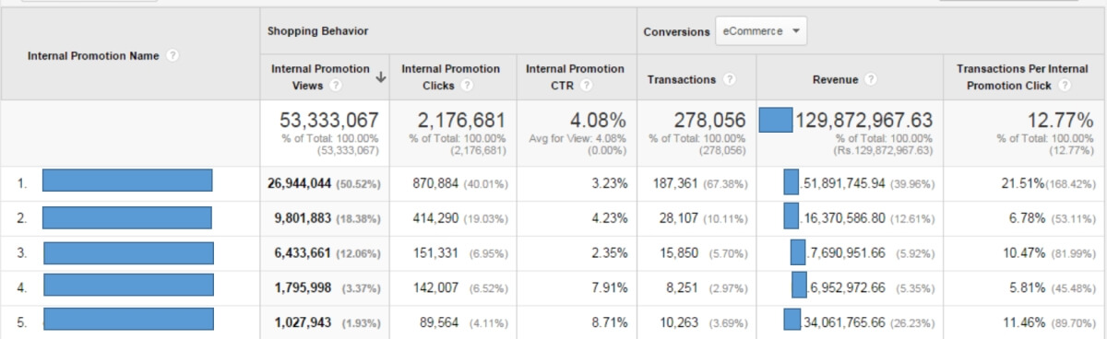
Internal promotion report
How many clicks has occurred through your internal promotional banners.
Click through rate from all the promotion campaigns.
Understand which promotion channel is driving maximum revenue.
Number of times the users viewed your promotion help determine the magnitude of your promotion campaign.

Slide 18
Enhanced Ecommerce
Order Coupon: This report lets you see how your order-level coupons performed in terms of: Revenue (includes tax and shipping), Total no of Transactions and Average Value of transactions
Product Coupon: This report lets you see how your product-level coupons performed in terms of: Revenue (includes tax and shipping), Unique Purchases and Product Revenue per Purchase.
Affiliate Code: The Affiliate Code report lets you track revenue, transactions, and average order value associated with affiliate sites that drive customers to your site.

Slide 19
Thank You!!!

