Slide 1
COMPARATIVE STUDY OF DEEP LEARNING MODELS FOR SIGN LANGUAGE RECOGNITION
SWETHA MARIYA JOSE
MCA23-160
Guided by
Dr FOUSIA M SHAMSUDEEN

Slide 2
PROBLEM STATEMENT
Sign language: A vital communication method for the deaf and hard-of-hearing communities.
Limitations of traditional methods: Older techniques depend on manual features or heuristics, which struggle with diverse signing styles or environmental factors.
This project seeks to address these limitations by leveraging advanced deep learning models such as ResNet50, MobileNetV2, and EfficientNet.

Slide 3
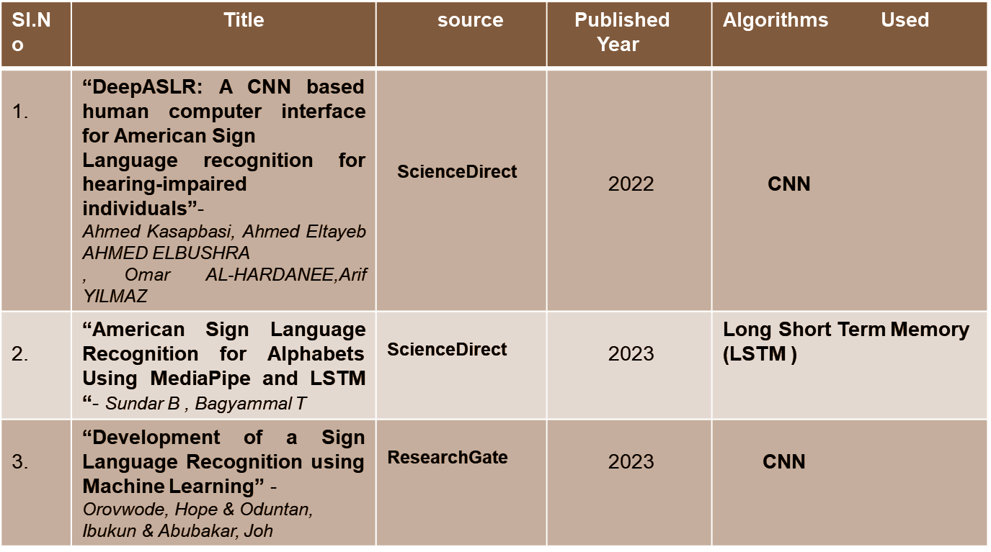
LITERATURE SURVEY

Slide 4
GAPS IDENTIFIED
Previous works in sign language recognition have faced several limitations:
Many studies have encountered a shortage in the size of datasets available for training models on sign language gestures, impacting the robustness and scalability of the results.
Research often relies on custom CNN architectures, with limited exploration of powerful pretrained models like Resnet50 and InceptionResnetV2, which may enhance performance.
Many studies focus on static images for individual signs rather than dynamic, real-time
gestures, which would more accurately reflect real-world applications.

Slide 5
STRATEGY
Dataset: A dataset of alphabets containing 2000 samples of each alphabet is used .
Data Preprocessing: This may involve resizing images, converting to grayscale or a consistent colour space, normalizing pixel values, etc
Choosing the model: The best models are to be examined and selected, the models used here are InceptionResnetV2,ResNet50 and MobileNetV2

Slide 6
Training the model: the models are trained to check the accuracy for
selecting the best model. InceptionResNetV2 is the best model.
RealTime Detection: The symbols are predicted and sentences are
made by combining the predicted letters in real time.

Slide 7
RESULTS AND DISCUSSION

Slide 8
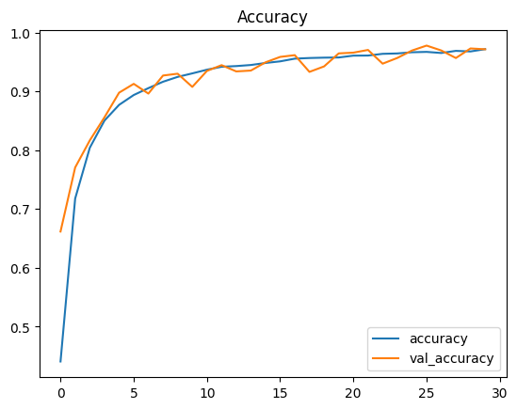
ResNet50 (Model 1)
The graph shows the training accuracy and validation accuracy over 30 epochs using the ResNet50 architecture.
Achieved an accuracy of 97.17%
No significant signs of overfitting

Slide 9
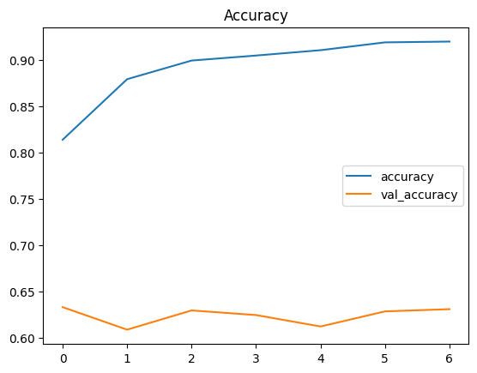
MobileNetV2(Model 2)
The graph shows the training accuracy and
validation accuracy over 7 epochs using
the MobileNetV2 architecture.
Achieved an accuracy of 63%.

Slide 10
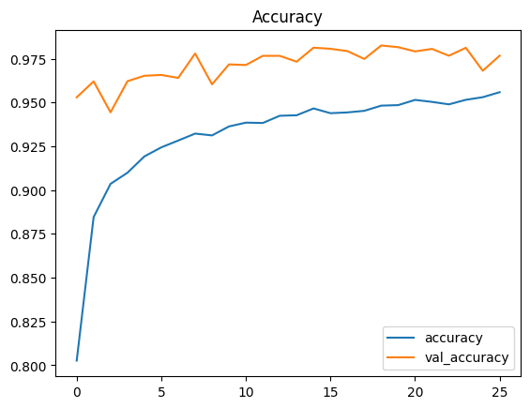
InceptionResNetV2(Model 3)
The graph shows the training accuracy and
validation accuracy over 18 epochs using
the MobileNetV2 architecture.
Achieved an accuracy of 97.95%
No signs of overfitting.

Slide 11
COMPARISON OF MODELS
Both ResNet50 and InceptionResnetV2 showed high accuracy of 97.17% and 97.95%.
MobileNetv2 showed an accuracy of 63%.

Slide 12
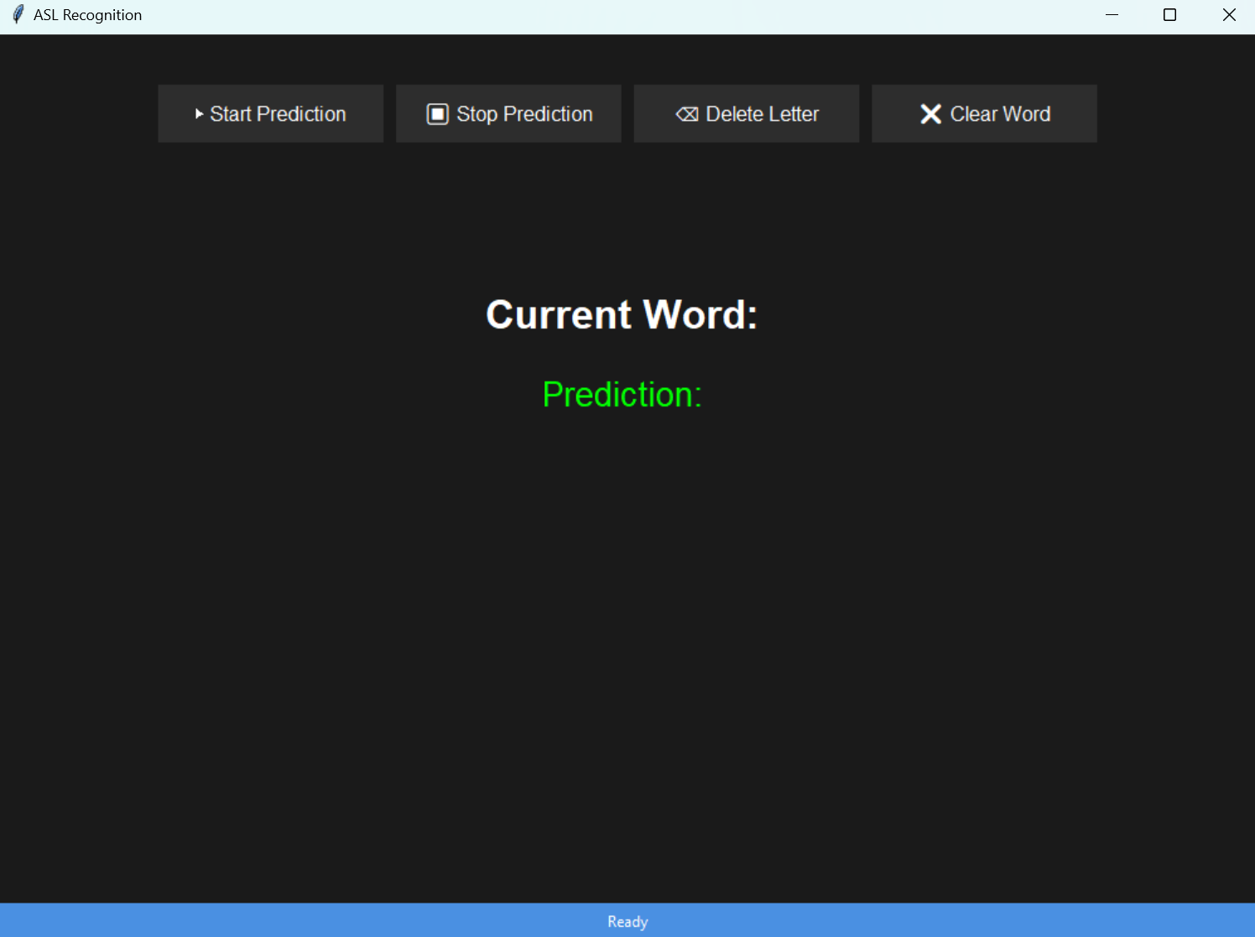
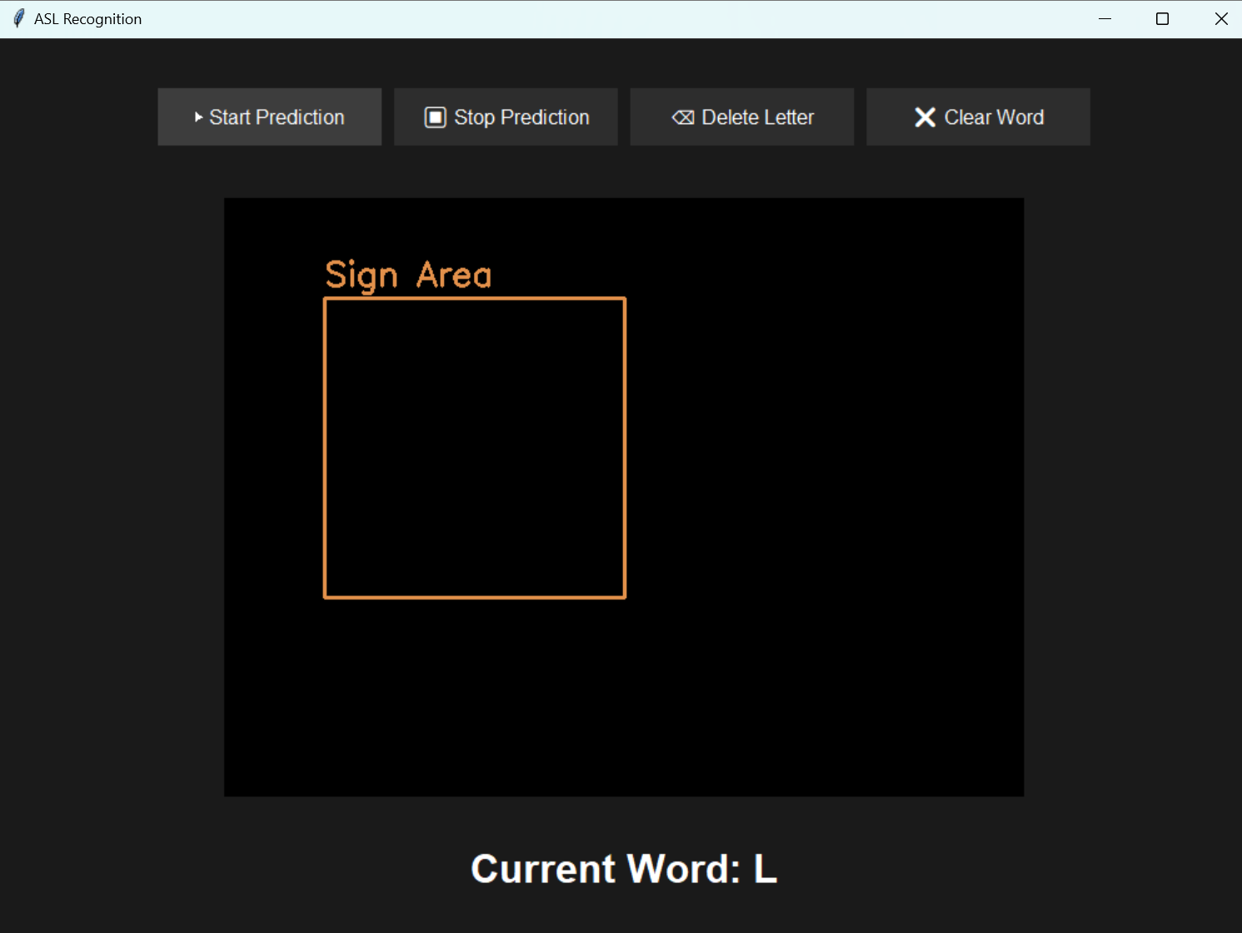
SCREENSHOTS

Slide 13
FUTURE ENHANCEMENT
Support for multi sign languages: Now American sign language is only used, other languages like Indian Sign Language and British sign languages can be used
Speech output for sign recognition: It can improve communication of sign language users with others

Slide 14
THANKYOU

