Slide 1
Digital potfolio

Slide 2
Personal detail
Student name: Deepika.M
Register number and NMID: 2422 k1562 and
absru4q2422k1562
Department: computer science
College: ksg College of arts and science
University: bharathiar University

Slide 3
Agenda
i. Problem Statement ii. Project Overview iii, End Users iv. Tools and Technologies v. Portfolio Design and Layout vi. Results and Screenshots vii. Features and Functionality viii. Conclusion ix, GitHub Link

Slide 4
Student potfolio
Using frontend development

Slide 5
Problem Statement
Clearly define the problem your project addresses Why is this problem important? What are the current limitations

Slide 6
Project Overview
A project overview typically includes: - *Project goals*: What the project aims to achieve - *Objectives*: Specific, measurable targets - *Scope*: What’s included and excluded - *Timeline*: Key milestones and deadlines - *Deliverables*: Expected outcomes Would you like to: - Create a project overview for a specific project? - Review and refine an existing overview? - Discuss project planning strategies?

Slide 7
Who are the End Users
End-users are individuals who will ultimately interact with or benefit from a product, service, or system. They can include: - *Customers*: People who purchase or use a product or service - *Employees*: Staff members who use internal systems or tools - *Consumers*: Individuals who use a product or service for personal purposes Understanding end-users’ needs, goals, and behaviors is crucial for: - *Designing user-friendly interfaces* - *Developing relevant features and functionality* - *Ensuring accessibility and usability*

Slide 8
Tools and Technologies
Tools and techniques can vary depending on the project or context. Here are some general categories: - *Project management tools*: Asana, Trello, Jira, Microsoft Project - *Collaboration tools*: Slack, Microsoft Teams, Google Workspace - *Version control*: Git, SVN - *Agile methodologies*: Scrum, Kanban - *Testing and quality assurance*: Selenium, Junit, TestNG Some techniques include: - *Agile development*: Iterative and incremental development - *Test-driven development*: Writing tests before code - *Continuous integration and delivery*: Automating testing and deployment

Slide 9
Potfolio design and layout
Portfolio design and layout are crucial for showcasing work effectively. Here are some tips: - *Clear navigation*: Make it easy for visitors to find what they’re looking for - *Visual hierarchy*: Use size, color, and placement to draw attention to key pieces - *Consistent branding*: Reflect your personal or company brand throughout - *Contextual information*: Provide background and context for each project - *Visual storytelling*: Use images, videos, or graphics to tell the story behind your work Some popular portfolio layouts include: - *Grid-based*: A clean and organized layout - *Masonry-style*: A more dynamic and flexible layout - *Single-page scrolling*: A layout that tells a story or showcases work in a continuous fLow

Slide 10
Features and functionality
Some key aspects to consider: - *Core features*: Essential functionalities that solve user problems or meet their needs - *User experience*: How intuitive, accessible, and enjoyable the features are to use - *Performance*: How well the features function in terms of speed, reliability, and efficiency When discussing features and functionality, you might consider questions like: - What are the primary features and benefits of the product or system? - How do these features address user needs or pain points? - Are there any unique or innovative features that set it apart?

Slide 11
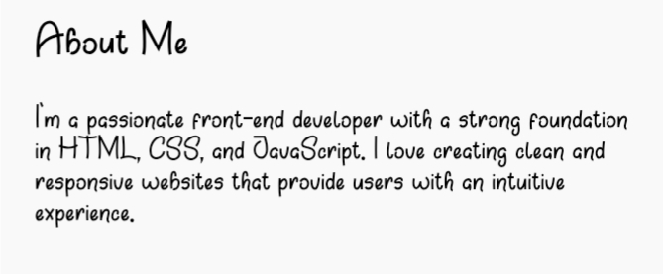
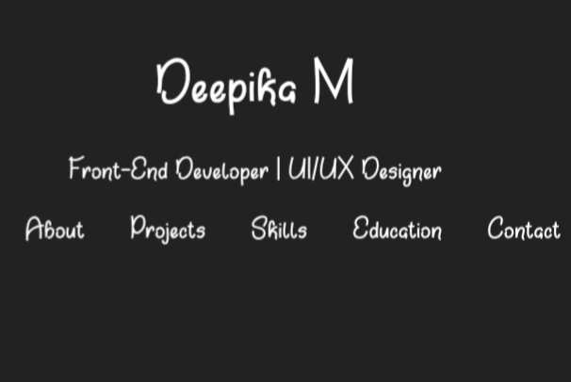
Results and screenshot

Slide 12
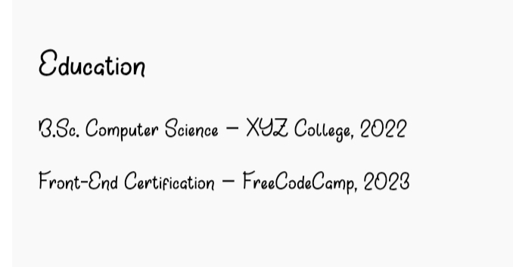
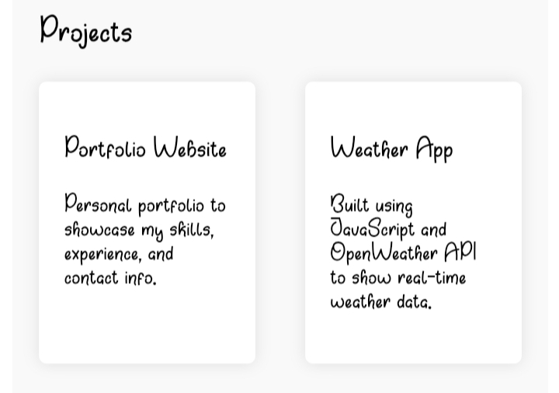
RESEARCH AND SCREENSHOT

Slide 13
Conclusion
A conclusion typically summarizes the main points and reiterates the key takeaways. It provides a final thought or call to action, leaving the audience with something to consider or act upon. Some possible elements of a conclusion include: - *Summary of key points*: A brief recap of the main ideas - *Restating the purpose or thesis*: Reiterating the central argument or objective - *Final thoughts or recommendations*: Providing guidance or suggestions for next steps - *Call to action*: Encouraging the audience to take action or engage further

