Slide 1
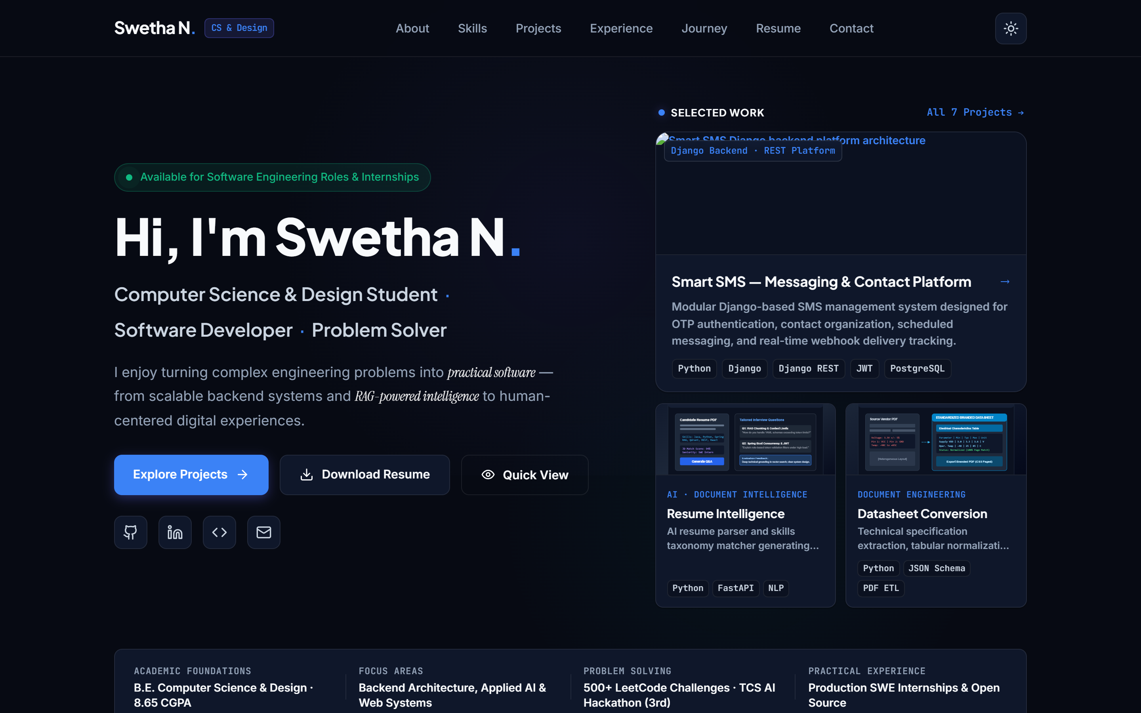
PORTFOLIO & TECHNICAL CAPSTONE
Personal Developer
Portfolio Website
A digital showcase bridging Computer Science fundamentals with human-centered design.
Swetha N.
B.E. Computer Science and Design (Class of 2028)
Rajalakshmi Engineering College, Chennai
● Live Build: my-portfolio-nine-psi-98.vercel.app

Slide 2
CORE PHILOSOPHY
The Problem & The Purpose
Moving beyond flat resumes to establish verified engineering credibility.
THE PROBLEM
Static PDF resumes fail to convey live engineering craftsmanship, interactive problem-solving, or system design.
Developers need an authentic digital platform that proves capability through live code, production internship outcomes, and architectural depth.
01
Showcase Production Engineering
Highlight genuine enterprise experience from Zoho Corporation — specifically OpenAPI RAG workflows, vector embeddings, and backend services.
02
Prove Algorithmic Fluency
Provide verified credentials through 500+ LeetCode problems solved across Trees, Graphs, Dynamic Programming, and Competitive Hackathons.
03
Deliver Thoughtful Ergonomics
Execute a zero-framework, accessible web experience (<50ms load time) with persistent dark/light theming and human-centered design.

Slide 3
USER JOURNEY & EXPERIENCE
Website Structure & Visitor Flow
How a technical reviewer or recruiter moves through the portfolio seamlessly.
01
Hero
First Impression & Role
02
About
Academic & CS Philosophy
03
Skills
6 Concrete Domains
04
Projects
7 Verified Case Studies
05
Experience
Zoho SWE & LeetCode
06
Resume
PDF & Summary Badges
07
Contact
Validated Recruiter Form
Editorial Dark Theme & Zero Flash
A refined midnight palette (#090D16) paired with an inline localStorage theme-engine prevents white flashes on reload while offering dark/light comfort.
Evidence-Based Competencies
Replaced arbitrary skill percentage bars with categorized, tangible toolsets and verifiable milestone counts (500+ LeetCode problems solved).
Frictionless Recruiter Conversion
Quick-view modals allow rapid project inspection without leaving context. One-click resume download and client-validated contact channels facilitate direct outreach.

Slide 4
ENGINEERING STACK
Technology & Implementation Flow
A disciplined, zero-framework stack prioritizing speed, accessibility, and reliability.
01 · STRUCTURE
Semantic HTML5
• ARIA landmark architecture (<header>, <main>, <nav>, <section>)
• Accessibility-first keyboard skip-link navigation
• OpenGraph & Twitter meta tags for rich social indexing
02 · STYLING
Vanilla CSS3 System
• CSS Custom Properties (:root) for instant theme variables
• Modern CSS Grid & Flexbox for multi-device responsiveness
• Subtle glassmorphic backdrops and fluid clamp() typography
03 · INTERACTIVITY
Vanilla JavaScript (ES6+)
• Zero external framework bloat — pure browser native code
• Theme persistence controller with localStorage synchronization
• Active scroll-spy navigation listener & Quick View modal logic
04 · INFRASTRUCTURE
Git, GitHub & Vercel
• Production version control on GitHub main branch
• Automated continuous deployment via Vercel Edge CDN
• Zero build-step pipeline ensuring instantaneous deployments

Slide 5
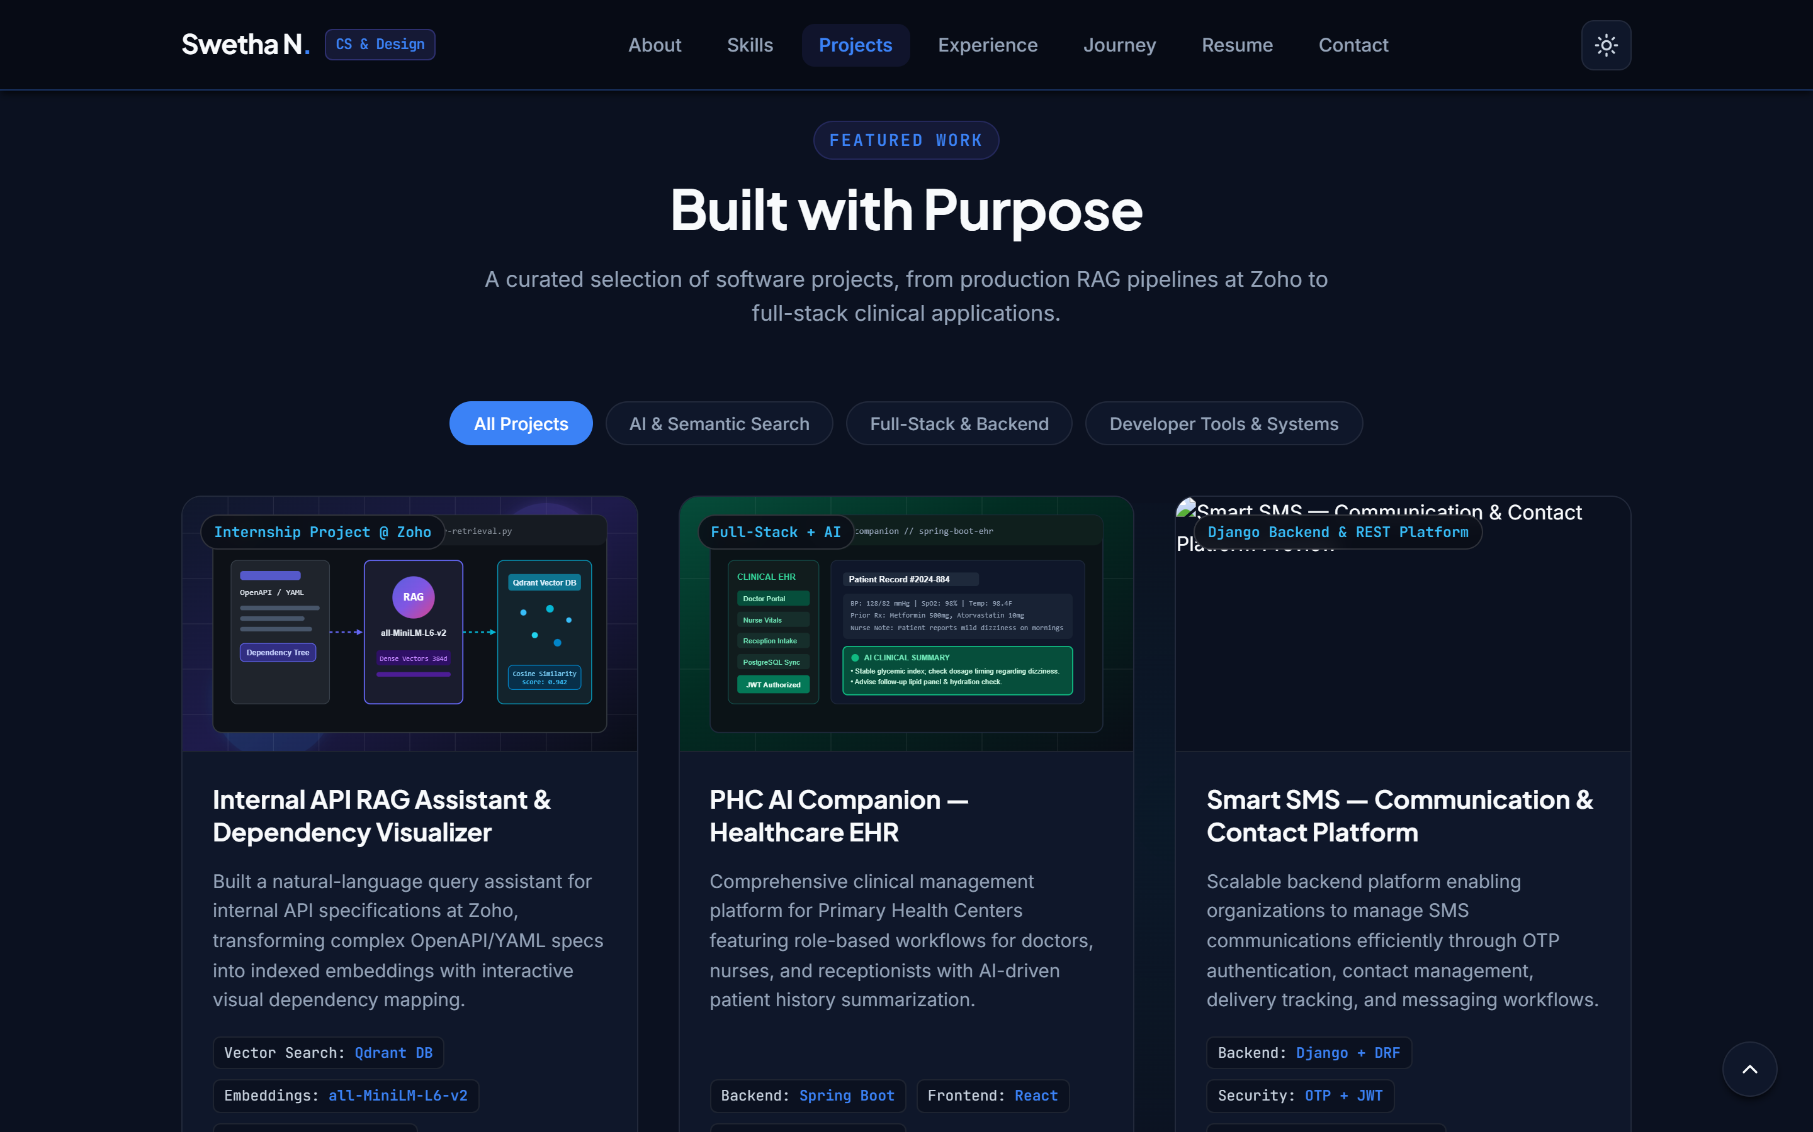
VISUAL PROOF
The Implemented Website
Genuine high-resolution captures showing the live design system in action.
Hero & Selected Work Overview
Balanced personal introduction, role pill, live status indicator, and multi-project quick cards.
Featured Projects Showcase
Deep engineering breakdowns: Zoho OpenAPI RAG Assistant, Healthcare EHR, and Smart SMS Django Platform.

Slide 6
PROJECT SUMMARY
Outcomes, Roadmap & Conclusion
Verified deliverables, technical evaluation, and future engineering trajectory.
VERIFIED PROJECT OUTCOMES
✓ Production-Ready Deployment
Successfully hosted on Vercel Edge with zero downtime, instant SSL, and worldwide CDN distribution.
✓ Zero-Dependency Architecture
Pure HTML5, CSS3, and ES6+ delivering sub-50ms render speed without heavy client bundle overhead.
✓ Dual-Theme Precision
Flawless dark and light modes with localStorage persistence and zero layout shift.
✓ Authentic Technical Depth
Seamlessly integrates real Zoho Corporation RAG internship contributions and 500+ LeetCode milestones.
FUTURE ROADMAP
→ Live LeetCode GraphQL Sync
Dynamic pipeline updating active problem counts and streak heatmaps automatically.
→ Interactive RAG Playground
In-browser live demonstration of OpenAPI and YAML semantic vector retrieval.
Thank You!
Swetha N. — B.E. Computer Science and Design
Rajalakshmi Engineering College · Chennai

