Slide 1
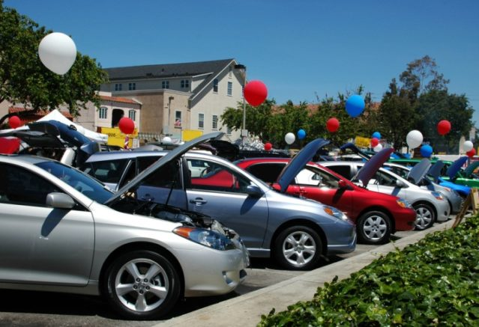
Car Sales - Data Analysis
by Swetha Nallamilli

Slide 2
EDA of Car Sales Data Set
Car Sales Trends over the period of time.
How the car sales business is doing?
Most sold Car Brands?
Market trends?
Is this still a profitable Business?

Slide 3
EDA of Car Sales Data Set
Started with Hypothesis
We have observed an overwhelming percentage of increase in car sales.
Stable Sales.
Good sales and good profits.

Slide 4
EDA of Car Sales Data Set
Problem statement
Is car sales business profitable?
Do the Car Sale firms need to look back?

Slide 5
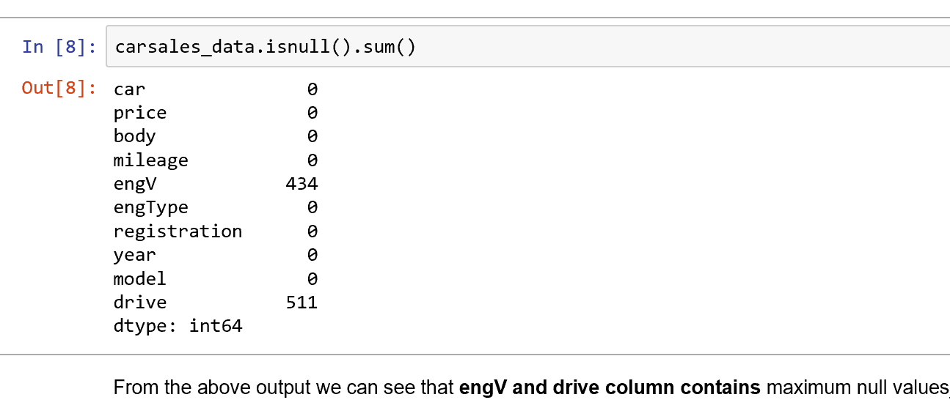
EDA of Car Sales Data Set
What did you do?
Data Loading and Describing.
Data Processing.
Pre-profiling of data.

Slide 6
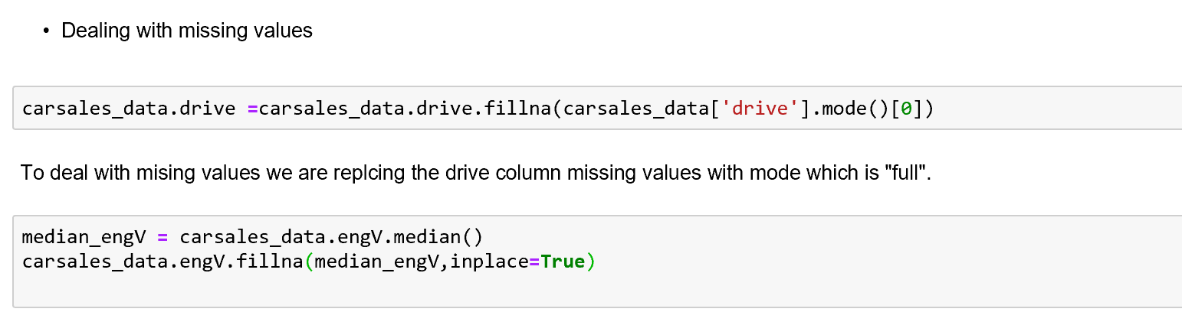
EDA of Car Sales Data Set
What did you do?
Pre-Profiling

Slide 7
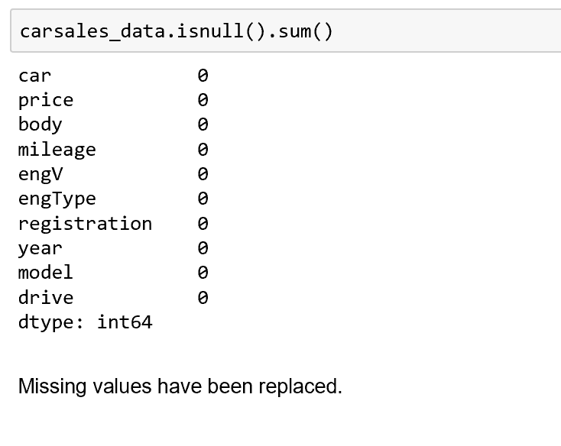
EDA of Car Sales Data Set
What did you do?
PostProfiling

Slide 8
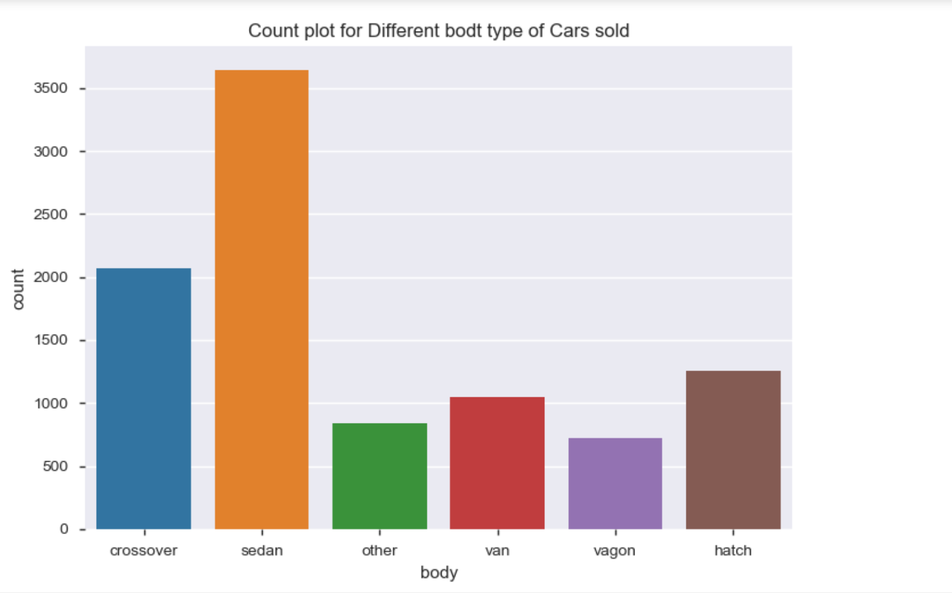
EDA of Car Sales Data Set
Key Aspects of Analysis

Slide 9
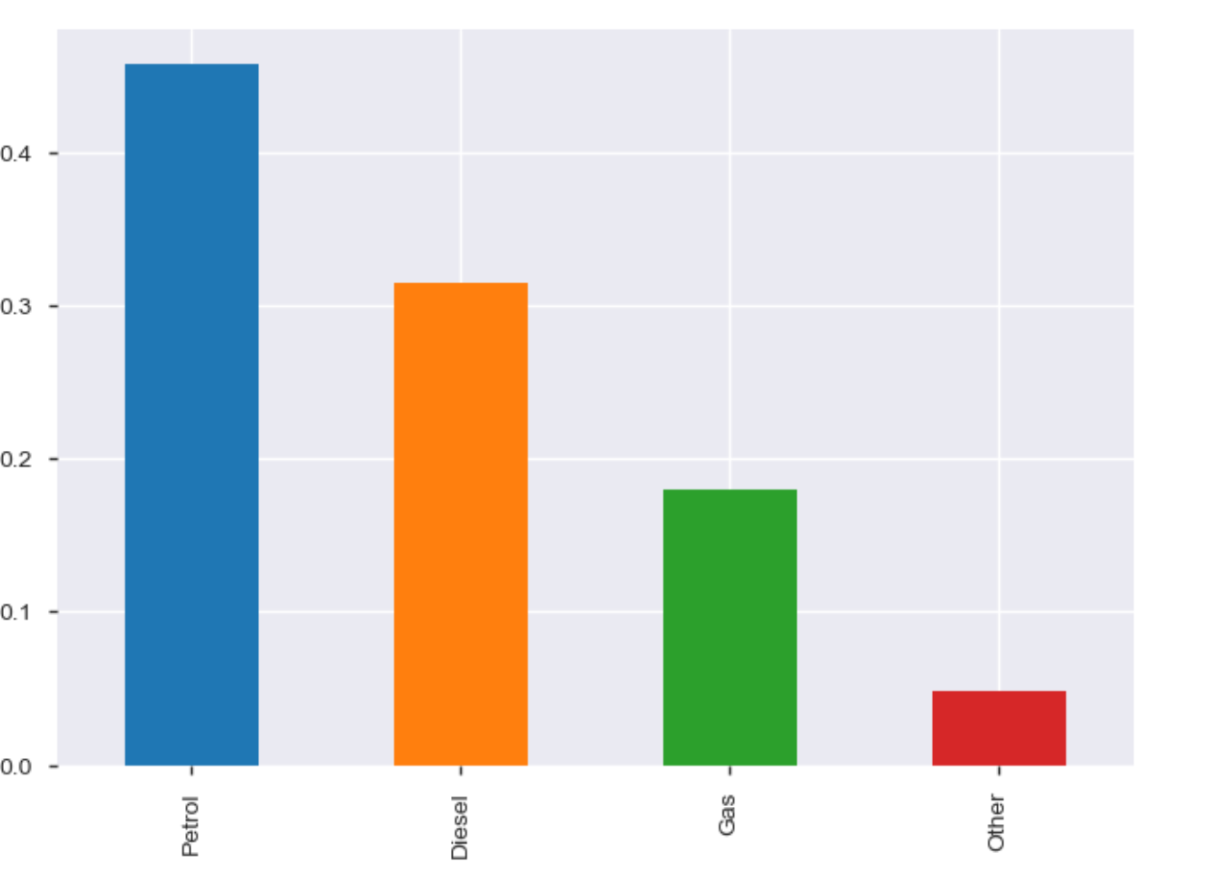
EDA of Car Sales Data Set
Key Aspects of Analysis

Slide 10
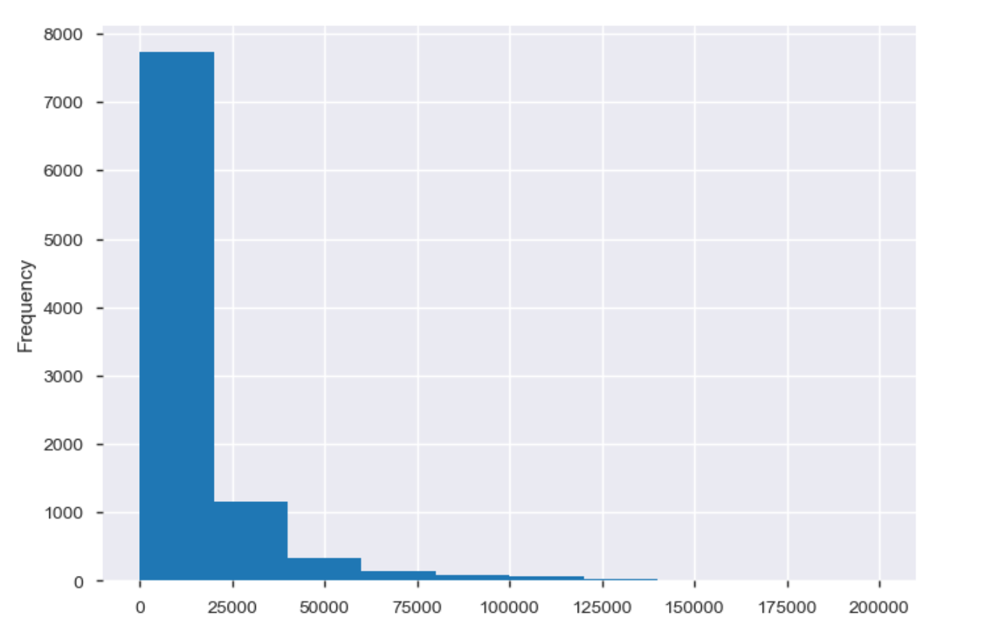
EDA of Car Sales Data Set
Key Aspects of Analysis

Slide 11
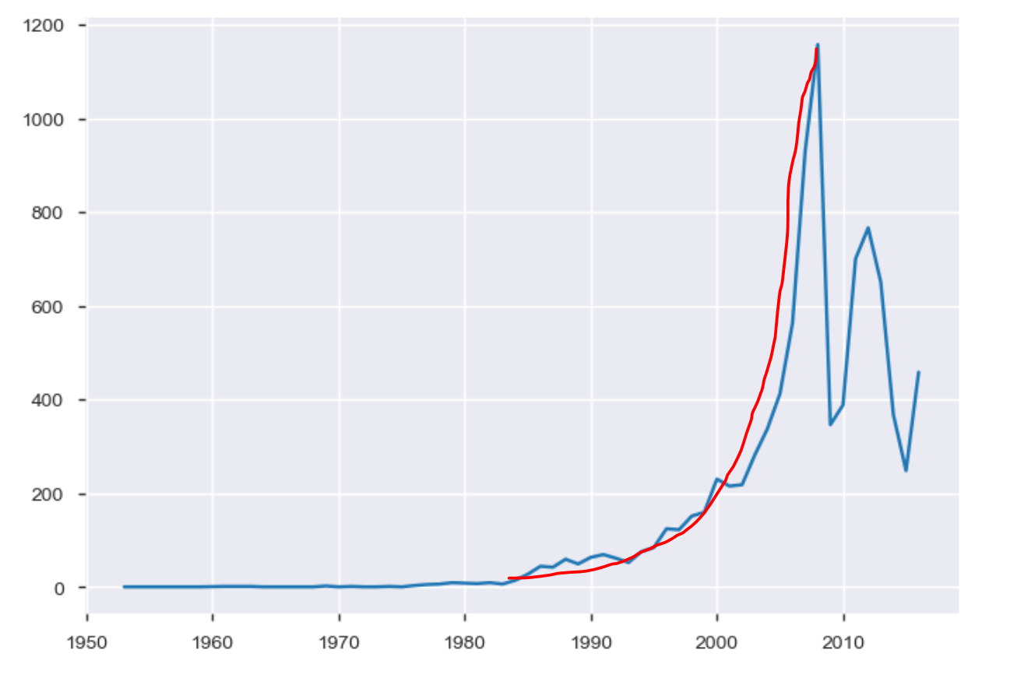
EDA of Car Sales Data Set
Key Aspects of Analysis

Slide 12
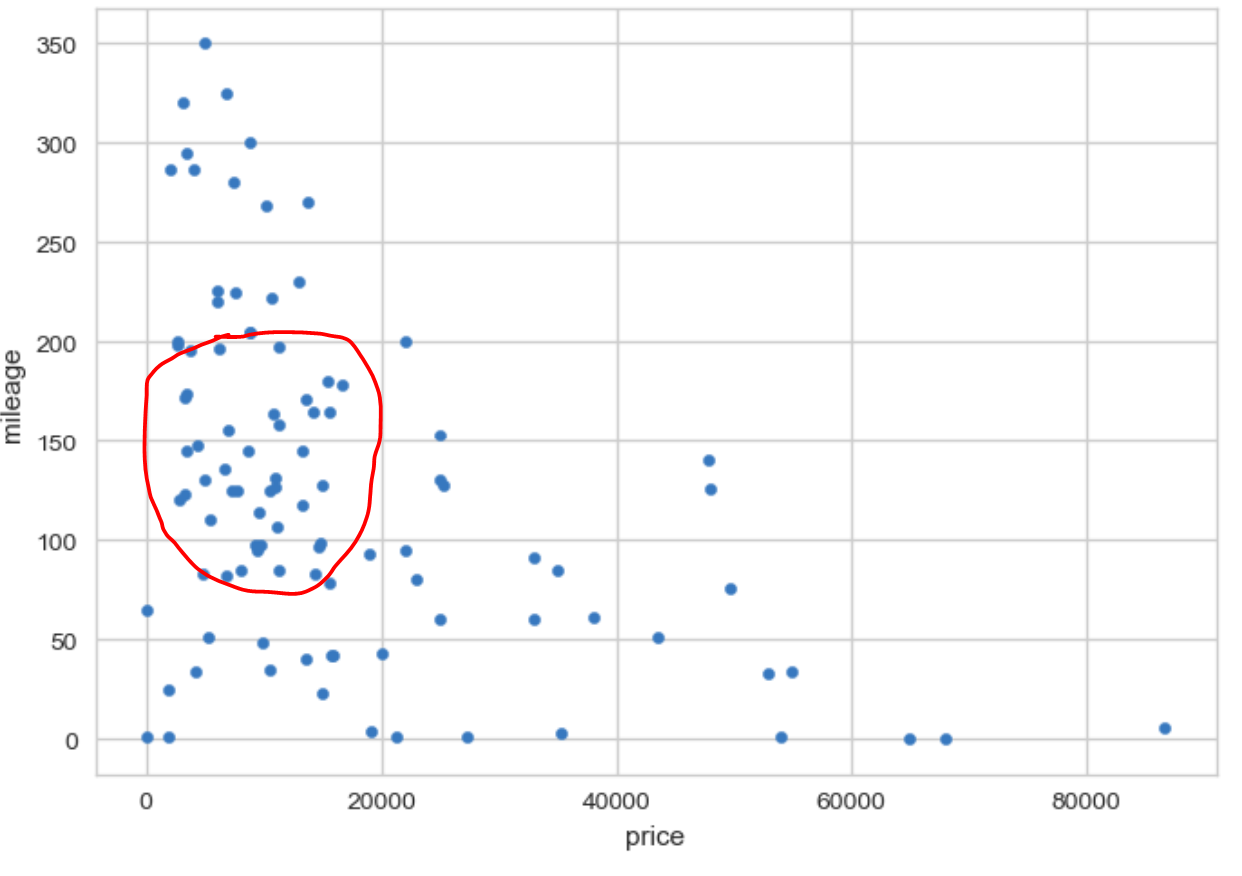
EDA of Car Sales Data Set
Key Aspects of Analysis

Slide 13
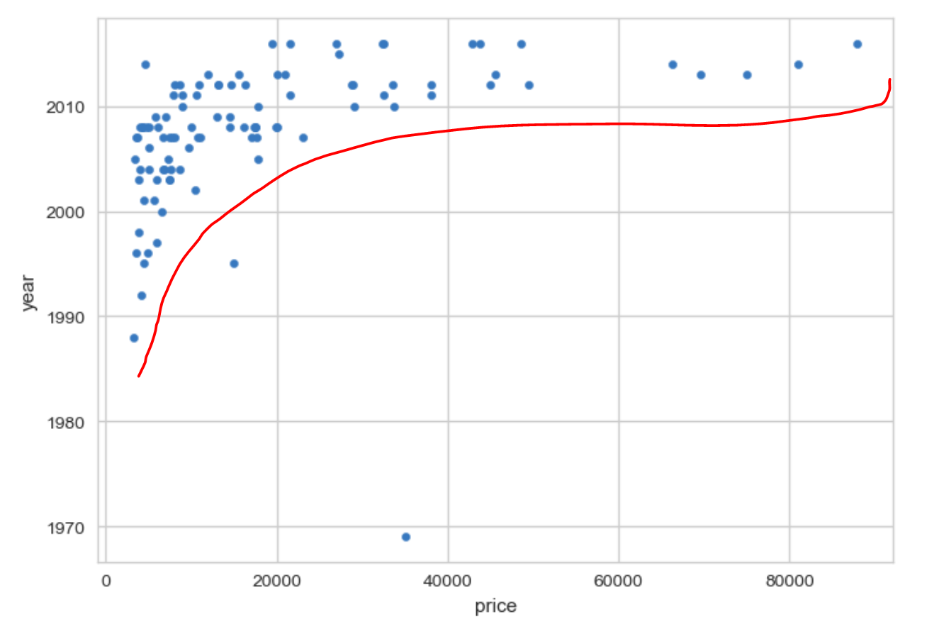
EDA of Car Sales Data Set
Key Aspects of Analysis

Slide 14
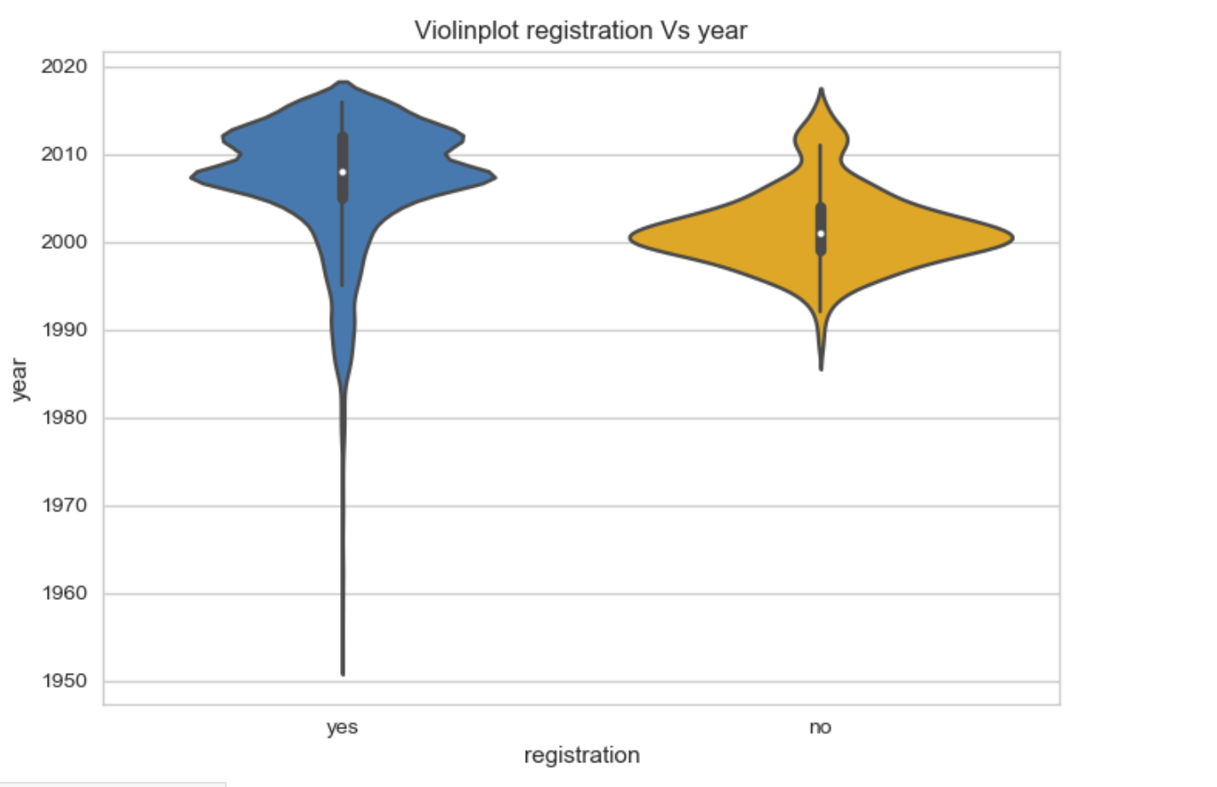
EDA of Car Sales Data Set
Key Aspects of Analysis

Slide 15
Conclusion
Car Sales got increased exponentially between 2005 to 2010.
36% of sales done is sedan cars in over all sales.
43%+ are of petrol type cars followed by Diesel and Gas.
VolksWagen, Mercedes-Benz and BMW are most preferable Brands.
As car Mileage increase price is getting increased.
Most of the sold car model is E-Class.
After year 2010 car sales started going down.
We don't see stable car sales after that.

