Slide 1

Insurance Data Model Prediction
by
Anurag Nandigama
Swetha Nallamilli

Slide 2
Problem Statement
Can we make buying life insurance easier for both the organization and the consumer?
Currently for an insurance company, risk analysis of a current/prospective customer is huge and tedious
Even for a customer of that company, getting the policy is more time taking
Approach to solve this
Develop a predictive model that accurately classifies risk relating to a customer’s application for the insurance company, using the existing data points

Slide 3
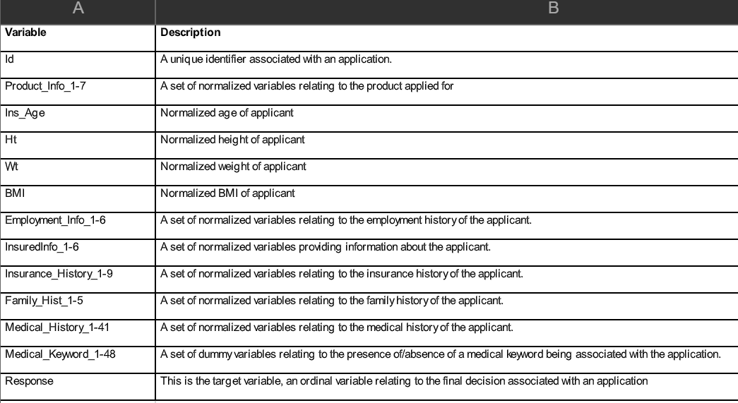
EDA
Customer data of insurance company.
Which contains 59381+ records and 128 columns.

Slide 4
Features to Consider for Linear & Logistic Models
Zeroed down to 9 features that have direct impact on the risk factor (Response)
This was done through correlation matrix with a threshold > 0.1 for the correlation index between various features and target variable (Response)
Product_Info_4 | InsuredInfo_6 | Medical_History_4
Medical_History_6 | Medical_History_13 | Medical_History_23
Medical_History_33 | Medical_History_39 | Medical_History_40

Slide 5
Linear Regression Model
Interpretation
A unit increase in | Risk Rating(response) increases by
Product_Info_4 | 1.35
InsuredInfo_6 | 0.48
Medical_History_4 | 0.79
Medical_History_6 | 0.41
Medical_History_13 | 0.33
Medical_History_23 | 0.53
Medical_History_33 | 0.15
Medical_History_39 | 0.71
Medical_History_40 | 0.81
Metrics
 | Train Data | Test Data
Mean Absolute Error (MAE) | 1.766 | 1.777
Mean Squared Error (MSE) | 4.744 | 4.794
Root Mean Squared Error (RMSE) | 2.178 | 2.189

Slide 6
Logistic Regression Model
Metrics
 | Test Data
Accuracy Score | 42%
Precision | 0.42
Recall | 0.42
F1 Score | 0.42
We are just 42% confident when classifying the risk factor associated with an applicant with this model

Slide 7
Decision Tree Model
Metrics
 | Test Data
Accuracy Score | 40.1%
Precision | 0.401
Recall | 0.401
F1 Score | 0.401
We are just 40% confident when classifying the risk factor associated with an applicant with this model

Slide 8
RandomForest Model
Metrics
 | Test Data
Accuracy Score | 47.24%
Precision | 0.47
Recall | 0.47
F1 Score | 0.47
We are just 47% confident when classifying the risk factor associated with an applicant with this model

Slide 9
Conclusion
After trying different models, we gained confidence with:
Logistic Regression model at 42%
Decision Tree model at 40%
RandomForest model at 47%
Linear Regression is a better model than the above for we are able to predict with very low error margin. (RMSE - 2.18)
Hence, for an applicant, with given set of 9 features, we would now be able to predict the risk factor associated with that application, give or take 2 units of the 8 levels of ‘Response’, the target variable.

