Slide 1

Enron Scandal
Analysing the Enron email corpus using text analytics for financial fraud detection
Group - 14
Amit Prusty A0186053E
Architha Kishore A0185991L
Onni Niemela A0185992J
Spatika Narayanan A0088416X
Swetha Narayanan A0074604J
.

Slide 2



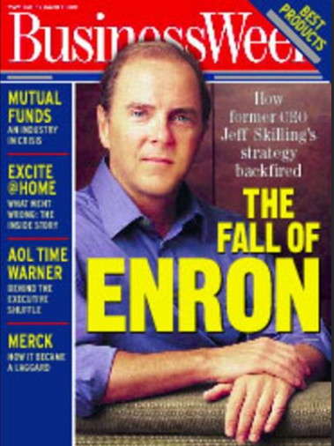
7th largest corporation in America in 2000
Notes:
7th largest corporation in America.
One of the largest companies to produce electricity, natural gases, and other communication initiatives such as internet bandwidth, risk management, weather derivatives (weather insurance), etc.
The Enron scandal surfaced in the October of 2001, leading to the bankruptcy of the Enron Corporation.
Enron's net worth valued at over 70 billion dollars before the bankruptcy.

Slide 3

One of the largest companies to produce electricity, natural gases, and other communication initiatives such as internet bandwidth, risk management, weather derivatives (weather insurance)
Notes:
7th largest corporation in America.
One of the largest companies to produce electricity, natural gases, and other communication initiatives such as internet bandwidth, risk management, weather derivatives (weather insurance), etc.
The Enron scandal surfaced in the October of 2001, leading to the bankruptcy of the Enron Corporation.
Enron's net worth valued at over 70 billion dollars before the bankruptcy.

Slide 4

Enron's net worth valued at over 70 billion dollars before the bankruptcy.
Notes:
7th largest corporation in America.
One of the largest companies to produce electricity, natural gases, and other communication initiatives such as internet bandwidth, risk management, weather derivatives (weather insurance), etc.
The Enron scandal surfaced in the October of 2001, leading to the bankruptcy of the Enron Corporation.
Enron's net worth valued at over 70 billion dollars before the bankruptcy.

Slide 5





The Problem
Declining Market
Partnerships
Trust
Policy Changes
Numbers
The company claimed to be a multi-billion dollar company when they were actually in mass amounts of debt.
Enron created partnerships, and then passed the losses to eliminate the losses from their balance sheets
Hide, manipulate and deceive official accounts and auditors for years
Changes in federal policies on deregulation of the energy business
Tweaking the numbers in their financial statements with accounting techniques to hide their losses

Slide 6
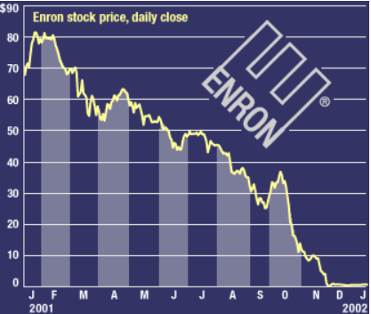


Who was affected?
Auditing
Employees/ Shareholders
Economy
The following year, publicly traded companies spent an average of $2.3 million more on auditing than previously
Losses suffered by over 20,000 employees–many of whom had much of their retirement money~2billion invested in the company’s shares
The decline of Enron stock from $90 a share to 50 cents a share in a single year has taken a massive $67 billion of shareholder wealth out of the economy
Notes:
Economic Setbacks From 2000-2002, publicly traded companies lost value of around $7 trillion
Investors of Enron lost $60 billion in market value
Partners of Enron lost billions of dollars
Led to fall of many other high-profile companies charged with fraud
Employees
More than 20,000 employees lost their jobs
$2 billion lost in pension money
401(k) loss
retirees and long-standing employees lost all of their money
many families lost of all their money
Change in the Auditing World
Arthur Andersen
company who audited Enron, charged of obstruction of justice after fall of Enron for shredding documents of Enron's financial woes
surrendered CPA licenses, lost billions of dollars and jobs
The following year, publicly traded companies spent an average of $2.3 million more on auditing than previously

Slide 7
Facts and Figures
A quick look at who lost how much!
From 2000-2002,Publicly traded companies lost value of around 7 trillion USD.
$7T
$60B
$2B
$2 billion lost in pension money and 401(k) loss.
Investors of Enron lost $60 billion in market value.
Partners of Enron lost billions of dollars.

Slide 8

Our Analysis
Prepare Data
Text Feature Construction
Cleanse and subset data. Map and group the emails to the relevant stakeholders.
Dictionary Approach, Topic Modelling, Word2Vec and Gensim used.
150 Users
0.5Mn Emails
Model
Interpret Results
Baseline models, Ensemble models and models using feature engineered variables.
Compare results of baseline and ensemble models. Translate the results after feature engineering.

Slide 9
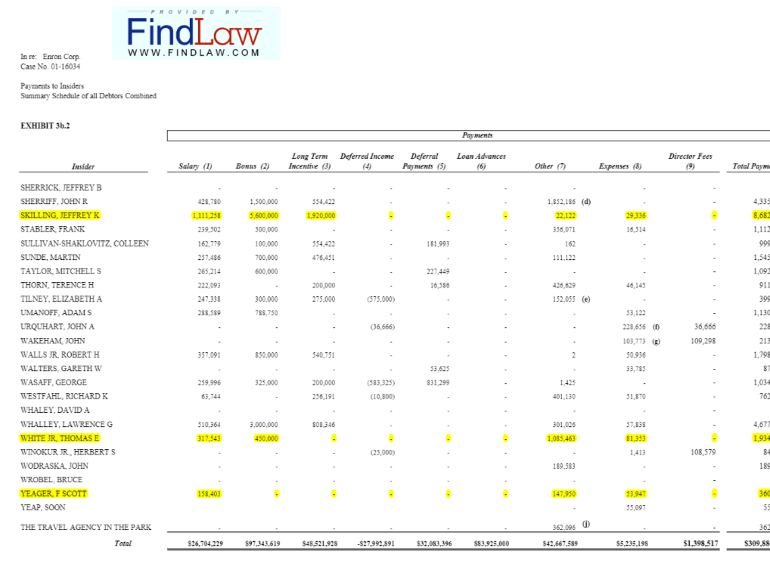
Data Preparation
Enron Email Text dataset obtained from Kaggle.
Enron Finance + Email Metadata Pkl dataset file from Udacity Projects Github Repository
Upsampled the class with lower frequency
Data Imputation & handling missing values
Outlier Detection
Data Cleaning & Merging
70:30 Training : Validation Split on the dataset

Slide 10
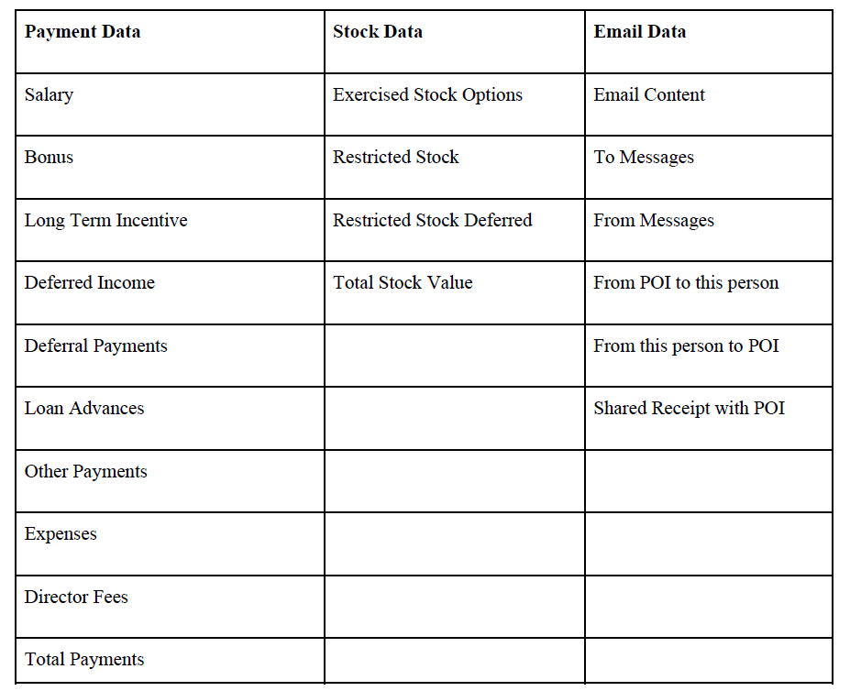

Slide 11
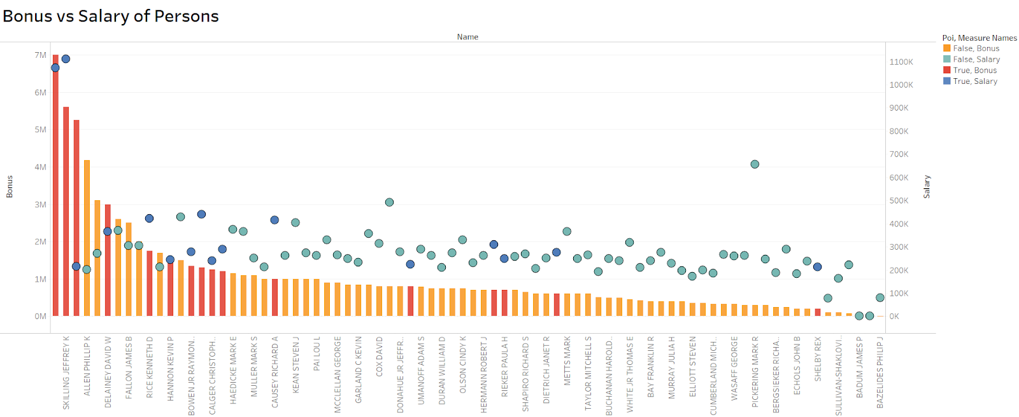
Visualizations
Visualised data and performed initial analysis to understand the data

Slide 12
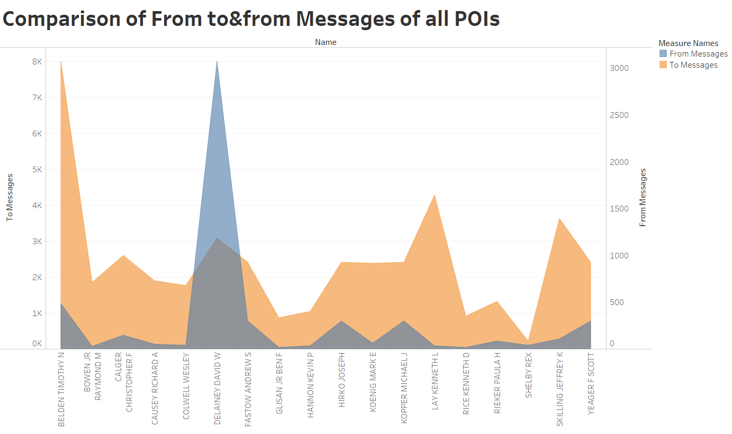
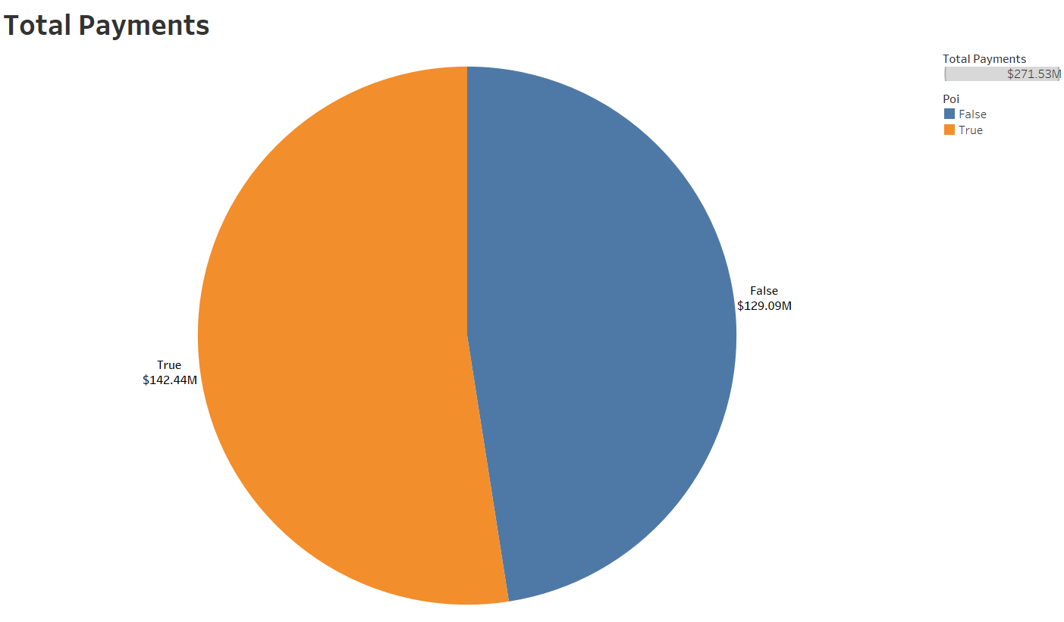
Visualizations
Visualised data and performed initial analysis to understand the data

Slide 13
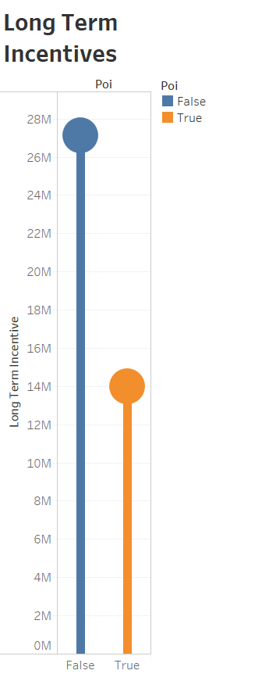
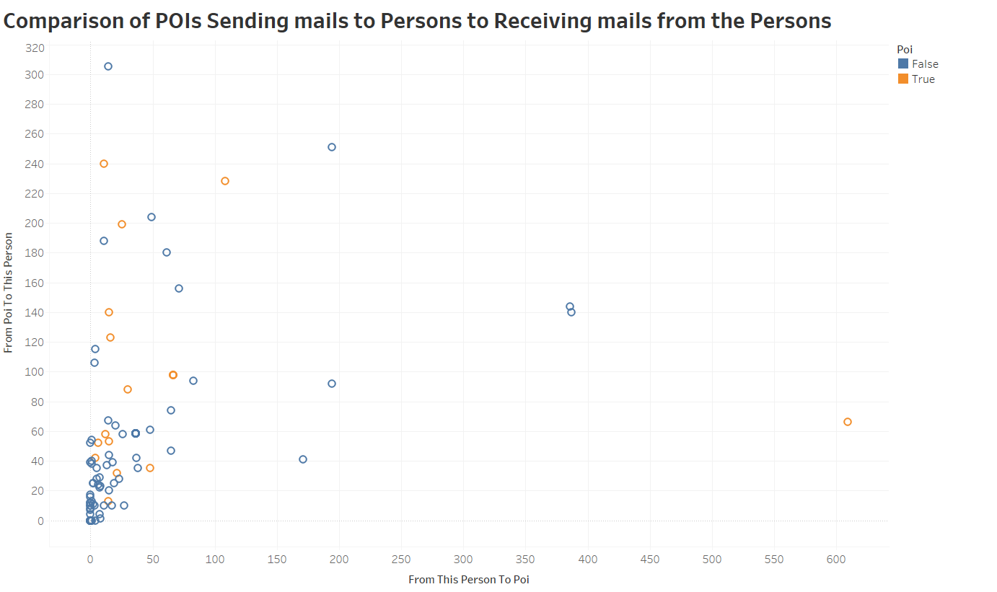
Visualizations
Visualised data and performed initial analysis to understand the data

Slide 14
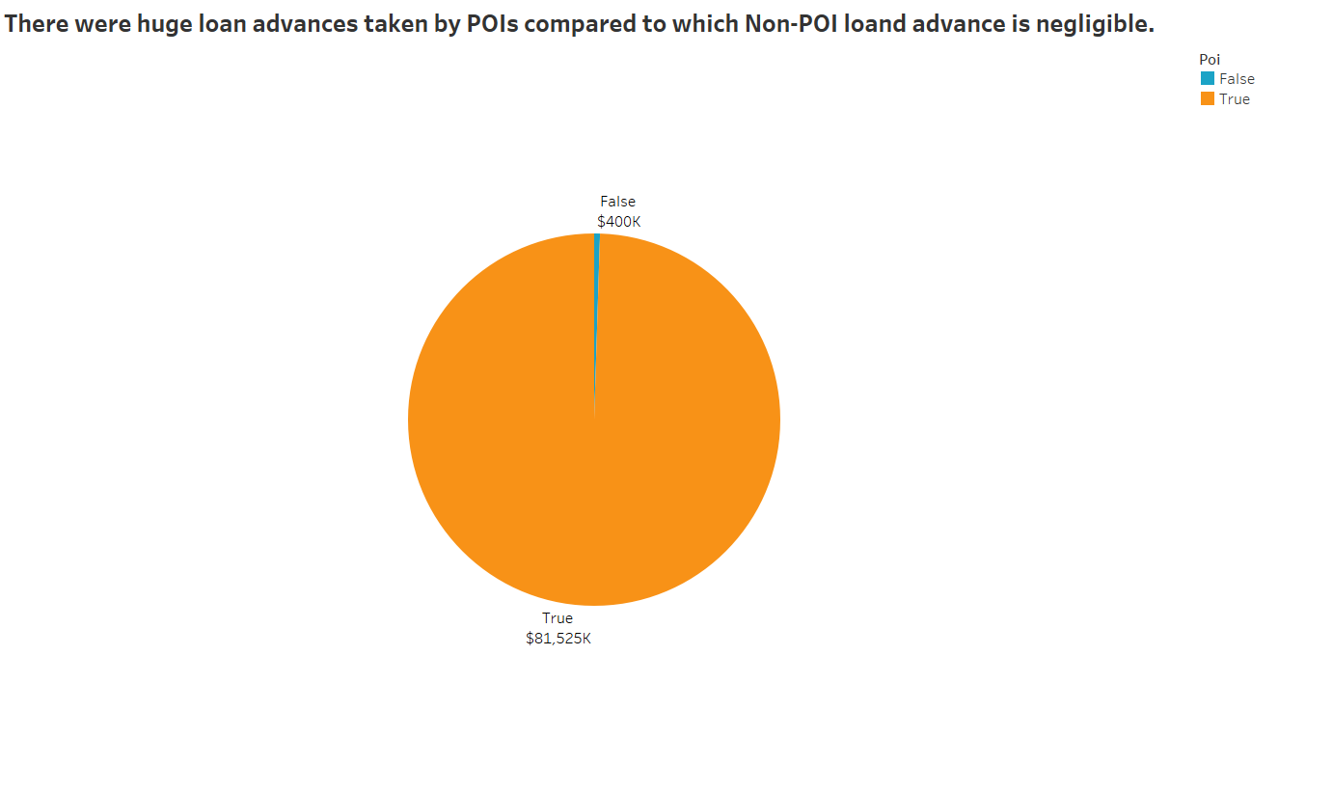
Visualizations
Visualised data and performed initial analysis to understand the data

Slide 15

Feature construction
Dictionary Approach
Topic Modelling
LSA Modelling
Gensim - Doc2Vec

Slide 16
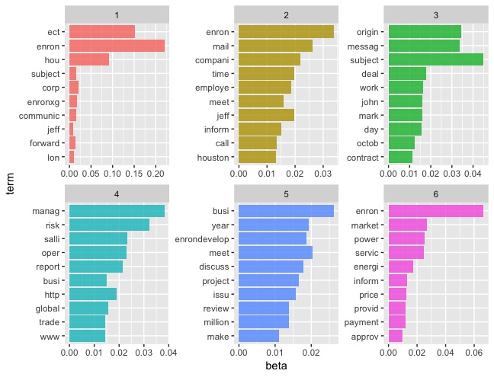
Topic Modelling

Slide 17
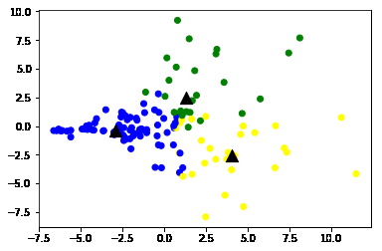
Final Clusters

Slide 18
Models
Baseline results
Model | Best Tune | Training Accuracy | Training Precision | Training Recall | Test Accuracy | Test Precision | Test Recall | Test F1 | Test AUC
KNN | K = 3 | 0.8539 | 0.48 | 1.000 | 0.7838 | 0.333 | 0.6 | 0.42 | 0.706
C5.0 | Trials = 5, winnow = TRUE | 1 | 1 | 1.0 | 0.84 | 0.4 | 0.4 | 0.4 | 0.65
RPart | CP = 0.1 | 0.8539 | 0.4783 | 0.9167 | 0.7568 | 0.333 | 0.8 | 0.471 | 0.775
Neural Networks | Size = 2, Decay= 0 | 0.898 | 0.61 | 0.91 | 0.6 | 0.19 | 0.6 | 0.29 | 0.6
SVM | C = 1 | 0.988 | 0.92 | 1.0 | 0.7027 | 0.29 | 0.8 | 0.42 | 0.74

Slide 19
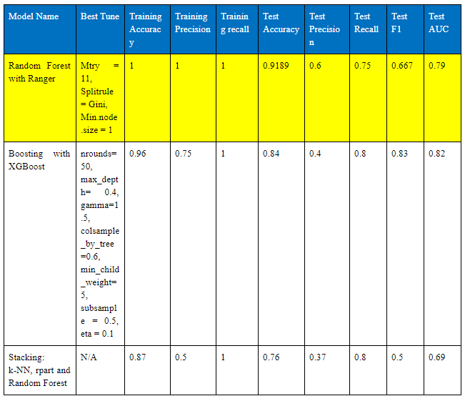
Models
Ensemble learning results

Slide 20
Models
Baseline & Ensemble Learning Result Comparison
All ensemble methods performed at least to the same level as best baseline models
Random Forest reached to 1.0 test recall, showing well improved and powerful performance
Random forest also achieved 0.92 test accuracy and 0.79 AUC, making it also our best performing model overall
AUC - ensemble models outperformed baseline models

Slide 21
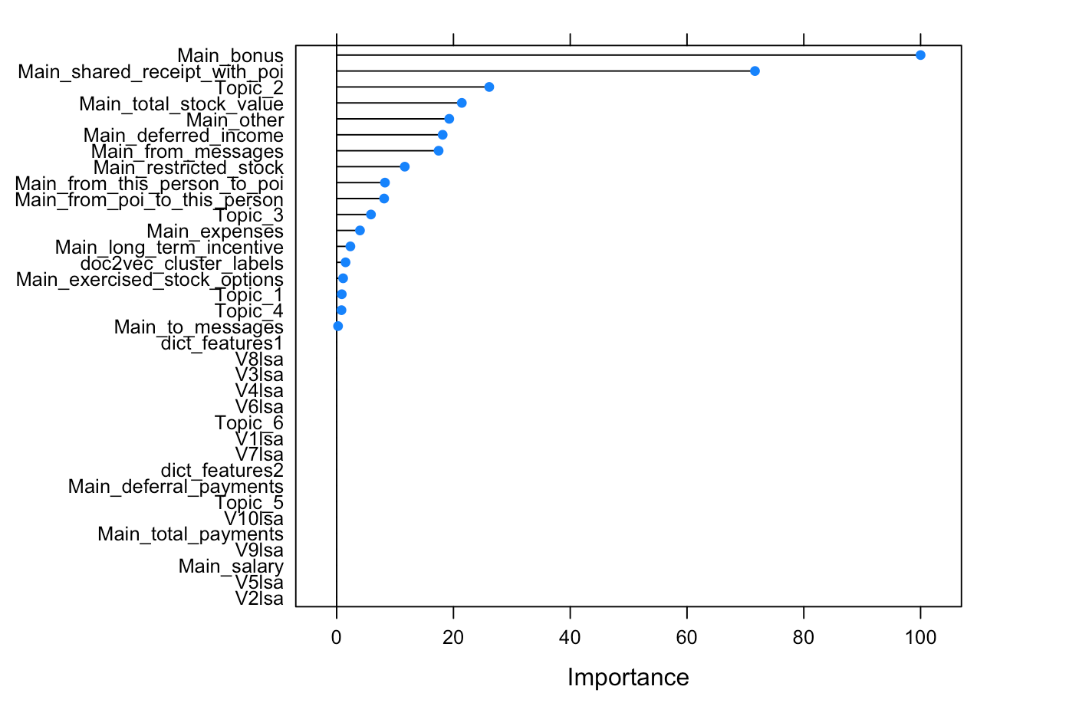
Models
Variable Importance Plot - XGBoost

Slide 22
Feature Engineering
The ratio of emails to an individual from a person of interest to all emails addressed to that individual
The ratio of emails from an individual to a person of interest to all emails addressed from that individual.
The ratio of email receipts shared with a person of interest to all emails addressed to that individual.

Slide 23
Feature Engineering
Capture unbalanced pay information in financial data
Bonus w.r.t to Salary
Bonus w.r.t to Total Payments

Slide 24
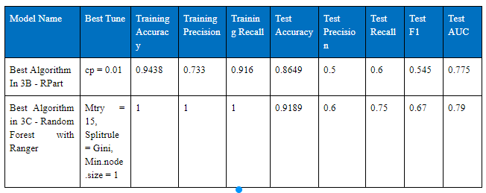
Results after Feature Engineering

Slide 25
Interpret Results
Identifying persons of interest ~ Minority
Identifying the common topics discussed among POIs
Larger dataset for robustness
Email and financial data cannot capture the entire phenomena

