Slide 1


SWETHA PATIL
BMS College Of Engineering
Swiggy Clone

Slide 2
PROJECT TITLE
SWIGGY CLONE WEBSITE

Slide 3

AGENDA
PROBLEM STATEMENT
PROJECT OVERVIEW
THE END USERS
SOLUTION AND ITS VALUE PROPOSITION
THE WOW IN THE SOLUTION
MODELLING
RESULTS

Slide 4

PROBLEM STATEMENT
Swiggy website clone building. The user interface is quite dull and the payment method may take long process.

Slide 5

PROJECT OVERVIEW
The project is built using html, css and javascript.
This project is clone of food delivery app swiggy where the users can order food online and make payment online.
Here they need to signup and then login to website in order to order food and they can also add the food to the favourites.
Once the food is added it can be viewed in the cart page.
And then on checkout the money is deducted from the wallet.
This clone website has improved user interface.

Slide 6

WHO ARE THE END USERS?
The end users include the customers of the restaurants who order the food, the owners of the restaurant who receives the order, the admin of the website who add the restaurants to the list.

Slide 7

YOUR SOLUTION AND ITS VALUE PROPOSITION
In order to improve the payment and make the users to pay easily, the website has wallet.
Where the users add their money and during checkout the money can be deducted from the wallet where the users need not again enter all the details.

Slide 8

THE WOW IN YOUR SOLUTION
Here there is a wallet section, where the users add their money and while ordering food the amount is deducted from that wallet instead of the bank account.
The user interface for landing page, sign up, login is enhanced.
The users can add food to the favorites section and can visit whenever he wants.

Slide 9
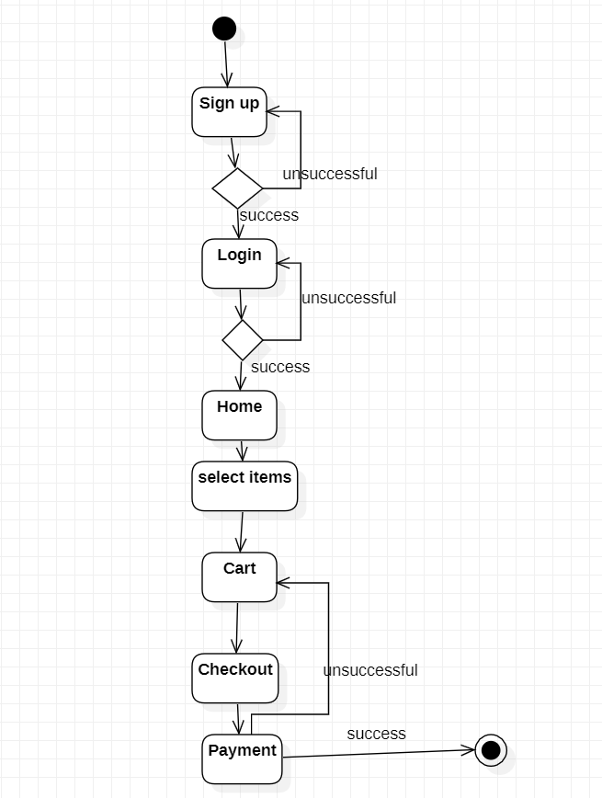
MODELLING
Userflow model

Slide 10
RESULTS
Project Code link:
https://github.com/swethapatil-168/FED

Slide 11
THANK YOU

