Slide 1
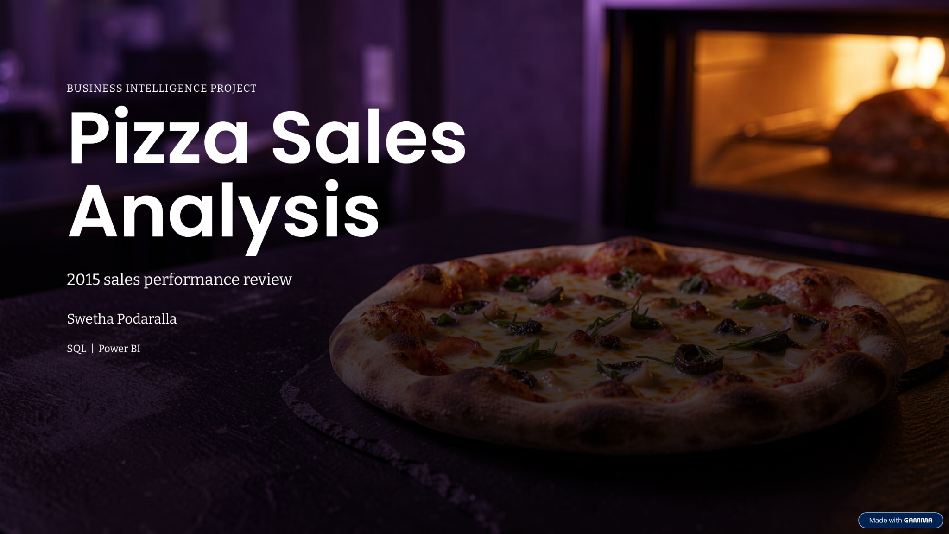

Slide 2
Executive Summary
A quick view of the business performance and the questions this analysis answers.
TOTAL REVENUE
PIZZAS SOLD
ORDERS PLACED
AVG. ORDER VALUE
$817.9K
48,620
21,350
$38.31
Illustrative full-year sales
Units across all categories
Customer transactions
Revenue ÷ orders
KEY TAKEAWAYS
Classic and Supreme-style pizzas contribute a large share of demand.
Large-size pizzas are a major revenue driver.
Demand tends to strengthen around lunch and dinner periods.
The next opportunity is to improve quieter dayparts and lift add-on sales.
PIZZA SALES ANALYSIS • ILLUSTRATIVE SAMPLE DATA
02 / 12

Slide 3
Project Scope & Methodology
A clear process turns transaction-level records into practical business decisions.
01 DATA INPUT
02 ANALYSIS
03 OUTPUT
Order ID and order date
Clean and validate records
Performance dashboard
Pizza name, category and size
Calculate revenue and order KPIs
Product and demand insights
Quantity and unit price
Compare time, category and size
Actionable recommendations
DATA NOTE: No transaction dataset was supplied for this deck. All figures and patterns in slides 2–11 are illustrative sample values for presentation practice—not verified business results.
PIZZA SALES ANALYSIS • ILLUSTRATIVE SAMPLE DATA
03 / 12

Slide 4
Sales Performance at a Glance
Core KPIs establish the baseline before drilling into patterns.
GROSS REVENUE
TOTAL ORDERS
PIZZAS SOLD
$817,860
21,350
48,620
Sales value
Unique order count
Total quantity
AVERAGE ORDER VALUE
AVG. PIZZAS / ORDER
AVG. PRICE / PIZZA
$38.31
2.28
$16.82
Revenue per order
Units per transaction
Revenue per unit
Interpretation: A $38.31 average order value and 2.28 pizzas per order suggest customers commonly purchase more than one pizza per transaction.
PIZZA SALES ANALYSIS • ILLUSTRATIVE SAMPLE DATA
04 / 12

Slide 5
Monthly Revenue Trend
Illustrative monthly revenue shows seasonality and helps plan campaigns and staffing.
Jan
$65K
Feb
$62K
HIGHLIGHT
December is the strongest month in this sample, while February is the softest. Validate holiday and promotion effects against actual order dates.
Mar
$68K
Apr
$66K
May
$69K
Jun
$67K
Jul
$71K
Aug
$70K
Sep
$64K
Oct
$66K
Nov
$68K
Dec
$73K
PIZZA SALES ANALYSIS • ILLUSTRATIVE SAMPLE DATA
05 / 12

Slide 6
Sales by Day of Week
Day-level demand can guide roster planning, prep levels and targeted offers.
Monday
2,750 orders
Tuesday
2,820 orders
WEEKEND EFFECT
Saturday and Friday lead the sample week. Consider stronger staffing and inventory coverage for these days.
Wednesday
2,860 orders
Thursday
2,940 orders
Friday
3,300 orders
Saturday
3,500 orders
Sunday
3,180 orders
PIZZA SALES ANALYSIS • ILLUSTRATIVE SAMPLE DATA
06 / 12

Slide 7
Order Volume by Hour
Peak periods help align kitchen capacity, delivery operations and staffing.
10 AM
450
11 AM
1,050
PEAK WINDOWS
Lunch: 12–2 PM
Dinner: 7–8 PM
Use these windows for staggered breaks, prep planning and order handoff capacity.
12 PM
2,100
1 PM
2,350
2 PM
1,750
3 PM
900
4 PM
650
5 PM
950
6 PM
1,850
7 PM
2,450
8 PM
2,300
9 PM
1,150
PIZZA SALES ANALYSIS • ILLUSTRATIVE SAMPLE DATA
07 / 12

Slide 8
Revenue by Pizza Category
Category mix reveals where the menu earns most of its revenue.
Classic
$260K
CLASSIC LEADS
Classic contributes about 32% of sample revenue. Keep core classics visible while testing new variants in smaller batches.
Supreme
$220K
Chicken
$190K
Veggie
$148K
PIZZA SALES ANALYSIS • ILLUSTRATIVE SAMPLE DATA
08 / 12

Slide 9
Revenue by Pizza Size
Size mix supports pricing, upselling and inventory decisions.
Small
$90K
LARGE SIZE CONTRIBUTION
Large pizzas account for roughly 43% of sample revenue. Test a clear upgrade prompt from Medium to Large.
Medium
$205K
Large
$350K
X-Large
$145K
XX-Large
$28K
PIZZA SALES ANALYSIS • ILLUSTRATIVE SAMPLE DATA
09 / 12

Slide 10
Product Performance: Winners & Watchlist
Use product-level results to protect popular items and investigate weak performers.
TOP PERFORMERS
WATCHLIST
Classic Deluxe — broad appeal and reliable repeat demand
Low-volume specialty items — check awareness and menu placement
BBQ Chicken — differentiated flavor and premium positioning
High-cost toppings — review margin, waste and portion control
Thai Chicken — opportunity for cross-category discovery
Slow-moving sizes — test bundles before removing options
Product names are examples; validate rankings with actual item-level sales and margin data.
PIZZA SALES ANALYSIS • ILLUSTRATIVE SAMPLE DATA
10 / 12

Slide 11
Business Recommendations
Translate the analysis into a short list of testable actions.
01 STAFF FOR PEAKS
Schedule extra kitchen and dispatch capacity for lunch and dinner rushes.
02 PROMOTE LARGE
Offer a simple, visible size-up option and track conversion rate.
03 PROTECT BESTSELLERS
Maintain availability of high-demand classic and premium pizzas.
04 TEST QUIET-PERIOD OFFERS
Use limited-time bundles during slower hours or weekdays.
05 TRACK PROFIT, NOT JUST SALES
Add food cost, discounts and delivery fees to measure contribution margin.
PIZZA SALES ANALYSIS • ILLUSTRATIVE SAMPLE DATA
11 / 12

Slide 12
THANK YOU
Pizza Sales
Analysis
QUESTIONS?
Thank you for your time.
From sales data to smarter decisions.
Swetha Podaralla
SQL | Power BI
Note: All analytical values are illustrative sample data.

