Slide 1
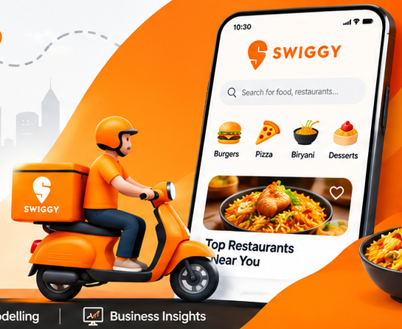
DATA ANALYTICS | SQL PROJECT
DATA ANALYTICS PROJECT | SQL SERVER
SWIGGY SALES
ANALYSIS
SWIGGY SALES
ANALYSIS
Restaurant listings • Menu pricing • Food categories
Customer ratings • City-wise patterns
SQL Data Analytics Project
Restaurant listings • Food prices
Customer ratings • City-wise insights
197,430 records | 993 restaurants | 28 cities
SQL SERVER
197K+ ROWS
INDIA-WIDE
Portfolio case study based on the supplied Swiggy dataset
A data-driven look at Swiggy's restaurant and menu landscape
01

Slide 2
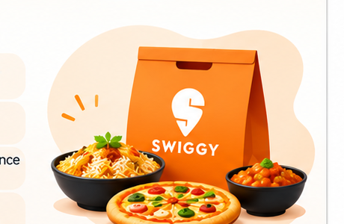
Project Overview
A SQL-led exploration of restaurant, menu and rating data
197,430
993
28
28
DATASET RECORDS
UNIQUE RESTAURANTS
CITIES
STATES
PROJECT PURPOSE
TOOLS & TECHNIQUES
Understand restaurant distribution, menu-price patterns, food categories and customer ratings across Indian cities.
SQL Server: data validation, duplicate handling, star-schema modelling, aggregations, date analysis and rankings.
Dataset period: 01 Jan 2025 – 31 Aug 2025
10 columns covering location, restaurant, dish, price, rating and rating count.
SWIGGY SALES ANALYSIS | SQL PROJECT
02

Slide 3
Business Problem & Objectives
The questions this project is designed to answer
PROBLEM STATEMENT
BUSINESS OBJECTIVES
Swiggy aims to analyze restaurant and food-related data across different cities in India to understand restaurant distribution, food pricing, customer ratings and food-category trends.
• Measure restaurant coverage by city, state and locality.
• Compare menu prices across categories and dishes.
• Identify restaurants and categories with strong listing presence.
• Understand rating distribution and rating-count patterns.
• Generate insights that can guide better business decisions.
CORE BUSINESS QUESTION
What do restaurant listings, menu prices and customer ratings reveal about food options and restaurant presence across different locations?
SWIGGY SALES ANALYSIS | SQL PROJECT
03

Slide 4
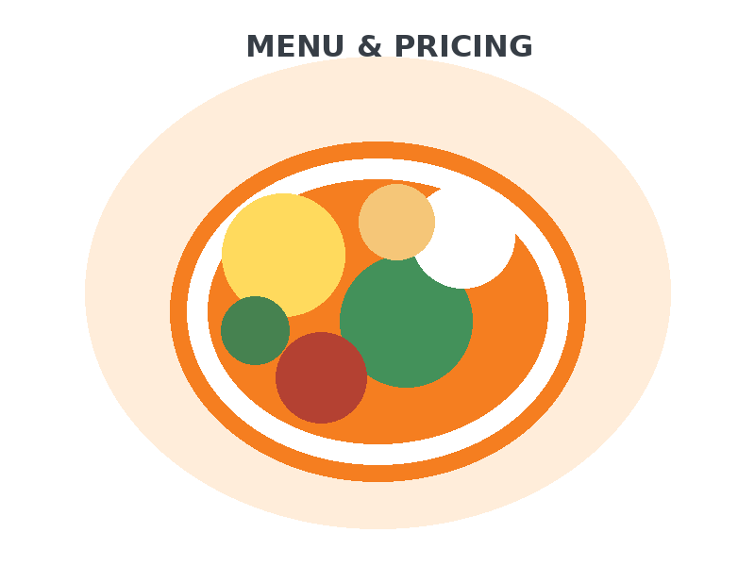
Dataset Description
Actual source: Swiggy_Data.csv — 197,430 rows and 10 columns
State
City
State name
City name
Order Date
Restaurant Name
Date field
Restaurant listing
Location
Category
Local area
Food/menu category
Dish Name
Price (INR)
Listed food item
Menu price in rupees
Rating
Rating Count
Displayed rating
Number of ratings
Coverage: 993 unique restaurants | 28 cities | 28 states | 4,972 distinct category labels
SWIGGY SALES ANALYSIS | SQL PROJECT
04

Slide 5
Data Cleaning & Validation
Checks in the supplied SQL script and actual CSV inspection
0
27
1
8,000
NULL CELLS IN CSV
EXACT DUPLICATE ROWS
LOWEST PRICE (₹)
HIGHEST PRICE (₹)
VALIDATION TASKS
DUPLICATE HANDLING
Check NULLs and blank strings in State, City, Order_Date, Restaurant_Name, Location, Category, Dish_Name, Price_INR, Rating and Rating_Count.
The SQL script detects duplicates using business columns and uses ROW_NUMBER() to retain one row per duplicate group.
CSV inspection found no null cells and 27 exact duplicate rows. Review duplicate meaning before deletion; repeated menu records may not always be erroneous.
SWIGGY SALES ANALYSIS | SQL PROJECT
05

Slide 6
Dimensional Modelling – Star Schema
The supplied SQL script separates descriptive dimensions from the central fact table
DIM_DATE
DIM_RESTAURANT
Full date • Year • Month • Quarter • Week
Restaurant_Name
FACT_SWIGGY_ORDERS
DIM_CATEGORY
Price_INR • Rating • Rating_Count
Dimension keys
Category
DIM_LOCATION
DIM_DISH
State • City • Location
Dish_Name
Purpose: reduce repeated descriptive data and make location, date, restaurant, category and dish analysis more structured.
SWIGGY SALES ANALYSIS | SQL PROJECT
06

Slide 7
KPI Framework
Measures defined in the SQL script — interpret carefully against source fields
Record count
Unique restaurants
Average dish price
197,430
Rows in the supplied dataset
993
Distinct restaurant names
₹268.51
Average listed item price
Average rating
Rating count sum
Distinct cities
4.34/5
Mean displayed rating
5,591,574
Sum of source rating-count values
28
Geographic coverage
The SQL script labels some row counts as “Total Orders” and SUM(Price_INR) as “Total Revenue”. The source CSV has no transaction ID or quantity sold, so these should be treated as record-count and listed-price proxies, not verified orders or sales revenue.
SWIGGY SALES ANALYSIS | SQL PROJECT
07

Slide 8
Location Analysis – Top Cities
Bengaluru has the highest record volume in the uploaded dataset
TOP CITY
Bengaluru
20,077 records
GEOGRAPHIC FOOTPRINT
28 cities across 28 states
BUSINESS USE
Compare restaurant presence and menu options by city; investigate locations with fewer listings.
SWIGGY SALES ANALYSIS | SQL PROJECT
08

Slide 9
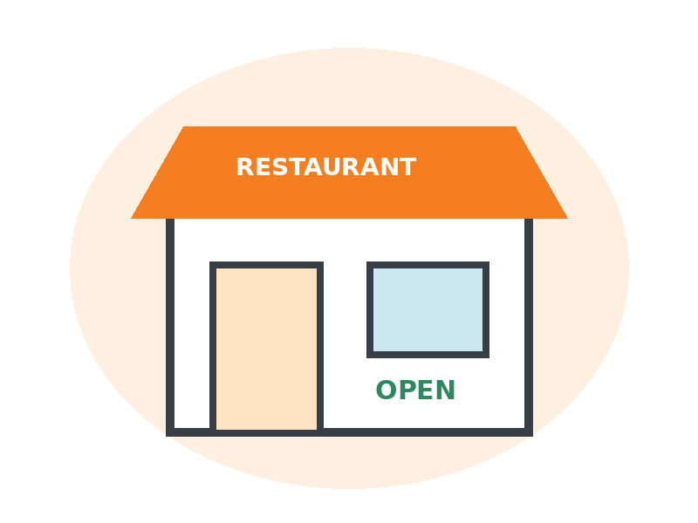
Restaurant Analysis
Most frequently represented restaurant names in the dataset
MOST REPRESENTED
McDonald's
13,530 records
NEXT IN RANK
KFC
12,961 records
Record frequency is not the same as order volume, market share or revenue.
SWIGGY SALES ANALYSIS | SQL PROJECT
09

Slide 10
Food Category & Pricing Analysis
Understand menu mix and the distribution of listed prices
MOST COMMON CATEGORY LABELS
LISTED PRICE BANDS
Average listed price: ₹268.51 | Median listed price: ₹229.00. Price bands follow the SQL script: under ₹100, ₹100–199, ₹200–299, ₹300–499 and ₹500+.
SWIGGY SALES ANALYSIS | SQL PROJECT
10

Slide 11
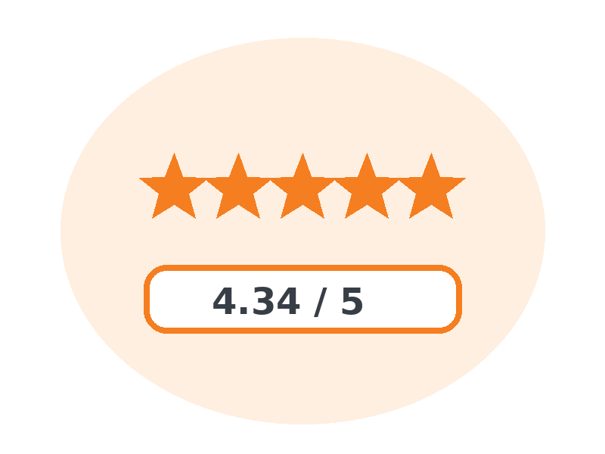
Ratings & Date-Based Analysis
Review rating patterns and the source date field
RATING DISTRIBUTION
MONTHLY RECORD COUNTS
INTERPRETATION
Average rating is 4.34/5. Monthly counts represent rows grouped by the recorded date, not confirmed completed orders.
SWIGGY SALES ANALYSIS | SQL PROJECT
11

Slide 12
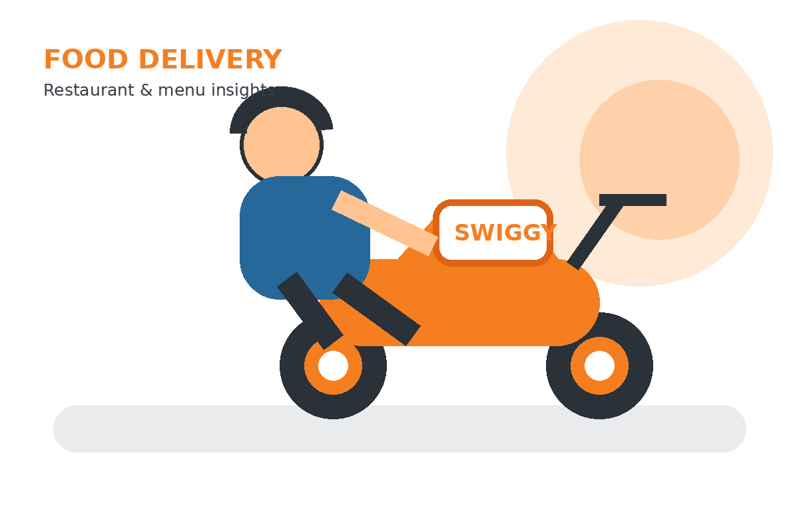
SWIGGY SALES ANALYSIS
CONCLUSION & NEXT STEPS
Turning Swiggy data
into useful insights
THANK YOU!
SQL helps structure the dataset, validate data quality and compare restaurant listings, menu prices, categories, ratings and location patterns. These findings can support better restaurant and menu intelligence.
Swiggy Sales Analysis
SQL Data Analytics Project
Analyzing restaurant presence, menu pricing,
food categories and customer ratings across cities.
Explore
Monitor restaurant and city coverage
Compare
Review prices, categories and ratings
RESTAURANTS
PRICING
RATINGS
Improve
Validate findings with transaction-level data
Thank you for your time and consideration.
Thank you | Swiggy Sales Analysis using SQL
12

