Slide 1
Digital Portfolio
STUDENT NAME:mohana swetha.r
REGISTER NO AND NMID:24131211802522043, ASANM121ANM12124214044
DEPARTMENT: B.SC.COMPUTER SCIENCE
COLLEGE: COLLEGE/ UNIVERSITY:
IMMACULATE COLLEGE FOR WOMEN /ANNAMALAI UNIVERSITY

Slide 2
WEBDEVELOPMENT:
FORM CREATION
TABLE CREATION

Slide 3
AGENDA:
Problem Statement
Project Overview
End Users
Tools and Technologies
Portfolio design and Layout
Features and Functionality
Results and Screenshots
Conclusion
Github Link

Slide 4
PROBLEM STATEMENT:
FOR FORM CREATION
Design and develop a web-based registration form using HTML, CSS, and JavaScript that collects essential user information and provides real-time validation.
FOR TABLE CREATION
Design and develop a student record table using HTML, CSS, and JavaScript that displays and organizes student information in a clear and interactive manner.

Slide 5
PROJECT OVERVIEW:
This project demonstrates the creation of a Student Admission Portal using HTML, CSS, and JavaScript. It consists of two main modules: a registration form and a student records table. The registration form collects user details such as name, email, phone, gender, course, and address. Form fields are validated using JavaScript to ensure correct input (e.g., email format, phone number pattern, required fields). The form is styled with CSS to provide a clean, user-friendly, and responsive design. The student records table displays student information in a structured format with columns for Roll No, Name, Course, Marks, and Grade. CSS is used to style the table with alternate row colors, hover effects, and responsiveness. JavaScript adds interactivity by enabling column sorting and a search feature to filter records. This makes it easy to organize, find, and manage student details. The project highlights frontend web development skills including layout design, styling, and client-side scripting.

Slide 6
WHO ARE THE END USERS?
Students / Applicants
They use the registration form to enter their personal and academic details for admission.
They interact with the form fields, validations, and submit their information.
College / University Administration
They use the student records table to view, sort, and search student data.
Helps in managing admission records efficiently.
Teachers / Staff
They can check student details, marks, and grades from the table.
Useful for maintaining departmental records.
System Developers / Designers (secondary end users)
They test and enhance the form and table functionalities.
Use the project as a learning/demo tool for frontend web development.

Slide 7
TOOLS AND TECHNIQUES
TOOLS
🔹 Tools Used:
HTML5 – for creating the structure of the form and table.
CSS3 – for styling (colors, fonts, borders, hover effects, responsiveness).
JavaScript – for adding validation to the form, sorting, and searching in the table.
Text Editor / IDE – e.g., Visual Studio Code, Sublime Text, or Notepad++.
Web Browser – e.g., Google Chrome / Mozilla Firefox for testing and execution.
TECHNIQUES
🔹 TECHNIQUES APPLIED:
Form Creation Techniques
Input fields (text, email, tel, date, radio, checkbox, file upload).
Validation using HTML attributes (required, pattern, minlength) and JavaScript.
CSS styling for user-friendly interface.
Table Creation Techniques
Table structure with <table>, <thead>, <tbody>, <tr>, <td>.
CSS styling: borders, row striping, hover highlighting, responsive design.

Slide 8
POTFOLIO DESIGN AND LAYOUT
Cover Page – Project Title, Your Name/Roll No, College/Dept, Year.
Index – List of sections with page numbers.
Introduction – Brief on forms & tables in web development.
Problem Statement & Objectives – Why the project is needed and its goals.
Tools & Techniques – HTML, CSS, JavaScript, Browser, Editor.
System Design – Layout diagrams/wireframes of form and table.
Implementation – Code snippets + screenshots of output.
Results – Successful form validation & interactive table.
Conclusion – Key learnings & outcomes.
Future Scope – Database integration, login, export features.
References – Books, websites, or tutorials used.

Slide 9
FEATURES AND FUNCTIONALITY
🔹 Form Creation
User-friendly form with labeled fields (Name, Email, Phone, DOB, etc.).
Validation using HTML5 and JavaScript (required fields, email format, number limits).
🔹 Table Creation
Structured data display using rows and columns.
Styled layout with CSS (borders, alternating row colors, hover effects).
Dynamic update (new entries can be added from form into table).

Slide 10
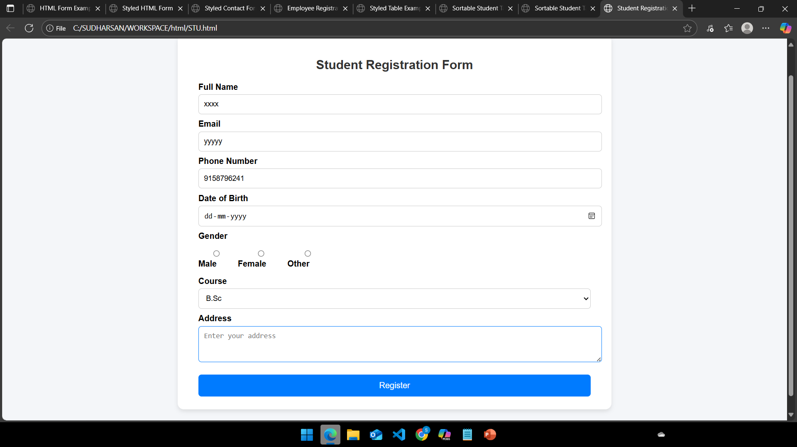
RESULT AND OUTPUT

Slide 11
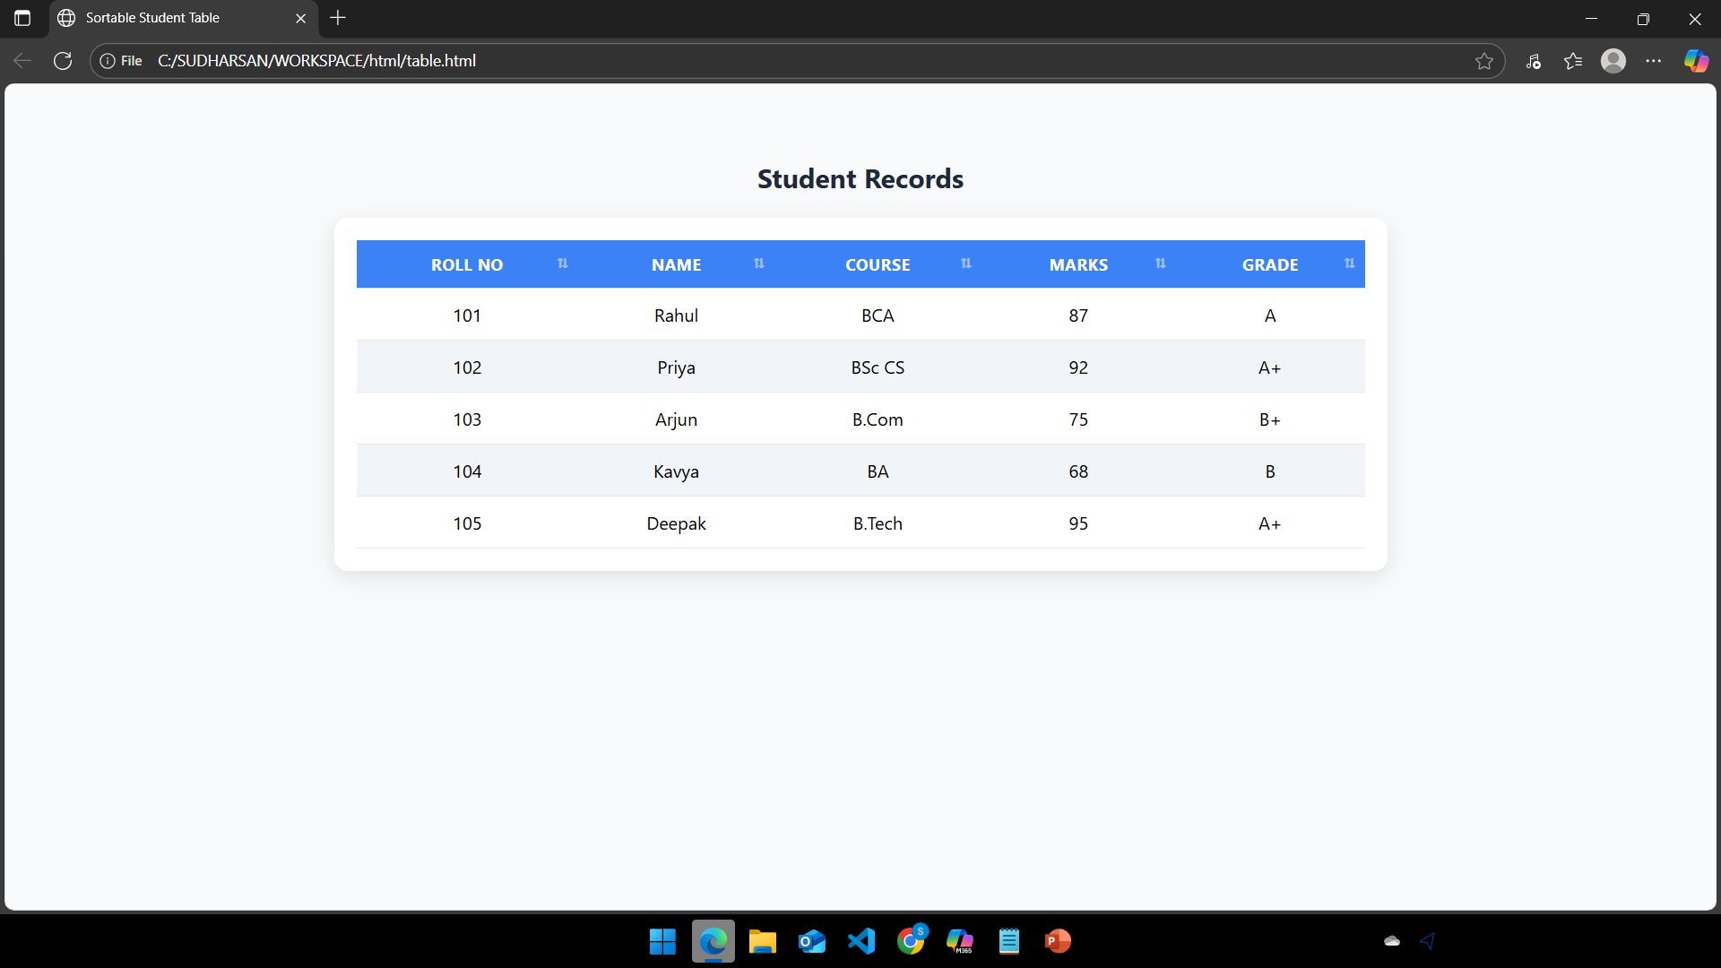

Slide 12
CONCLUSION
The Form and Table Creation project demonstrates the effective use of HTML, CSS, and JavaScript in building interactive and user-friendly web applications. The form allows structured data collection from users with validation for accuracy, while the table provides an organized and readable display of the collected information. Styling with CSS enhances the visual appeal, and JavaScript adds interactivity such as validation, sorting, or dynamic updates.
This project highlights how basic web technologies can be combined to create simple yet powerful tools for data entry and management, which can be further extended for real-world applications like student registration systems, employee records, or online surveys.

