Slide 1
HOTEL RESERVATION CANCELLATION PREDICTION
119cs0025
T. Swetha Reddy

Slide 2
Problem Statement
Given a dataset containing data of reservations made by customers in different hotels, build a machine learning model to predict whether the customer cancels his/her hotel reservation or not.

Slide 3
About the Dataset
No. of rows = 119390
No. of attributes = 32
Target variable = is_cancelled
No. of independent variables = 31
No. of numeric variables = 12
No. of object variables = 19

Slide 4
Independent variables in the dataset
Hotel
Lead_time
Arrival_date_year
Arrival_date_month
Arrival_date_week_number
Arrival_date_day_of_month
Stays_in_weekend_nights
Stays_in_week_nights
Adults
Children
Babies
Meal
Country
Market_segment
distribution_channel
is_repeated_guest
previous_cancellations
previous_bookings_not_cancelled
reserved_room_type
assigned_room_type
booking_changes
deposit_type
agent
company
days_in_waiting_list
customer_type
adr
required_car_parking_spaces
total_of_special_requests
reservation_status
reservation_status_date

Slide 5
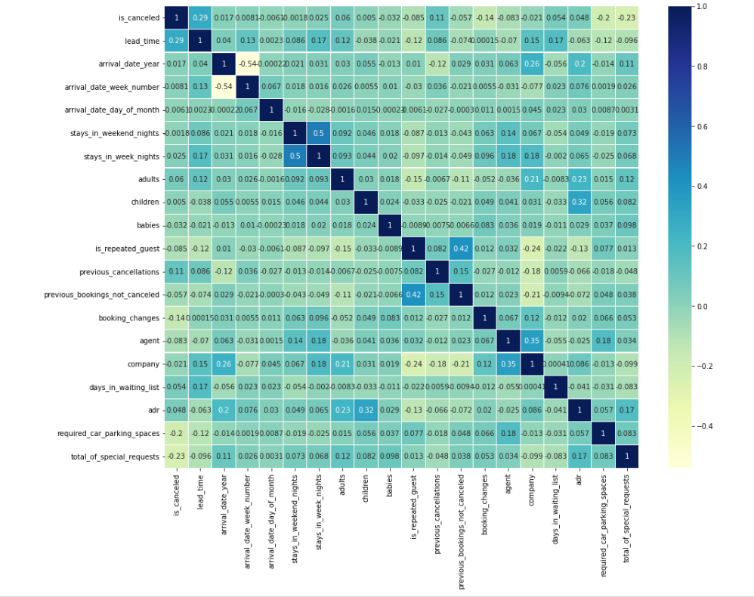
Correlation Matrix

Slide 6
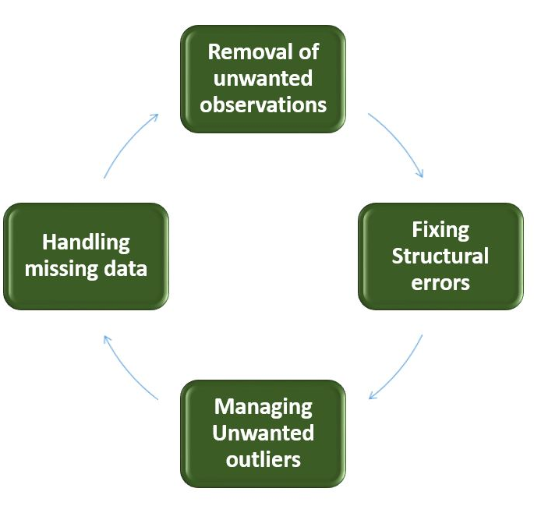
Data Cleaning
Data Cleaning is the process of identifying the incorrect, incomplete, inaccurate, duplicated, irrelevant or missing part of the data and then modifying, replacing or deleting them according to the necessity
Replacing NULL/MISSING Values
Replacing numerical missing values with MEAN/MEDIAN
No. of null values in [children] = 4
No. of null values in [agent] = 16340
No. of null values in [company] = 112593

Slide 7
Data Cleaning
Replacing NULL/MISSING Values
Replacing categorical missing values with MODE
No. of null values in [country] = 488
Removing the Duplicate Values
No. of duplicate values in the data set = 32013
Since we have 32013 duplicate records in the data, we will remove this from the data set so that we get only distinct records. Post removing the duplicate, we will check whether the duplicates have been removed from the data set or not.
No. of rows in the dataset after removing duplicates = 87377

Slide 8
Encoding Categorical Data
Encoding categorical data is a process of converting categorical data into integer format so that the data with converted categorical values can be provided to the different models.
An approach to encoding categorical values is to use a technique called label encoding. Label encoding is simply converting each value in a column to a number.
Categorical variables in our data set:
Hotel
arrival_date_month
meal
country
Market_segment
distribution_channel
reserved_room_type
assigned_room_type
deposit_type
customer_type
reservation_status
reservation_status_date

Slide 9
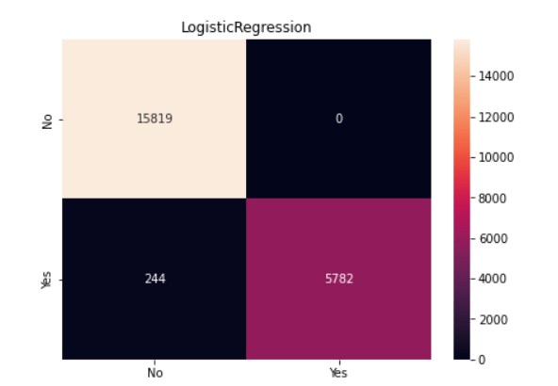
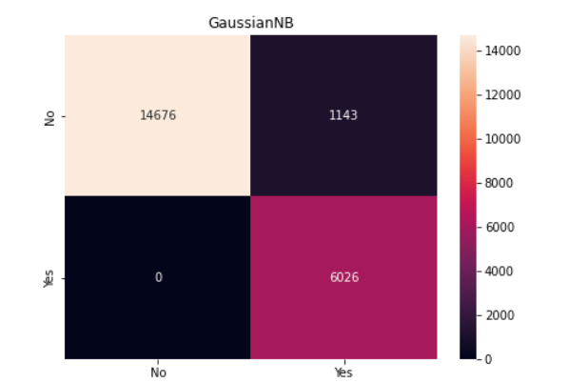
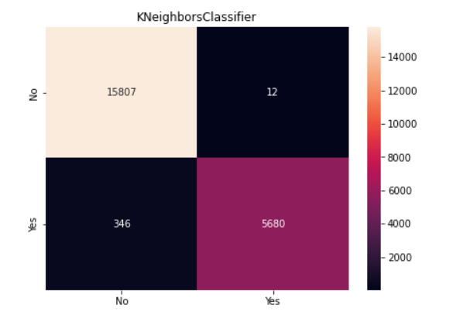
Training the Model
Size of training data = 75%
Size of testing data = 25%
Confusion Matrix

Slide 10
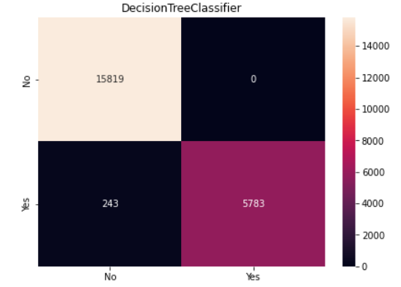
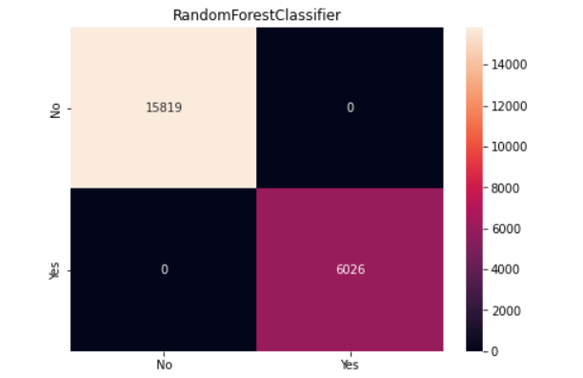
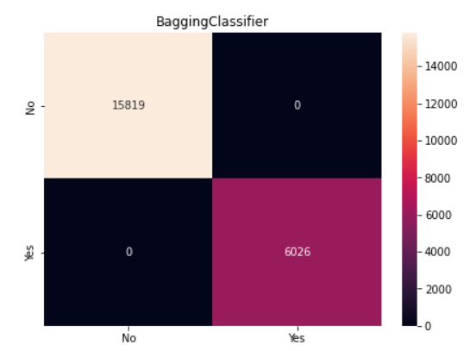
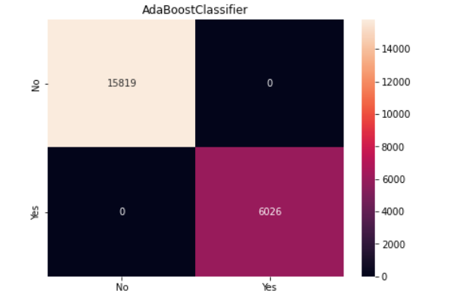
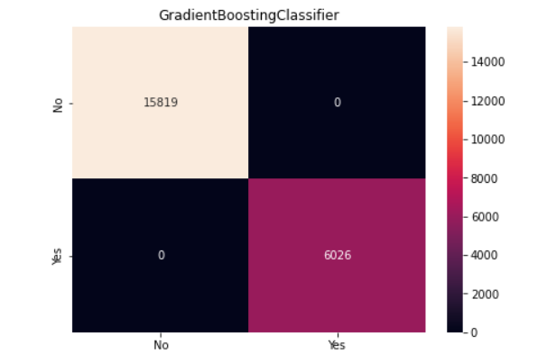
Confusion Matrix

Slide 11
Accuracy using Various Classifiers
Logistic Regression
Training Accuracy : 0.9882194958188366
Testing Accuracy : 0.9888303959716183
Decision Tree Classifier
Training Accuracy : 0.9882347555392785
Testing Accuracy : 0.9888761730373083
Gaussian Naive Bayes
Training Accuracy : 0.9460568882378075
Testing Accuracy : 0.9476768139162279
Random Forest Classifier
Training Accuracy : 1.0
Testing Accuracy : 1.0
K Neighbors Classifier
Training Accuracy : 0.9882500152597204
Testing Accuracy : 0.983611810482948

Slide 12
Conclusion
The highest accuracy in this problem is obtained using the Random Forest Classifier.
Highest accuracy = 100%

