Slide 1
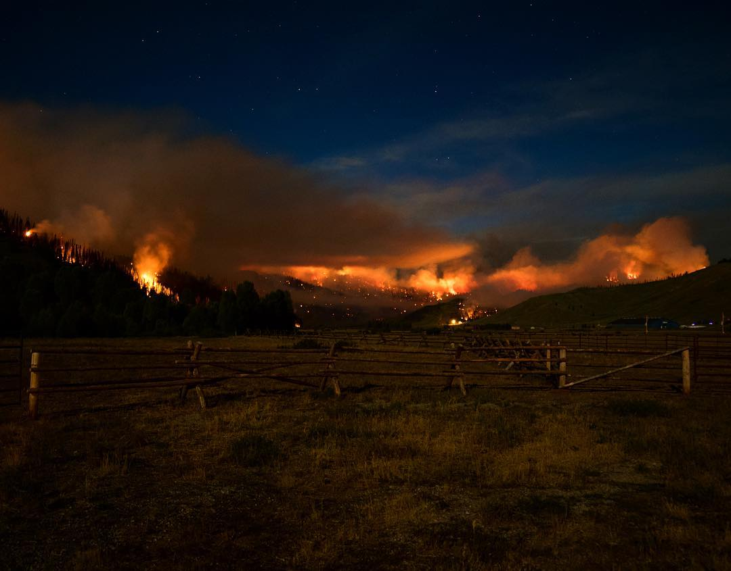
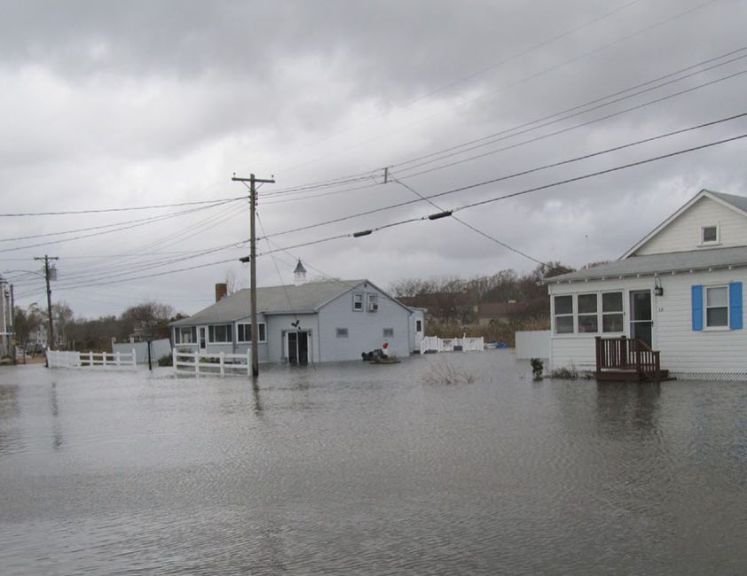
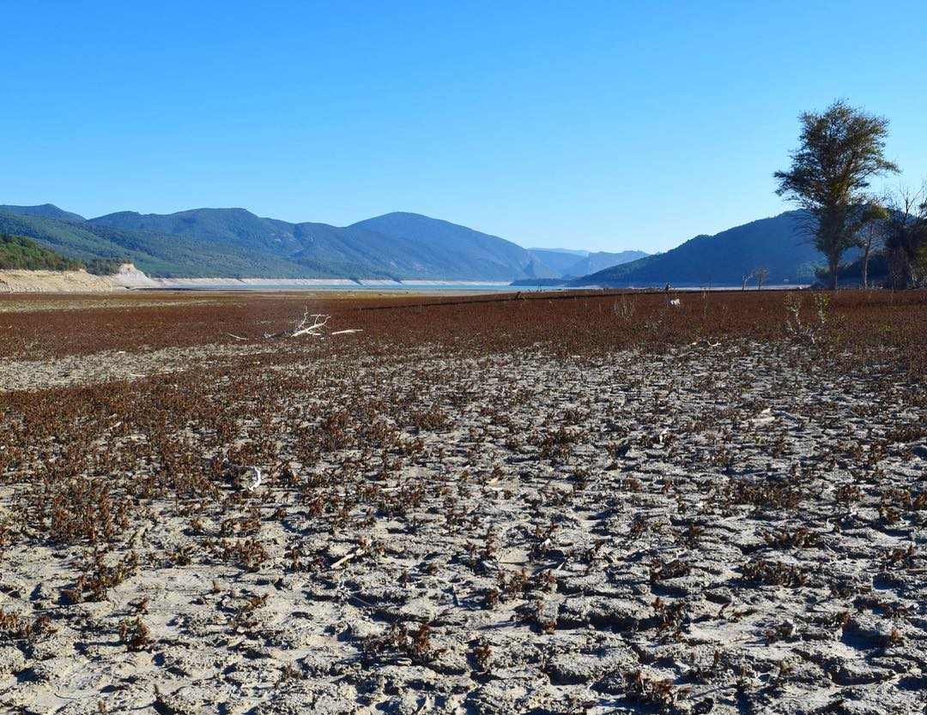
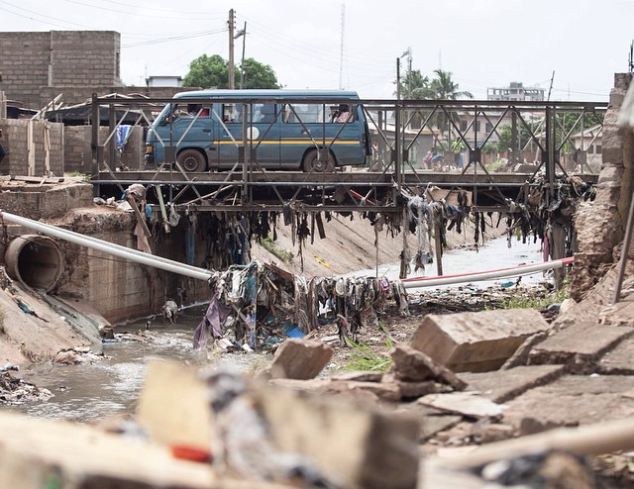
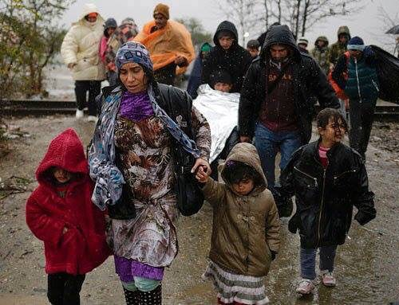

Fires
Floods
Natural Landscape
Infrastructural
Human
Non-Damage

Slide 2
Fires
Floods
Natural Landscape
Infrastructural
Human
Non-Damage

