Slide 1
Marker | Description
'o' | Circle | Try it »
'*' | Star | Try it »
'.' | Point | Try it »
',' | Pixel | Try it »
'x' | X | Try it »
'X' | X (filled) | Try it »
'+' | Plus | Try it »
'P' | Plus (filled) | Try it »
's' | Square | Try it »
'D' | Diamond | Try it »
'd' | Diamond (thin) | Try it »
'p' | Pentagon | Try it »
'H' | Hexagon | Try it »
'h' | Hexagon | Try it »
'v' | Triangle Down | Try it »
'^' | Triangle Up | Try it »
'<' | Triangle Left | Try it »
'>' | Triangle Right | Try it »
'1' | Tri Down | Try it »
'2' | Tri Up | Try it »
'3' | Tri Left | Try it »
'4' | Tri Right | Try it »
'|' | Vline | Try it »
'_' | Hline

Slide 2
Line Reference
Line Syntax | Description
'-' | Solid line | Try it »
':' | Dotted line | Try it »
'--' | Dashed line | Try it »
'-.' | Dashed/dotted line
Note: If you leave out the line value in the fmt parameter, no line will be plotted.

Slide 3
Color Reference
Color Syntax | Description
'r' | Red | Try it »
'g' | Green | Try it »
'b' | Blue | Try it »
'c' | Cyan | Try it »
'm' | Magenta | Try it »
'y' | Yellow | Try it »
'k' | Black | Try it »
'w' | White | Try it »

Slide 4
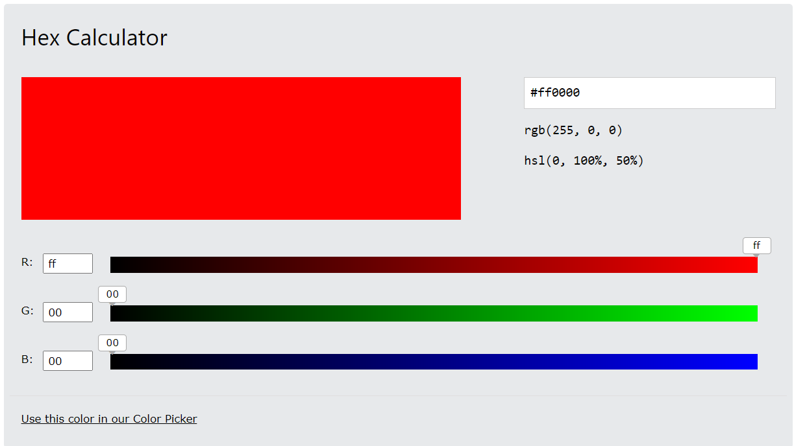

Slide 5
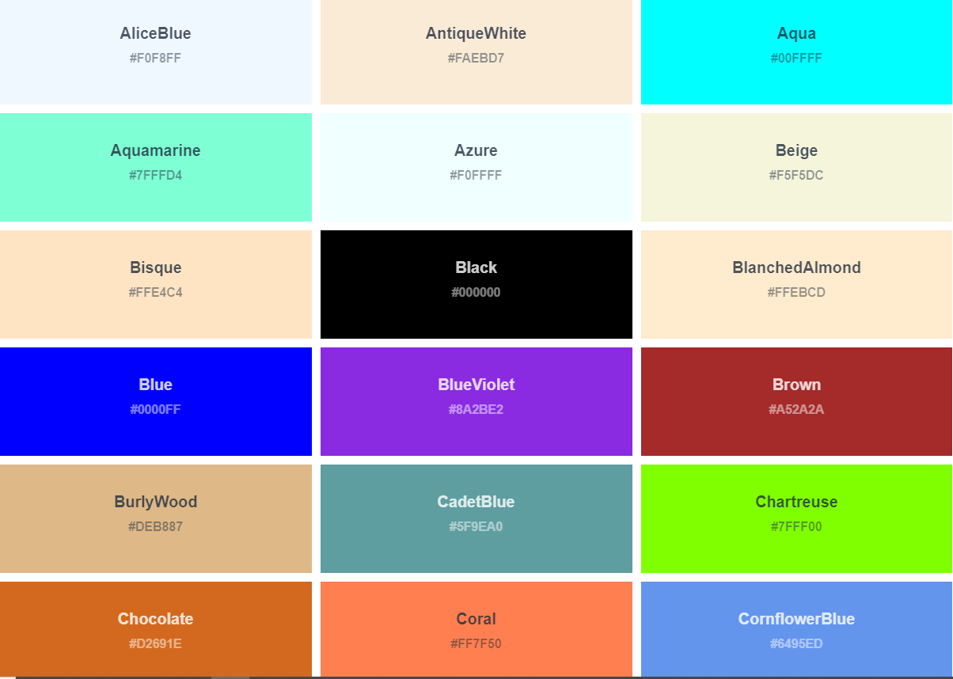

Slide 6
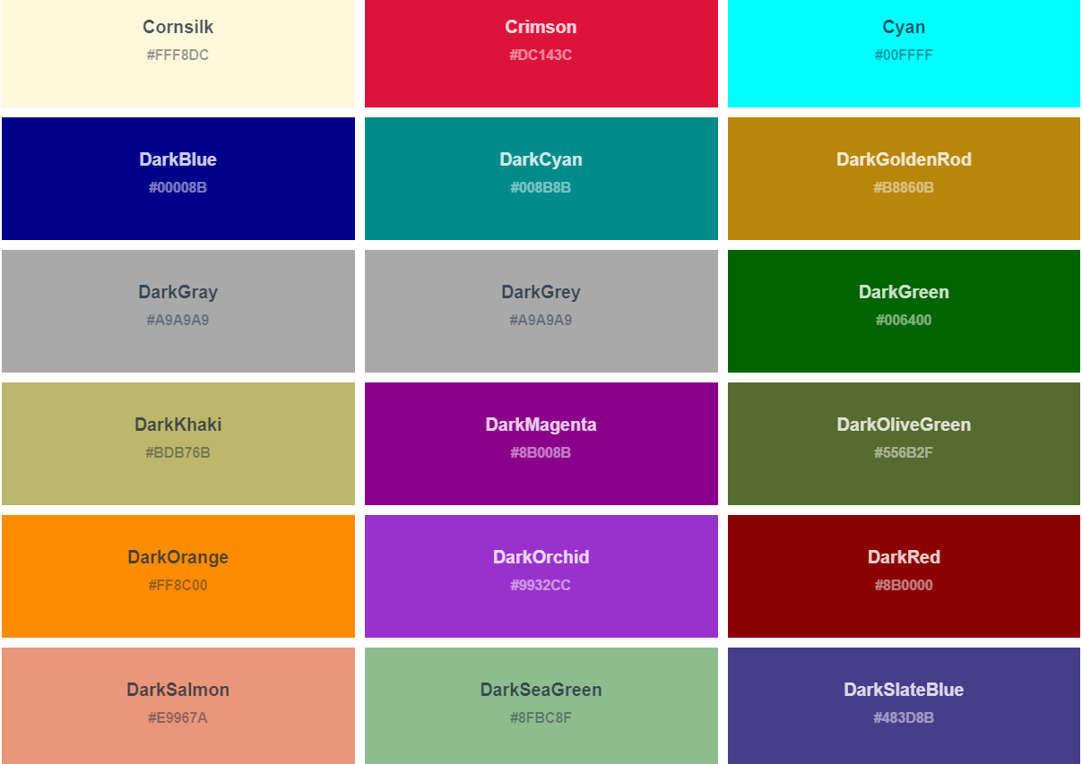

Slide 7
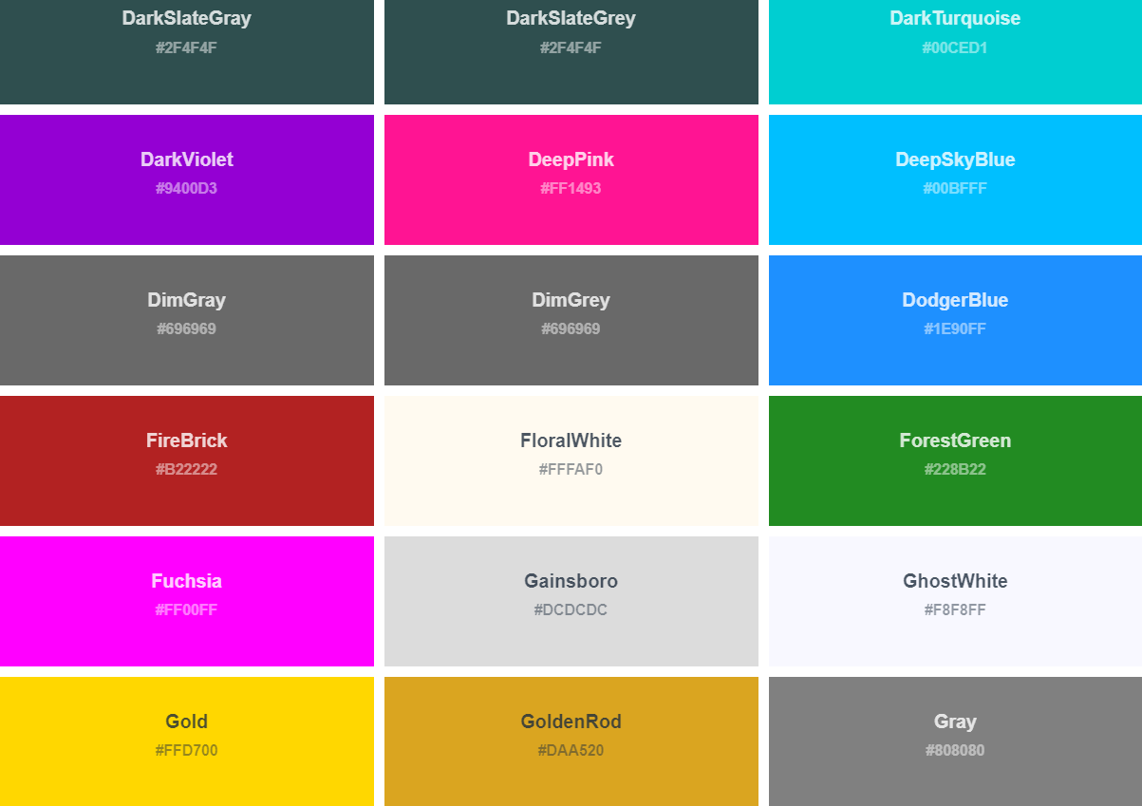

Slide 8
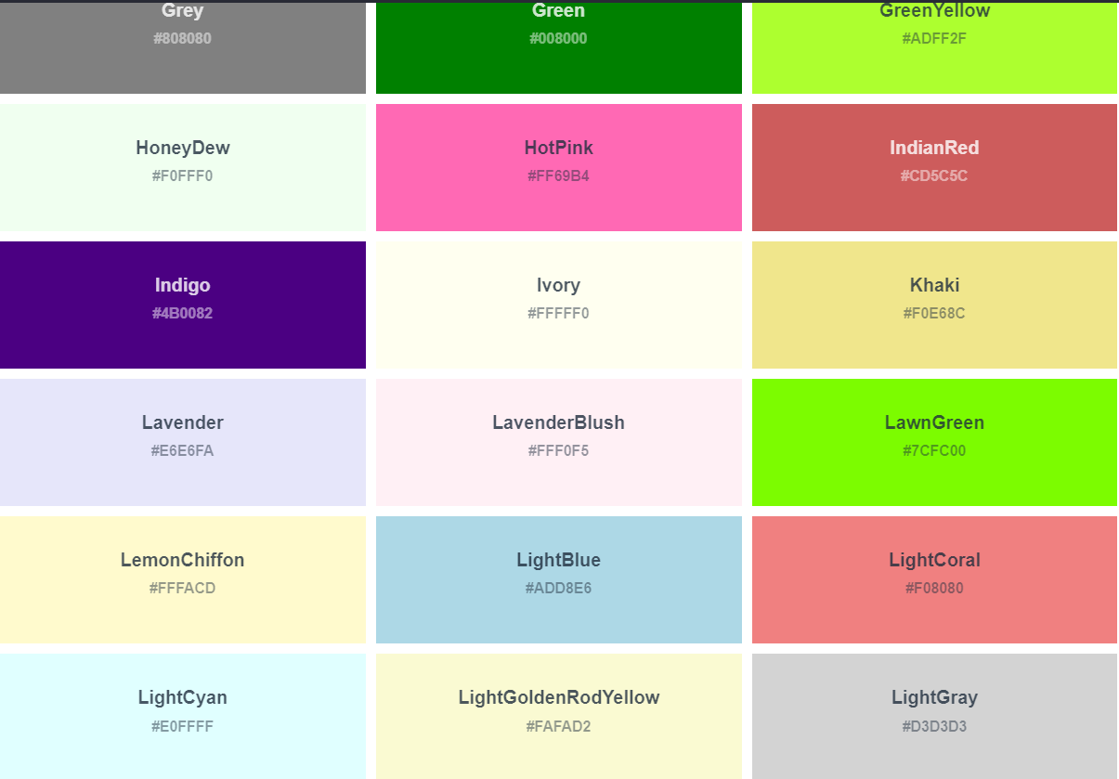

Slide 9
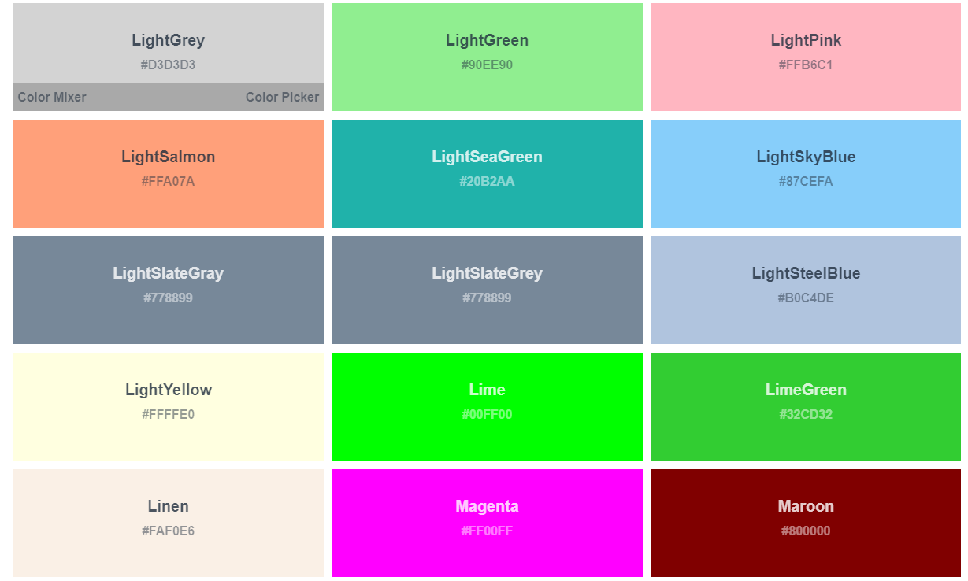

Slide 10
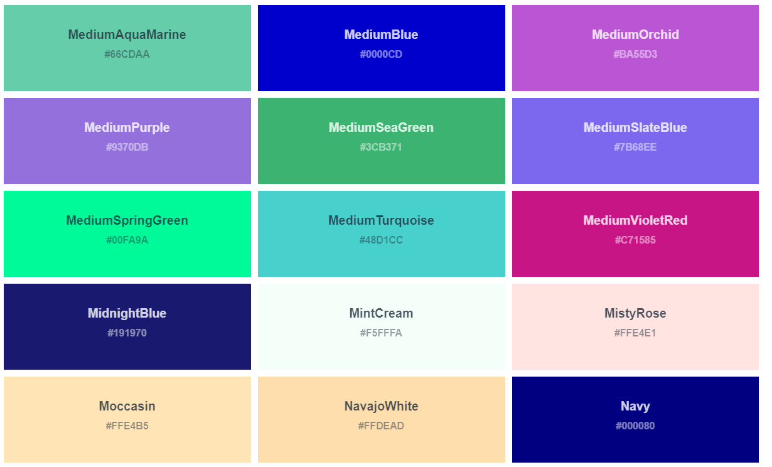

Slide 11
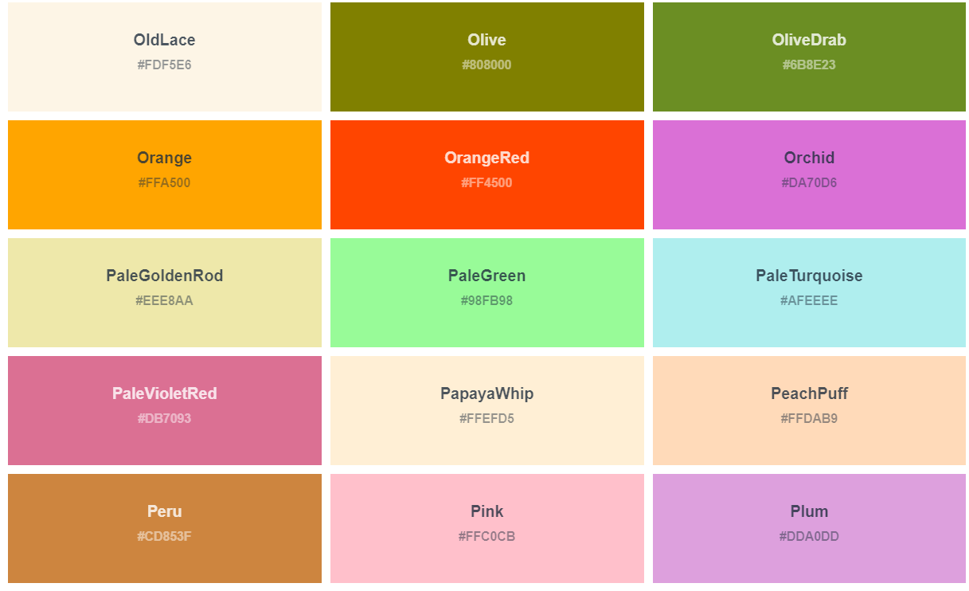

Slide 12
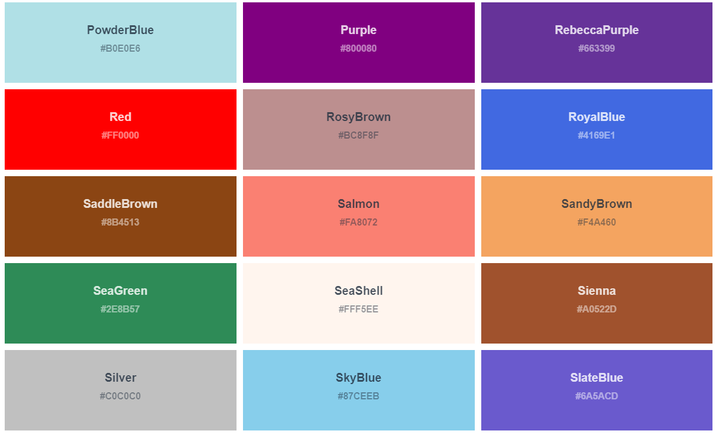

Slide 13
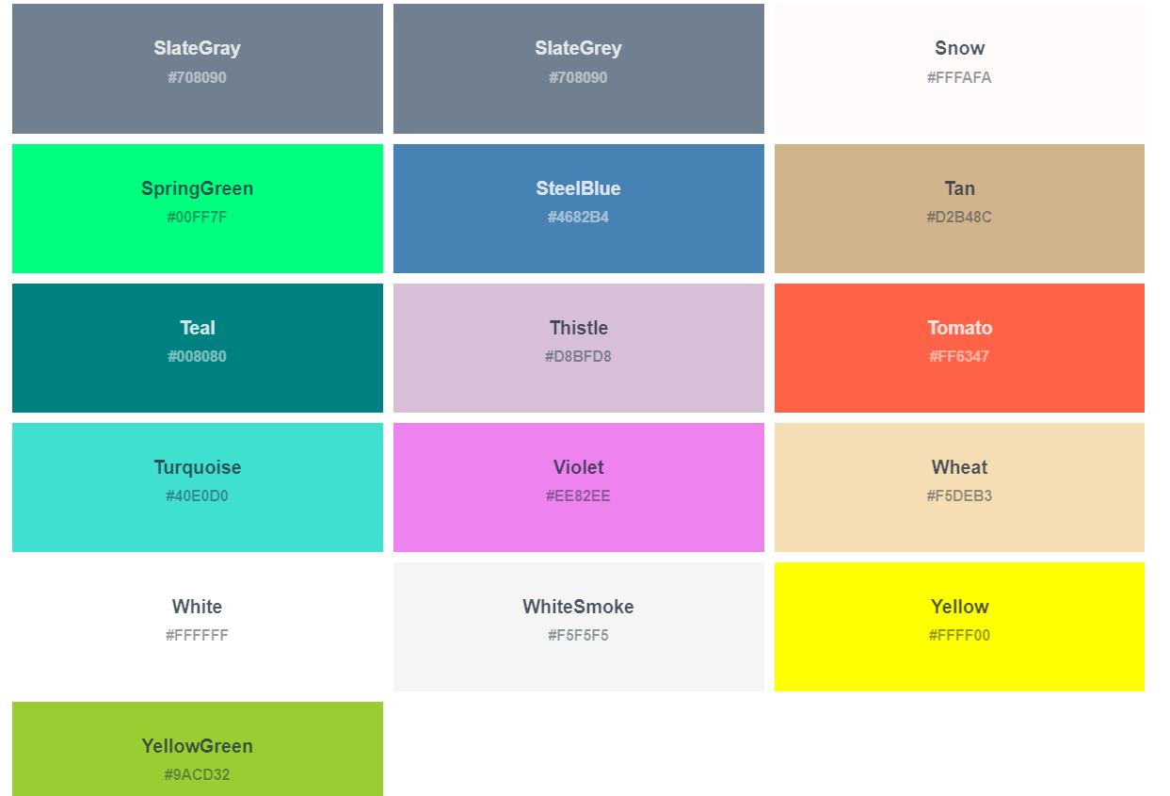

Slide 14
Name |  |  | Reverse
Accent | Try it » |  | Accent_r | Try it »
Blues | Try it » |  | Blues_r | Try it »
BrBG | Try it » |  | BrBG_r | Try it »
BuGn | Try it » |  | BuGn_r | Try it »
BuPu | Try it » |  | BuPu_r | Try it »
CMRmap | Try it » |  | CMRmap_r | Try it »
Dark2 | Try it » |  | Dark2_r | Try it »
GnBu | Try it » |  | GnBu_r | Try it »
Greens | Try it » |  | Greens_r | Try it »
Greys | Try it » |  | Greys_r | Try it »
OrRd | Try it » |  | OrRd_r | Try it »
Oranges | Try it » |  | Oranges_r | Try it »
PRGn | Try it » |  | PRGn_r | Try it »
Paired | Try it » |  | Paired_r | Try it »
Pastel1 | Try it » |  | Pastel1_r | Try it »
Pastel2 | Try it » |  | Pastel2_r
PiYG | Try it » |  | PiYG_r | Try it »
PuBu | Try it » |  | PuBu_r | Try it »
PuBuGn | Try it » |  | PuBuGn_r | Try it »
PuOr | Try it » |  | PuOr_r | Try it »
PuRd | Try it » |  | PuRd_r | Try it »
Purples | Try it » |  | Purples_r | Try it »
RdBu | Try it » |  | RdBu_r | Try it »
RdGy | Try it » |  | RdGy_r | Try it »
RdPu | Try it » |  | RdPu_r | Try it »
RdYlBu | Try it » |  | RdYlBu_r | Try it »
RdYlGn | Try it » |  | RdYlGn_r | Try it »
Reds | Try it » |  | Reds_r | Try it »
Set1 | Try it » |  | Set1_r | Try it »
Set2 | Try it » |  | Set2_r | Try it »
Set3 | Try it » |  | Set3_r | Try it »
Spectral | Try it » |  | Spectral_r | Try it »
Wistia | Try it » |  | Wistia_r | Try it »
YlGn | Try it » |  | YlGn_r

Slide 15
YlGnBu | Try it » |  | YlGnBu_r | Try it »
YlOrBr | Try it » |  | YlOrBr_r | Try it »
YlOrRd | Try it » |  | YlOrRd_r | Try it »
afmhot | Try it » |  | afmhot_r | Try it »
autumn | Try it » |  | autumn_r | Try it »
binary | Try it » |  | binary_r | Try it »
bone | Try it » |  | bone_r | Try it »
brg | Try it » |  | brg_r | Try it »
bwr | Try it » |  | bwr_r | Try it »
cividis | Try it » |  | cividis_r | Try it »
cool | Try it » |  | cool_r | Try it »
coolwarm | Try it » |  | coolwarm_r | Try it »
copper | Try it » |  | copper_r | Try it »
cubehelix | Try it » |  | cubehelix_r | Try it »
flag | Try it » |  | flag_r
gist_earth | Try it » |  | gist_earth_r | Try it »
gist_gray | Try it » |  | gist_gray_r | Try it »
gist_heat | Try it » |  | gist_heat_r | Try it »
gist_ncar | Try it » |  | gist_ncar_r | Try it »
gist_rainbow | Try it » |  | gist_rainbow_r | Try it »
gist_stern | Try it » |  | gist_stern_r | Try it »
gist_yarg | Try it » |  | gist_yarg_r | Try it »
gnuplot | Try it » |  | gnuplot_r | Try it »
gnuplot2 | Try it » |  | gnuplot2_r | Try it »
gray | Try it » |  | gray_r | Try it »
hot | Try it » |  | hot_r | Try it »
hsv | Try it » |  | hsv_r | Try it »
inferno | Try it » |  | inferno_r | Try it »
jet | Try it » |  | jet_r | Try it »
magma | Try it » |  | magma_r | Try it »
nipy_spectral | Try it » |  | nipy_spectral_r | Try it »
ocean | Try it » |  | ocean_r

Slide 16
pink | Try it » |  | pink_r | Try it »
plasma | Try it » |  | plasma_r | Try it »
prism | Try it » |  | prism_r | Try it »
rainbow | Try it » |  | rainbow_r | Try it »
seismic | Try it » |  | seismic_r | Try it »
spring | Try it » |  | spring_r | Try it »
summer | Try it » |  | summer_r | Try it »
tab10 | Try it » |  | tab10_r | Try it »
tab20 | Try it » |  | tab20_r | Try it »
tab20b | Try it » |  | tab20b_r | Try it »
tab20c | Try it » |  | tab20c_r | Try it »
terrain | Try it » |  | terrain_r | Try it »
twilight | Try it » |  | twilight_r | Try it »
twilight_shifted | Try it » |  | twilight_shifted_r | Try it »
viridis | Try it » |  | viridis_r | Try it »
winter | Try it » |  | winter_r

