Slide 1

Failed Bank Transaction Analysis
Error Trends in Transactions

Slide 2
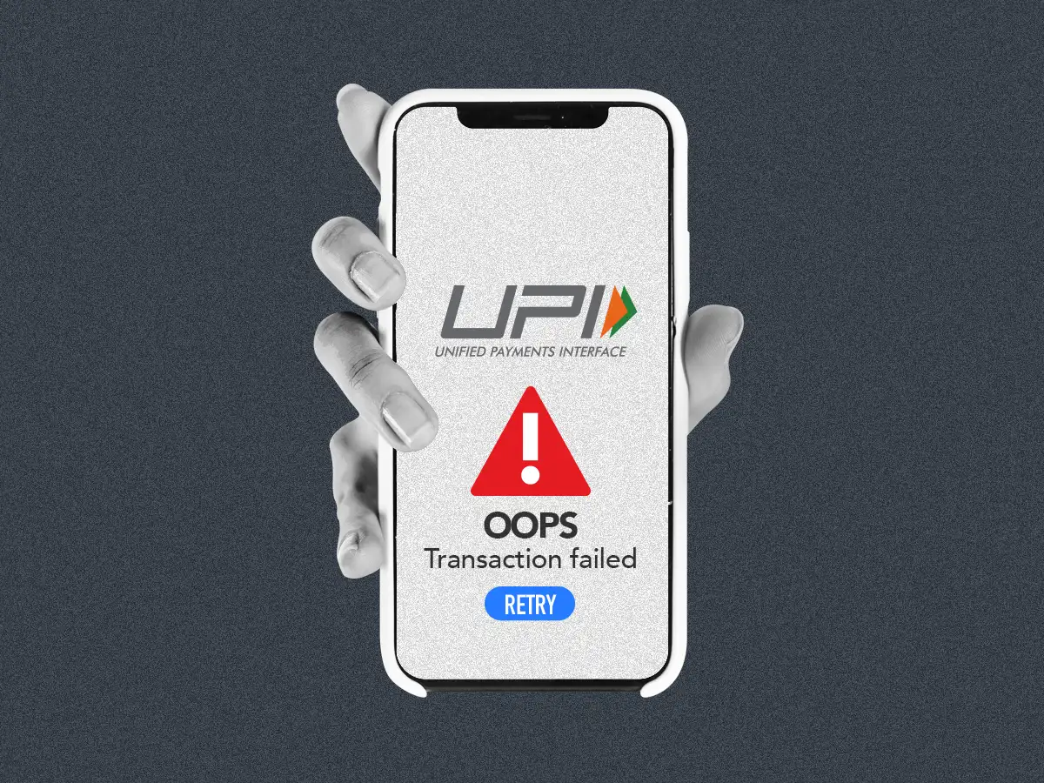
Purpose Behind This Study
Analyze failed transactions within a 7-day window
Identify most common error messages causing failures
Understand failure patterns by branch, city, and transaction type
Determine impact of amount and day on transaction failures
Provide insights to reduce future transaction issues
Support decision-making for operational improvements

Slide 3
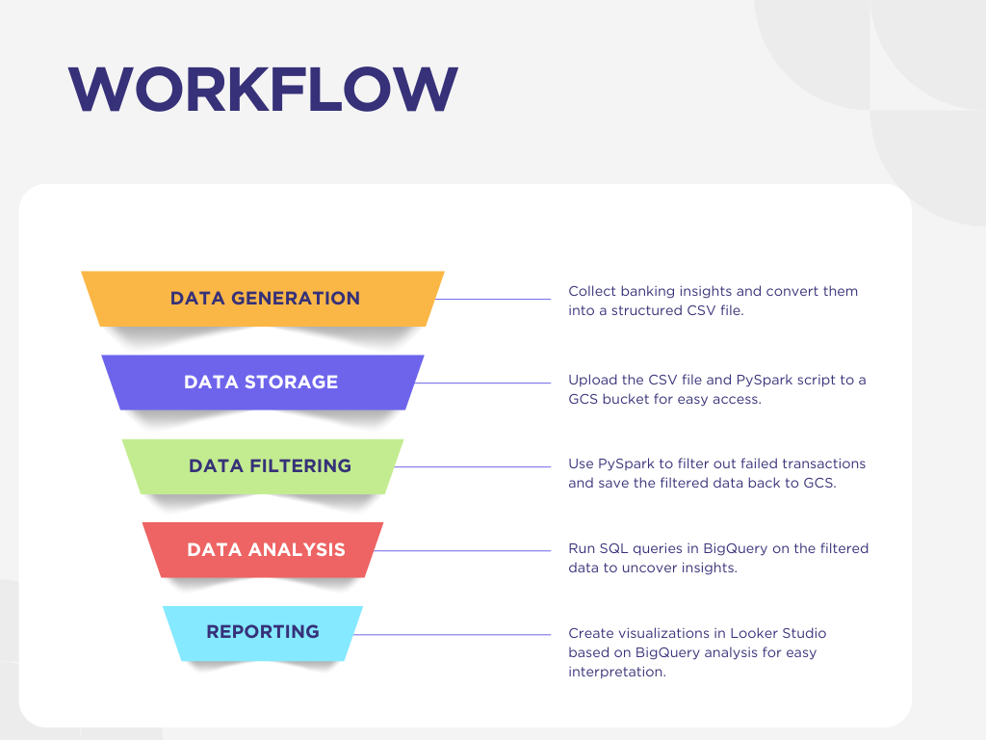
Deloitte Banking Insight
Google Cloud Storage
Dataproc
Cloud SQL Instance
BigQuery
Looker Studio

Slide 4

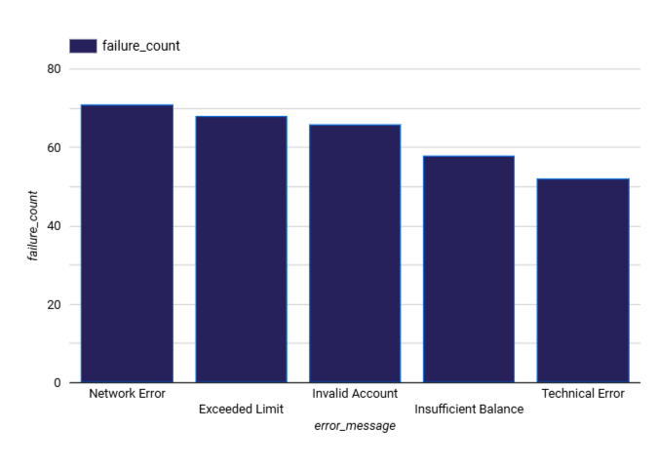
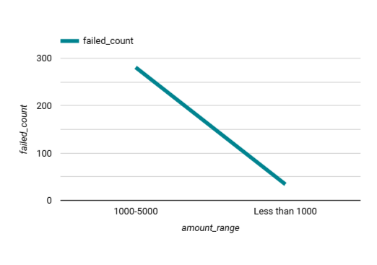

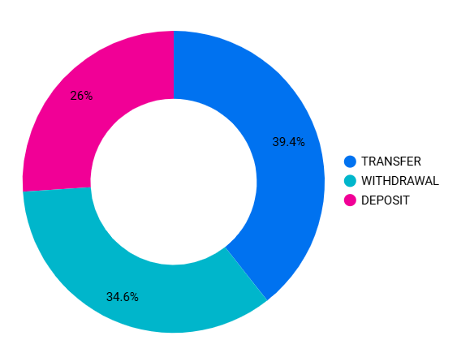

Top Transaction Errors
Failure by Transaction Type
Which transaction methods experience more failures.
Failures by Amount Range
Most common error messages causing transaction failures
How transaction failures vary across different amount ranges.

Slide 5
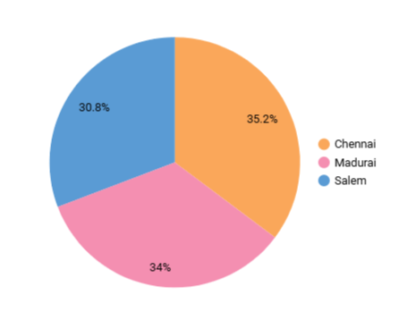
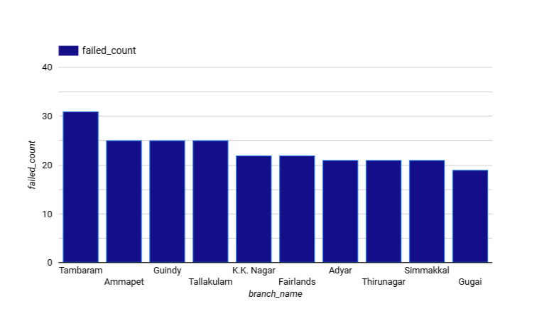
FAILURE BY BRANCH
FAILURES BY CITY
Cities where transaction failures are more frequent.
PEAK FAILURE DAY
Which Branches with higher occurrences of failed transactions
How The day with the highest total values lost due to failed trasactions

Slide 6

THANK YOU!

